Slide 1
Famous places in Slovakia
The city Trenčín

Slide 2
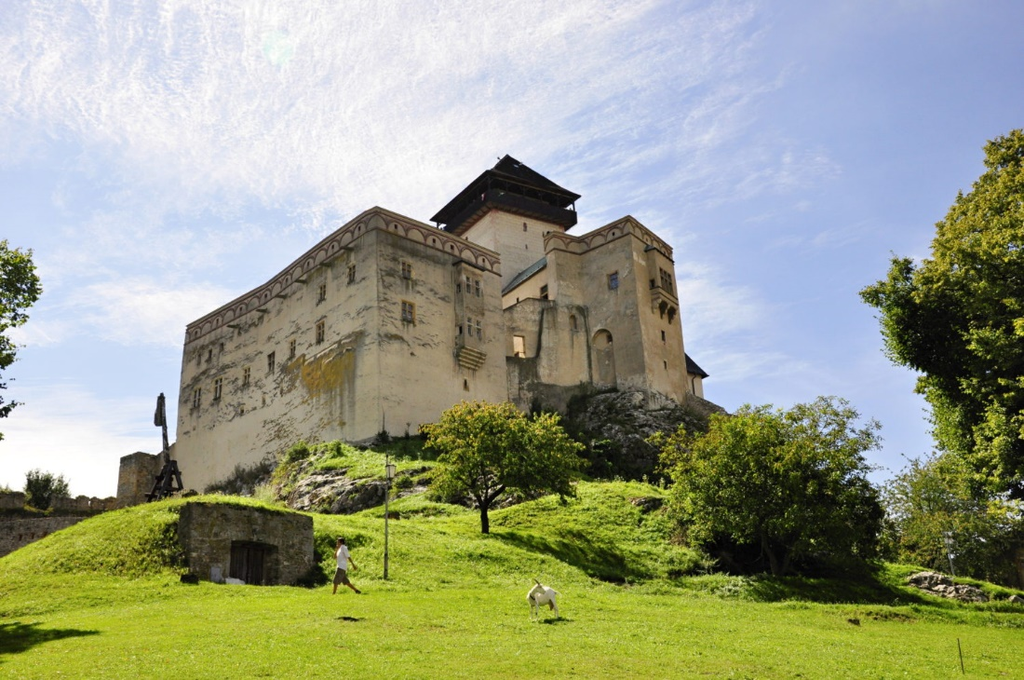
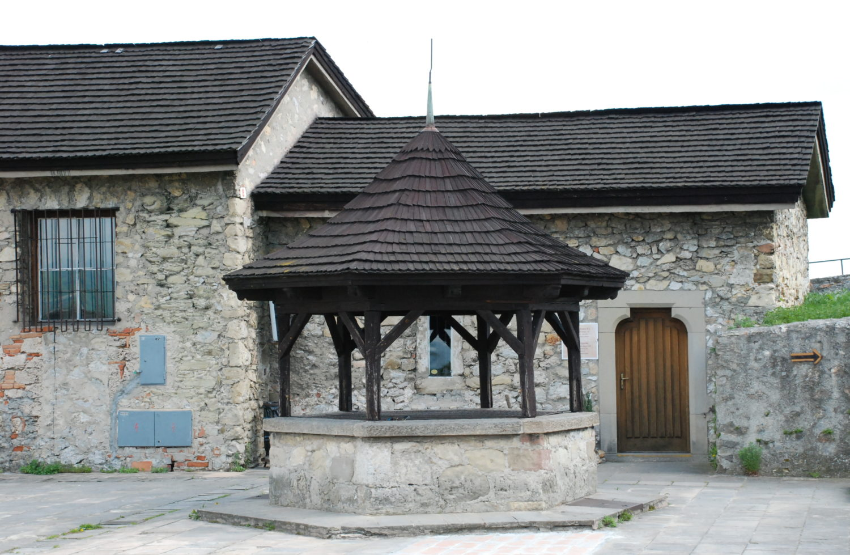
The Trenčín castle
Trencin Castle - one of the largest castles in Europe. Today's castle was built in the 11th century.
There are several exhibitions of the Trenčín Museum in its ancient interiors.
At the end of the 13th century the castle became the property of Matúš Čák, who owned nearly 50 castles and became the legendary lord of the Váh and Tatras.
From the highest Matus tower is a beautiful view of a large part of Povazie. In lower part of the castle were starving rooms, cannon bastions and the Well of love.
Today you will find an exhibition of medieval and modern guns. The starving room was originally built as an sight seeing tower.
The more adventurous can try to put their head in the bars, which are located in front of the starving room.
Resource: https://visit.trencin.sk/trenciansky-hrad/?

Slide 3
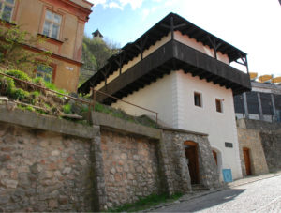
Hangman‘s house
The hangman's house is the only well kept building of this type in Trenčín, which was not significantly disturbed by later reconstructions.
It represents a characteristic townsman’s house with a circular wooden gallery, in which the living areas and the production parts were located.
Today, you can see the swords of the hangman, the uniform of the town policeman and other interesting historical objects.
Resource: https://visit.trencin.sk/katov-dom/

Slide 4
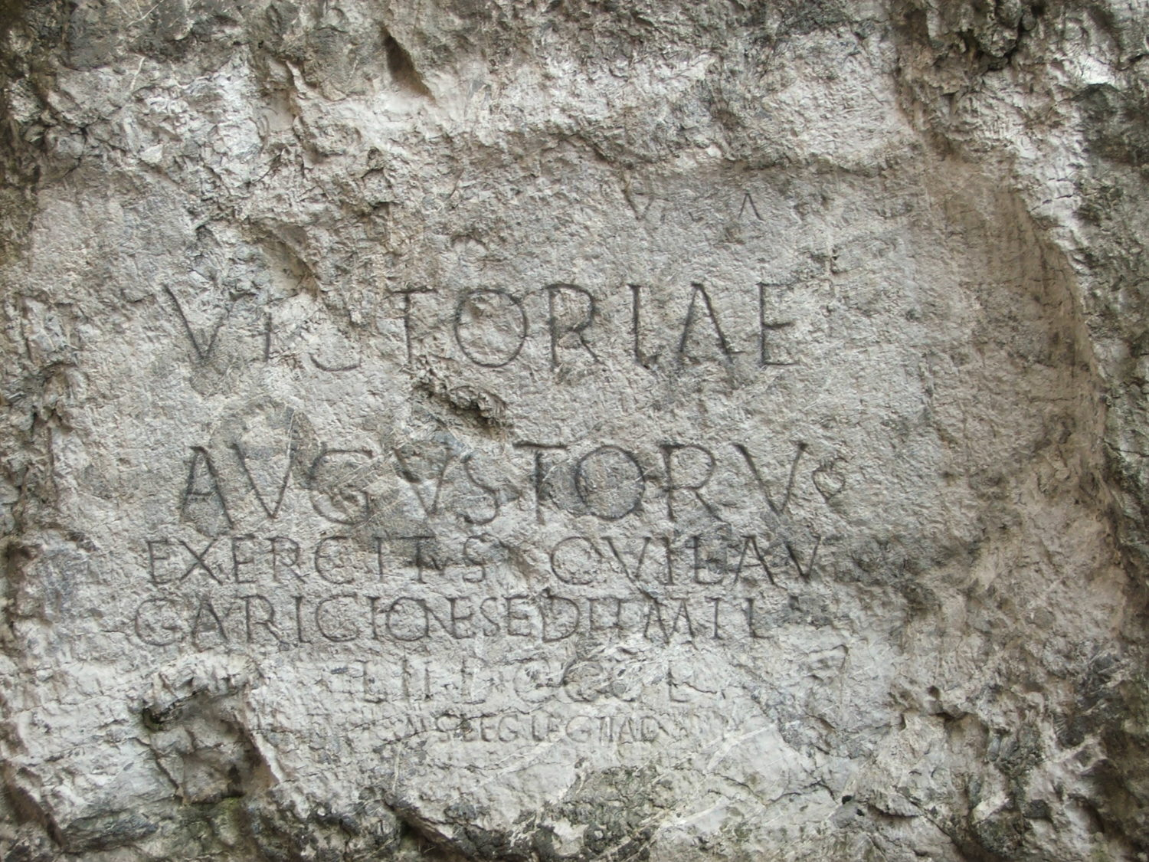
Roman sign on the castle hill
The Roman inscription from 179, which is carved into the castle hill, is one of the few Roman written mantions proving the Romans' stay in Central Europe.
The inscription on the castle rock is dedicated to the memory of the victory of the Romans over the Germanic Quads and in translation means: “The victory of the Emperors and the troops, which were based in Laugariciu, numbered 855 soldiers II. Legion, made by M. V. Maximianus, legate II. Auxiliary Legion. „
Resource: https://visit.trencin.sk/rimsky-napis-na-hradnej-skale/

Slide 5
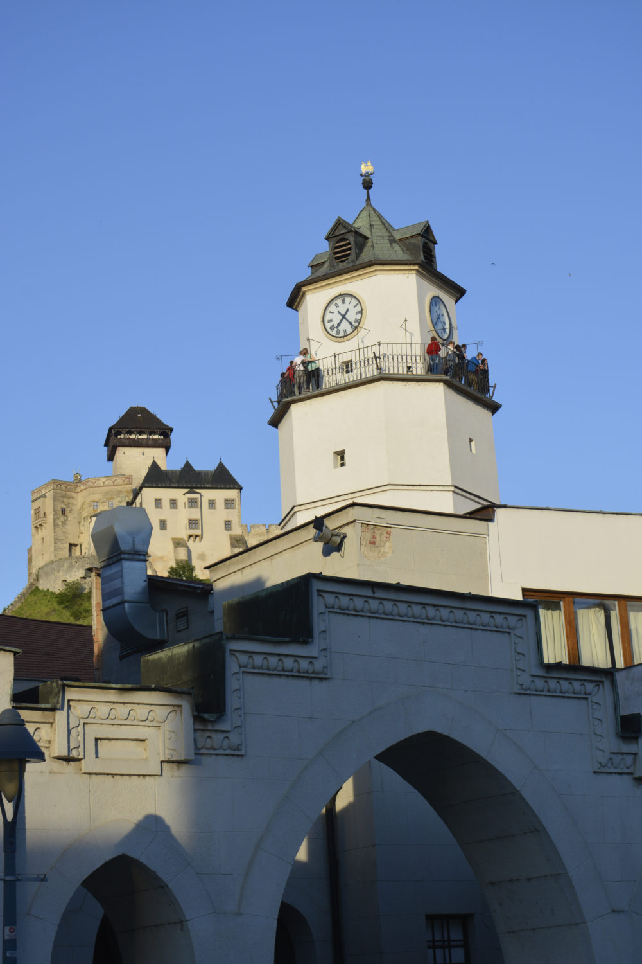
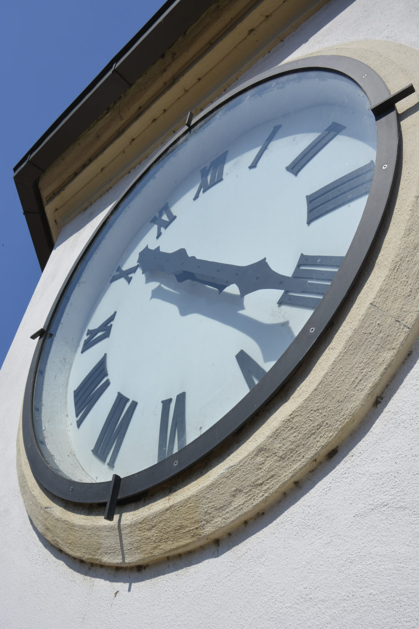
The City tower
The city tower offers a beautiful view of the Trenčín Castle and also the Peace Square.
It was built as part of the city barrier probably in the early 15th century. Since the Middle Ages, it has served as the southern entrance to the main, today the Peace Square.
It has the current six floors and 32 meters. At the top of the tower was originally a Renaissance clockwork from the 16th century, which you can see in the Hangman‘s house.
The Latin writing on the tower, which can be seen from both access points, shows the antique motto of Trenčín: If the Lord does not protect the city, who watches it is there for nothing.
Resource: https://visit.trencin.sk/mestska-veza/?

Slide 6
THANK YOU FOR WATCHING

