Slide 1
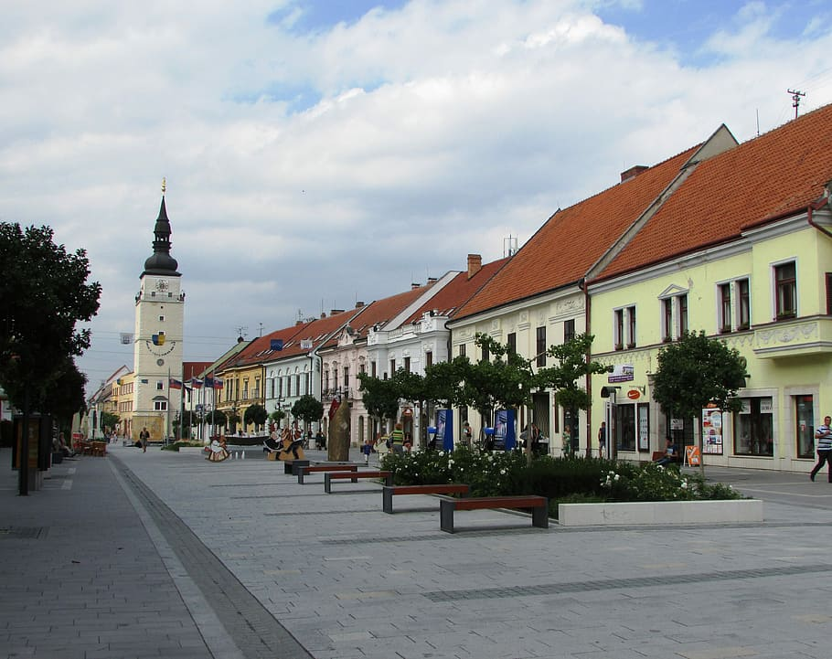
Trnava

Slide 2
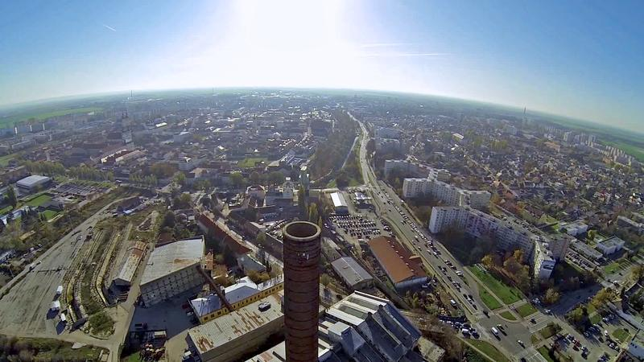
Trnava is a regional city in the west of Slovakia.
Trnava was one of the most important centers of the Roman Catholic Church in Slovakia.

Slide 3
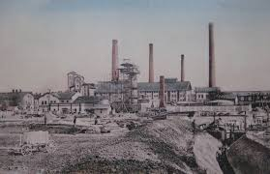
History
Trnava was the first town in the territory of present-day Slovakia to receive the privileges of a free royal town.
In the 13th century, the city built an extremely large fortification on an area of ​​almost 60 hectares.
28.4.1430 Battle of Trnava: Hussites defeated the Hungarian army.
Trnava entered the 18th century as a university city known throughout Europe.
August 1 to September 24, 1831 Trnava experienced a devastating cholera epidemic that claimed over 800 victims in two months.
25. augusta 1996 sa Trnava stala krajským mestom.

Slide 4
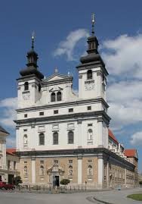
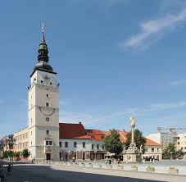
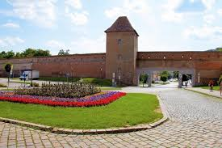
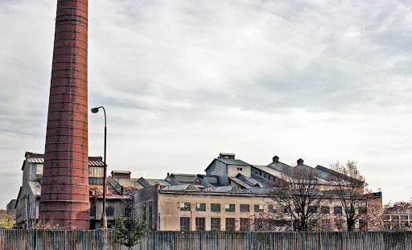
Monuments
Arcibiskupský palác
Molpír v Smoleniciach
Bazilika sv. Mikuláša
Cukrovar
Divadlo Jána Palarika
Evanjelicky kostol

