Slide 1
„Teach me your language“
eTwinning project

Slide 2
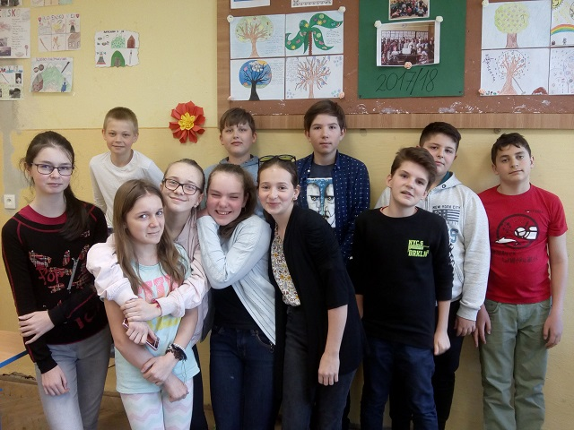
We are PRIMA

Slide 3
My name is Patrik
I like games.
I don´t like school.
I have got a lot of friends.

Slide 4
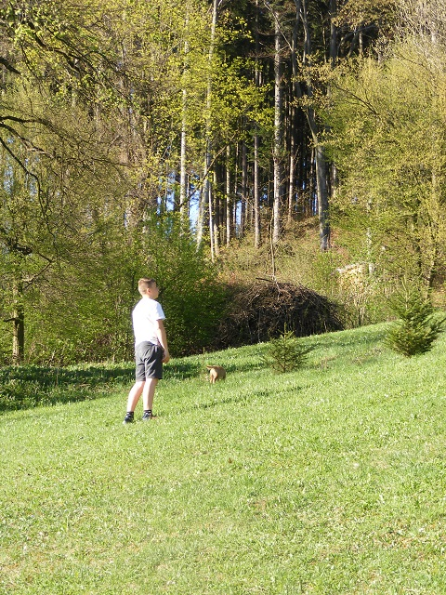
My name is Oliver
I like playing with my dog.
I don´t like vegetables.
I have one sister.

Slide 5
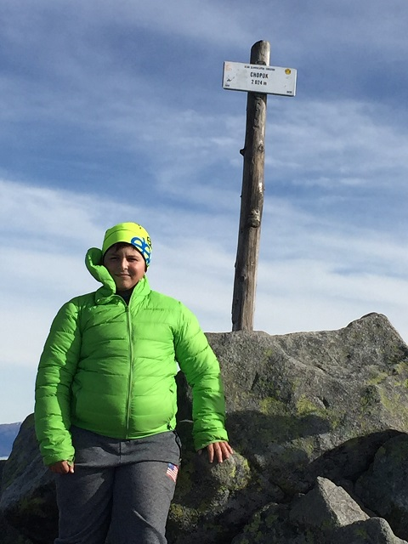
My name is Oliver, too
I like computer games.
I have a computer.
I don't have a motorcycle.

Slide 6
My name is Kika
I like dog = PUG.
I don't like spring.
I have brown hear.

Slide 7
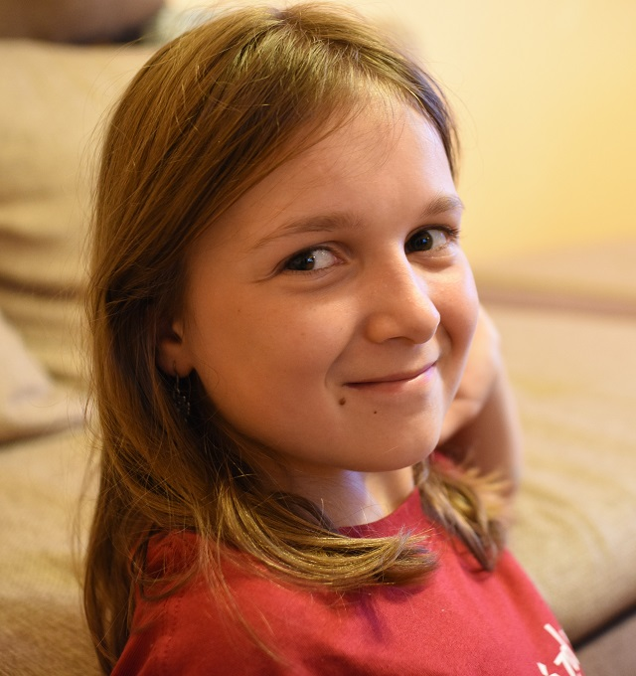
My name is Saška
I like animals.
I don´t like homework.
I have a cat and birds.

Slide 8
My name is Samuel
I like sports.
I don´t like cats, dogs, dars and big towers.

Slide 9
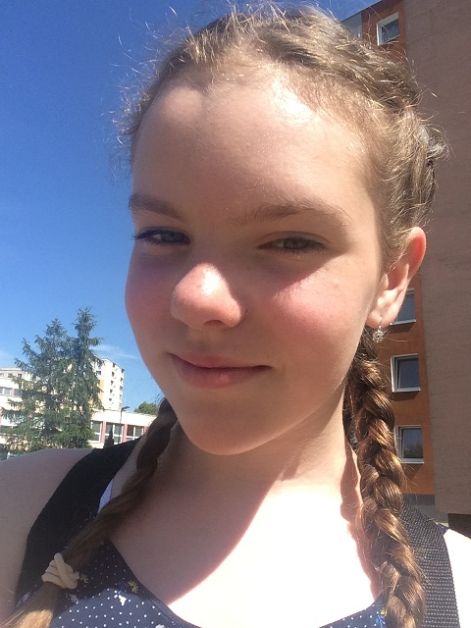
My name is Miška
I like my family.
I don’t like soup.
I have a fantastic family.

Slide 10
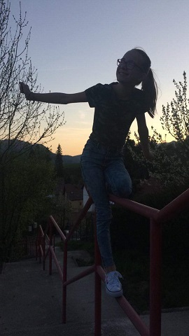
My name is Ema
I like food and dogs.
I don't like spiders.
I have two eyes and nose between them.

Slide 11
My name is Kamil
I like pizza
I don´t like biology.
I have a brother.

Slide 12
My name is Beny
I like PC games.
I don´t like school.
I have 4 older brothers.

Slide 13
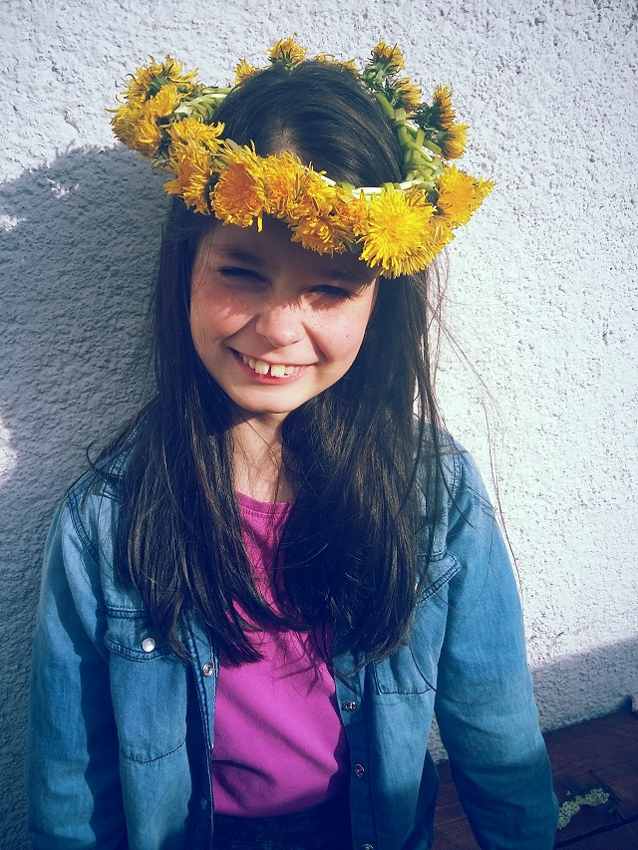
My name is Evka
I like animals.
I don´t like football and basketball.
I have a dog and cat.

Slide 14
My name is Filip
I like basketball.
I don´t like volleyball.
I have got many friends.

Slide 15
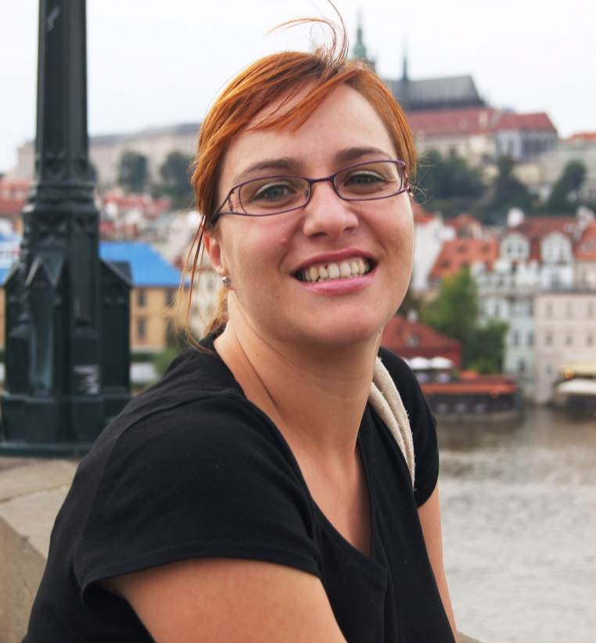
This is our English teacher
I like holidays.
I don´t like Mondays.
I have a twin sister.

Slide 16
Nice to meet you!

