Slide 1
CROATIAN LANGUAGE – HRVATSKI JEZIK
OŠ JOSIPOVAC, CROATIA

Slide 2
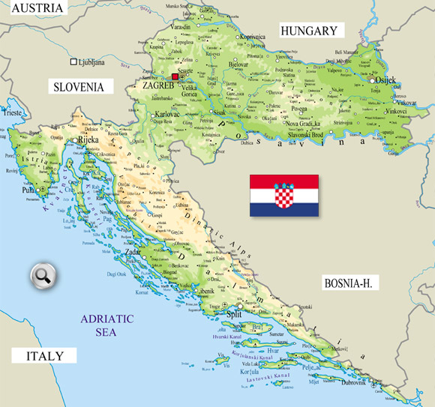
Josipovac

Slide 3
Croatian is the standard language of Croats in the Republic of Croatia
There are about 4,4 million inhabitants living in Croatia who speak Croatian
More than 800 thousand Bosnian Croats in Bosnia and Herzegovina, national minorities in Serbia, Slovenia, Hungary, Austria, Italy, and immigrants in Europe, America and Australia should also be added
Ttogether with the Slovenian and Serbian Croatian language belongs to the western group of South Slavic languages

Slide 4
Croatian language today is written in Latin script, which has 27 letters and three double letters: dž, lj and nj
There are three dialects in the Croatian language: Kajkavian (kajkavski) , Chakavian (čakavski), and western part of the Stokavian (štokavski) dialect

Slide 5
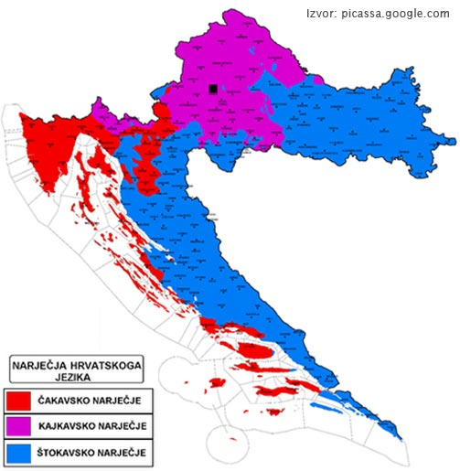

Slide 6
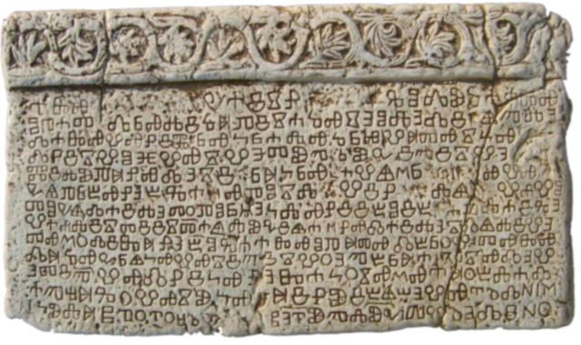
About the history of Croatian language
The oldest monuments of Croatian language originate from 11-12 centuries, written in Glagolitic script
The oldest of them and the most important BAŠČANSKA PLOČA

Slide 7
From 12th century in Bosnia and South Dalmatia the glagolitic is gradually replaced by Cyrillic, and from the 14th century around Sibenik and Zadar are also the first Croatian texts written in Latin
Therefore, it can be said that Croatian medieval literature was threelingual (Latin, Church Slavonic and Croatian) and threeletters (Latin, Glagolitic and Cyrillic)

