Slide 1
OŠ JOSIPOVAC PRIMARY SCHOOL JOSIPOVAC
REPUBLIKA HRVATSKA
CROATIA
„Teach me your language”
eTwinning project

Slide 2
Our school is near Osijek
Josipovac

Slide 3
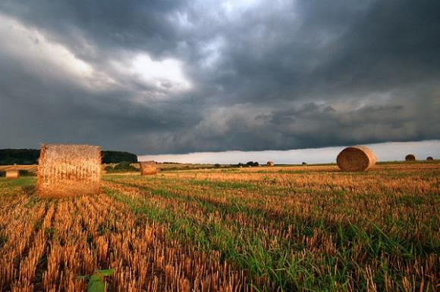
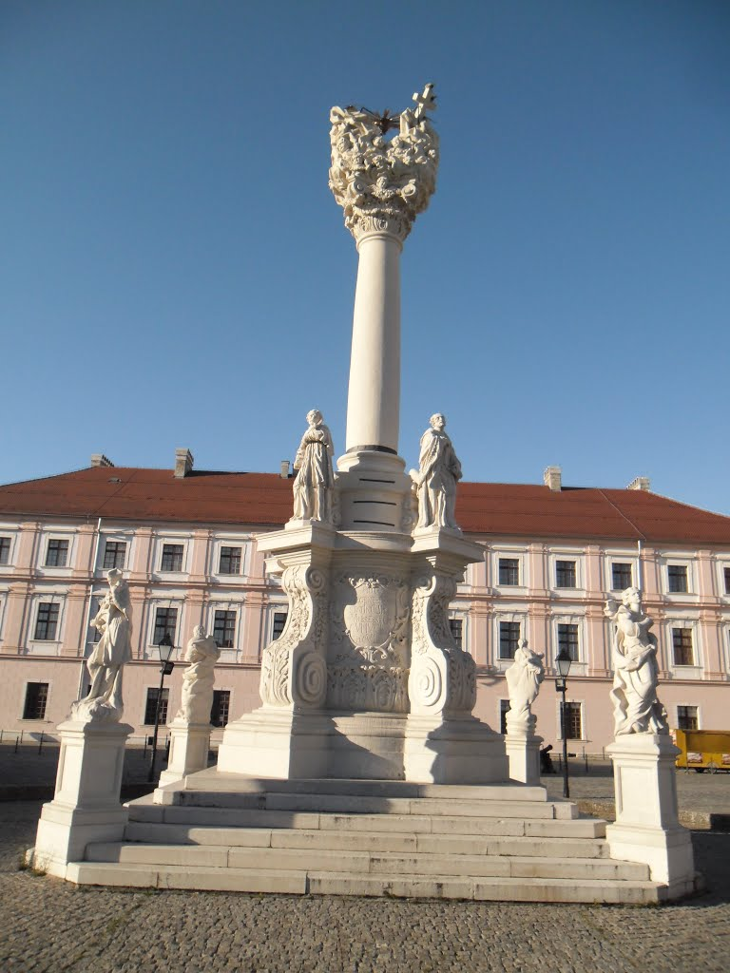
Osijek

Slide 4
Osnovna škola Josipovac – Primary school Josipovac

Slide 5
A school group of journalists – eTwinning team
Students: Barbara, Borna, Ema, Katja, Luka, Mirela, Urban, Vlatka
Teacher/Librarian: Anita Drenjančević

