Slide 1
BRIXIA – the latin name for ‘brescia’

Slide 2
An overview of HISTORic brescia

Slide 3
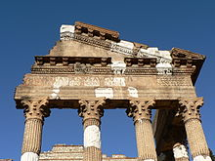
Ancient era
Various myths relate to the founding of Brescia: one assigns it to Hercules while another attributes its foundation to the king of the Ligures, Cidnus, who had invaded the Padan Plain in the late Bronze Age.
Colle Cidneo (Cidnus's Hill) was named after that version, and it is the site of the medieval castle.
Scholars attribute the founding to the Etruscans.
The city entered the Roman world peacefully, maintaining a certain administrative freedom. In 89 BC, Brixia was recognized as civitas.
Roman Brixia had three temples, an aqueduct, a theatre, a forum with another temple built under Vespasianus, and some baths.
In 402, the city was ravaged by the Visigoths. During the 452 invasion of the Huns under Attila, the city was besieged and sacked.
Forty years later, it was one of the first conquests by the Gothic general Theoderic the Great in his war against Odoacer.
Remains of the Roman Capitolium.

Slide 4
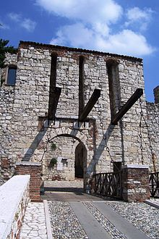
The Middle Ages
In 568 Brescia was taken from the Byzantines by the Lombards, who made it the capital of one of their duchies. The last king of the Lombards, Desiderius, had also been duke of Brescia.
In 774, Charlemagne captured the city and ended the existence of the Lombard kingdom in northern Italy.
Brescia became a free commune around the early 12th century.
Brescia, together with other Lombard cities, uprose against the German emperors and, after the fall of the Hohenstaufen, the leadership was contested between the families of the Maggi and the Brusati,
Later, the Scaliger of Verona sought to place Brescia under subjection.
In 1416 the Malatesta bartered Brescia to the Visconti who then sold it to the Venetians.
In his attempt to recover Brescia against the Venetians, the Visconti were defeated in the battle of Maclodio by general Carmagnola, commander of the Venetian army.
The castle of Brescia.

Slide 5
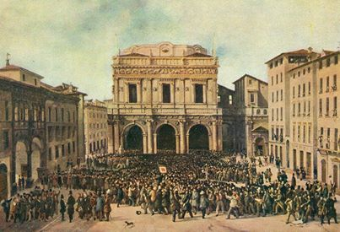
Modern era
Brescia shared the fortunes of the Venetians until the latter fell at the hands of Napoleon Bonaparte.
After the end of the Napoleonic era in 1815, Brescia was annexed to the Austrian puppet state known as the Kingdom of Lombardy-Venetia.
Brescia revolted in 1848 and in 1849: when the Piedmontese army invaded Austrian-controlled Lombardy, the people in Brescia resisted the Austrian army for ten days that are now celebrated as the Ten Days of Brescia. This prompted poet Giosuè Carducci to nickname Brescia ‘Leonessa d'Italia’ (Lioness of Italy)
On May 28, 1974, it was the seat of the bloody Piazza della Loggia bombing.
Faustino Joli da Brescia (1814-1876).
The people of Brescia gathered in the Piazza della Loggia.

Slide 6
Some hints at Transportation

Slide 7
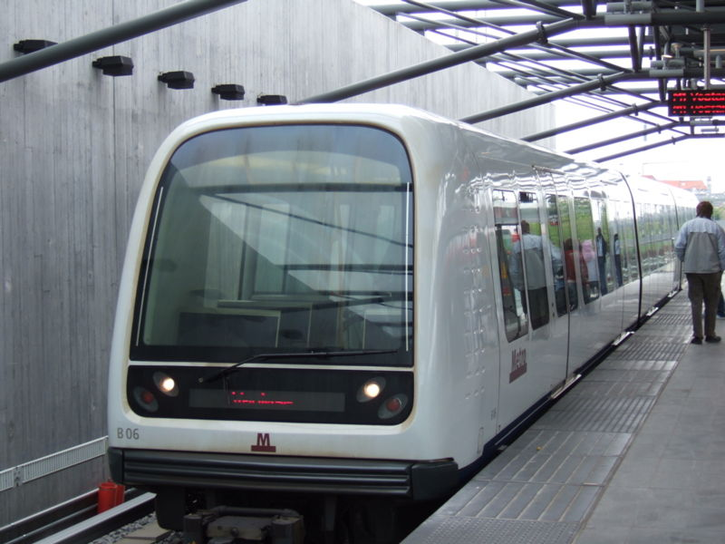
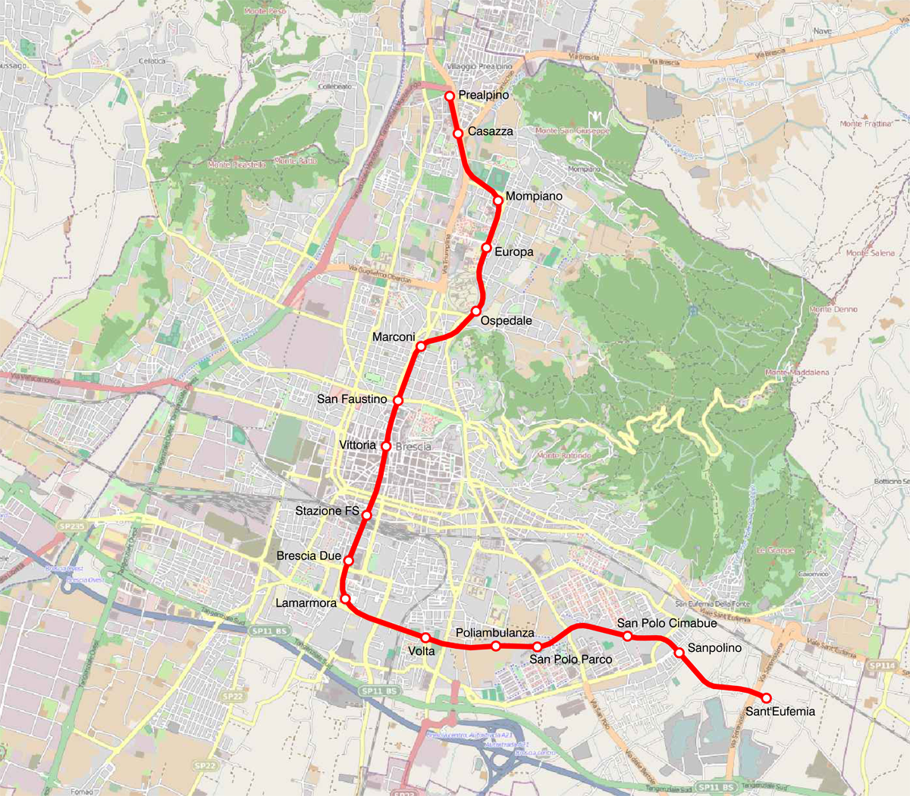
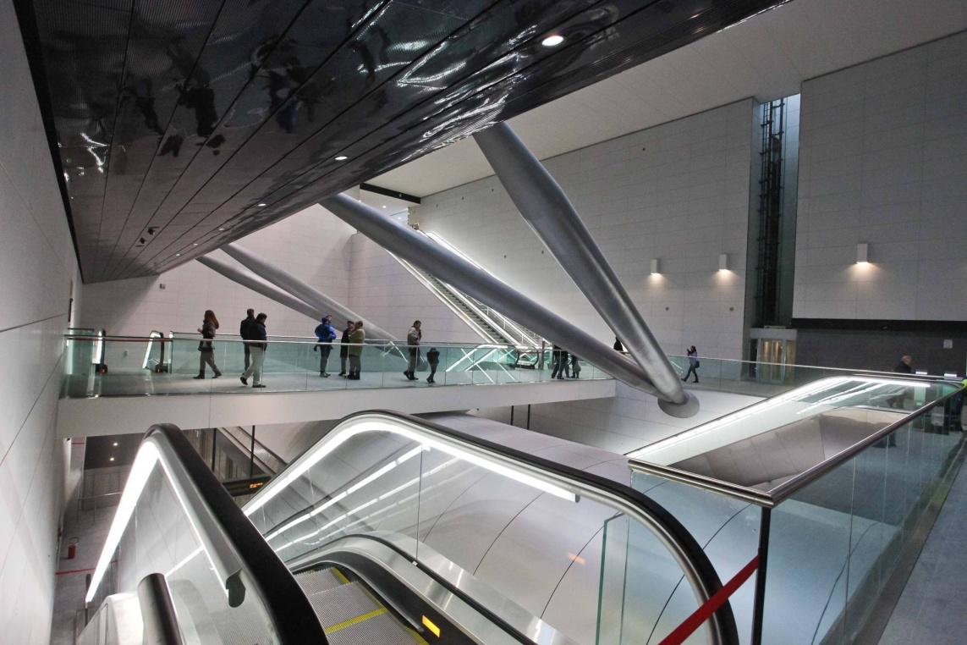
The Brescia Metro is a rapid transit network that opened on 2 March 2013.
The network comprises one line, 13.7 kilometres long, with 17 stations, between Buffalora and Prealpino, of which 13 are underground.

Slide 8
Main sights

Slide 9
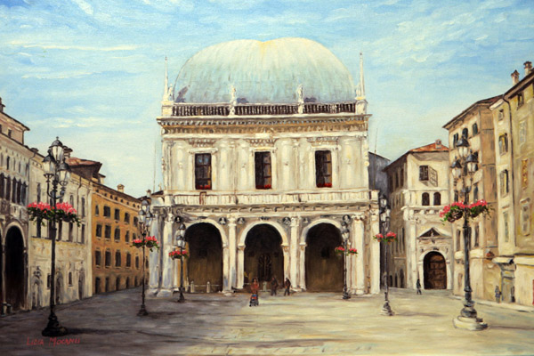
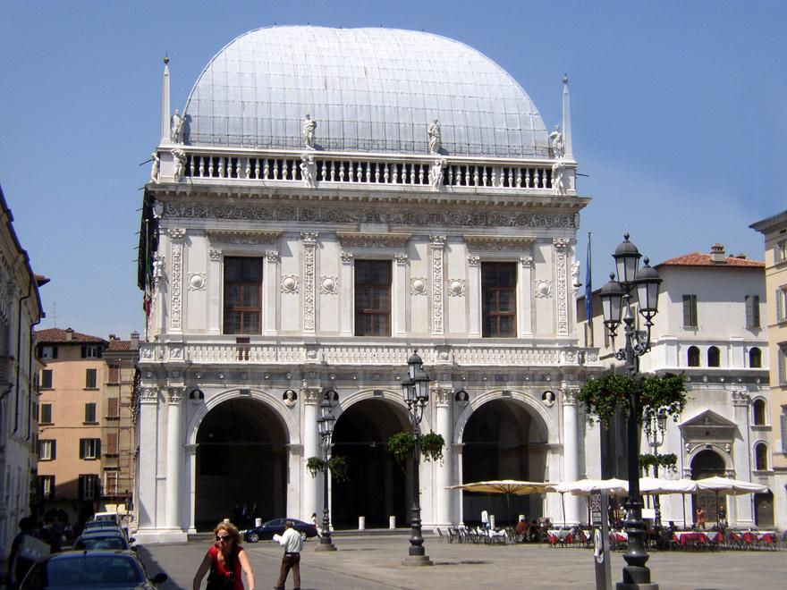
Piazza della Loggia
Piazza della Loggia (former Piazza Vecchia):
a beautiful example of Renaissance piazza, with the eponymous loggia (the current Town Hall).
Piazza della Loggia, with its Venetian influences.

Slide 10
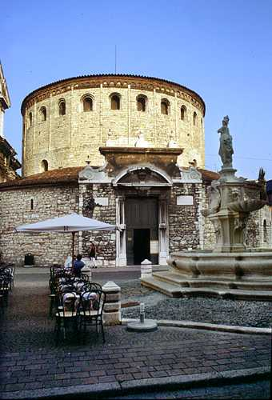
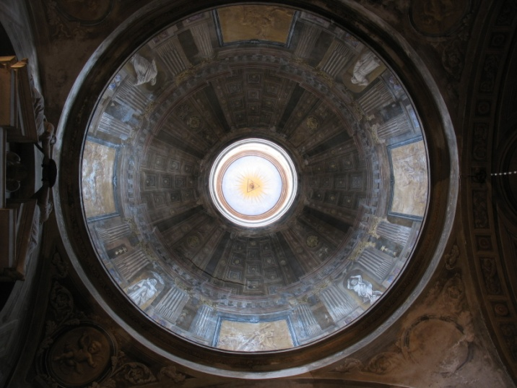
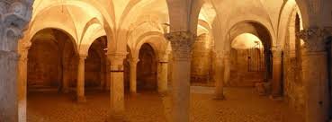
The Old Cathedral
Duomo Vecchio ("Old Cathedral"), also known as La Rotonda. It is an exteriorly rusticated Romanesque church, striking for its circular shape.
The main structure was built in the 11th century on the ruins of an earlier basilica. The structure houses paintings by Alessandro Bonvicino (known as il Moretto) and Girolamo Romanino.

Slide 11
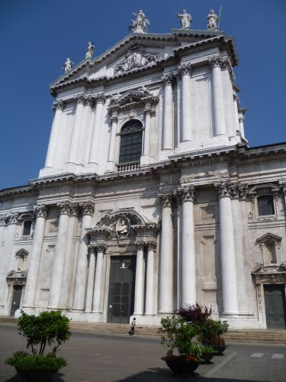
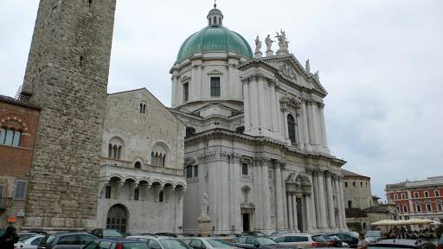
The New Cathedral
Duomo Nuovo ("New Cathedral"). Construction on the new cathedral began in 1604 and continued until 1825.
Initially a contract was awarded to Palladio, but, due to economic shortfalls, the work was prosecuted, still in a Palladian style, by the young Brescian architect Giovanni Battista Lantana.

Slide 12
The oldest part of the city
Piazzale Arnaldo
Piazza Tebaldo Brusato
Via Musei
San Salvatore-santa Giulia
and City Museum
Piazza del Foro
Via Cattaneo
Vicolo San Clemente
Via Trieste
Via Tosio
Corso Magenta

Slide 13
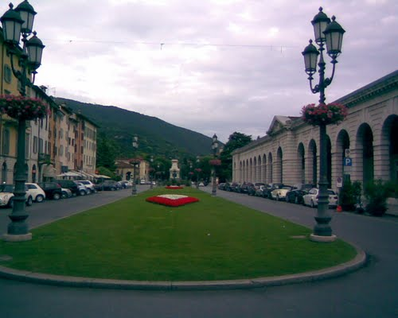
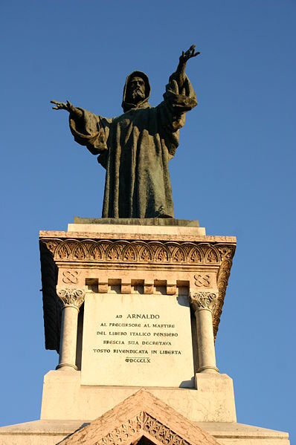
Piazzale Arnaldo: got its name in 1897 from the large bronze statue of Arnaldo of Brescia.
The statue is in memory of the monk, who preached against the corruption of the clergy and was executed in 1155.

Slide 14
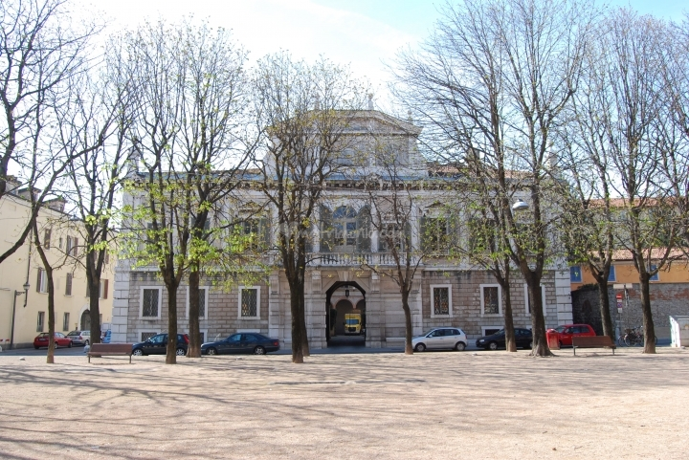
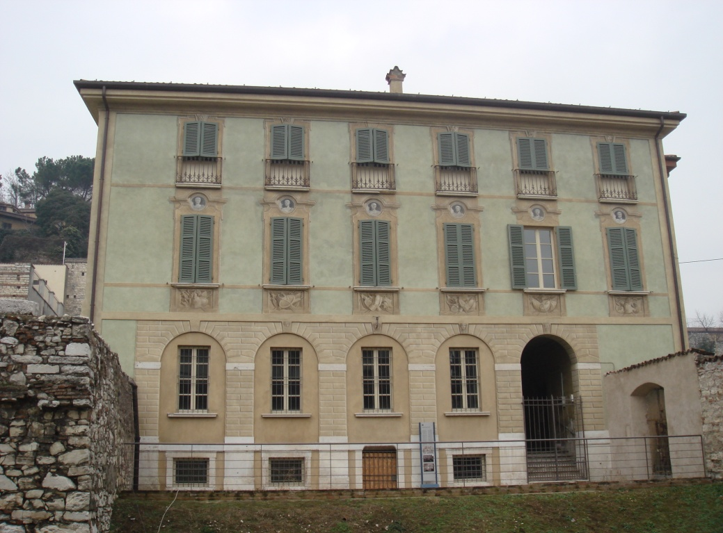
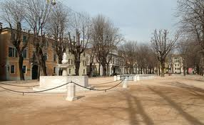
At the end of Piazzale Arnaldo you turn right towards Piazza Tebaldo Brusato. It was built in the Middle Ages and fights, duels, tournaments and jousting took place here.
Palazzo Cigola, at no. 35, stands out among the ancient buildings which surround Piazza Tebaldo Brusato.
Before leaving the square to go into Via Musei, you pass Palazzo Maggi at no. 22.

Slide 15
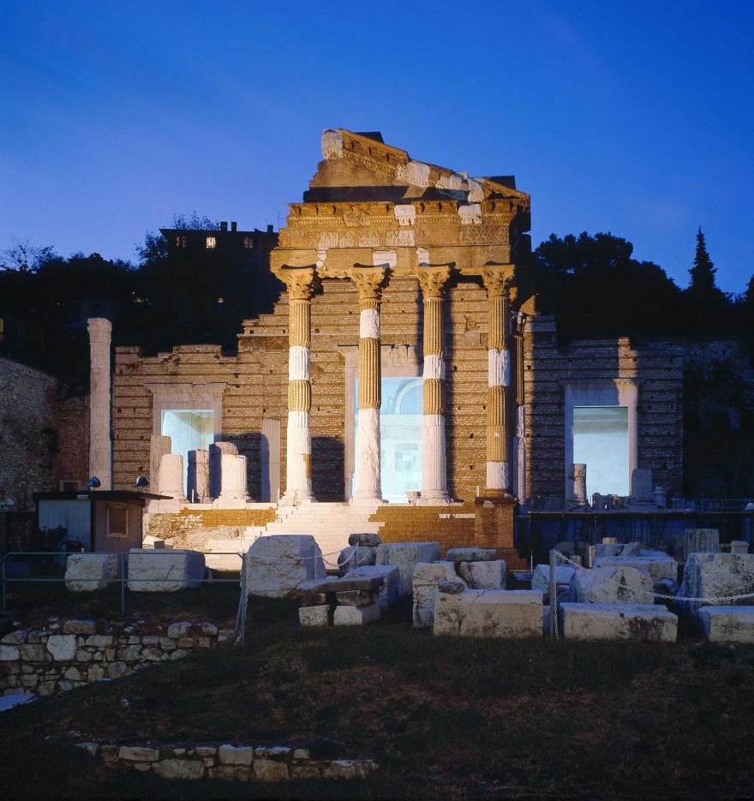
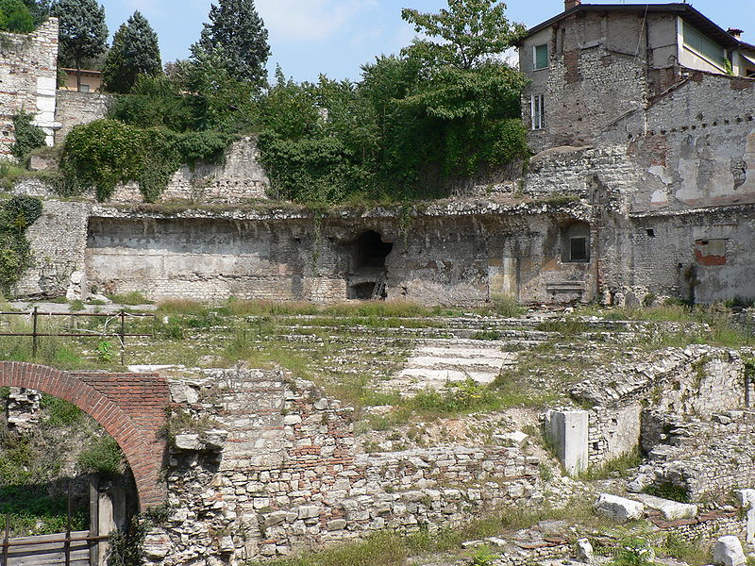
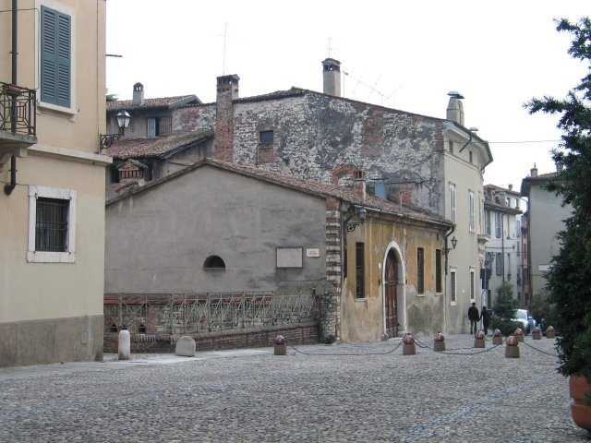
Via dei Musei is where the decumano massimo used to be. The Roman road, which is now about 5 metres below ground level, crossed the ancient centre of Brixia from east to west, traversing that part of the town enclosed within the city walls since the first century AD.
There are imposing buildings in this road: the Capitolium, with the Forum and the Roman Theatre, forms one of the major groups of monumental remains in Italy.

Slide 16
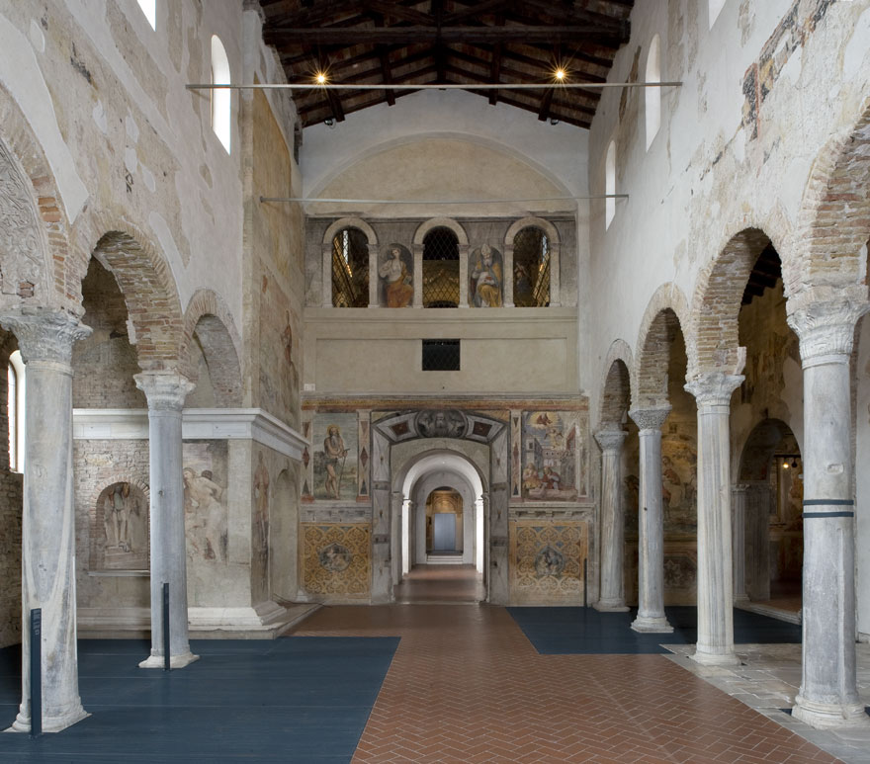
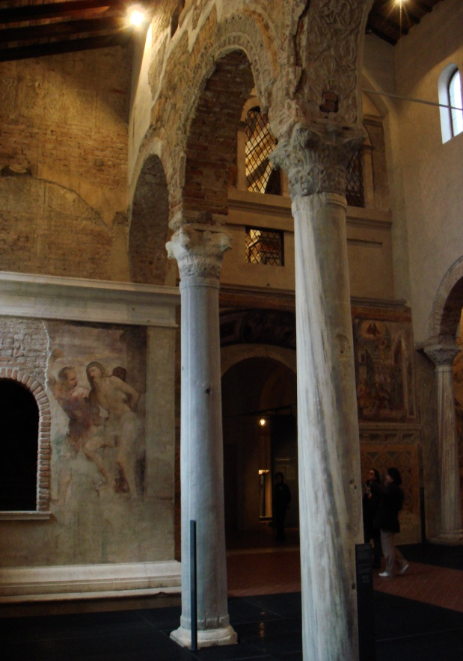
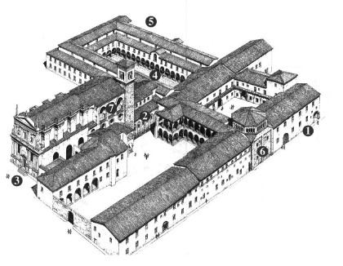
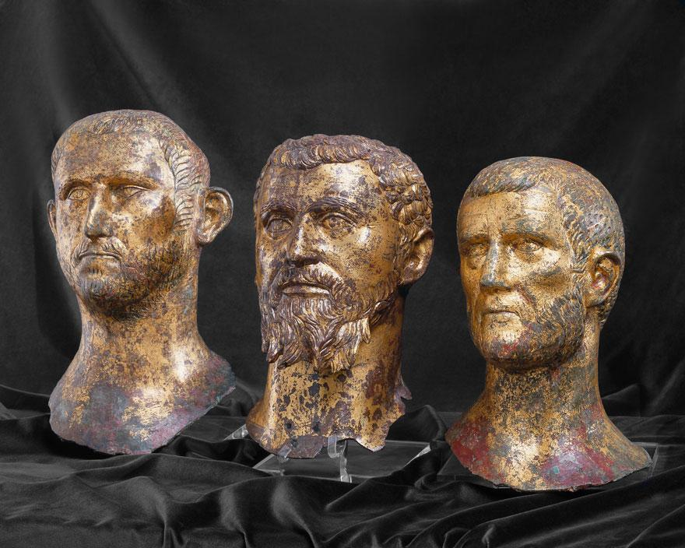
One of the finest buildings left to us from the Lombard period is in Via Musei: the Convent of San Salvatore - Santa Giulia.
It stands on one of the richest archeological sites in the city, where traces of Iron-Age, Roman and Lombard settlements have been found.
The monastery is considered the place where ‘Ermengarda’,or ‘Desiderata’, wife of Charlemagne, spent her exile.
In 2011, it became a
UNESCO World Heritage Site.

Slide 17
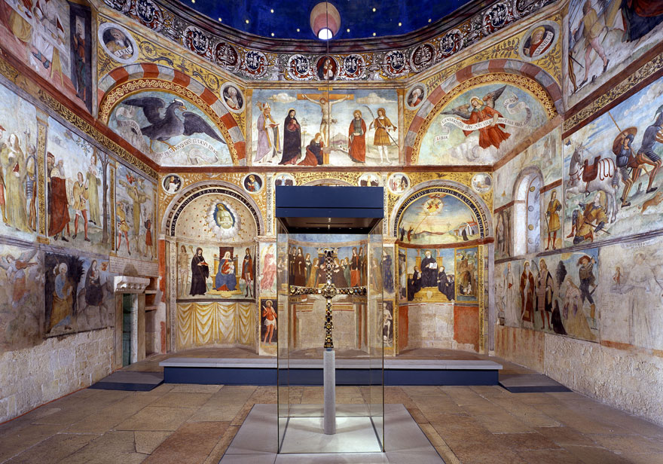
Continuing along Via Musei you skirt the south side of Santa Maria in Solario, the only wall of the votive chapel not incorporated in the convent complex S. Salvatore-S.Giulia.
Casa Benasaglio, almost directly opposite at no.50, has recently been restored.
Skirting the perimeter wall of the convent you turn left into Via Piamarta, the old road up to the castle.
Church of Santa Maria in Solario

Slide 18
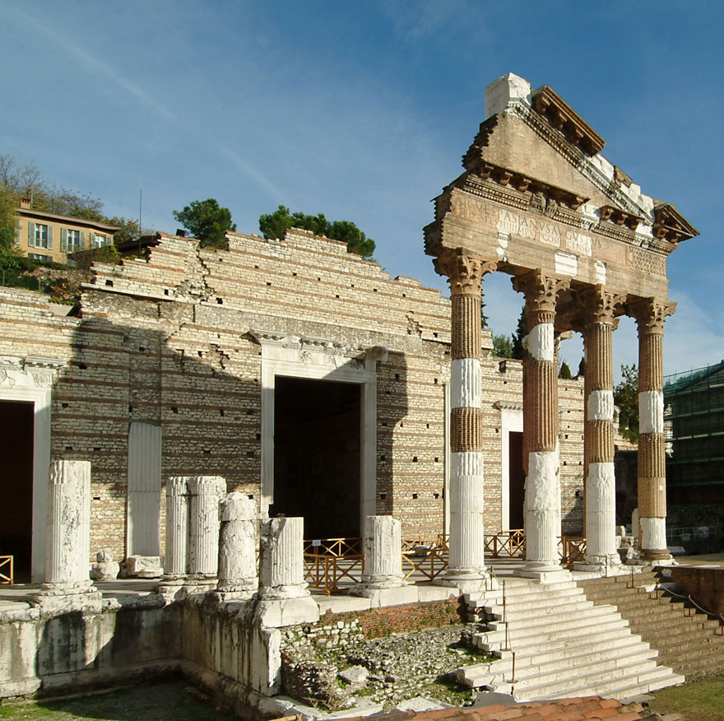
Coming out of Vicolo Fontanone you find yourself in the centre of the archeological site, whose present layout dates back to 1830.
It is also the result of restoration work carried out between 1939 and 1943 on the Capitolium Temple which is attached to the Roman Museum.

Slide 19
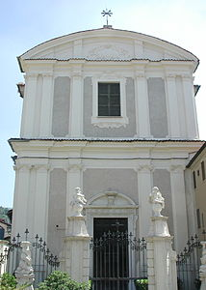
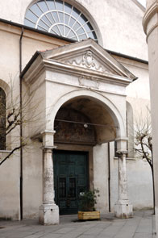
The Church of San Zeno in the Forum stands on the corner of Piazza del Foro.
On the opposite side of the square is Palazzo Martinengo Cesaresco Novarino.
There is a scale model of the archeological area of the town in the basement of this palace and the remains of a Roman spa, and of some tabernae (shops and taverns) can also be seen.
Turning into Vicolo San Clemente you go through alleyways following the original Roman layout; the town council has recently repaired these narrow little streets without changing their character.
In Piazzetta San Clemente you will find the Church of San Clemente. The church contains numerous works by Moretto, who is buried here.

Slide 20
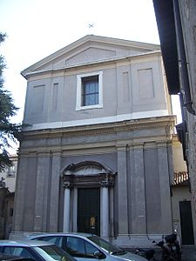
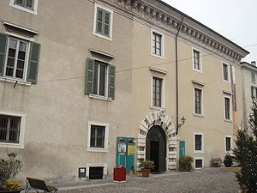
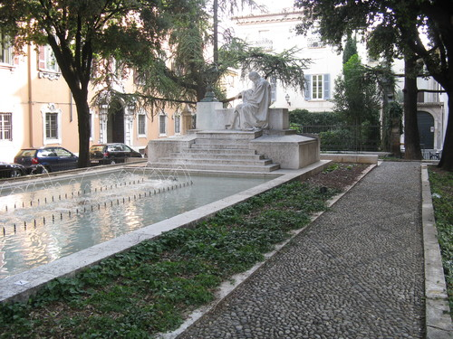
Skirting a block of medieval buildings, you come into Via Trieste.
No. 17 is Palazzo Martinengo Cesaresco, which nowadays houses the Università Cattolica and the Arici schools.
Where Via Trieste crosses Via Veronica Gambara there is a wall which according to tradition was erected by the Brescians to defend themselves against the barbarian invasions.
Number 9 Via Trieste is Palazzo Soardi, nowadays Palazzo Bruni-Conter. It is one of the most striking late Baroque edifices in Brescia.
In the square of the same name there is the Church of Santa Maria in Calchera.
Inside, in the second chapel on the right, there is one of Romanino's early works.

Slide 21
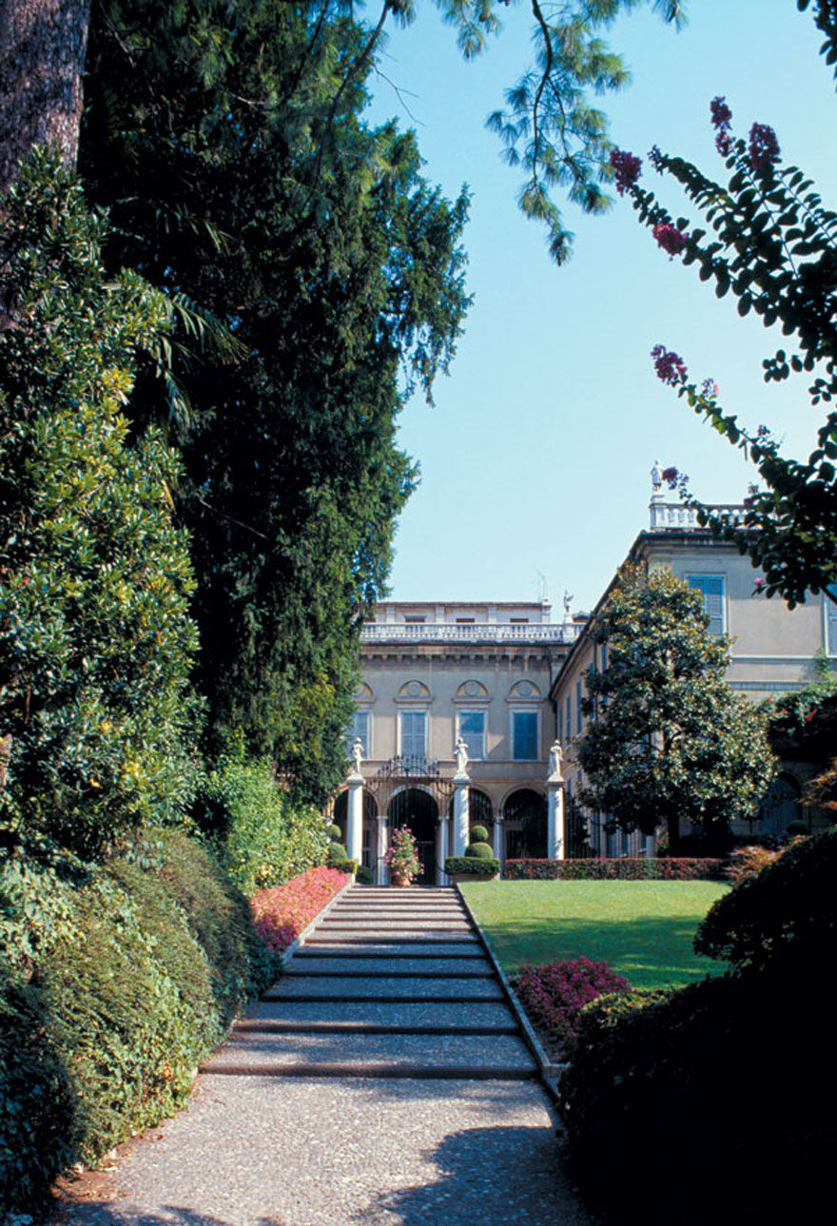
The Brescia Musical Instruments Museum is at no. 34 Via Trieste and is devoted to lutes and other stringed musical instruments.
Next you turn into Via Tosio the seat of the prestigious Brescian Academy of Science, Literature and the Arts.
Number 6 Via Tosio is Palazzo Martinengo da Barco, nowadays belonging to the Beretta family.
Looking through the entrance you can see the courtyard enclosed by railings which are visible from Corso Magenta.
Palazzo Martinengo da Barco,
now Beretta

Slide 22
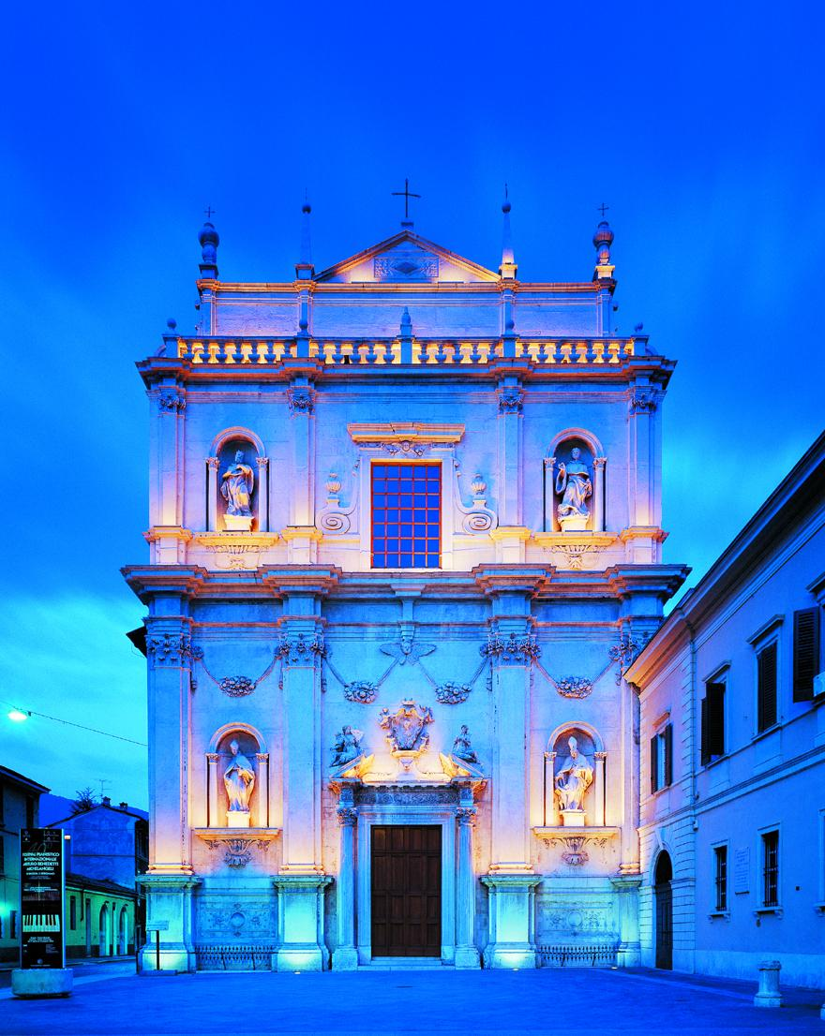
Further along you come to the Conservatorio Luca Marenzio, which was designed by the architect Luigi Donegani in 1837 and takes in part of the ancient Augustinian monastery of St. Barnabas.
The school was dedicated to the hero of the Risorgimento, Tito Speri.
Nearby is the former Church of San Barnaba, which is now used as a concert hall.
San Barnaba

Slide 23
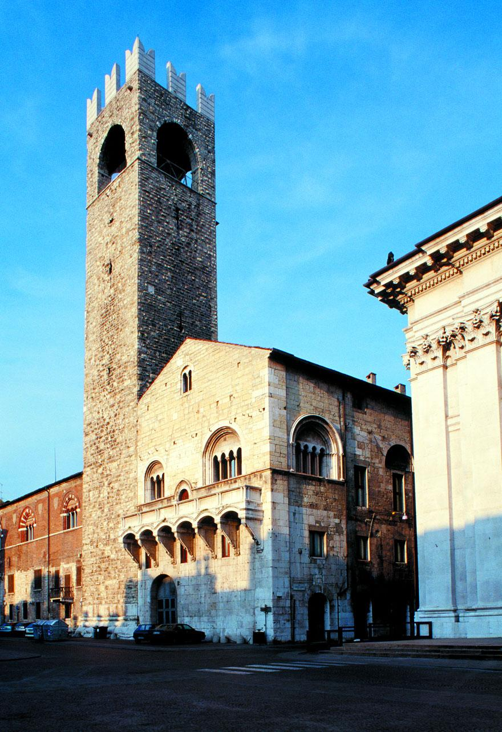
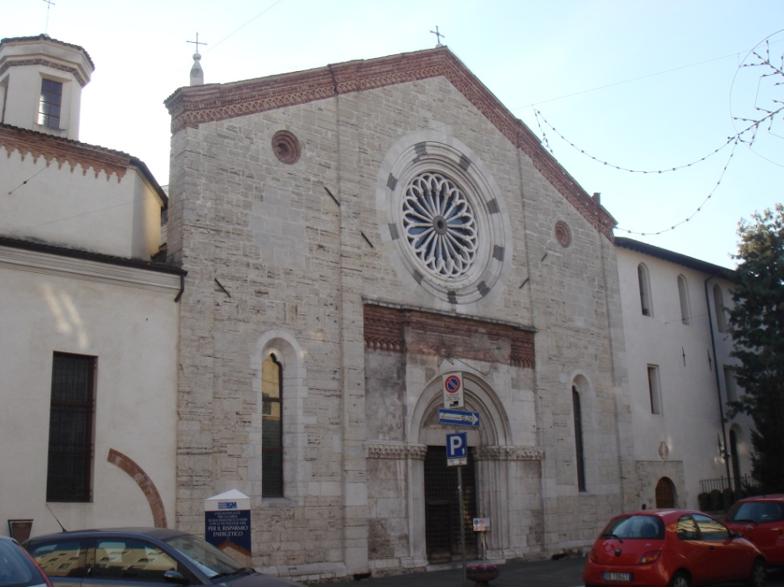
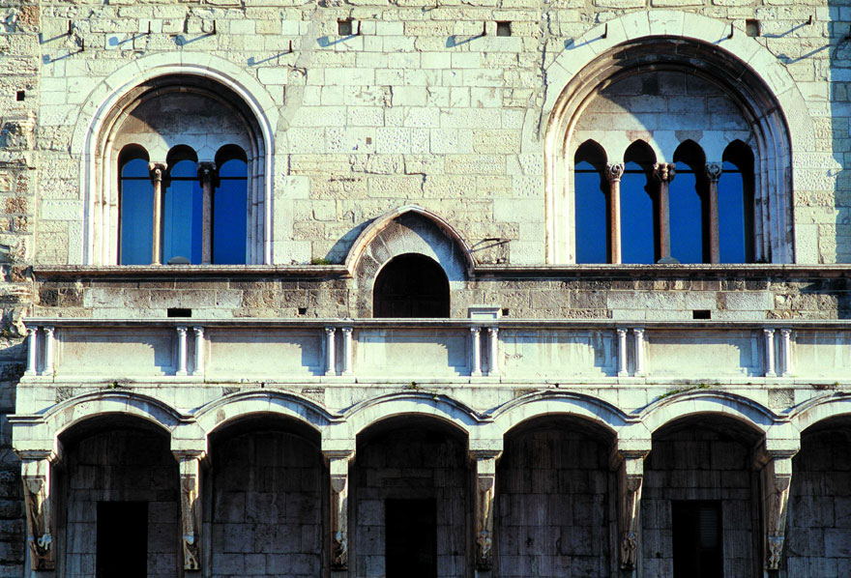
The Broletto, the medieval Town Hall, now hosts offices of both the Municipality and the Province. It is a massive 12th- and 13th-century building.
On the north side, still stands one (Lombard: Tòr del Pégol) of the two original city towers.
Santa Maria dei Miracoli (1488–1523), has a fine façade by Giovanni Antonio Amadeo, decorated with bas-reliefs and a Renaissance peristilium.

Slide 24
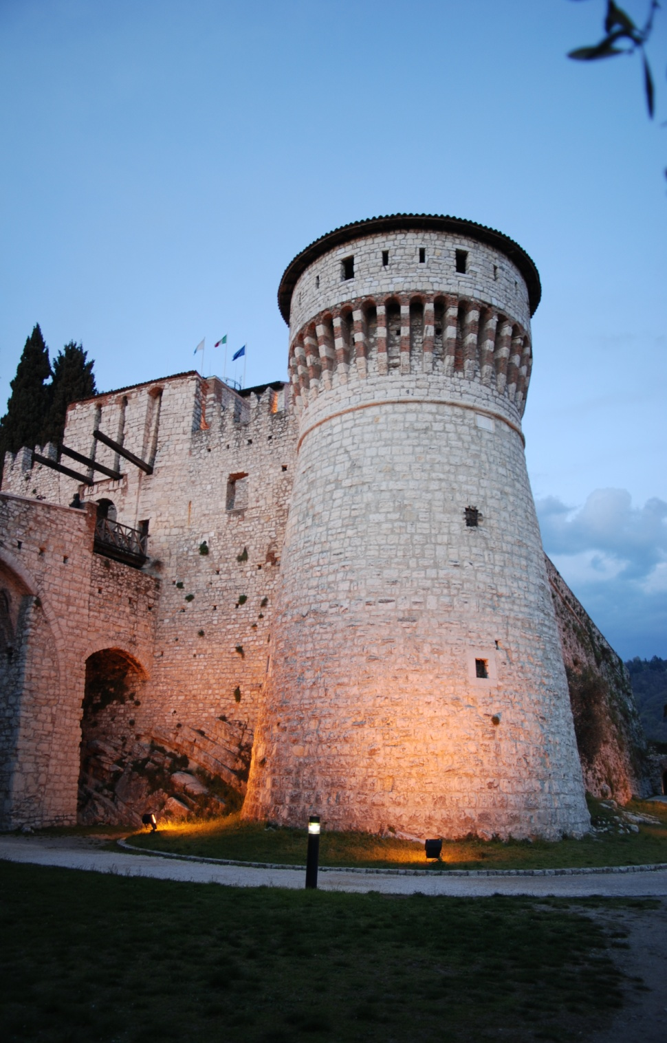
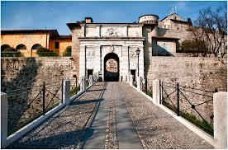
The castle, on top of Colle Cidneo.
Besides being a local favorite recreational area, it hosts:
the Arms Museum, with a fine collection of
weapons from the Middle Ages onwards;
the Risorgimento Museum, dedicated to the Italian independence wars of the 19th century;
an exhibition of model railroads;
an astronomical observatory.

Slide 25
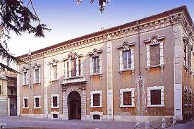
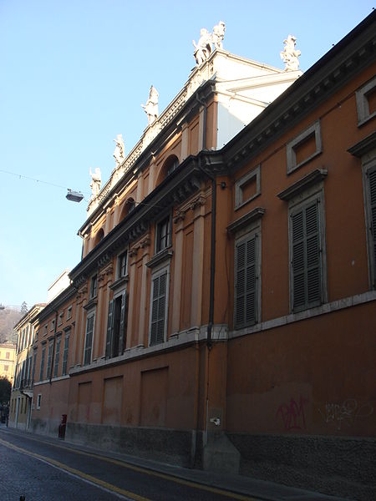
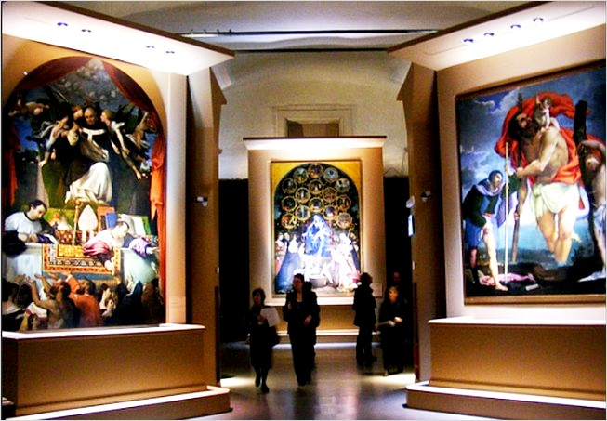
Pinacoteca Tosio Martinengo is the municipal art gallery; it hosts works of Romanino, Bonvicino, and Bonvicino's pupil, Giovanni Battista Moroni.
Biblioteca Queriniana (the ancient library) contains rare early manuscripts, including a 14th-century manuscript of Dante, and some rare incunabula.

