Slide 1
Dragan Stojkovic Piksi
Vuk Danculovic VI/3

Slide 2
Dragan Stojkovic is a Serbian former footballer.He
is known under the nickname Piksi.
He was born in 1965. in Nis.He started to train football very early in FC “Radnicki” from Nis.Also,Stojkovic began his proffesional career in that club,in the Yugoslav first League.He played as a midfielder.

Slide 3
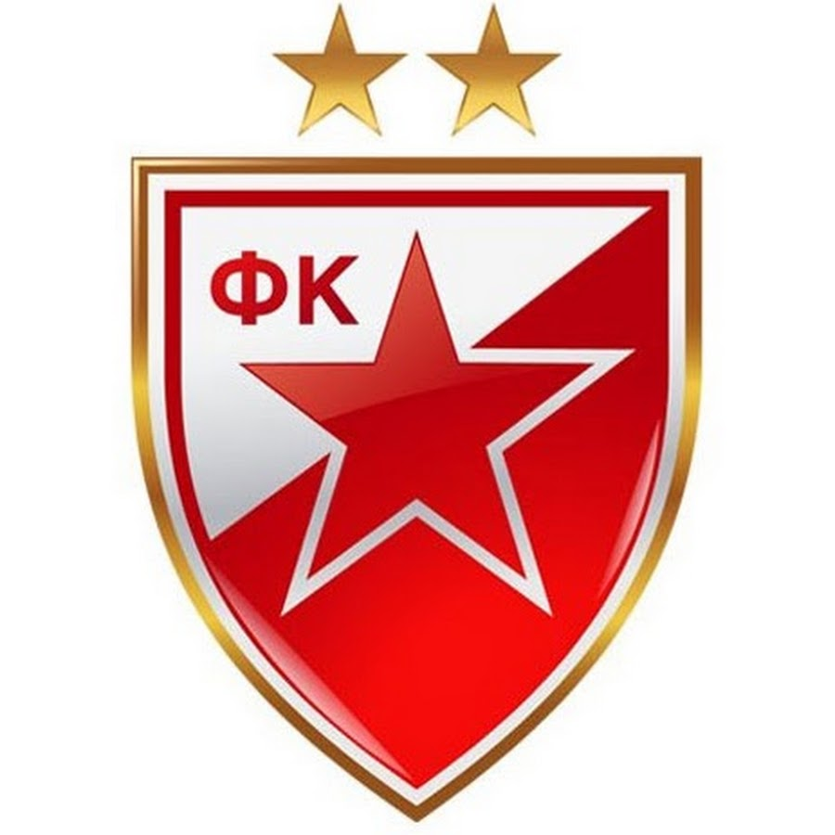
When he was twenty one year old,he moved to Red Star Belgrade.The next four seasons,he appeared in 120 matches for Red Star and scored 54 goals.He became famous.

Slide 4
In the summer of 1990,he moved to Olimpique de Marseille.

Slide 5
In 1994,Stojkovic signed with Japanese J-League team Nagoya Grampus Eight.

Slide 6
Also,he played for the Yugoslavia national football team and was its captain.

Slide 7
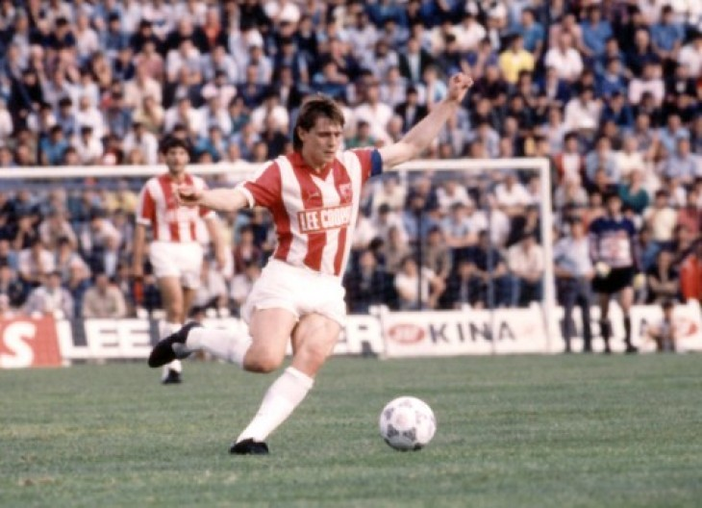
He was known in particular for his vision,technique,creativity,dribbling skills and passing ability.Despite his talent,his creer was
affected by several injures.
He won Yugoslav First League 1987/88 and 1988/89 and Yugoslav Cup with Red Star.

Slide 8
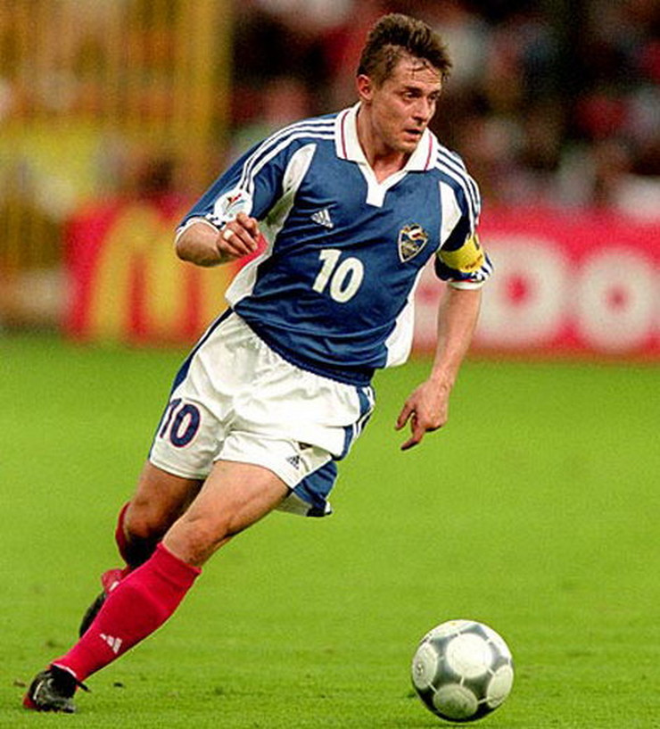
Also,he won French Division 1 1990/91 and UEFA Champions League 1992/93 with Olimpique .

Slide 9
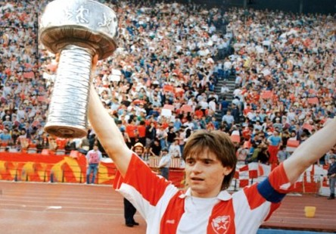
Stojkovic won E’mperor’s Cup 1995 and 1999 with Nagoya Grampus Eight and bronze medalist on the
Olimpics with Yugoslavia National Team,in 1984.
Individually,he got many awards like Yugoslav footballer of the Year,Star of the Red Star,Fifa World Cup All-Star Team,Japanese footballer of the Year and many other.

Slide 10
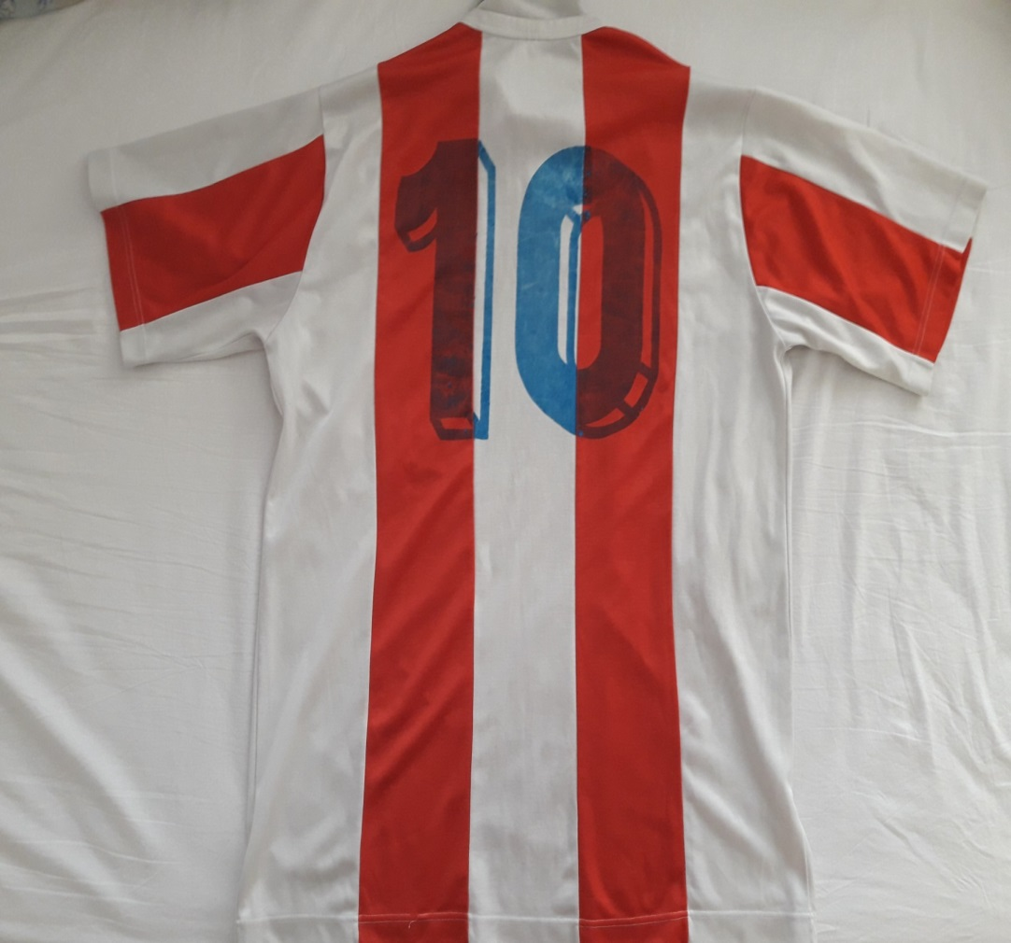
Later,he started his coaching in Nagoya Grampus.After that,he started with administrative functions,like a president of the Yugoslav Football Association and Red Star Belgrade president.

Slide 11
Now,Dragan Stojkovic is a manager of Guangzhou R&F.

