Slide 1
Famous
people
of
Serbia
Authors:
Ivana Vukadinovic 6/3
Helena Vidic 6/3
primary school Vasa Carapic

Slide 2
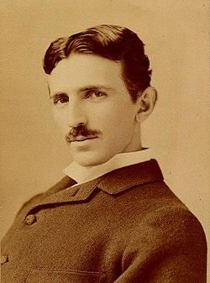
Nikola Tesla
Nikola Tesla (Smiljan, July 10, 1856 - New York, January 7, 1943).He was one of the most famous Serbian and world scientists. An international unit of measure was called after him. This renowned genius of the 20th century is responsible for many discoveries and inventions. Some of the most famous ones are the first hydroelectric power plant, alternating current, the induction motor, the system for the production and distribution of electricity and over 700 other patents.
The Belgrade airport was named after him.

Slide 3
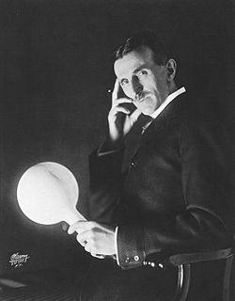
First Patent
The monument of Nikola Tesla
in Belgrade centre

Slide 4
Museum of Nikola Tesla in Belgrade
A hundred dinars

Slide 5
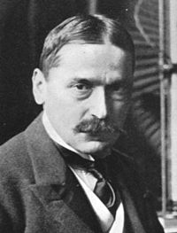
Michael Idrovski Pupin
Michael Idvorski Pupin (October 9,1854-New York,March 12,1935) was a Serbian and American scientist, inventor, professor at the university of Columbia.

Slide 6
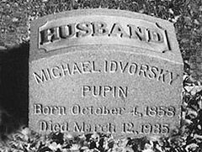
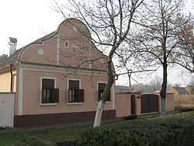
The tombstone of Michael Pupin
Birth house of Michael Pupin in the village of Idvor in Serbia

Slide 7
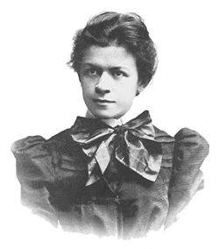
Mileva Maric-Einstein
Mileva Marić-Einstein (Titel, Austro-Hungarian, December 19, 1875 - Zurich, Switzerland, August 4, 1948) was the Serbian mathematician, the first woman of Albert Einstein, one of the most ingenious people of the 20th century.

Slide 8
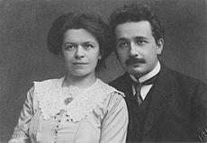
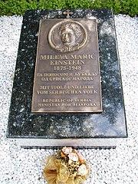
Mileva and Albert
The grave of Mileva Maric-Einstein in Zurich

Slide 9
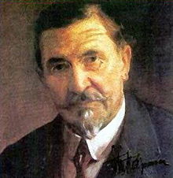
Stevan Stojanovic Mokranjac
Stevan Stojanovic Mokranjac (Negotin, January 9, 1856 - Skopje, September 28, 1914) was a Serbian composer and a classic of Serbian music.

Slide 10
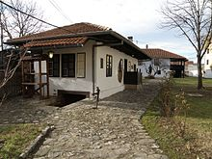
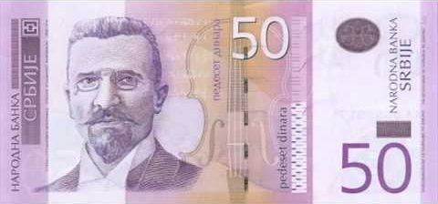
House of Stevan Stojanovic Mokranjac
Fifty dinars

Slide 11
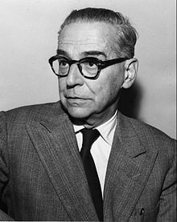
Ivo Andric
Ivo Andric (Dolac, October 9, 1892 - Belgrade, March 13, 1975) was a Serbian and Yugoslav writer and diplomat of the Kingdom of Yugoslavia. In 1961 he received the Nobel Prize for Literature for his novel The Bridge on the Drina which tells about Ottoman times on the Balkans.

Slide 12
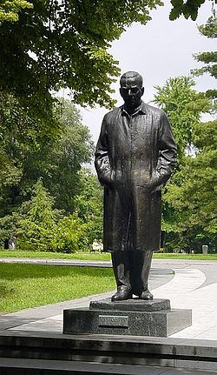
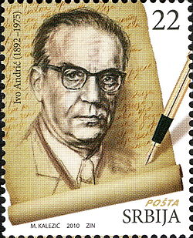
Monument to Ivo Andric in Belgrade
Postage stamp with the image of Ivo Andric

Slide 13
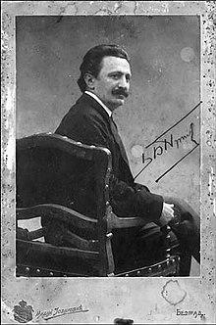
Branislav Nusic
Branislav Nusic (Belgrade, October 20, 1864 - Belgrade, January 19, 1938) was a Serbian writer, comedian, novelist, and drama writer.
His plays are still very popular today. He presented people’s characters very well.
ић

Slide 14
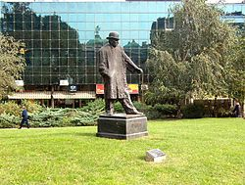
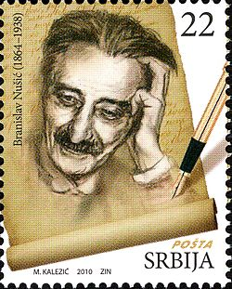
26/5000
Monument to Branislav Nusic
Postage stamp with the image of Branislav Nusic
П

