Slide 1
BELGRADE
VUK DANCULOVIC VI3

Slide 2
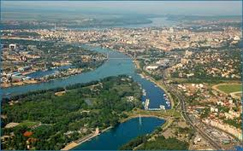
Belgrade is the capital of the Republic of Serbia.
It is one of the oldest cities in Europe.
Belgrade is located at the confluence of two big rivers-the Danube and the Sava.
The city has a long history and now Belgrade is a modern european city. It is an administrative, political and cultural centre of the country.

Slide 3
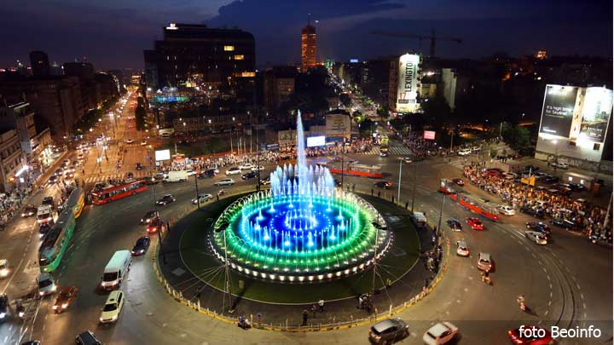
There are many interesting places to visit in Belgrade.
This is the newly restored Slavija Square with a fountain in the middle.

Slide 4
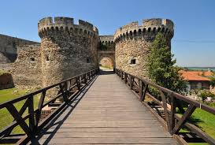
SIGHTS OF BELGRADE
The KALEMEGDAN FORTRESS consists of a citadel and Kalemegdan park. It is situated at the confluence of the rivers Sava and Danube. There are remnants from the Roman times, Serbs in the middle ages, Austrian and Turkish times.

Slide 5
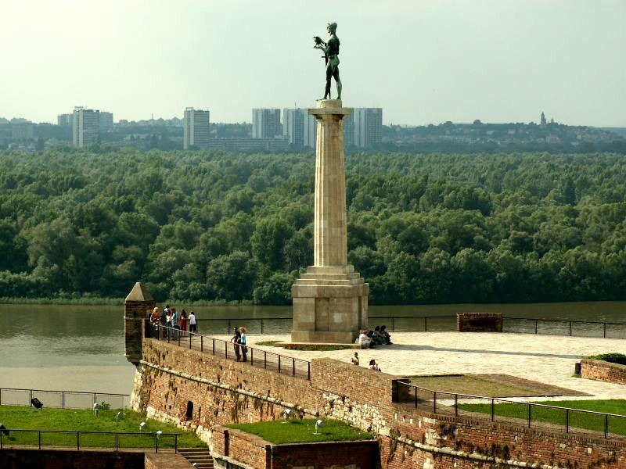
THE VICTOR - one of the symbols of Belgrade. It was built to commemorate Serbia‘s triumph over Austro-Hungarian Empire, that is why it overlooks this former empire. It was built between the WW1 and WW2.

Slide 6
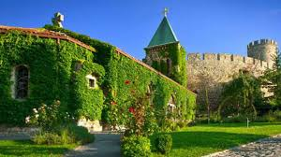
The RUZICA (Rose) CHURCH - a Serbian Orthodox church in Kalemegdan.

Slide 7
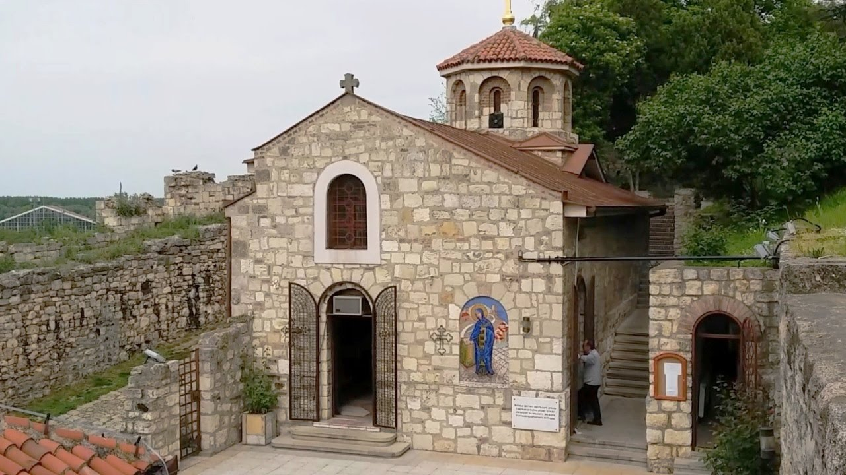
\
The SAINT PETKA church - It is situated near the famous ,,miracle” water spring in Kalemegdan.

Slide 8
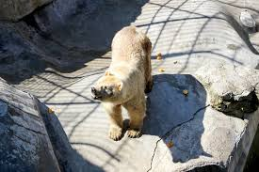
The BELGRADE ZOO - It is called The Belgrade Garden of Good Hope. It is one of the oldest zoos in Europe.

Slide 9
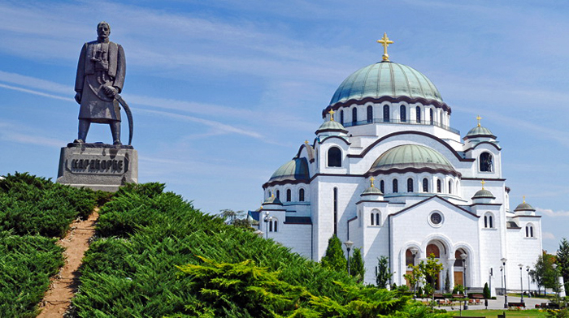
The SAINT SAVA TEMPLE - one of the biggest Orthodox churches in the whole world. It was built at the site where the Turks burnt relics of St. Sava in 1594. This is the monument to the leader of Serbs – Karadjorje – who lead the first Serbian uprising against the Turks in 1804.

Slide 10
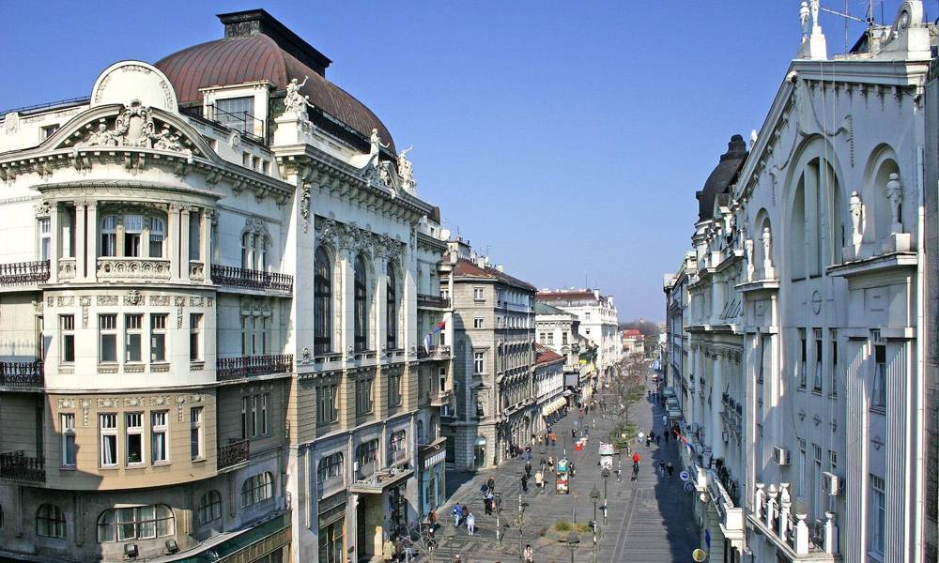
KNEZ MIHAILOVA STREET - one kilometer-long street. It was named after Mihailo Obrenovic, the Prince of Serbia, who ruled from 1860-1868. He is most famous for modernization of Serbian state.

Slide 11
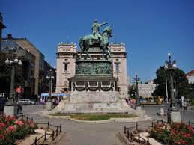
REPUBLIC SQUARE –one of the central town squares.It is often called,,by horse’’. The person on the horse is the Prince Mihailo Obrenovic.

Slide 12
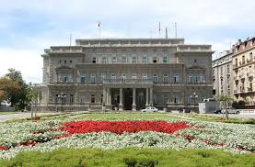
THE OLD ROYAL PALACE AT THE NIKOLA PASIC SQUARE - It was THE residence of THE Serbian kings (at the end of 19th century) and now it is used as town hall.

Slide 13
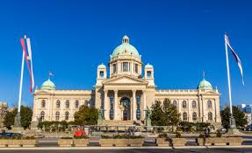
THE NATIONAL ASSEMBLY OF SERBIA is the building of the Serbian Parliament (built between WW1 and WW2).

Slide 14
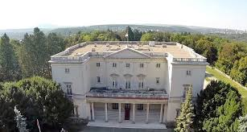
THE WHITE PALACE is a former royal residence of Karadjordjevic dynasty. It was built at the dawn of WW2. Later it was the residence of Josip Broz Tito, the president of Yugoslavia.

Slide 15
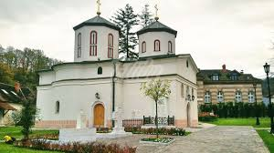
MONASTERY RAKOVICA- some famous people were buried there - Vasa Carapic, Patrijarch Pavle of Serbia.

Slide 16
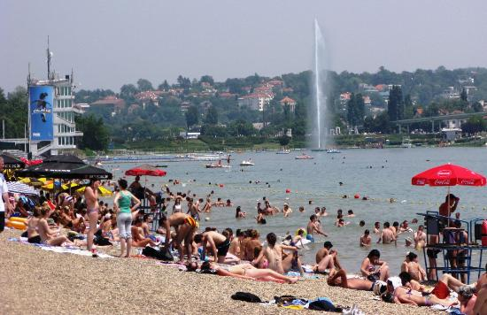
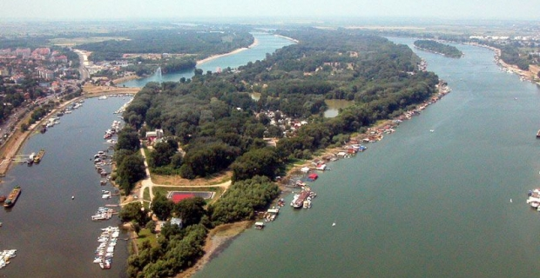
ADA CIGANLIJA – the river island on the Sava river. This is a great place for sports and picnics.

Slide 17
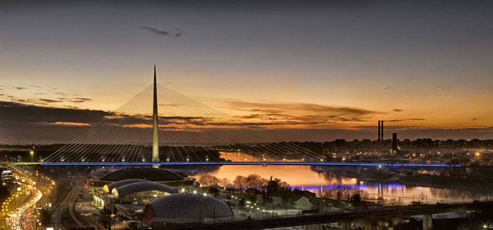
ADA BRIDGE - it is a bridge over the Sava river

Slide 18
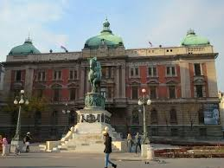
THE NATIONAL MUSEUM OF SERBIA is the largest and oldest museum in Serbia.

Slide 19
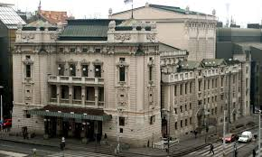
The NATIONAL THEATRE was built in mid-19th century.

Slide 20
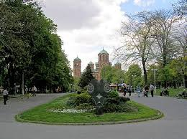
TASMAJDAN PARK – the public park. The name means ‘quarry’ in Turkish.

Slide 21
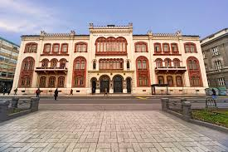
THE UNIVERSITY OF BELGRADE- it is the oldest and largest university in Serbia. It was founded in 1903.

Slide 22
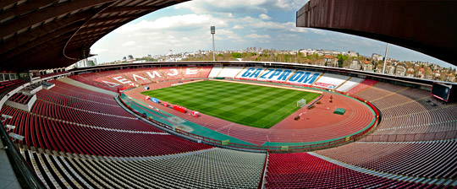
THE MARAKANA, as it is popularly called, bears the name of the football player Rajko Mitic. It is the stadium of the football club Red Star.

Slide 23
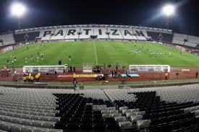
THE JNA STADIUM-it is the stadium of football club Partizan

Slide 24
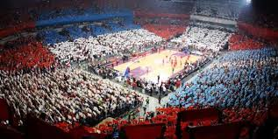
THE ARENA - one of the largest European indoor arenas.

Slide 25
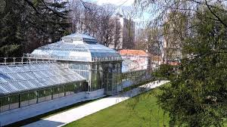
JEVREMOVAC BOTANICAL GARDEN – created in the second half of the 19th century with assistance of our famous botanist Josif Pancic. ‘Jevrem’ was the brother of Duke Milos, ruler of Serbia in the first half of the 19th century.

Slide 26
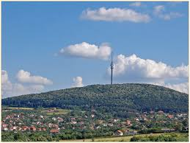
MOUNT AVALA - it stand at 511 metres above sea level. OUR SCHOOL IS AT THE FOOT OF AVALA MOUNTAIN.

Slide 27
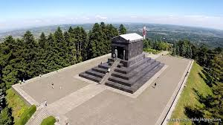
THE MONUMENT TO THE UNKNOWN HERO -it is a WWI memorial, built by the order of King Aleksandar I Karadjordjevic (1933).

Slide 28
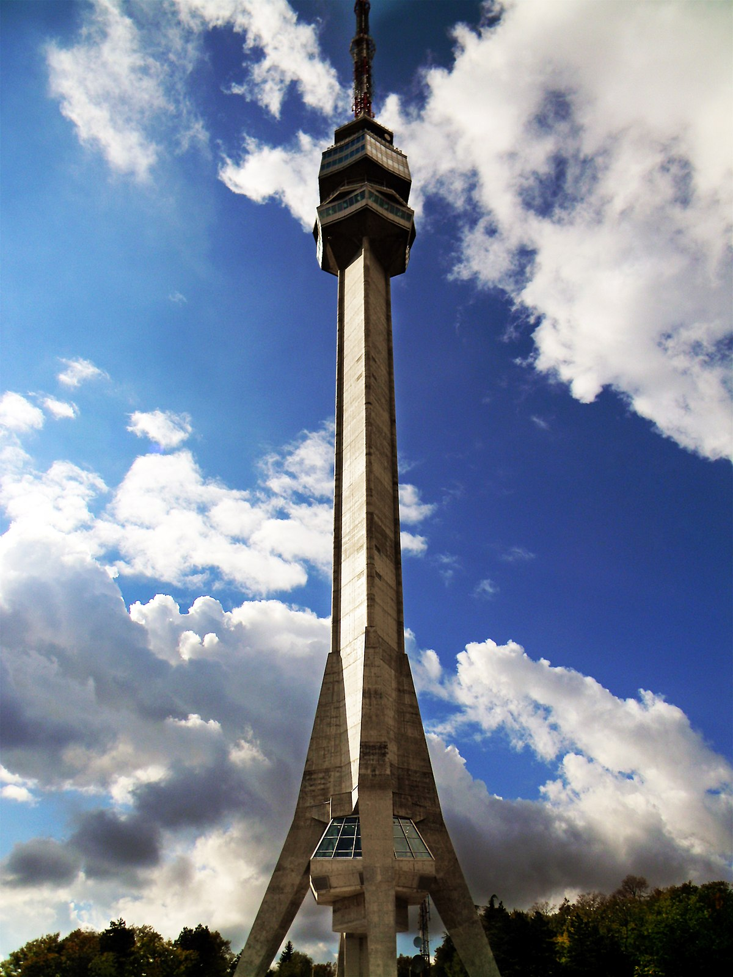
AVALA TOWER is a 204 m high telecommunications tower.

Slide 29
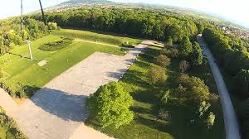
MEMORIAL PARK ,,JAJINCI”- it was a place for mass liquidation of prisoners from the German Nazi camps of the Belgrade settlement Banjica in WW2.

