Slide 2
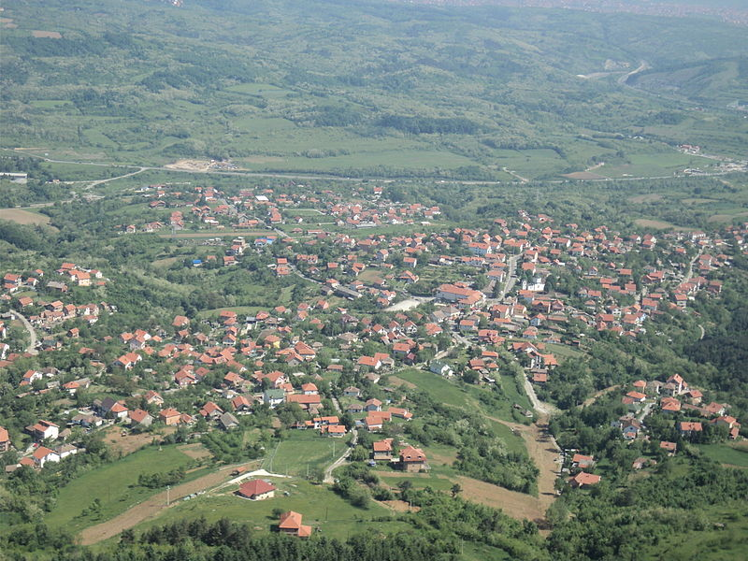
Vasa Čarapić, known as the Dragon from Avala, was born in 1770 in the village of Beli Potok, under the Avala mountain
Beli Potok (meaning
„white creek“
in Serbian)

Slide 3
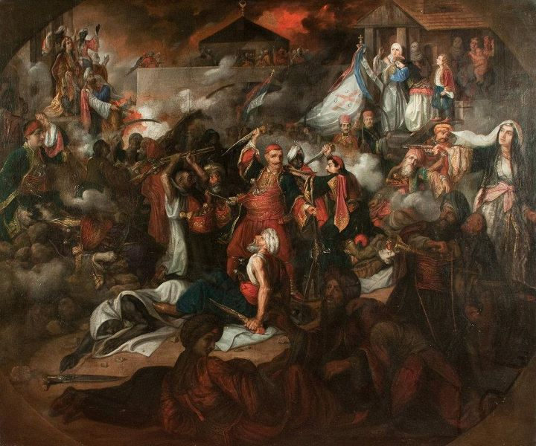
He was a Serbian military commander and one of the most important people of the First Serbian Uprising

Slide 4
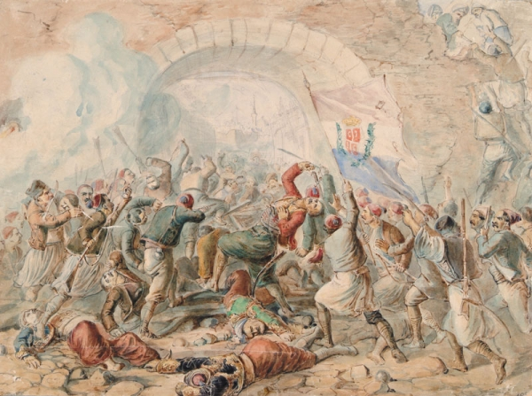
In 1806 he fought together with the Serbian revolutionary leader Karadjordje for the independence of Serbia and was wounded mortally in the near of the Stambol gate

Slide 5
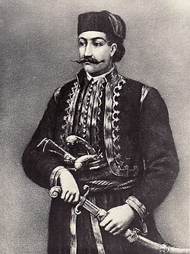
Two hours later, he died in Karadjordjes tent.
Before his death he
called his brother and told him to bury him at the Rakovica monastery.
His wish was fulfilled.

Slide 6
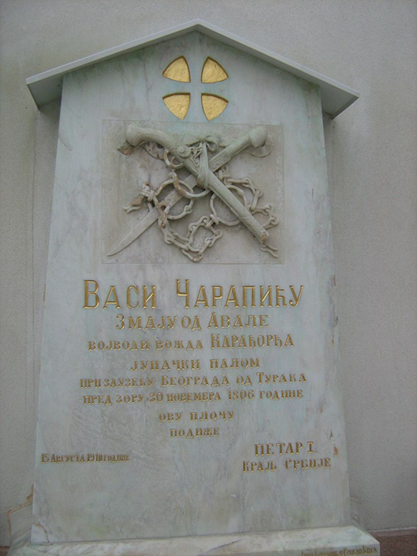
A century later (1910) and according
to the order of King Petar a monument was erected for Vasa Čarapić

Slide 7
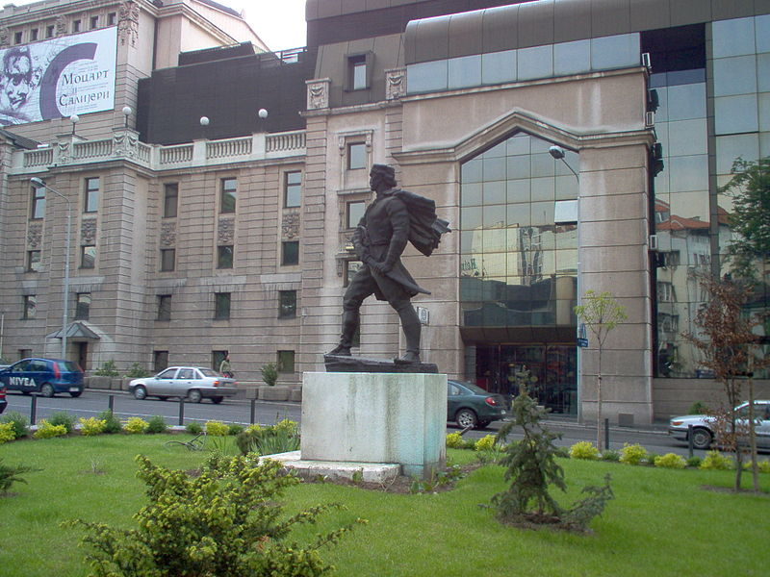
In Belgrade there is a monument to Vasa Čarapić in front of
the National Theatre, near the place where he was killed

Slide 8
In Belgrade a street is named after Vasa Čarapić and the main street in Beli Potok bears his name

Slide 9
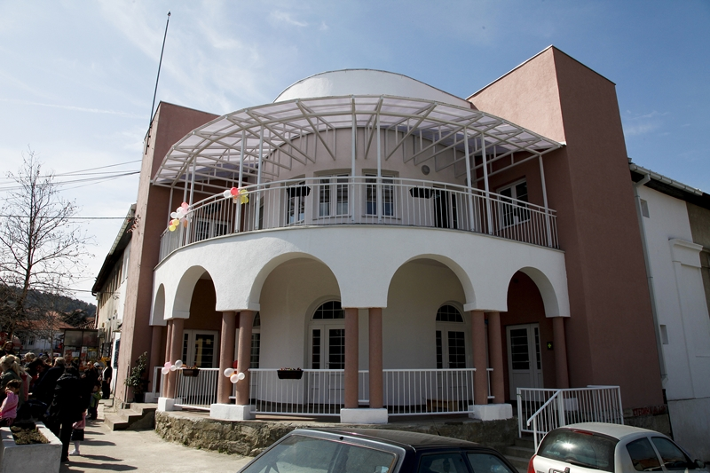
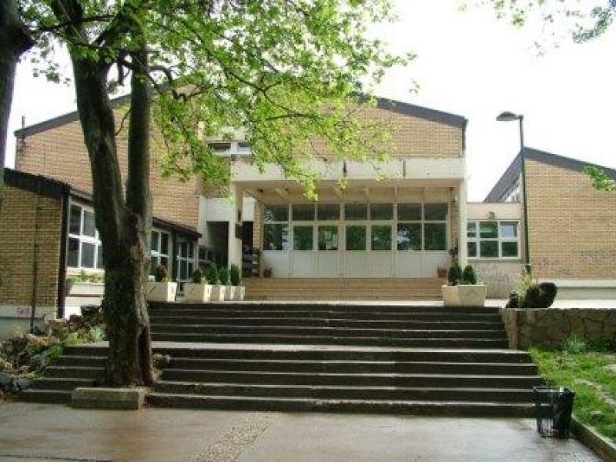
Also the kindergarten and the school in Beli Potok are named after him

Slide 10
The family of Vasa Čarapić got this interesting last name
because one of his ancestors accidentally killed a Turkish dog and he had to pay for it.
He sent the money in his sock (čarapa)...

Slide 11
There are 21 direct descendants of Vasa Čarapić
who live in Beli Potok.
Some of them go to the Vasa Čarapić school even today.

Slide 12
Vasa Čarapić is known as the ________ from Avala.
Vasa Čarapić was born in ____________ (place).
A monument was erected for Vasa Čarapić by the order of _____________.

Slide 13
Dd
 | TRUE | FALSE
Vasa Čarapić was born in 1806.
Vasa Čarapić was the King of Serbia.
Vasa Čarapić was buried at the Rakovica monastery.

Slide 14
Thank you for your attention!
Bjanka Trifunović, VI2
7 June 2018

