Slide 1
Belgrade

Slide 2
Belgrade is the capital of Serbia. It has about 2 million people. It is located at the confluence of the Sava and the Danube.

Slide 3
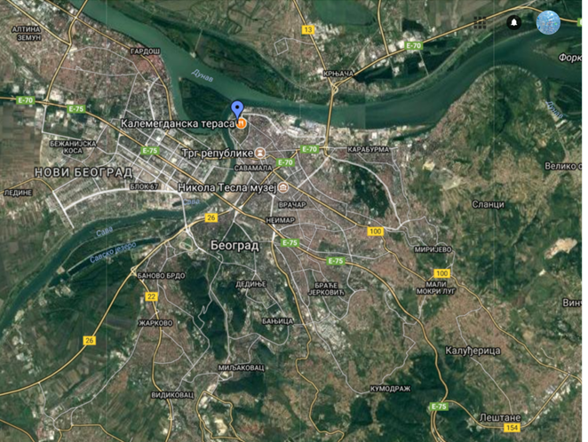
Map of Belgrade

Slide 4
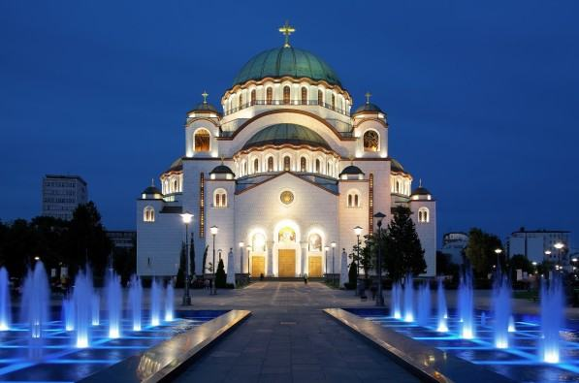
Temple of Saint Sava

Slide 5
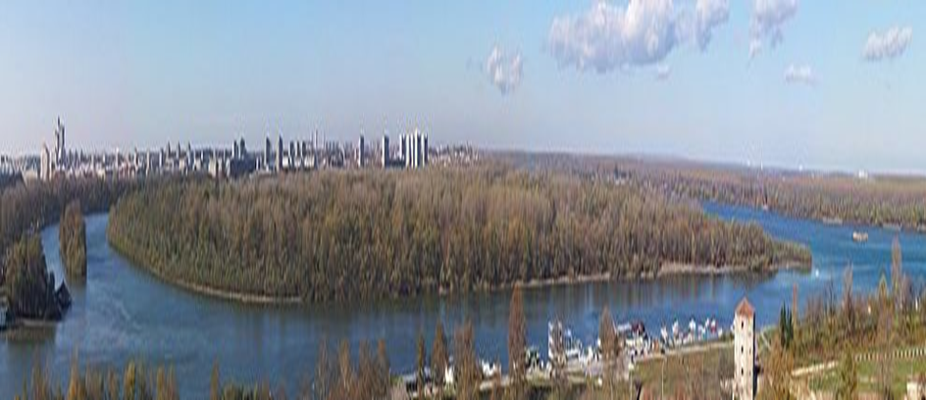
The Big War Island

Slide 6
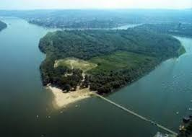
The Big War Island is surrounded by the rivers Sava and Danube.

Slide 7
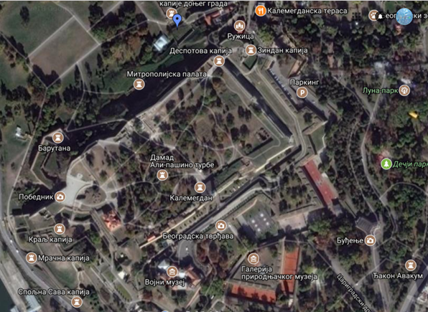
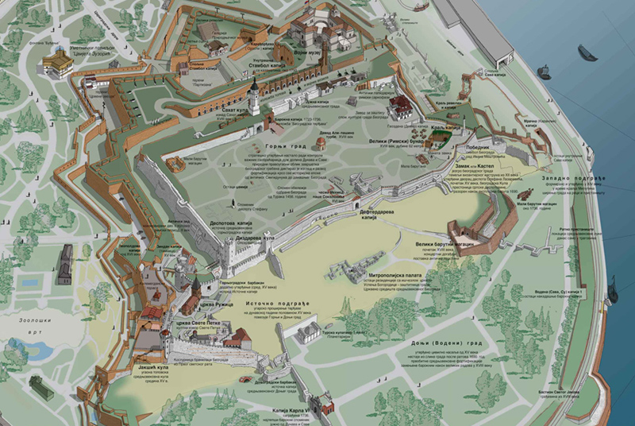
THE KALEMEGDAN FORTRESS

Slide 8
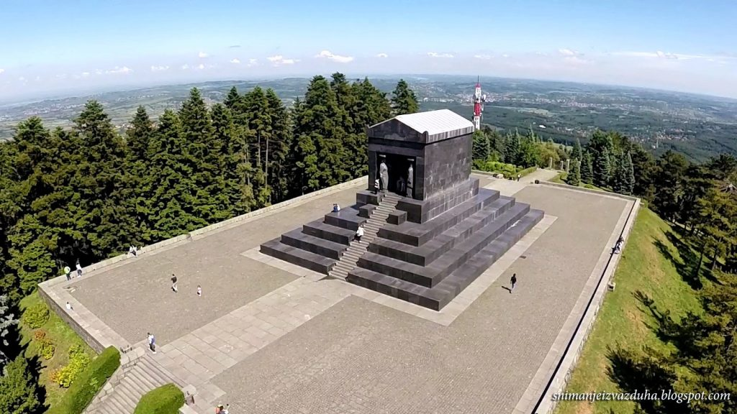
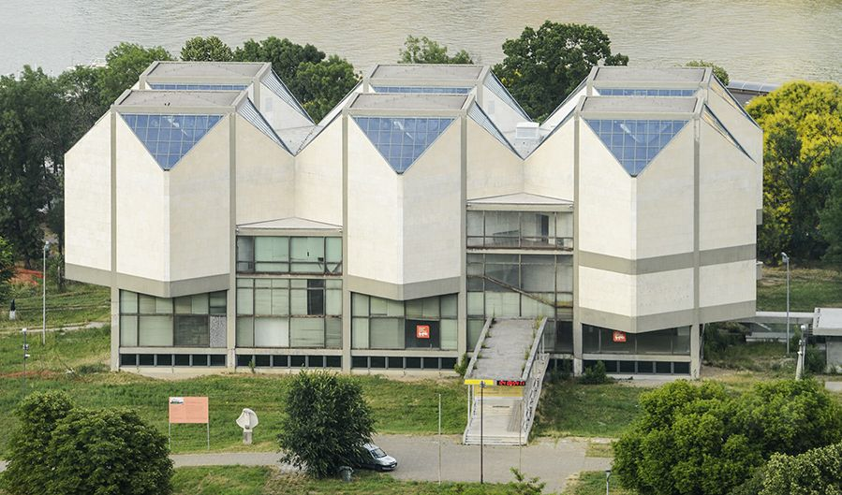
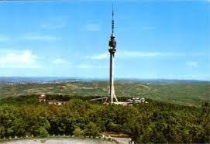
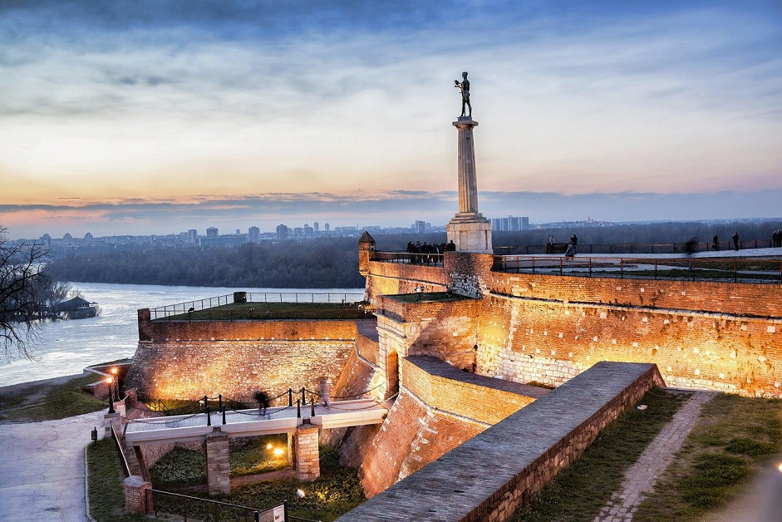
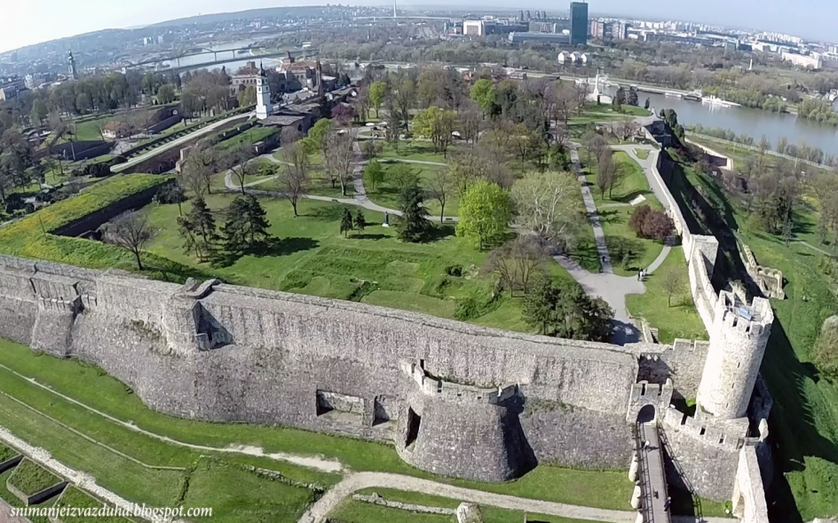
FAMOUS SITES OF BELGRADE

Slide 9
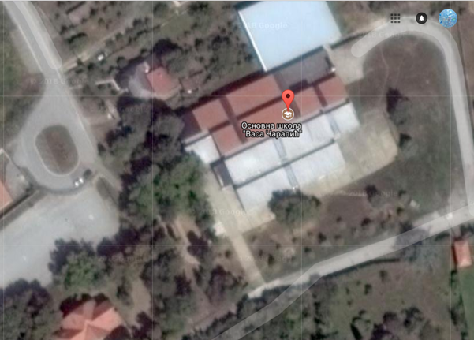
OUR SCHOOL!!!!!

Slide 10
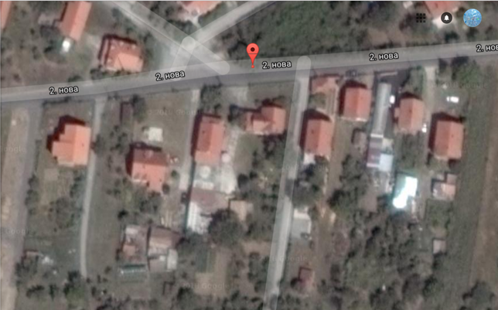
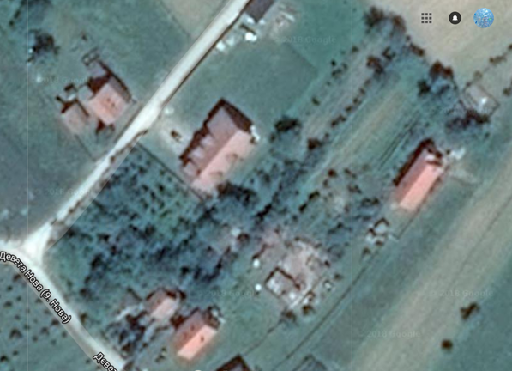
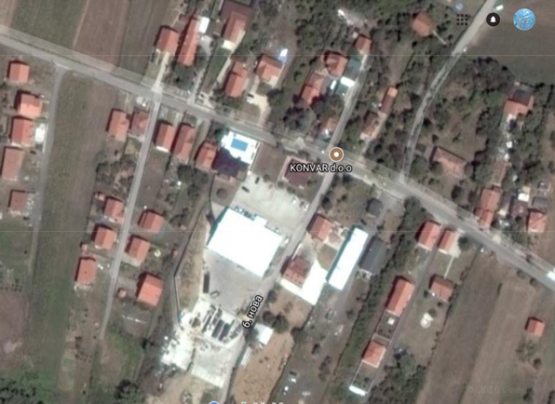
OUR HOMES

Slide 11
AUTHORS:
Teodora Manić 6/3
Larisa Đurić 6/3
Miloš Pavlović 6/3

