Slide 1
Visit to museum of science and mechanics

Slide 2
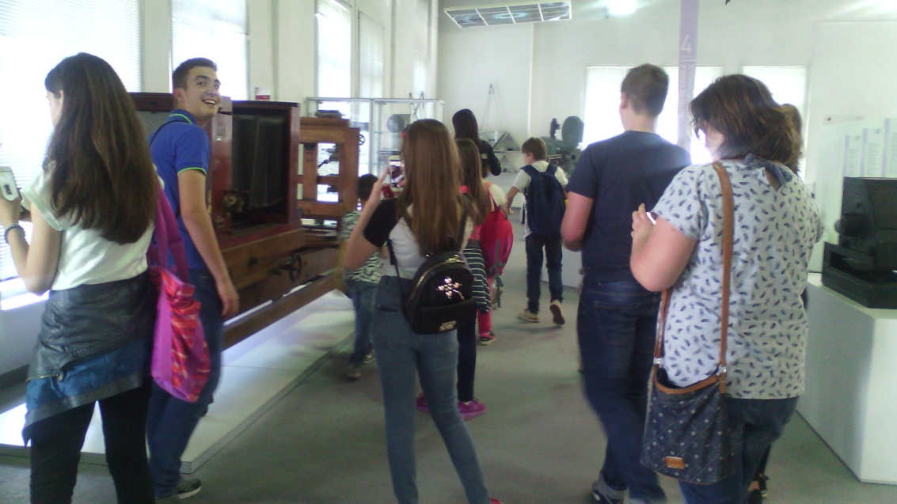
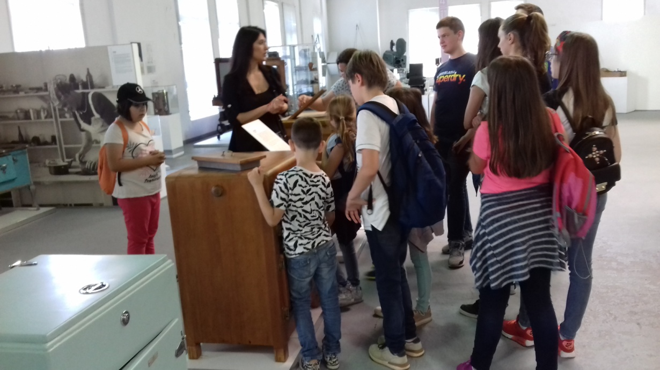
Students of elementary school “Vasa Carapic” visiting the museum.

Slide 3
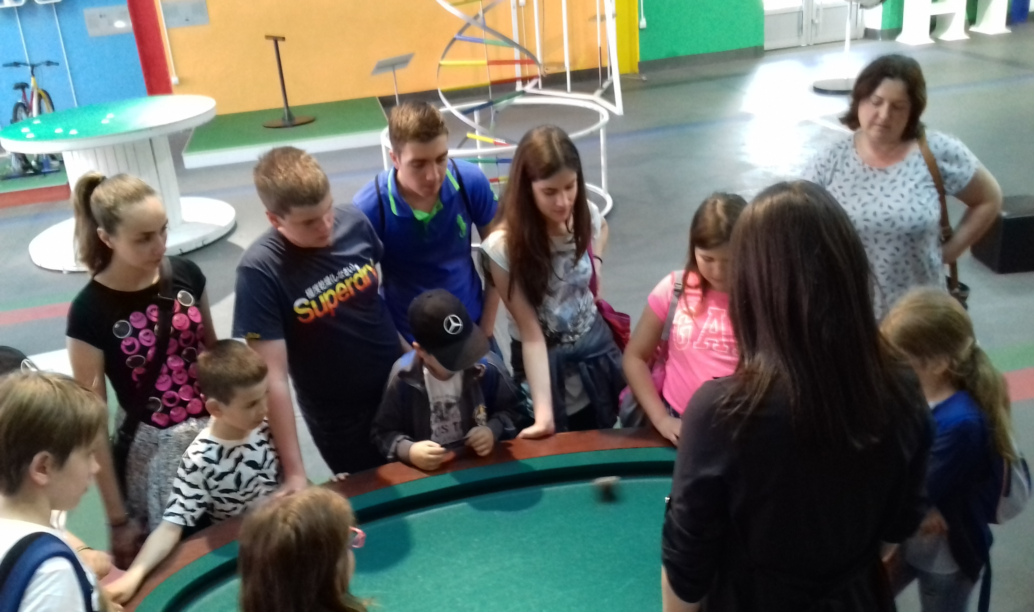

Slide 4
Windmill is a machine that converts the kinetic energy of the wind into mechanical energy. Mechanical energy can be used directly (for starting water, grinding flour) or it can be converted further into electrical energy.

Slide 5
Hydroelectric power plant is a plant in which the potential energy of water first turns into the kinetic energy of its flow, and then in the mechanical energy of rotating the shaft of the turbine and, finally, to the electrical energy in the electric generator.

Slide 6
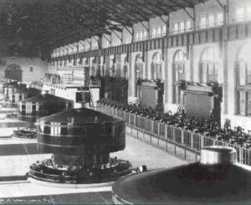
The first hydroelectric power plant was constructed by Nikola Tesla on Niagara Falls and was commissioned in 1895.

Slide 7
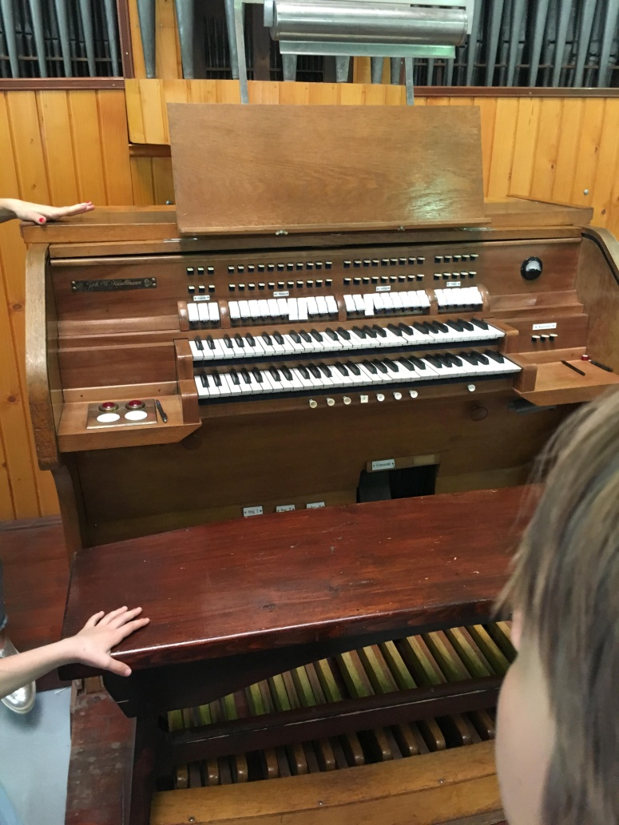
Sound is a mechanical longitudinal wave. The organs are an aerofoil instrument, for sound they produce air flow through one-ton playlists (registers). The registers are around the manual, and by their inclusion and combination, different colors of sound are obtained. The air that is needed to get the sound of the organ comes from one or more bellows that pump and hold the air under pressure. Today, this pressure is achieved by electric motors, and sometimes they were in charge of people, called kalkanti.

Slide 8
Terazije are a mechanical instrument for measuring the mass of unknown mass compares it to a known weight of weights. They are made in various bands and accuracy.

Slide 9
Presentation made by: Katarina Vucic, class 8/1 Nikola Mijailovic, class 8/1
Photos taken from private collections of students and teachers who participated in the visits: Vuk Peric, art teacher; Danijela Djokovic, history teacher; Svetlana Joka, physics teacher; Maja Hadzic, English teacher.

