Slide 1
Videoconference @ctive @nd Digital Citizenship Dimensions

Slide 2
VIDEOCONFERENCE
PROGRAMME OF THE VIDEOCONFERENCE:
Introduction
Presentation of Slovak team and their work on the project
Presentation of Italian/Romanian team
and their work on the project
Reflections about the project
Conclusion

Slide 3
THIS IS US – A SLOVAK TEAM @ WORK
@ctive @nd Digital Citizenship Dimensions

Slide 4
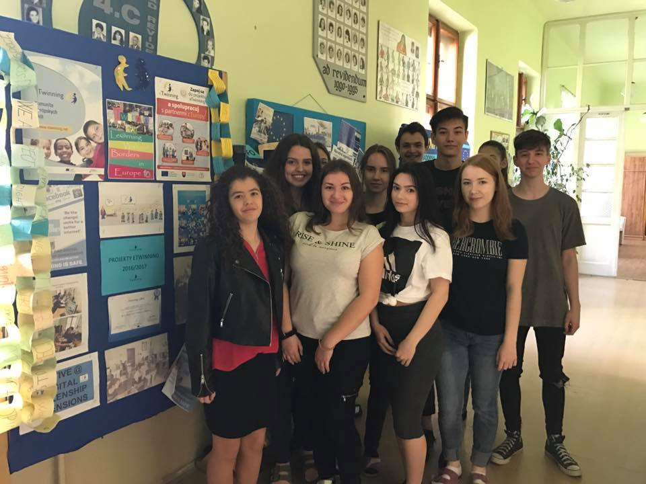
A SLOVAK TEAM STUDENTS OF 1.B

Slide 5
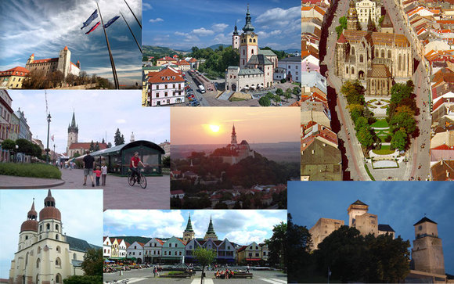
SLOVAKIA

Slide 6
OUR TOWN LEVICE

Slide 7
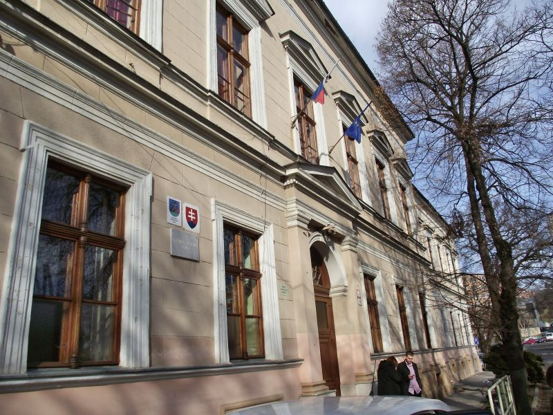
OUR SCHOOL BUSINESS ACADEMY
BUSINESS ACADEMY

Slide 8
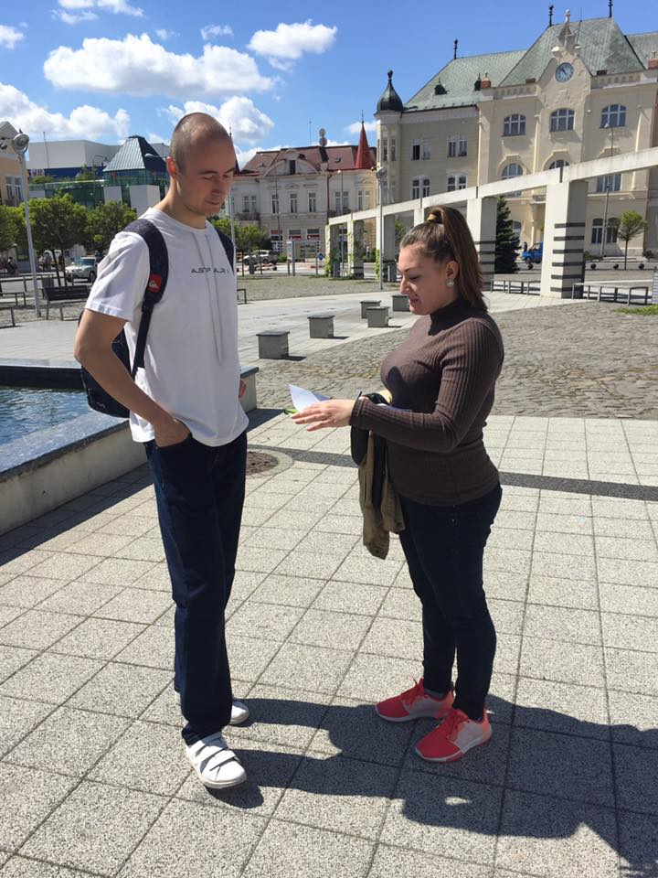
WORK ON THE SURVEY IN OUR TOWN

Slide 9
WORK ON THE SURVEY IN OUR TOWN
Most of the people spend around 3 hours a day on the net, the younger ones the more time on the net
They are on the net because of wor, communication or entarteinment
They use the Internet especially at home or school/work
Most visited site is Facebook
They often trust people on the net
Participants of our survey are pretty setisfied with their PC skills

Slide 10
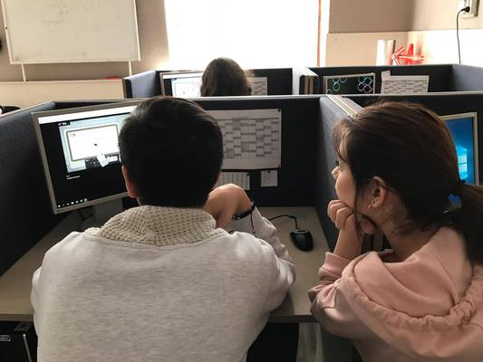
WORK ON PC ON THE PROJECT

Slide 11
WE AND DIGITAL WORLD

Slide 12
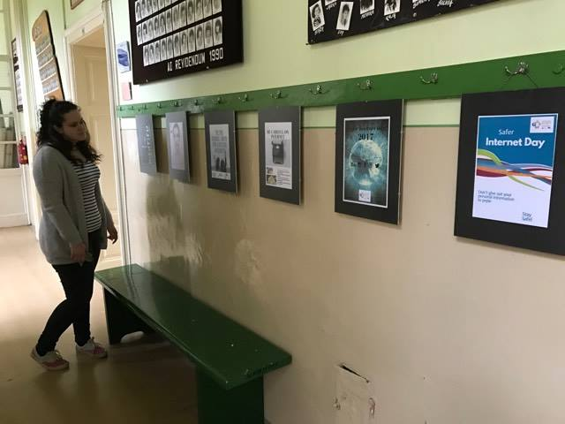
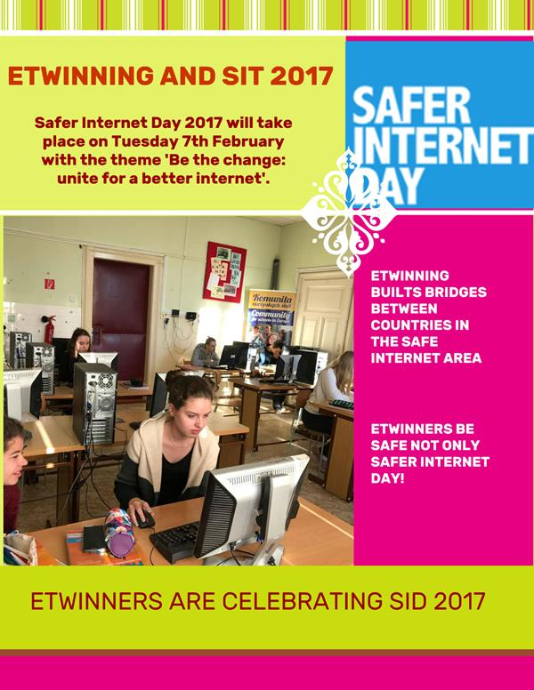
OUR POSTERS EXHIBITION

Slide 13
WE WERE DISCUSSING CYBERBULLYING
CYBERBULLYING BY STUDENTS OF BUSINESS ACADEMY

Slide 14
WEBPAGE OF THE PROJECT
https://digitalcitizenship0.wixsite.com/etwinning

Slide 15
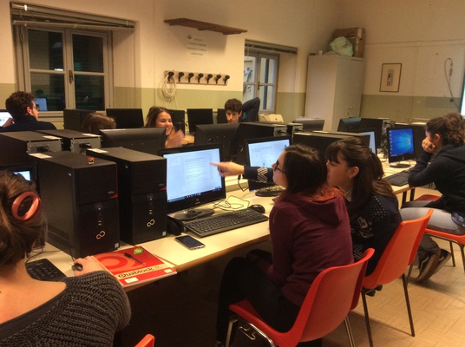
THANK YOU FOR THE COOPERATION ☺

Slide 16
BE DIGITAL BE SAFE! HAVE A NICE SUMMER ☺

Slide 17
YOUR SLOVAK FRIENDS

