Slide 1
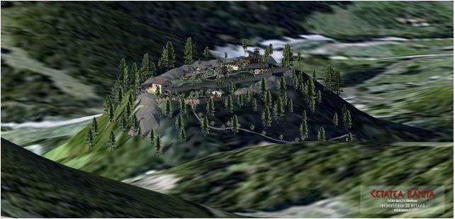
Banita Citadel
(
,
Erasmus+

Slide 2
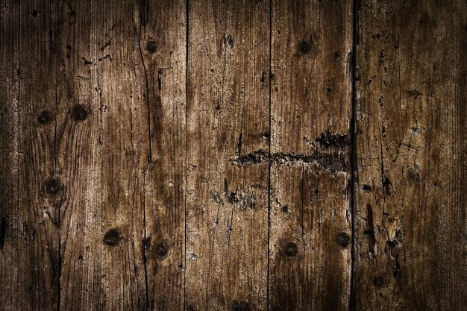
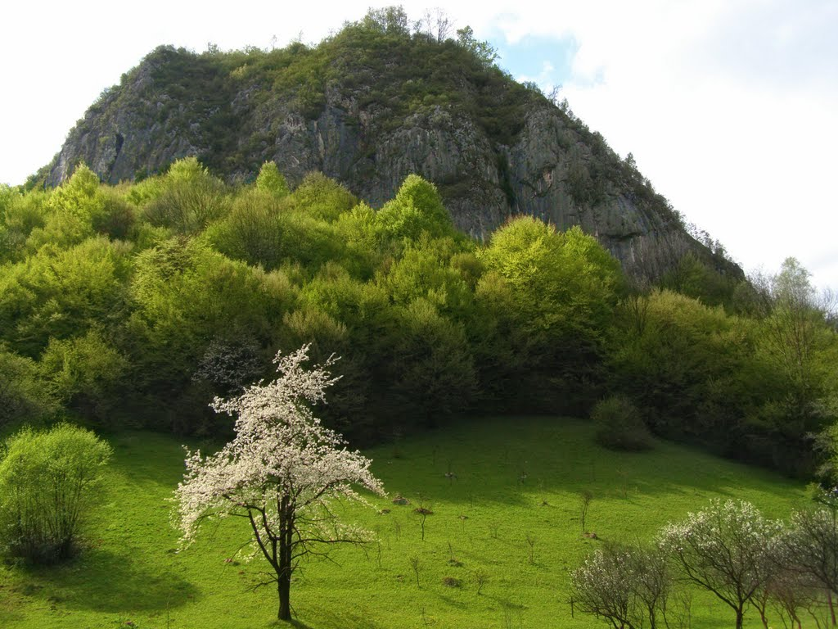
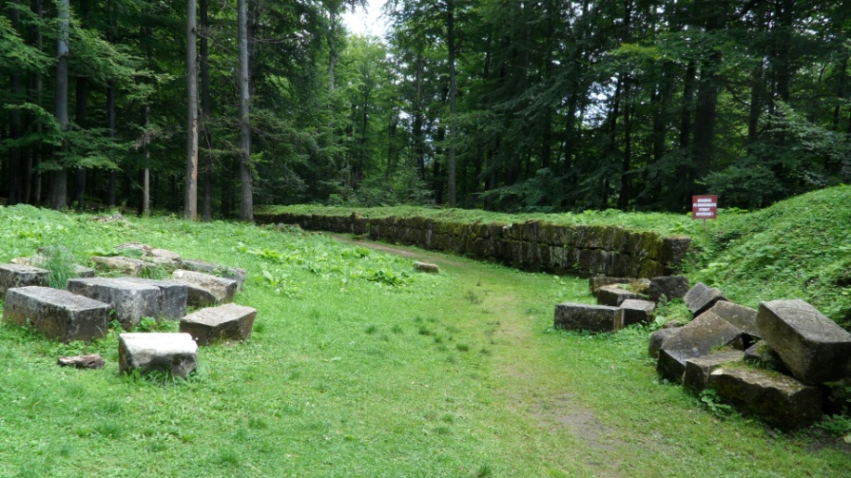
Territory organization
The role of the citadel was to defend from the south the access to Gradistea de Munte- Sarmisegetusa Regia. The dominant position of the chosen place, a rock with almost a perfect conic shape and a maximum altitude of 904m offered good visibility on the surroundings. The southern, eastern and western slopes of the Bolii Hill are particularly steep, therefore the Dacian fortifications were located only on the northern side.
The Blolii Hill
Sarmisegetusa

Slide 3
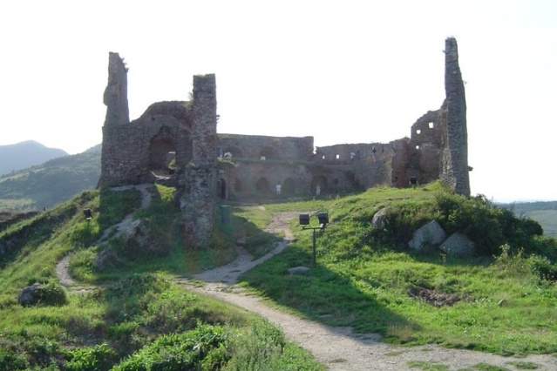
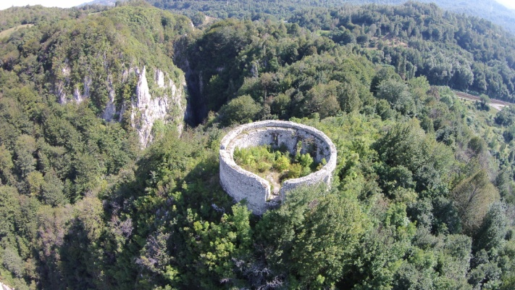
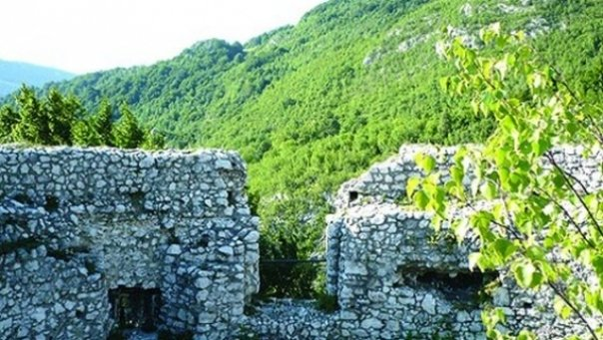
Archaeological objectives
The northern side was subject to fortification activities. The fortification includes several military constructions: protective walls, towers, fighting platforms, defensive structures meant to slow down the enemy advance
The first of these was a 115m long and 2m wide wall, built on the northern slope and partially on the north-eastern one. The construction technique is known as “murusdacicus”.
The second one of them is protected by a wall which has a thickness of 1.40 meters. The convention hall had the form of a rectangle with a length of 22 meters and a thickness of 17 meters.
The third terrace, in fact, the acropolis, with a dominant position (904m altitude) which is surrounded by a strong wall of a trapezoidal form, was built with the specific technique. In its middle, there was a rising tower, built of wooden, clay and straws.

Slide 4
Banita Citadel
(
,
The Map
The Reconstitution

Slide 5
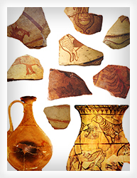
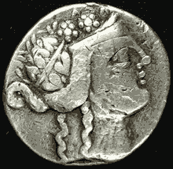
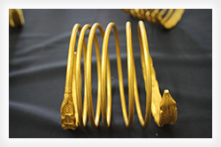
Artifacts
The archeological materials which were found here are represented by ceramic fragments from small bowls, as well as cups. There were also iron fragments varying from building materials to weapons, in a smaller quantity than they were found in other citadels from the Orastie Mountains.
Inside the citadel or somewhere near it there were found objects made from precious materials, such as a bracer, a coin, etc.

Slide 6
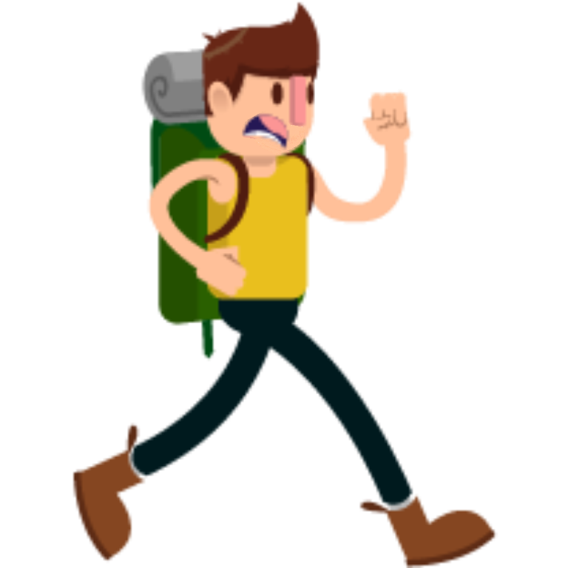
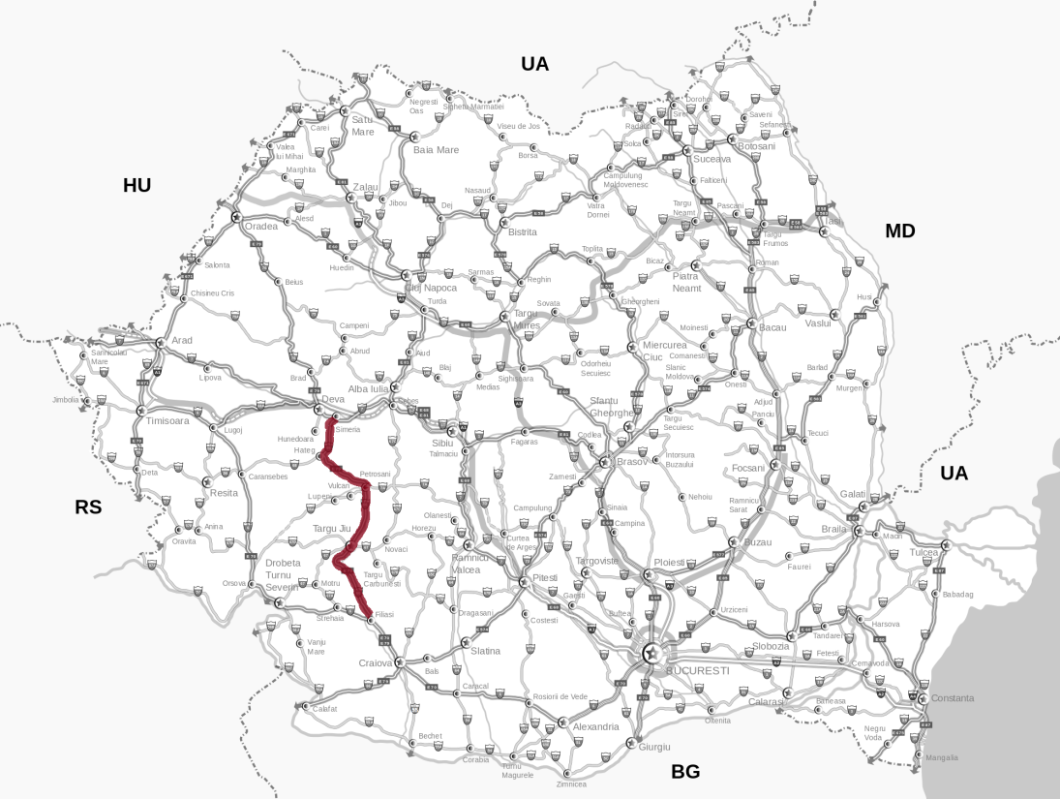
Access
You can get to the base of the rock by DN66, a road which connects Simeria and Petrosani. From here, there is a narrow road along a railway, which leads to the lowest terraces of the citadel. From this point the slope becomes very steep and the access to the vestiges is extremely difficult, in some cases dangerous

Slide 7
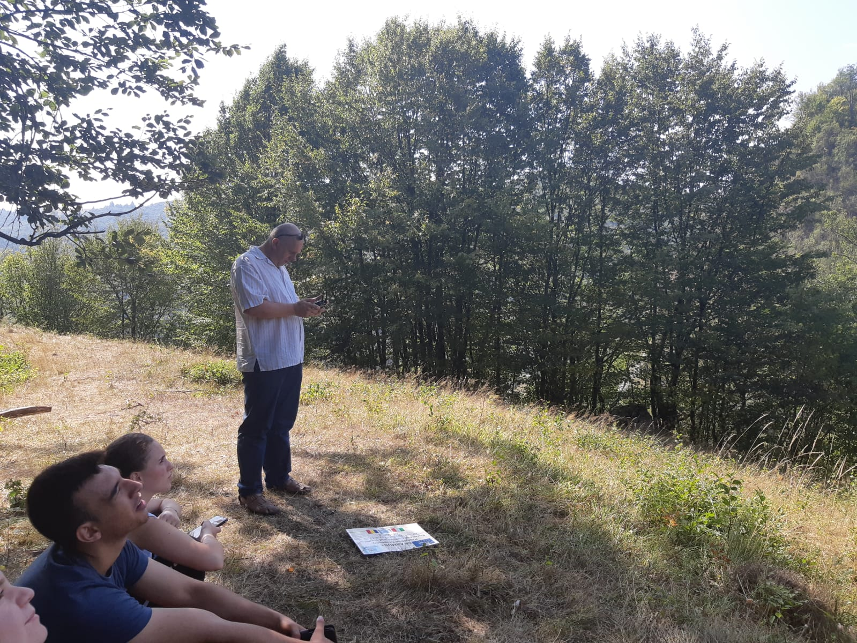

Slide 8
References(for legal reasons)
https://bpng.pngfly.com/dy/95a6abf8112b2d3d95392b9e985135d0/L0KzQYm3VcIyN5RxiJH0aYP2gLBuTfhqc5pzf59rYXPugLLqiBlvb15mhtt2YYTodH7tifxuNZRmiuZ4b36wRbO3U8JibWM2UaQ8ZUKxR4i4UcQ3PWQ2TaQBOUO3QoW5UcA0NqFzf3==/kisspng-hiking-backpacking-animated-film-cartoon-5b032ae21923e2.771146531526934242103.png
https://upload.wikimedia.org/wikipedia/commons/7/70/Romania_DN_66.png
https://p7.hiclipart.com/preview/234/279/803/5bbc2aff729f0-thumbnail.jpg
http://www.cetati-dacice.ro/sites/default/files/f18.jpg
http://www.cetati-dacice.ro/sites/default/files/f19.jpg
http://www.cetati-dacice.ro/sites/default/files/f16.jpg
https://banita.ro/istoric/images_istoric/moneda_romana.gif
https://image.epochtimes-romania.com/2015/06/2015_06_15_cetateadevei_rsz_crp.jpg
https://cache.bzi.ro/cache/3/305/s604x0_banita.jpg
https://upload.wikimedia.org/wikipedia/commons/0/01/Turn_de_cetate_%28ruine%29.JPG
https://mapio.net/images-p/52359962.jpg
https://banita.ro/istoric/images_istoric/varful_bolii.jpg
https://upload.wikimedia.org/wikipedia/commons/b/b3/Sarmisegetusa_Regia_-_Zidul_cetatii_%E2%80%93_Gradistea_de_Munte%2C_Muntii_Sureanu%2C_Hunedoara%2C_Romania_03.JPG
http://www.cnme-petrosani.ro/wp-content/uploads/2015/04/ANTET-copy.png
https://cdn.imgbin.com/19/3/15/imgbin-logo-erasmus-programme-erasmus-organization-project-others-6t2N1HqbsrxKL2R1KwrWVBLfn.jpg
https://cdn.imgbin.com/14/3/4/imgbin-european-union-erasmus-programme-erasmus-university-fear-turkey-aKdqZDBSc7enfshMj2nz2P1Mg.jpg

Slide 9
Thank you for your attention!

