Slide 1
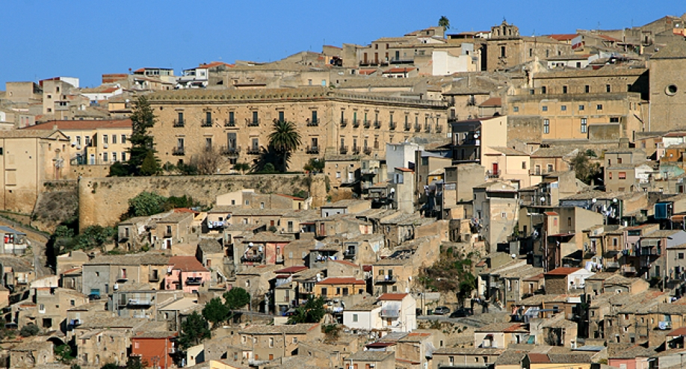
SHARE AND FOLK TRADITIONS
LEONFORTE TRADITIONS

Slide 2
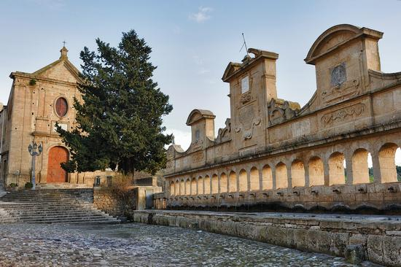
Although Leonforte is a small town in Sicily, it is rich of traditions.

Slide 3
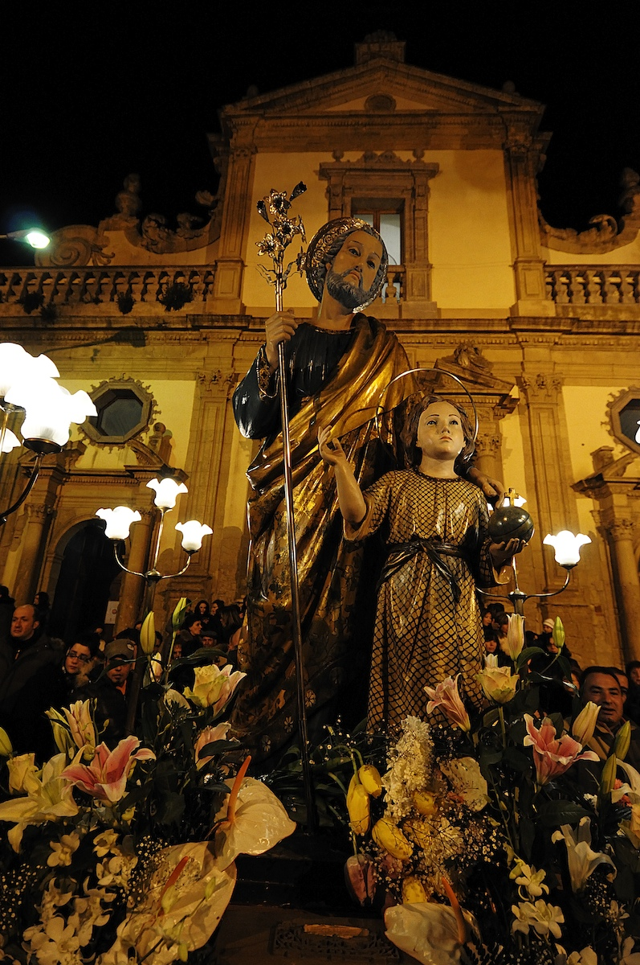
One of these is “L’ARTARA DI SAN GIUSEPPE“
This saint is one of the most important saints of Leonforte.

Slide 4
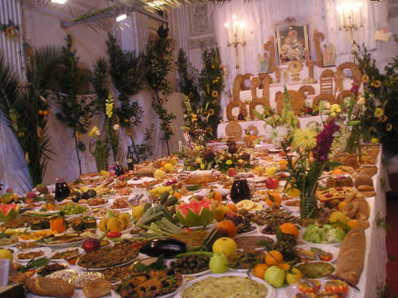
During this event that coincides with March 19th, the people prepare tables full of traditional food, in particular the bread that is the fundamental element.

Slide 5
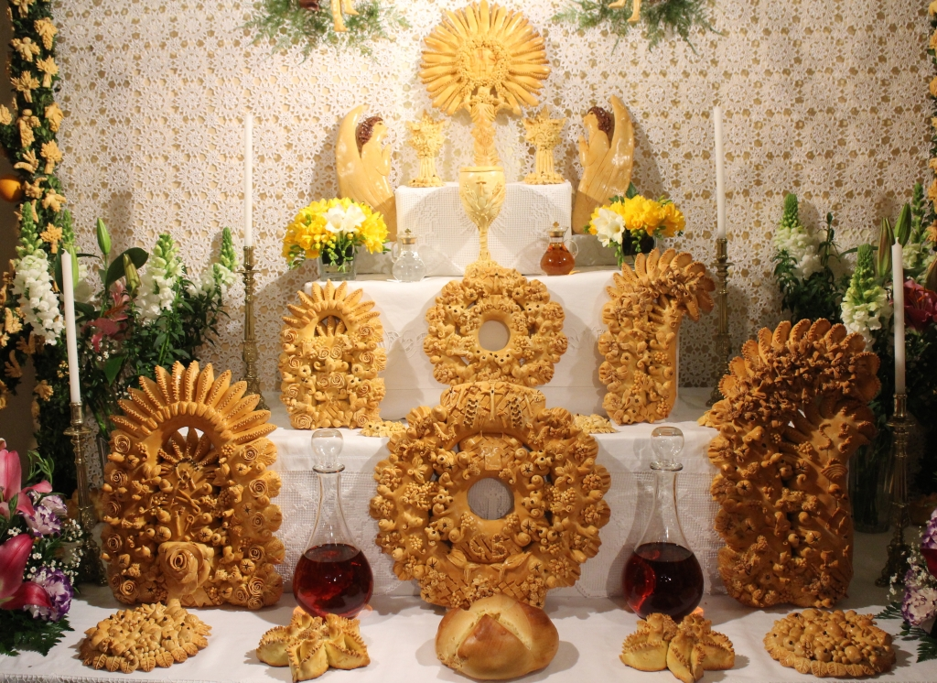
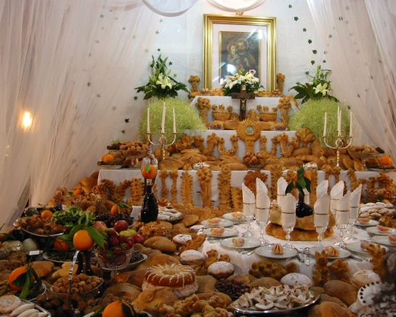
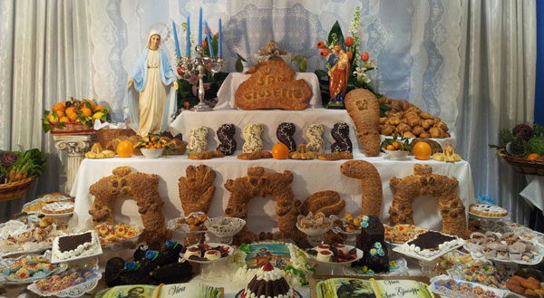

Slide 6
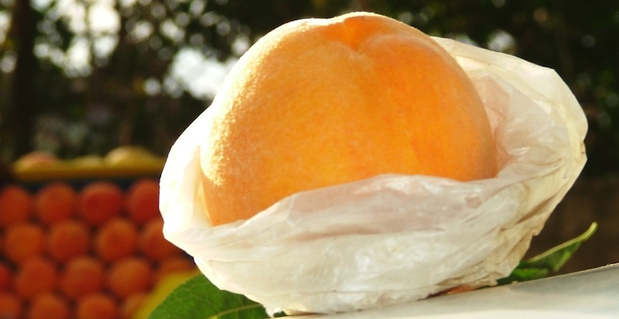
Another important tradition is the PEACH FESTIVAL

Slide 7
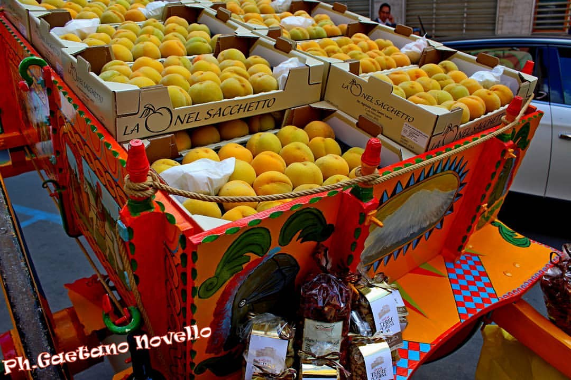
In this tradition, which coincides with the first weekend of October, the typical products of Leonforte are promoted and enhanced.

Slide 8
