Slide 1
Erasmus+ project: “PRomotion Of Identity, European Culture and Tradition (PR.O.I.E.C.T.)”
GENIKO LIKIO HORTIATI
2018-20200,
C3 short term mobility - Welcome ceremony
Presentation of the project’s activities
of Geniko Likio Hortiati
Petrosani - Romania, 28-11-2019

Slide 2
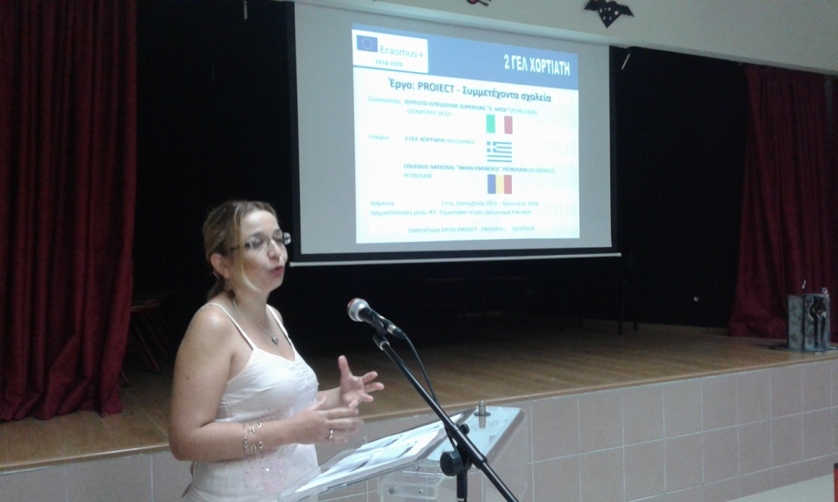
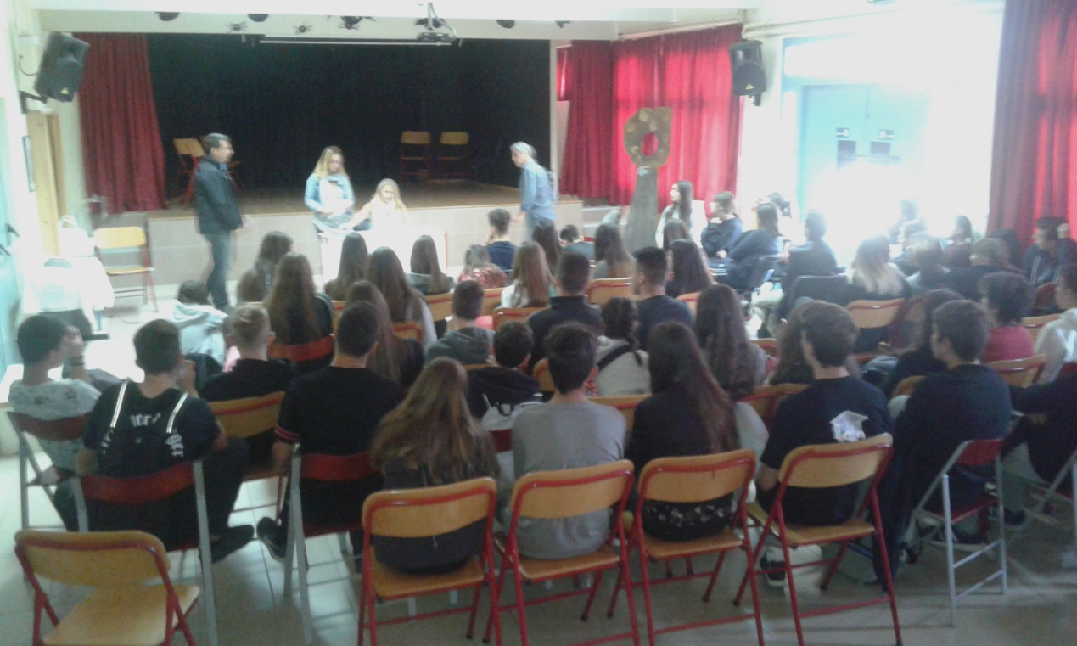
P1 Activities - September 2018
GENIKO LIKIO HORTIATI
2018-20200,
Information to teachers, parents and students;
Activity programming, selection of participants
Meeting with the selected students and division of the research sectors

Slide 3
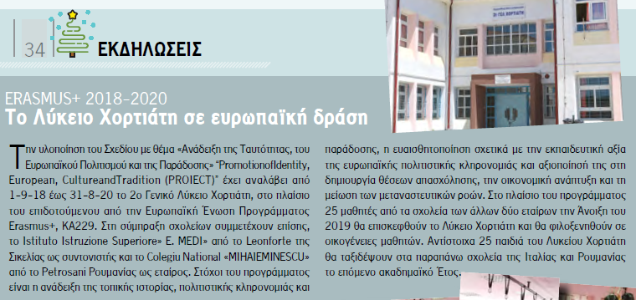
P2 Activities – October 2018 [1/2]
GENIKO LIKIO HORTIATI
2018-20200,
Signing of a contract with the National Agency
Press release of the project at the school website
Press release of the project at the municipality’s website
https://www.pilea-hortiatis.gr/web/guest/opengov/announcements/archive/31751
Press release of the project at the magazine of the municipality

Slide 4
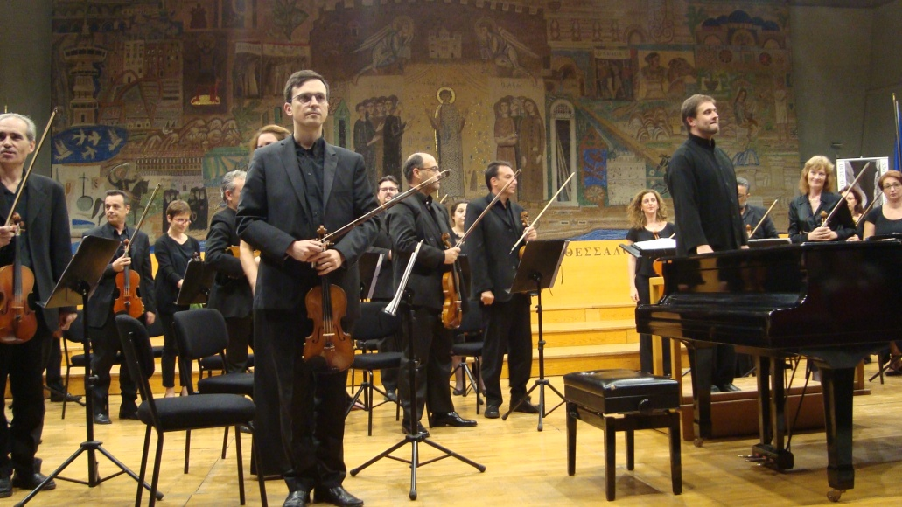
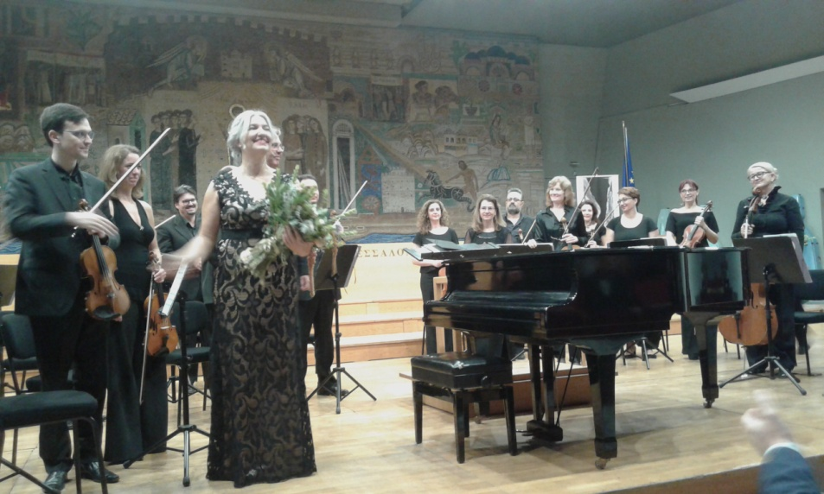
P2 Activities – October 2018 [2/2]
GENIKO LIKIO HORTIATI
2018-20200,
Attending the cultural events of the feast of Agios Dimitrios “Dimitria Festival” and producing a relative video.
You can find the video “Dimitria Festival” at: https://youtu.be/-fkIja0Kc2I

Slide 5
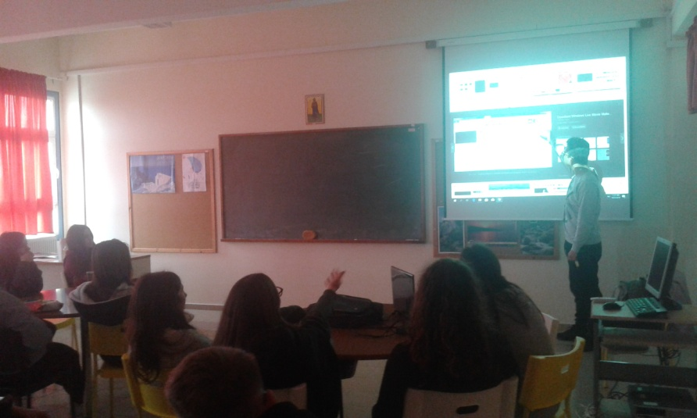
P3 Activities – November 2018 [1/4]
GENIKO LIKIO HORTIATI
2018-20200,
Attending Information and Communication Technology lessons by the more experienced pupils

Slide 6
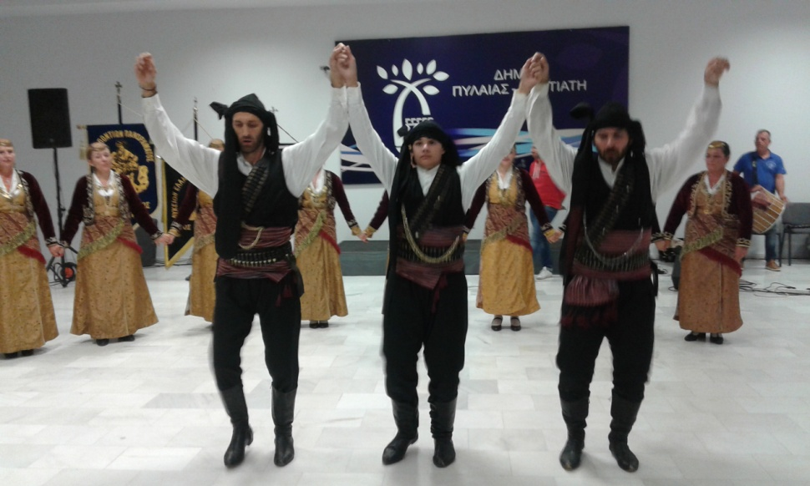
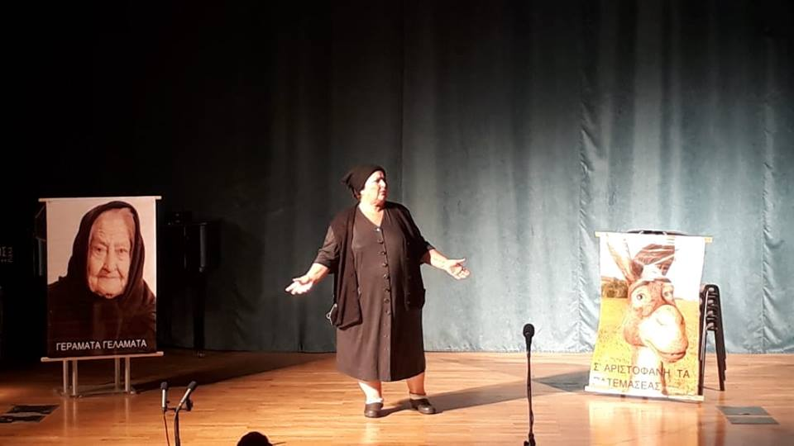
P3 Activities – November 2018 [2/4]
GENIKO LIKIO HORTIATI
2018-20200,
Attending the Arsakliotika Festival and producing a relative video.
You can find the video at: https://youtu.be/z69JNhKp0bo

Slide 7
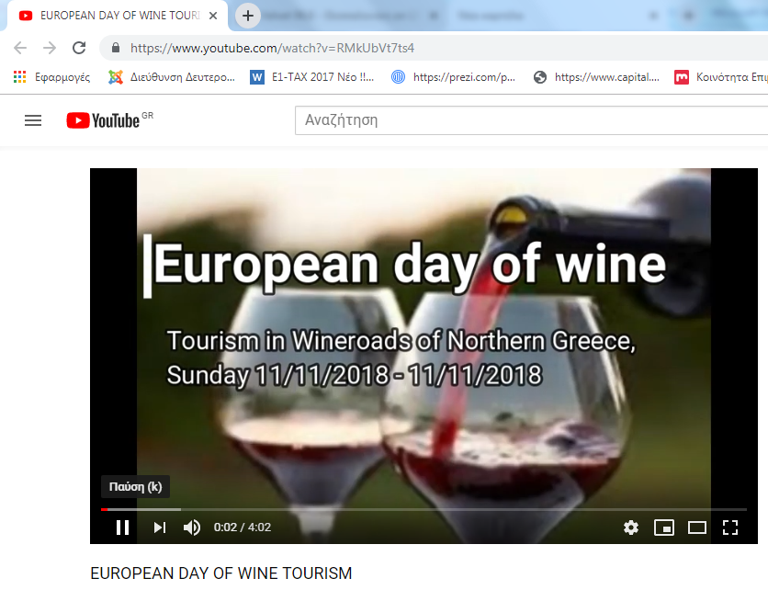
P3 Activities – November 2018 [3/4]
GENIKO LIKIO HORTIATI
2018-20200,
Deepening on the European Day of Wine Tourism and producing a relative video. You can find the video at : https://youtu.be/RMkUbVt7ts4

Slide 8
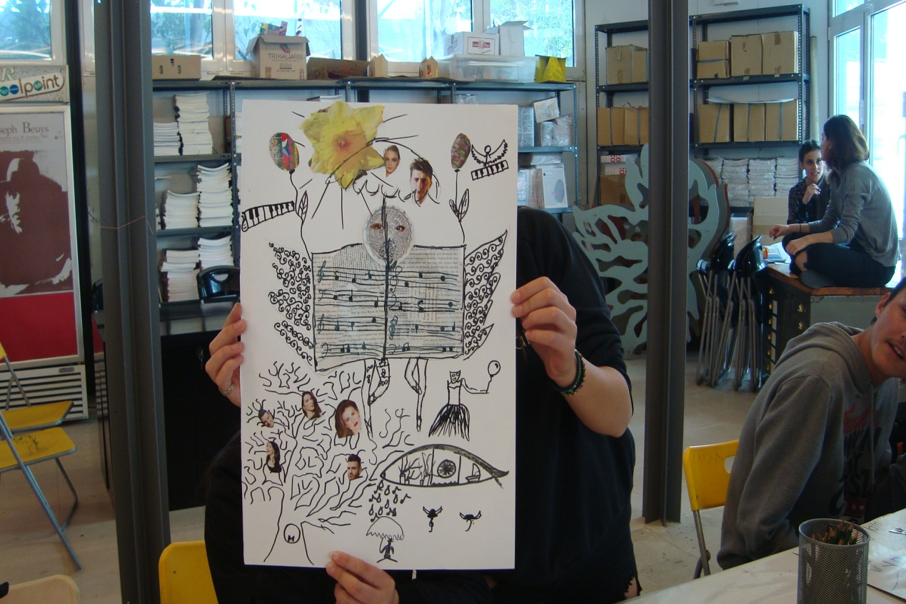
P3 Activities – November 2018 [4/4]
GENIKO LIKIO HORTIATI
2018-20200,
Visiting the Macedonian Struggle Museum and producing a relative presentation
Visiting the art exhibition “ALEXANDER IOLAS: THE HERITAGE” and participating in a surrealistic art workshop
Watching the play “The Curious Incident of the Dog in the Night-Time”

Slide 9
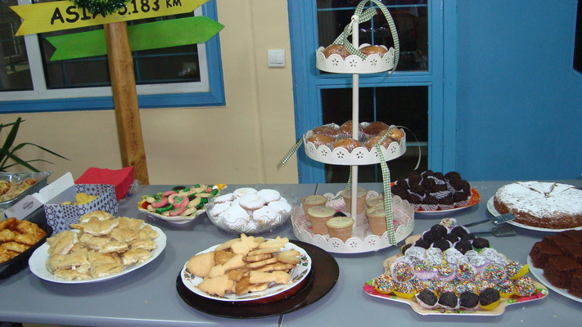
P4 Activities – December 2018 [1/2]
GENIKO LIKIO HORTIATI
2018-20200,
Deepening in Christmas customs in Greece as well as in traditional Christmas sweets, “vasilopita” and “melomakarona” and producing relative presentations.
Singing the Christmas Carols and producing a video https://youtu.be/Tll_7GqXyXo
Organizing a Christmas bazaar with traditional Christmas food-drinks and handmade gifts and presenting the project’s activities to the parents, teachers and pupils of the school and nearby schools.

Slide 10
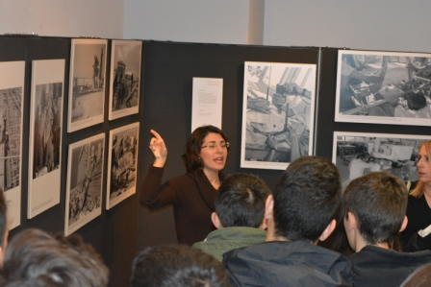
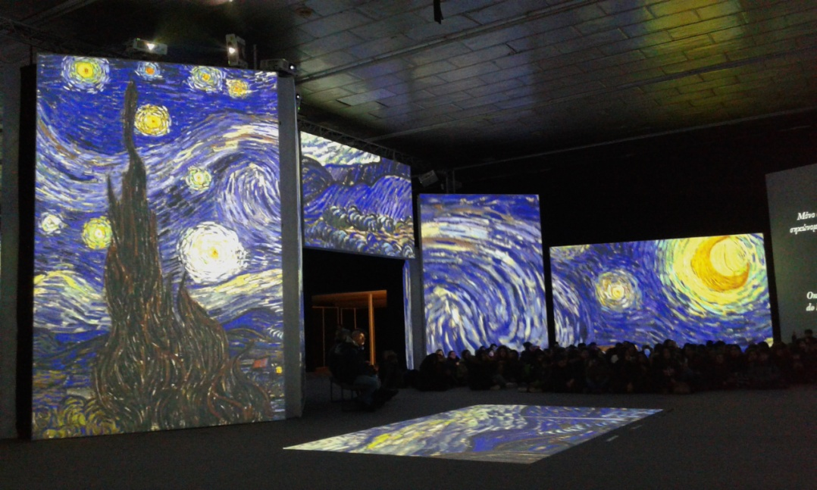
P4 Activities – December 2018 [2/2]
GENIKO LIKIO HORTIATI
2018-20200,
Visiting the exhibition “Chisel and memory. The contribution of marble crafts in the restoration of monuments”.
Visiting the exhibition “Van Gogh Alive – The Experience”.
Visiting the “Roupel” historical site.

Slide 11
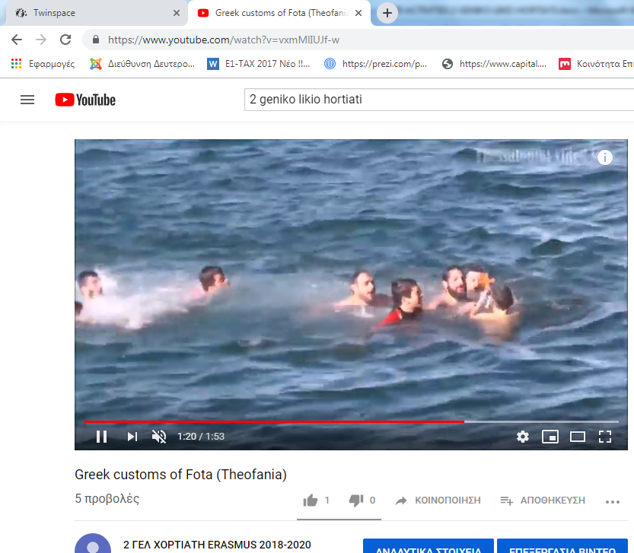
P5 Activities – January 2019 [1/2]
GENIKO LIKIO HORTIATI
2018-20200,
Attending the religious feast of Fota day (Theofania) and the feast of Saint John and producing a relative video https://youtu.be/vxmMlIUJf-w
Singing the “First Day of the Year Carols” and “Fota Carols” and producing relative videos https://youtu.be/5r8YbffDK3Q, https://youtu.be/YAe4YsZJD3U
Organizing the C2 mobility by two online meetings at Twinspace pratform

Slide 12
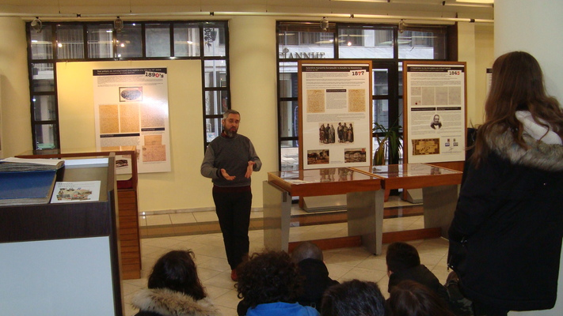
P5 Activities – January 2019 [2/2]
GENIKO LIKIO HORTIATI
2018-20200,
Studying four personalities of the Greek culture:
Manos Hatzidakis, composer, maestro, pianist, poet
Nikos Kazantzakis, novelist, translator, poet, philosopher, journalist, screenwriter
George Seferis, poet-diplomat, Nobel Prize of literature in 1963
Melina Merkouri, actor and politician, and producing a relative presentation
Educational visit at the exhibition “Evidence of Thessaloniki’s postal history”

Slide 13
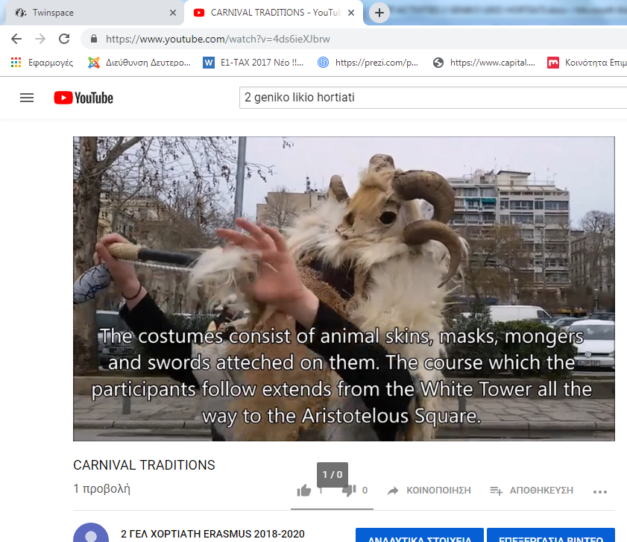
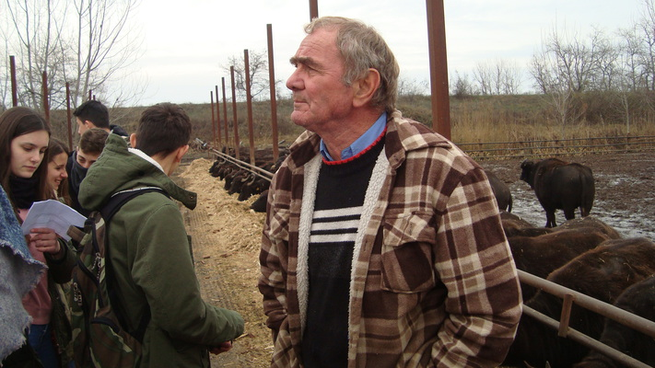
P7 Activities – February 2019
GENIKO LIKIO HORTIATI
2018-20200,
Attending local carnival traditions and producing a video:
https://youtu.be/4ds6ieXJbrw
Educational visit to a buffalo farm at lake Kerkini
C2 mobility organization and visiting the No50 Cultural Route Bus of the Urban Transportation in Thessaloniki

Slide 14
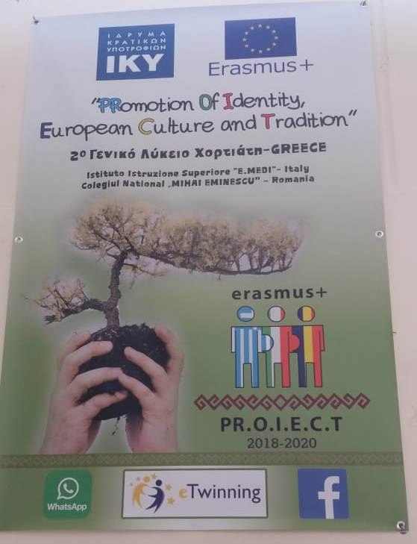
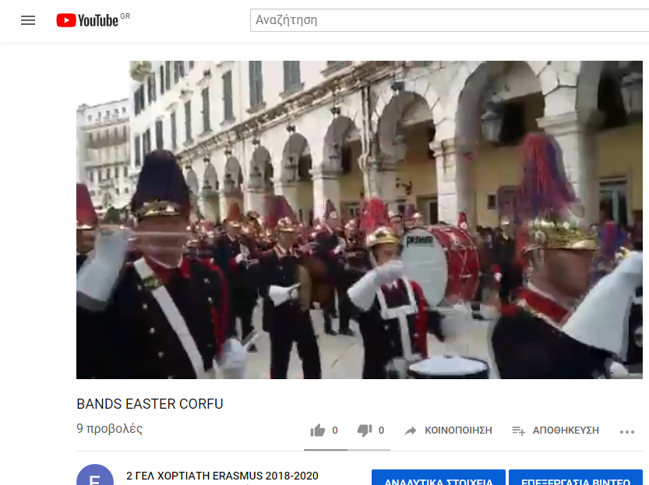
P6 Activities – March 2019 [1/2]
GENIKO LIKIO HORTIATI
2018-20200,
Deepening in the traditional rites of the Holy Week, traditional Greek soup “Magiritsa” and producing relative presentations, visiting Corfu and producing a video about the bands in Corfu on Palm Sunday https://youtu.be/yy-Zcnp4QZ0
C2 mobility organization and preparation of the presentations of the monuments of Thessaloniki, Hortiatis and the Folklore Museum of Panorama
Project’s logo competition and producing the banners of the project
Watching the theatrical performance “BAL you…!!!”
Workshop about the social entrepreneurship

Slide 15
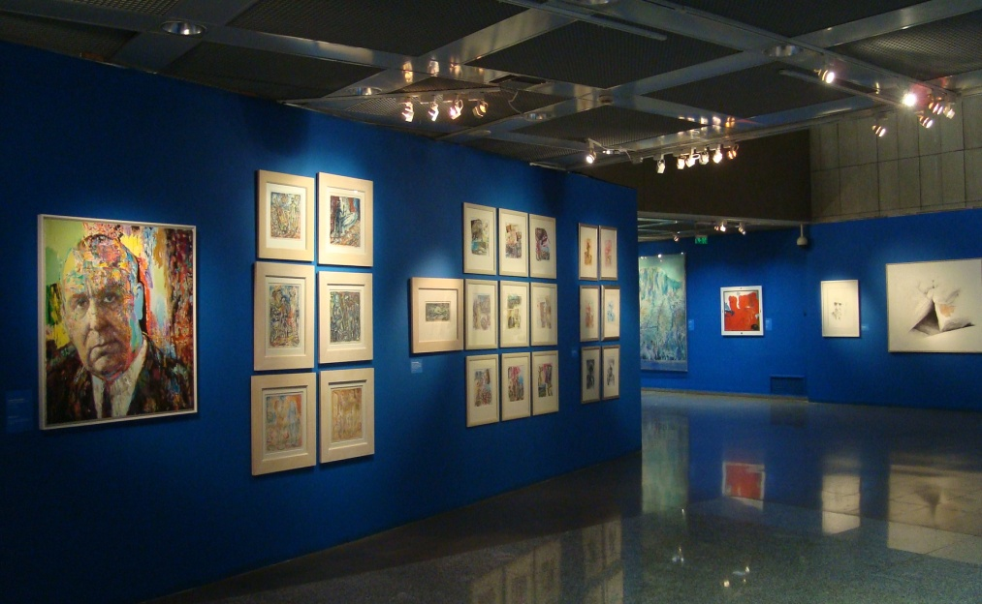
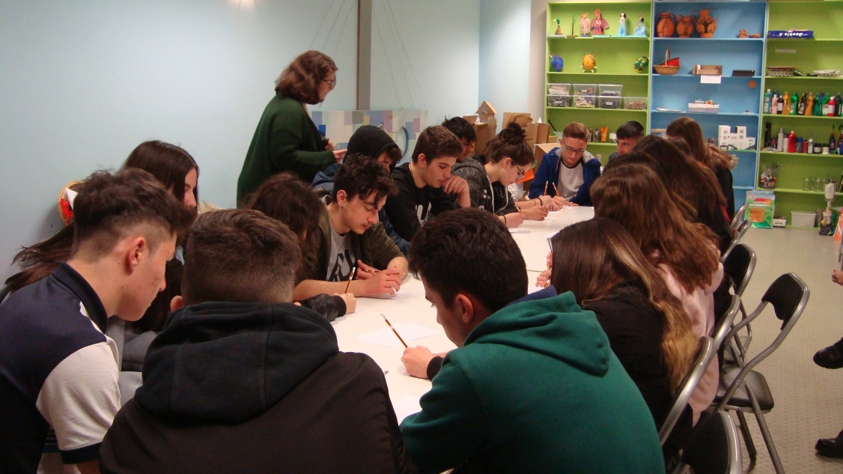
P6 Activities – March 2019 [2/2]
GENIKO LIKIO HORTIATI
2018-20200,
Educational visit at the exhibition: "When the light dances, I speak fairly. Giorgos Seferis and his poetry through painting and photography” and participating in a relative workshop

Slide 16
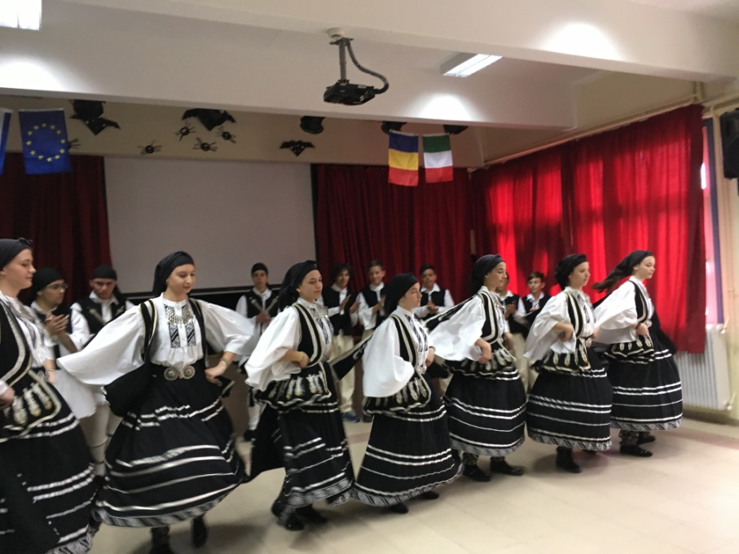
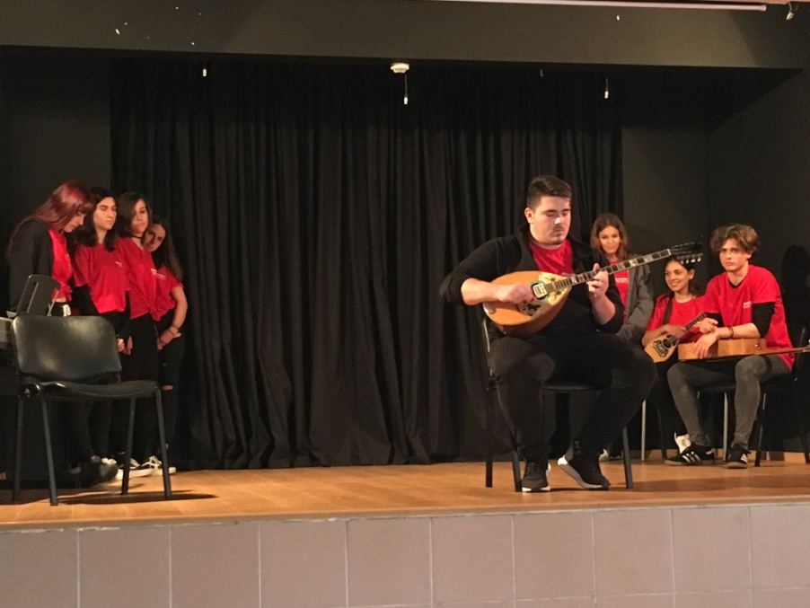
C2 short term mobility in Greece “Greek cultural and linguistic heritage knowledge related with Easter to know similarities and differences with other partners' heritage”– 6 to 15 April 2019 [1/9]
GENIKO LIKIO HORTIATI
2018-20200,
Welcome ceremony, presentation of the three schools, folklore Greek dances - “Tsamiko”: Traditional Easter dance, buffet with traditional dishes of the Easter’s fasting, traditional Greek songs, teaching of a traditional Greek dance

Slide 17
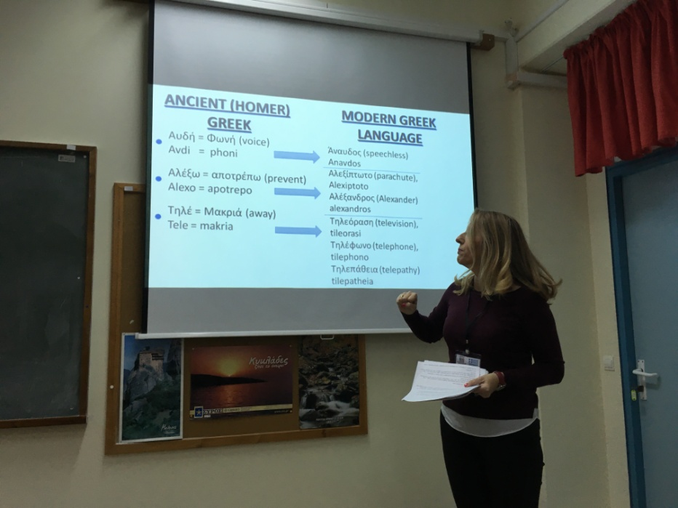
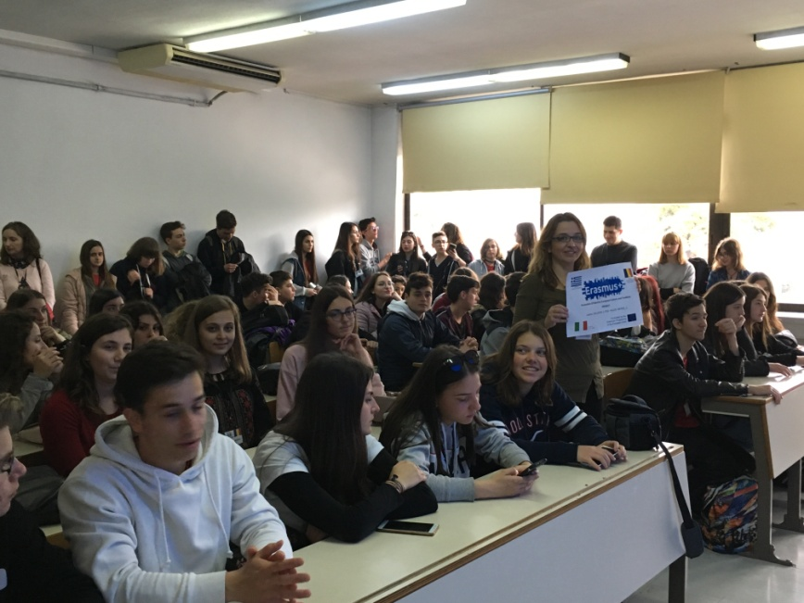
C2 short term mobility in Greece 6 to 15 April 2019 [2/9]
GENIKO LIKIO HORTIATI
2018-20200,
History, philosophy, linguistic and Olympic Games lessons
Presentation of the “Tourism Services of Thessaloniki”
Educational visit at the University of Macedonia

Slide 18
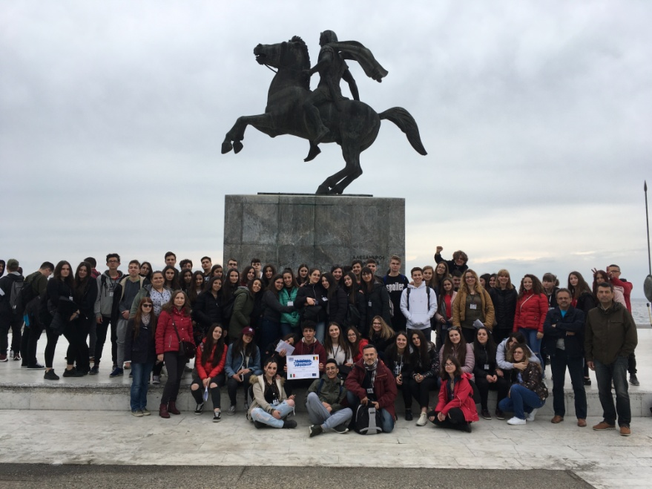
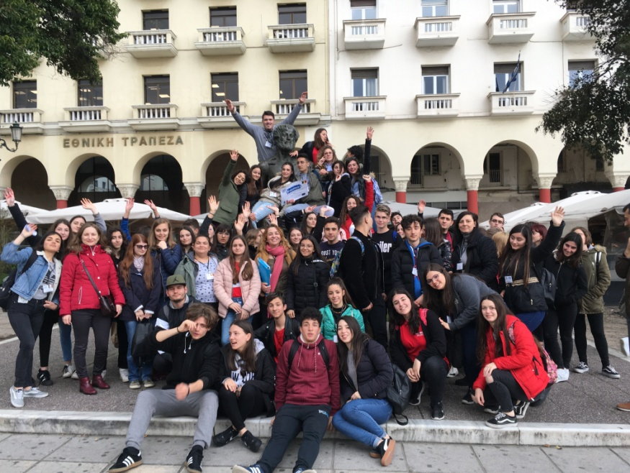
C2 short term mobility in Greece 6 to 15 April 2019 [3/9]
GENIKO LIKIO HORTIATI
2018-20200,
Guided walking and sightseeing in the center of Thessaloniki

Slide 19
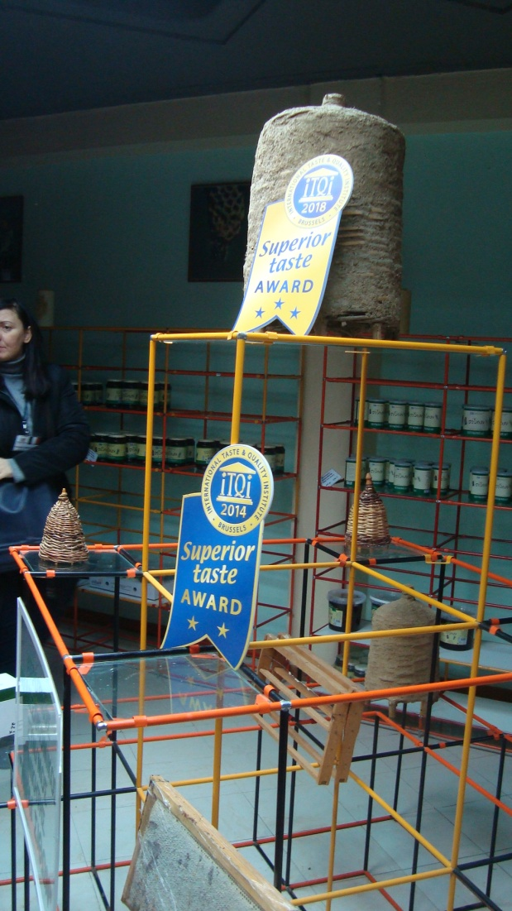
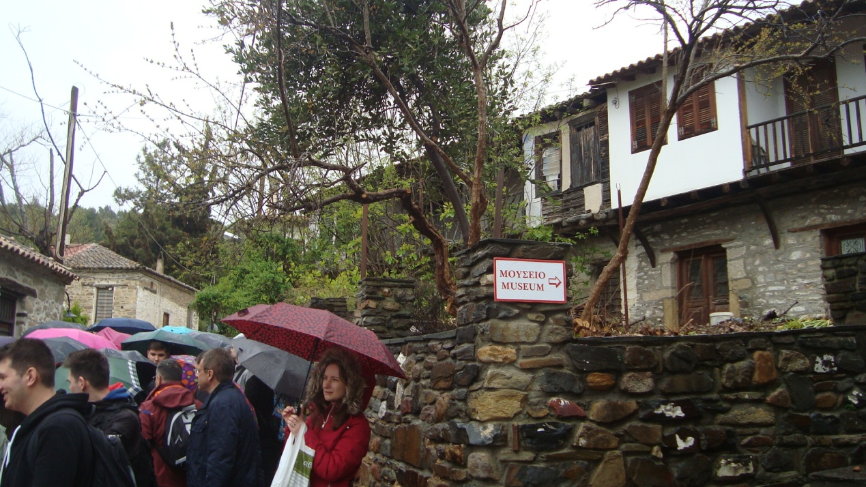
C2 short term mobility in Greece 6 to 15 April 2019 [4/9]
GENIKO LIKIO HORTIATI
2018-20200,
Visiting the Agricultural Cooperative of Beekeepers Nikiti of Chalkidiki and the folklore museum - walking at the traditional settlement of Nikiti, guided walking at the traditional settlement of Afytos Chalkidiki

Slide 20
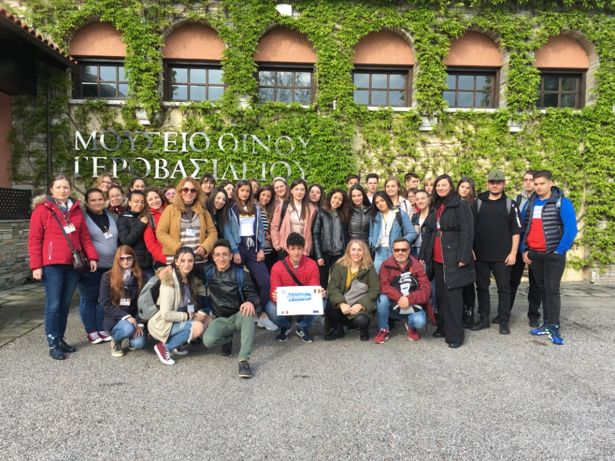
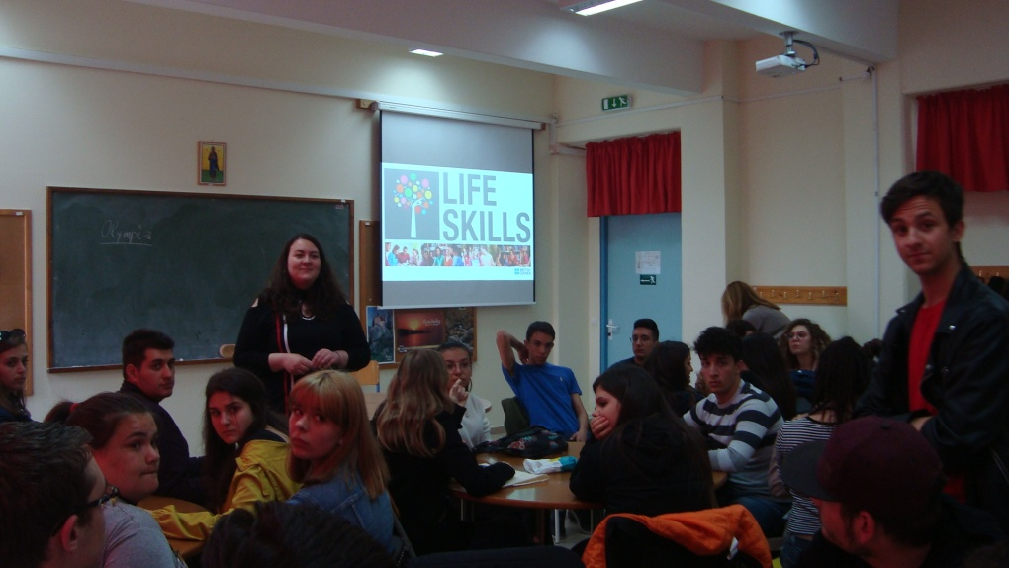
C2 short term mobility in Greece 6 to 15 April 2019 [5/9]
GENIKO LIKIO HORTIATI
2018-20200,
Educational program at the winery “Ktima Gerovassiliou” and the Gerovassiliou wine museum
Workshop. Life Skills – Developing Social Entrepreneurs

Slide 21
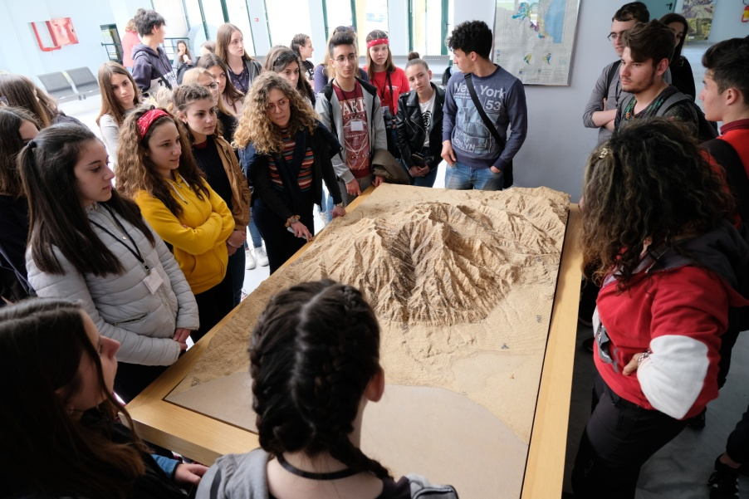
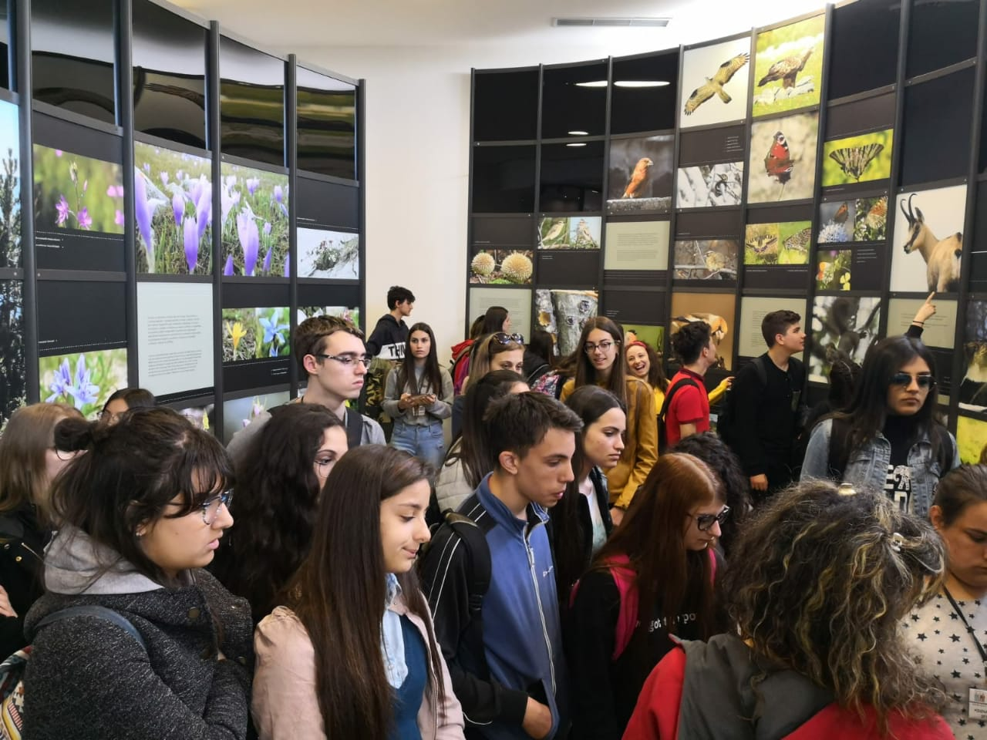
C2 short term mobility in Greece 6 to 15 April 2019 [6/9]
GENIKO LIKIO HORTIATI
2018-20200,
Guided visit at the archaeological site and museum of Vergina – Aigai
Guided visit at the Olympus National Park Management Agency, guided walking at Enipeas gorge - Mount Olympus

Slide 22
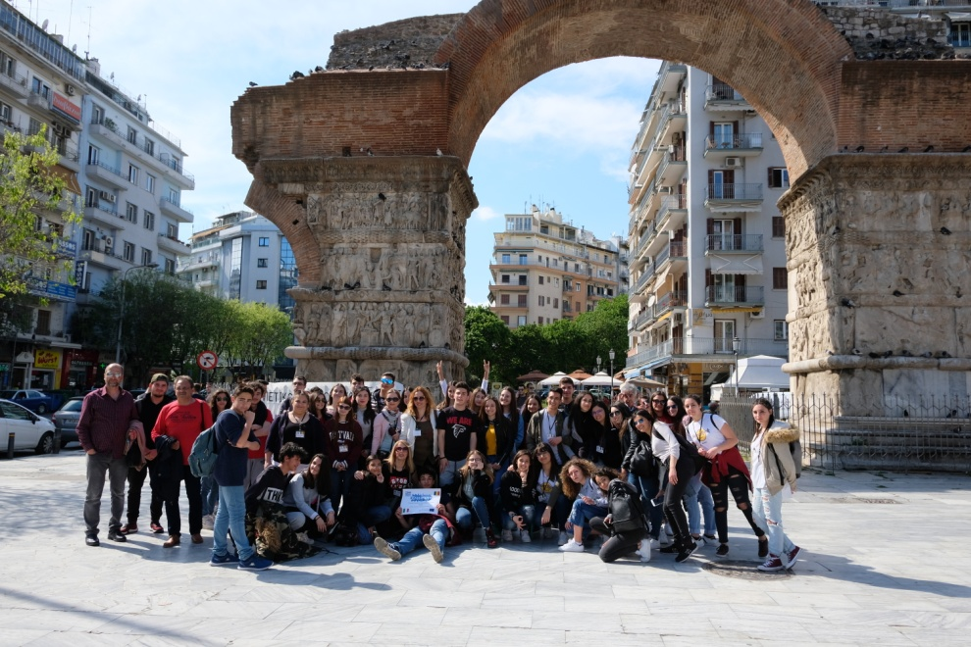
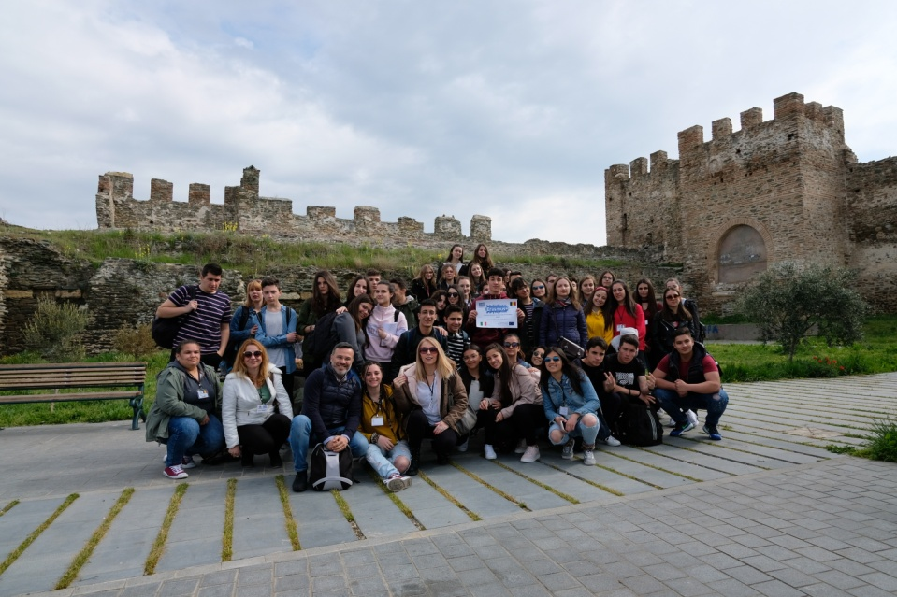
C2 short term mobility in Greece 6 to 15 April 2019 [7/9]
GENIKO LIKIO HORTIATI
2018-20200,
Guided visit at the museums and the monuments of UNESCO World Heritage of Thessaloniki

Slide 23
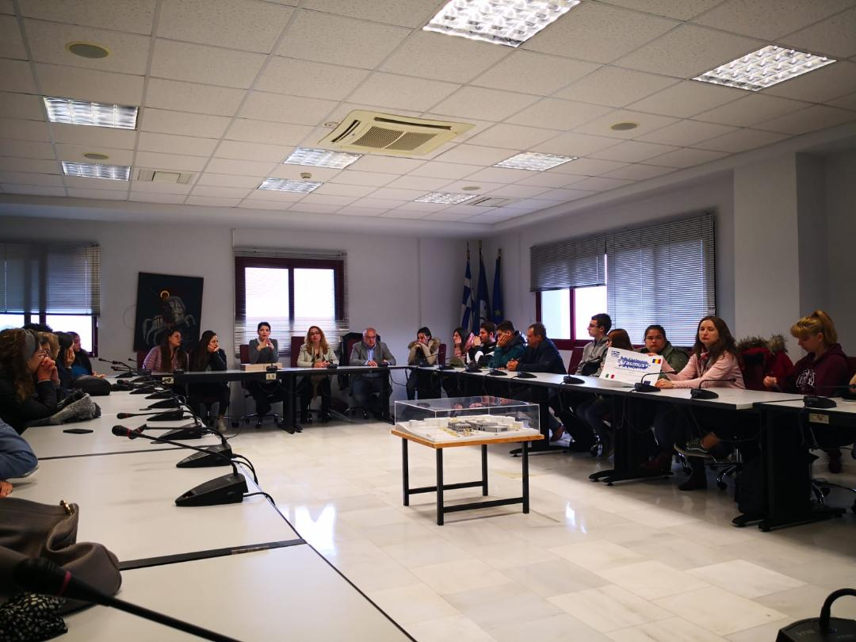
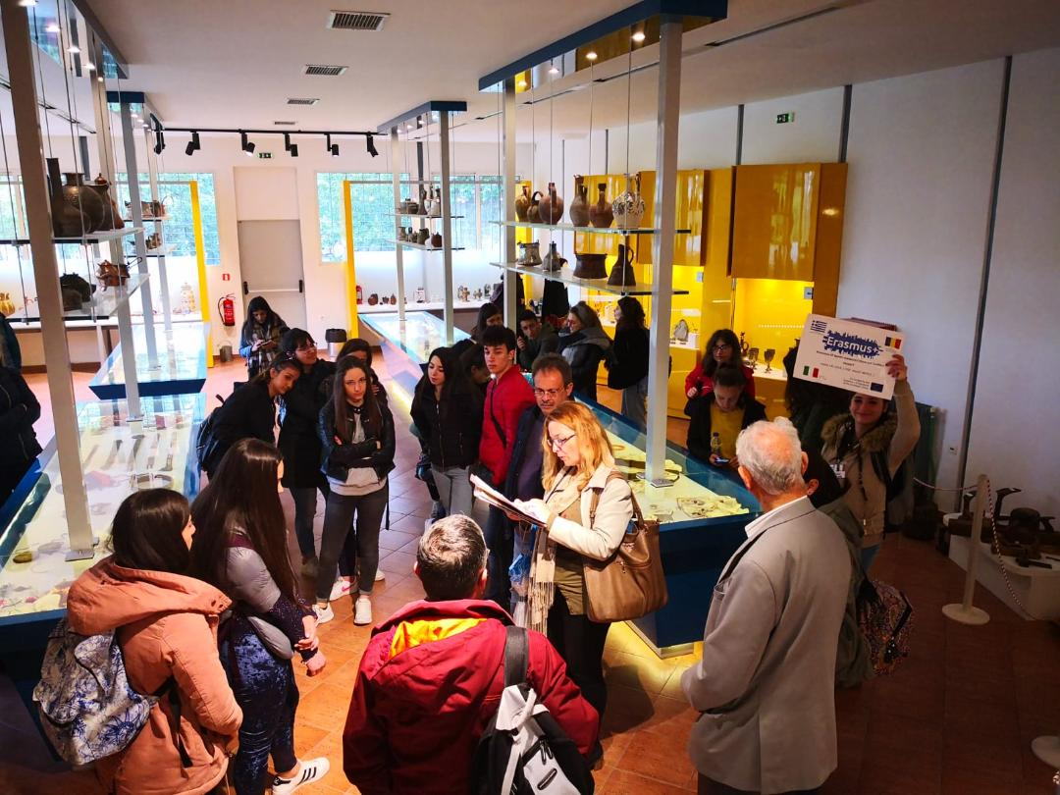
C2 short term mobility in Greece 6 to 15 April 2019 [8/9]
GENIKO LIKIO HORTIATI
2018-20200,
Meeting with the vice Mayor – presentation of the municipality’s project of social entrepreneurship
Educational visit at the Folklore Museum of Panorama

Slide 24
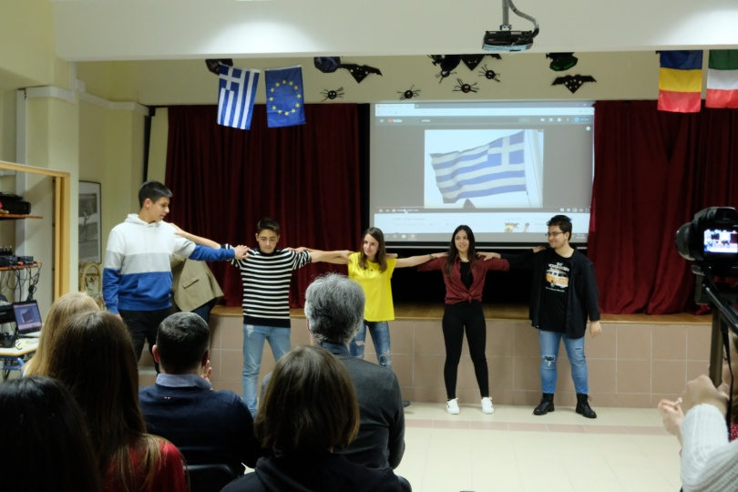
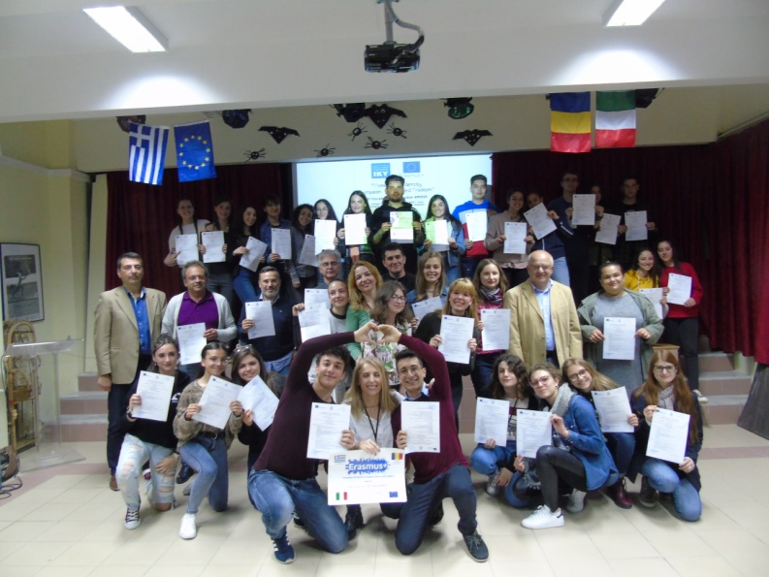
C2 short term mobility in Greece 6 to 15 April 2019 [9/9]
GENIKO LIKIO HORTIATI
2018-20200,
Farewell ceremony - awarding the attendance certificates and gifts
The video of the C2 mobility produced by the Italian school:
https://drive.google.com/file/d/1KQXGmv3UqAgpip3qsOjsoxZ_1wUhvs_5/view?usp=sharing

Slide 25
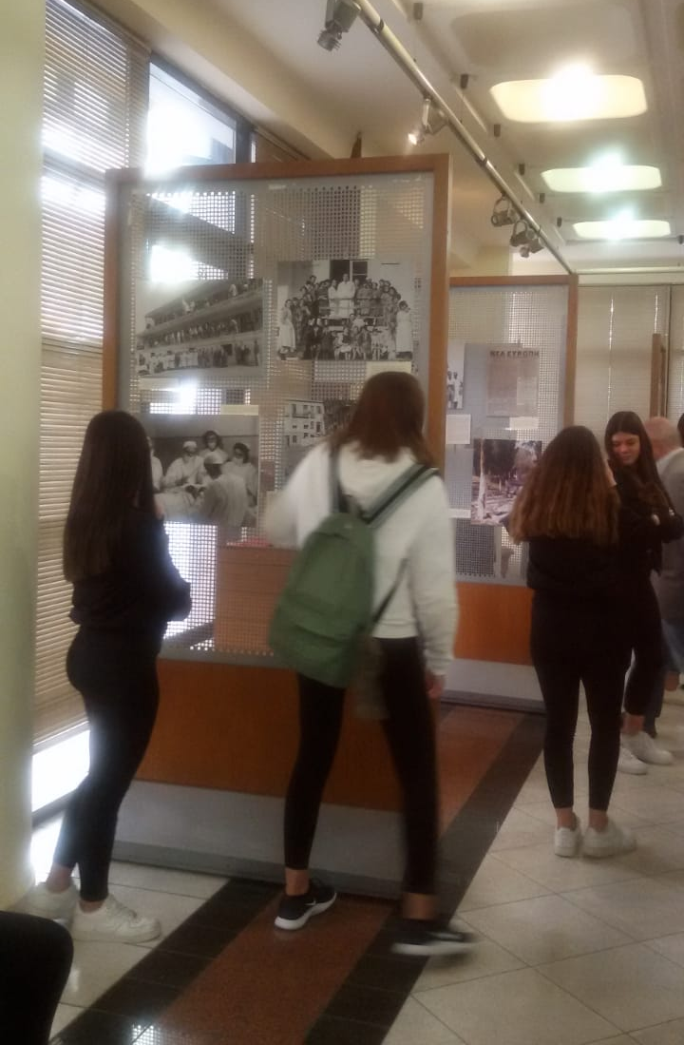
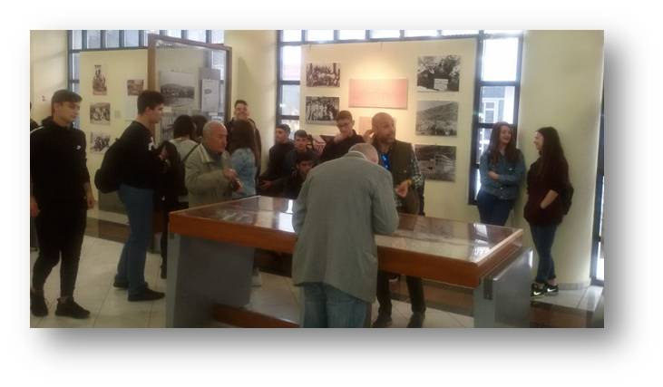
P8 Activities – April 2019
GENIKO LIKIO HORTIATI
2018-20200,
Educational visit at the exhibition “The history of the tuberculosis sanatorium and the G. Papanikolaou Hospital” and producing a relative presentation

Slide 26
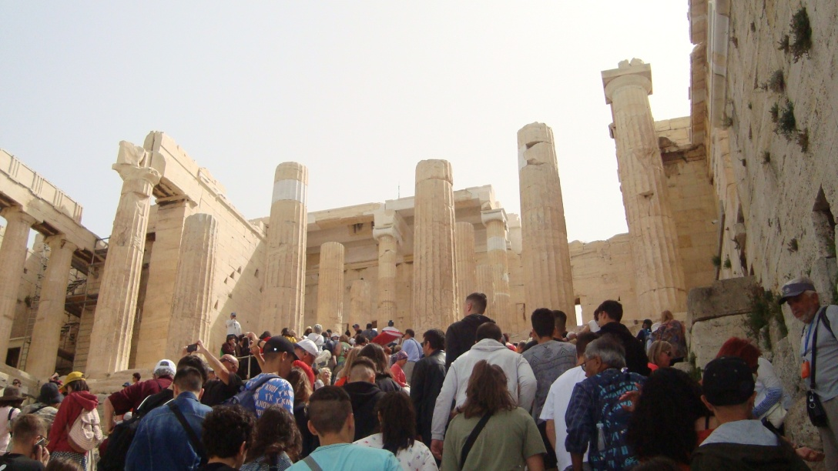
P9 Activities – May 2019
GENIKO LIKIO HORTIATI
2018-20200,
Project information about the C2 mobility through the internet and local press
Administration of satisfaction and self-assessment questionnaires about the C2 mobility
Educational visit at the Acropolis and the museum of Acropolis in Athens

Slide 27
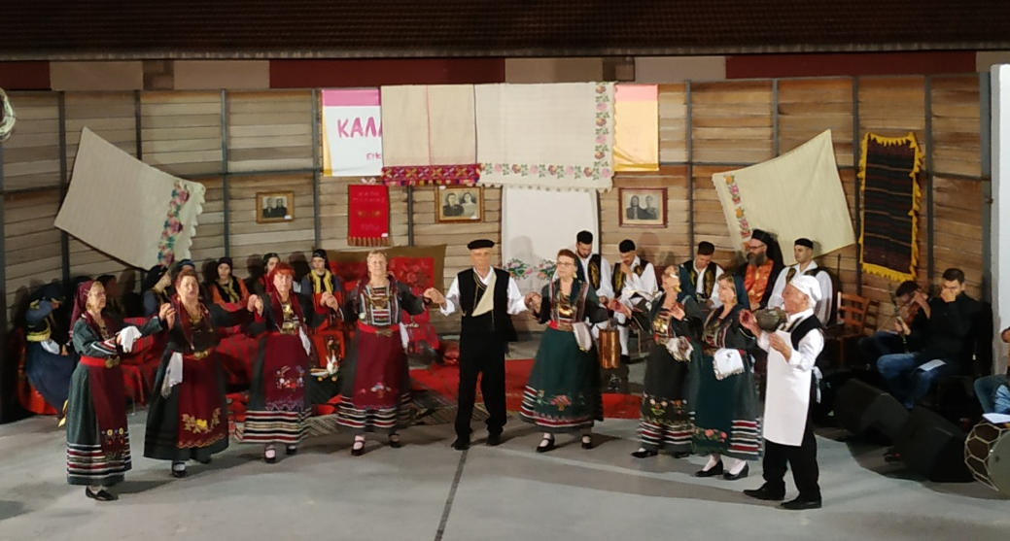
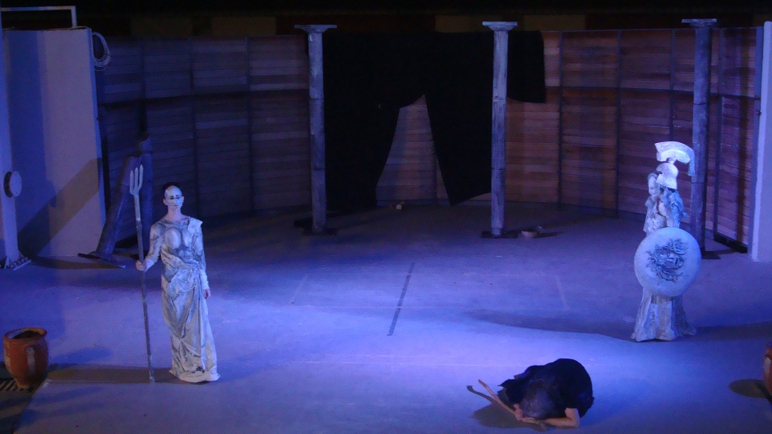
P10 Activities – June 2019
GENIKO LIKIO HORTIATI
2018-20200,
Administration of satisfaction and self-assessment questionnaires for all the project’s activities until May 2019
Sharing with students, teachers, parents and the local community of the experience and the progress of the project
Attending the “Artistic June Festival” of the municipality of Pilea-Hortiatis, in particular a theatrical performance about the literacy work of the famous Greek writer Nikos Kazantzakis, folklore dances and a drama performance “The Women of Troy” by the ancient writer Euripides

Slide 28
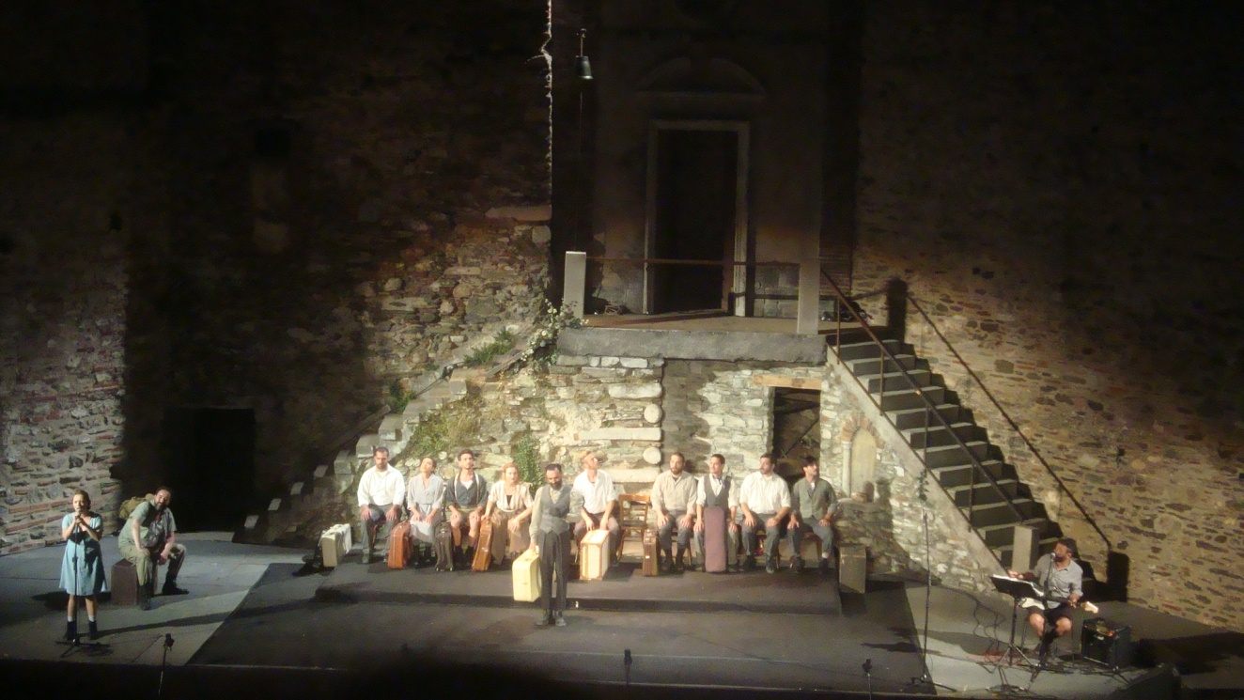
P11 Activities – July 2019
GENIKO LIKIO HORTIATI
2018-20200,
Attending the theatrical play "Eptapyrgio - A Century in a Day 1899-1989“. A theatrical narrative of a place with powerful memories that has been breathing for many centuries, forming part of the history of Thessaloniki.

Slide 29
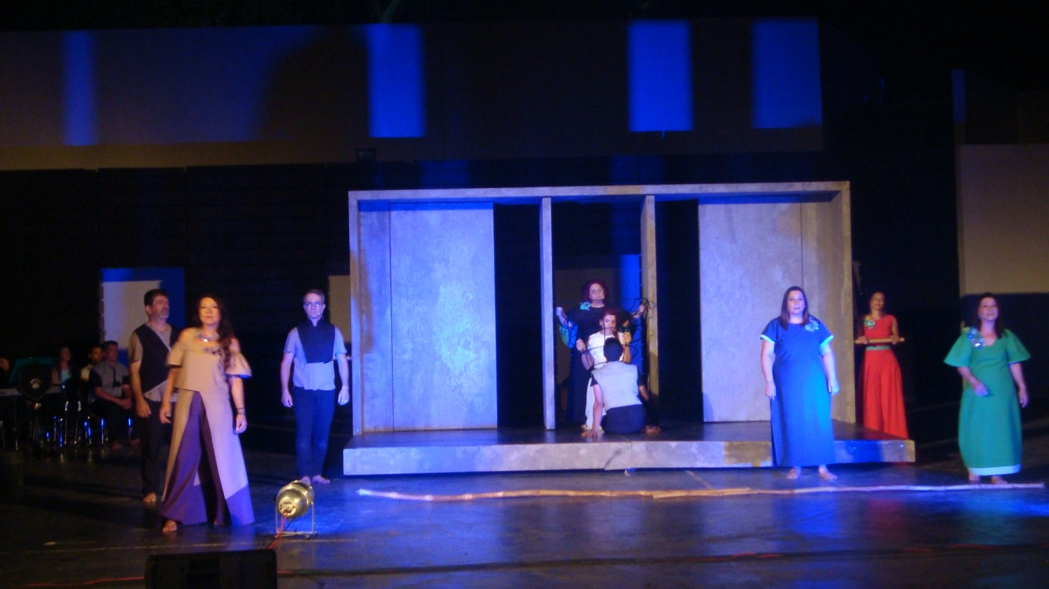
P12 Activities – August 2019
GENIKO LIKIO HORTIATI
2018-20200,
Attending the theatrical play “Erotokritos” by Vincenzos Cornaros. This masterpiece combines the Greek and Western literary tradition and highlights the particular cultural identity of Crete. Erotokritos marks an entire era for the Greek musical tradition, greatly defining the linguistic idiom of Crete. It praises love, friendship, virtue, bravery.

Slide 30
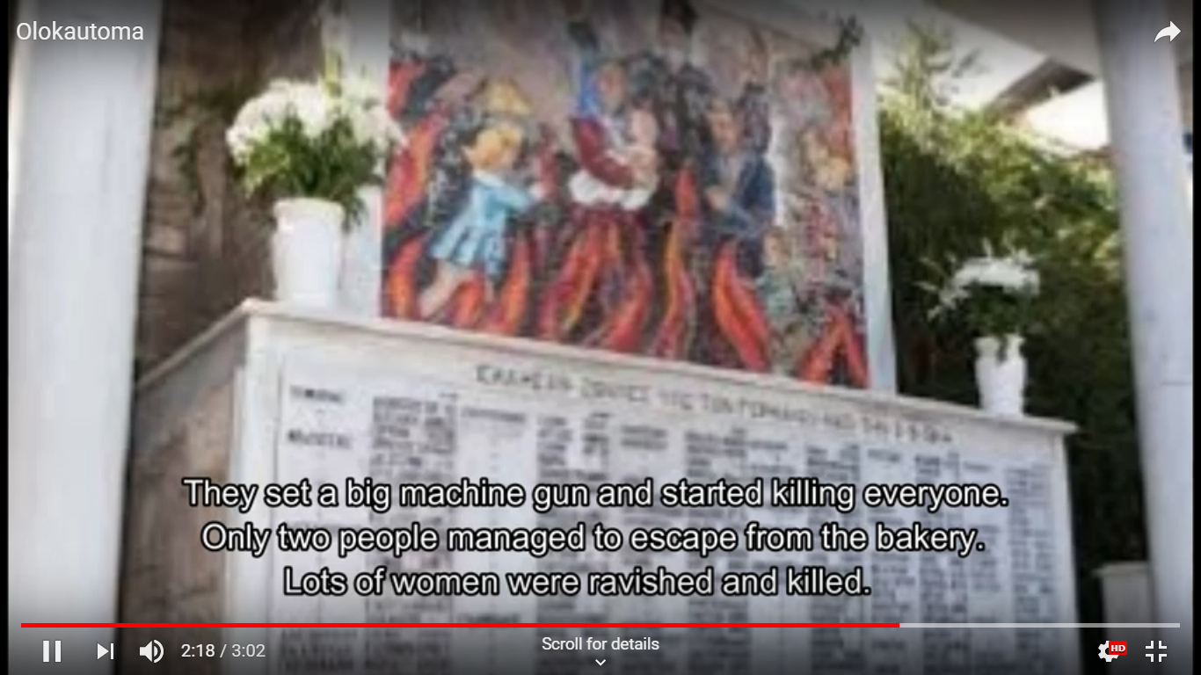
P13 Activities – September 2019
GENIKO LIKIO HORTIATI
2018-20200,
Deepening in the history of the Holocaust of Hortiatis on 2nd September 1944 by the Nazis and producing a relative video: https://youtu.be/4iCC3lc3Wzs

Slide 31
P14 Activities – October 2019
GENIKO LIKIO HORTIATI
2018-20200,
Educational visit at the I World War Cemetery “Zeitenlik” in Thessaloniki and producing a relative video: https://youtu.be/gdiUdpMnZIY

Slide 32
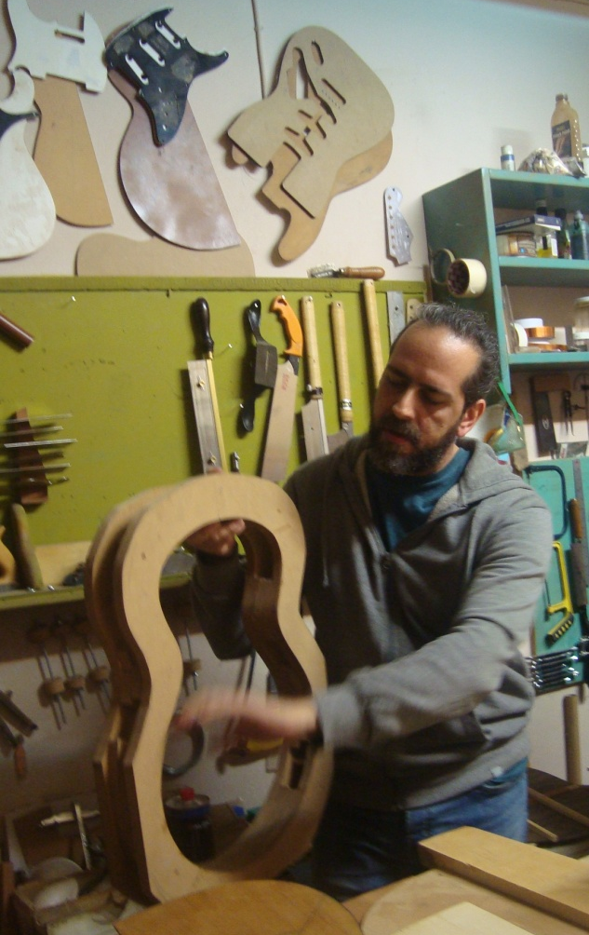
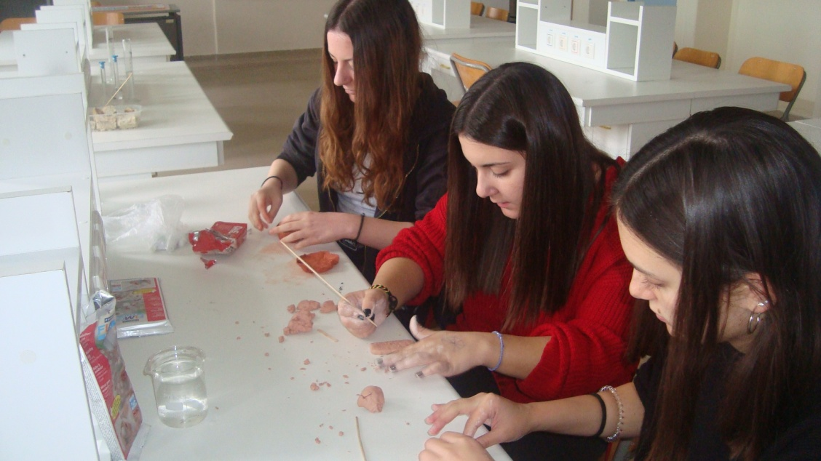
P15 Activities – November 2019
GENIKO LIKIO HORTIATI
2018-20200,
Educational visit at a workshop of handmade guitars and a workshop of silk-screen printing
Preparing ppt presentations, videos, artefacts and dances for the C3 mobility in Petrosani-Romania
Meeting with parents for the organization of the C3 mobility

Slide 33
Twinspace platform of the project
GENIKO LIKIO HORTIATI
2018-20200,
All the activities of the participating schools are published at the following pages of the project’s twinspace platform:
Local traditions and events: https://twinspace.etwinning.net/77604/pages/page/484343
Local religious feasts: https://twinspace.etwinning.net/77604/pages/page/484344
Local culture: https://twinspace.etwinning.net/77604/pages/page/484363
Local traditional food: https://twinspace.etwinning.net/77604/pages/page/484364
Local traditional songs:https://twinspace.etwinning.net/77604/pages/page/484366
Local traditional events: https://twinspace.etwinning.net/77604/pages/page/484367
Local traditional rites of Holly Week:
https://twinspace.etwinning.net/77604/pages/page/484370
Local artistic heritage: https://twinspace.etwinning.net/77604/pages/page/484371
Mobility in Greece: https://twinspace.etwinning.net/77604/pages/page/484375
Local traditional dances: https://twinspace.etwinning.net/77604/pages/page/495322
Local history: https://twinspace.etwinning.net/77604/pages/page/484360
Handmade souvenirs: https://twinspace.etwinning.net/77604/pages/page/646258
Local heritage: https://twinspace.etwinning.net/77604/pages/page/671176

Slide 34
GENIKO LIKIO HORTIATI
2018-20200,
Thank you for your attention!

