Slide 1
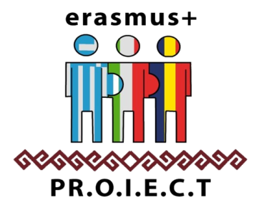
THE WORKERS’COLONIES FORM THE JIU VALLEY
by Alexandra Mihai, Georgiana Pițec, Erika Soo, Sergio Ionașc
ERASMUS+ PRomotion Of Identity, European Culture and Tradition nr. ref. 2018-1-IT02-KA229-047925_3
KA2 – Cooperation for innovation and the exchange of good practices KA229 - School Exchange Partnerships

Slide 2
Starting with the Middle Ages, the first information on the privileges granted to miners for the purpose of building their own homes appears. Among these privileges we mention the freedom to choose the place of the future construction and to cut for free the wood necessary for the construction without performing other additional work for the house.

Slide 3
In Transylvania, starting from 1880 - 1890, a uniformization and a systematization of the houses is achieved. Single workers as well as those who could not return home daily due to the great distance still lived in barracks. The oldest dwellings in the new separate system are those from the coal mines from the Drâncova mines and those from the Jiu Valley.

Slide 4
The depression of the Jiu Valley has a small space for urban development, so the colonies had to adapt to the existing situation. The colony of Aninoasa developed along a watercourse. Smaller colonies appeared, such as the one in Petrila. Where space allowed, separate colonies for workers and officials appeared, such as the "Officers' Colony" in Lupeni or the "Teodorescu Colony" in Petrosani.

Slide 5
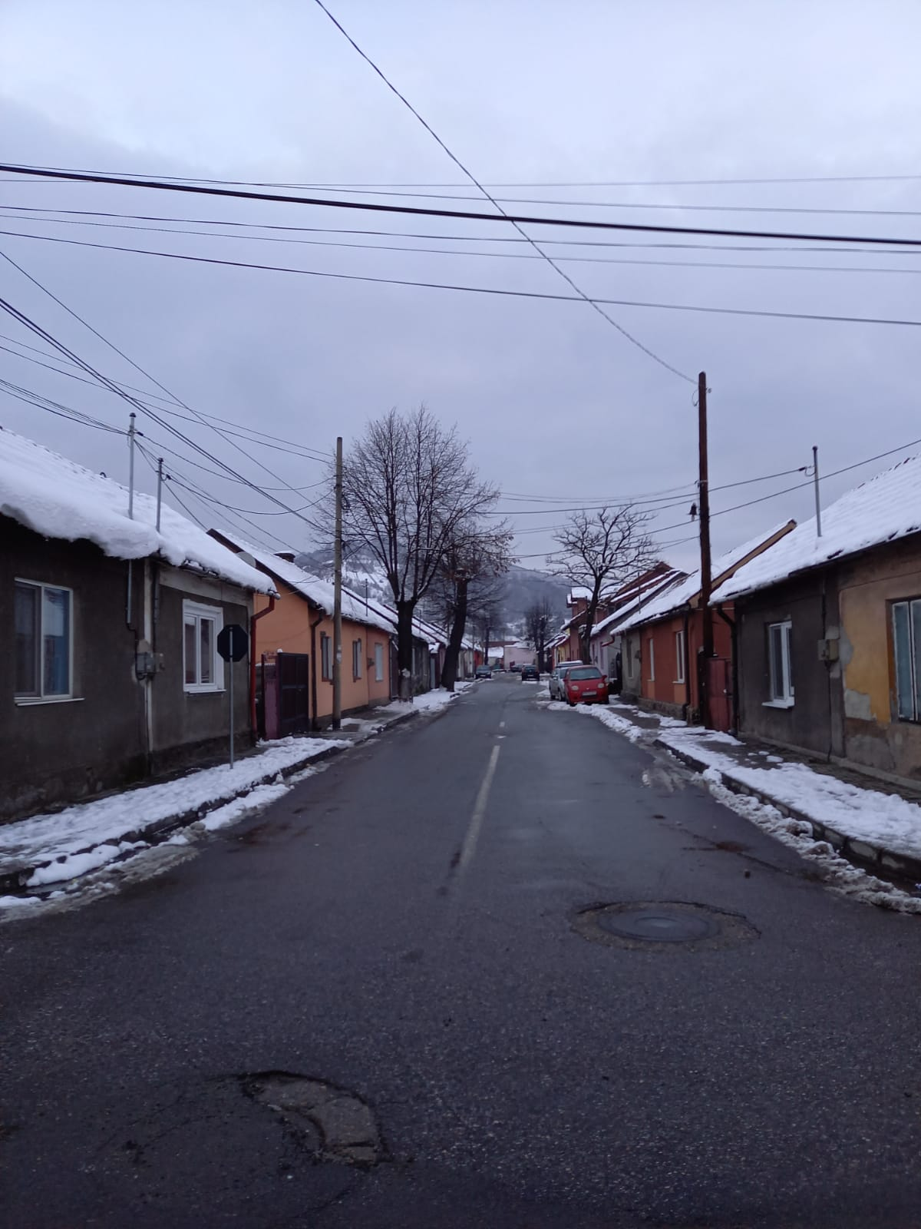
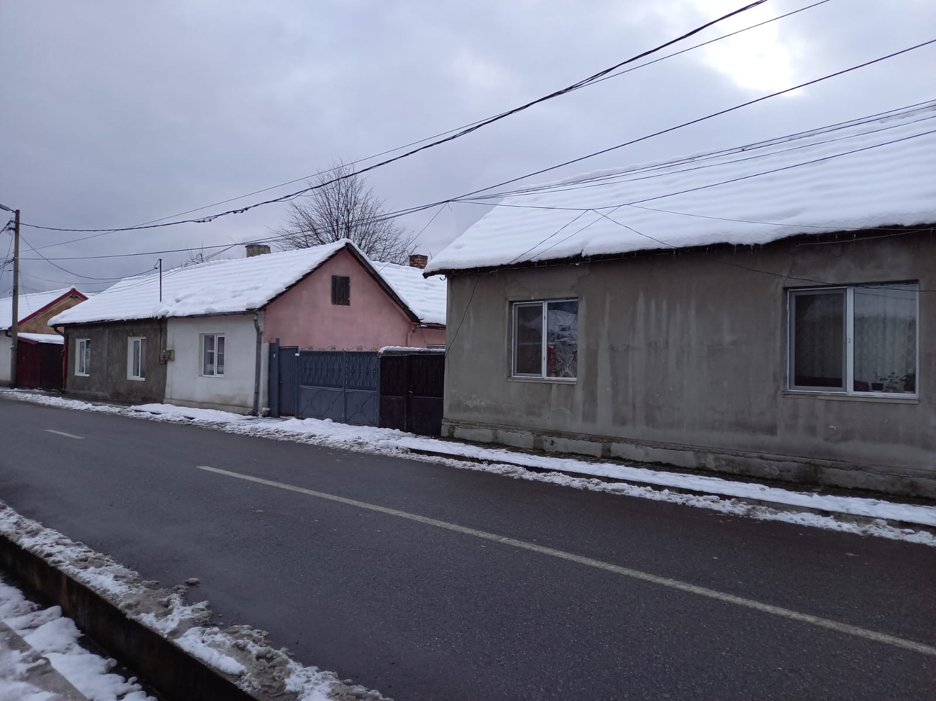
The Workers’Colony from Petroșani in the past
The Workers’Colony from Petroșani at present

Slide 6
THE WORKERS’ CASINO FROM PETROSANI
In the colony of Petrosani there was even a beautiful communal bathroom, as well as a casino, which now houses the headquarters of a company

Slide 7
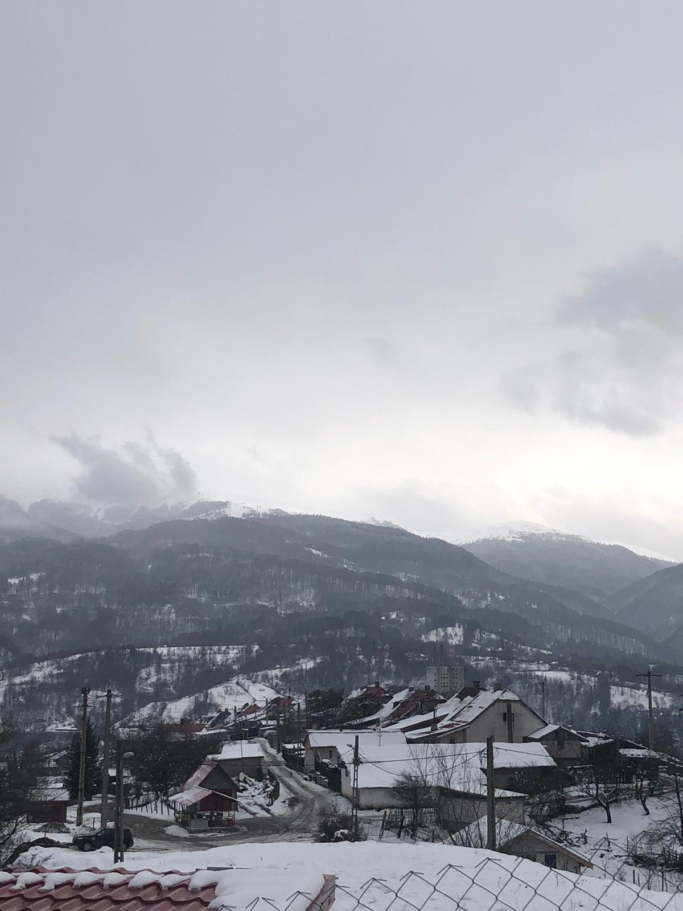
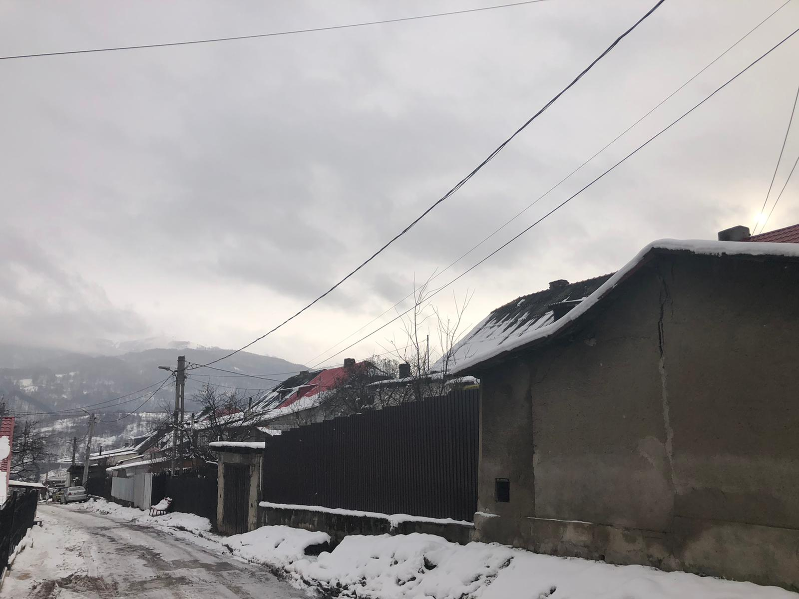
After 1892, in Lupeni, the “Uricani –Valea Jiului” Society began to build, instead of wooden barracks, the first brick houses that were the basis of the ten colonies that were completed by the First World War.
The Workers’ Colony from Lupeni in the past
The Workers’ Colony from Lupeni at present

Slide 8
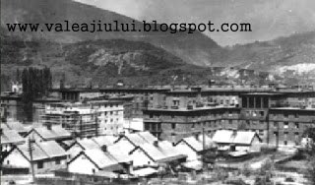
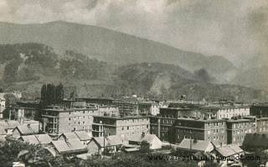
The Workers’ Colony from Vulcan in the past
The Workers’ Colony from Vulcan today

Slide 9
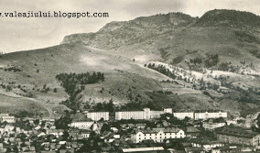
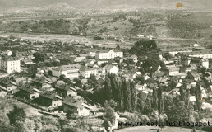
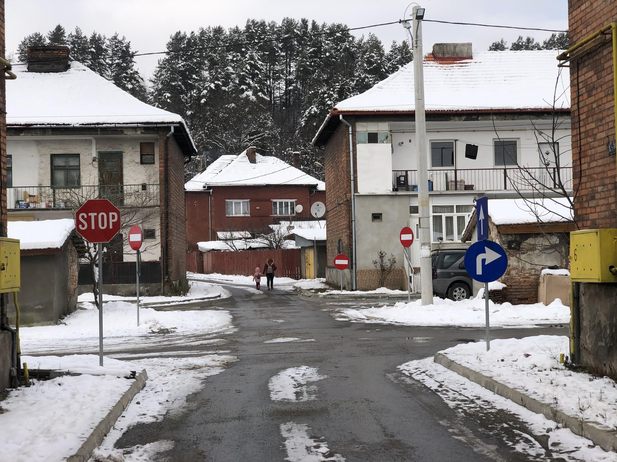
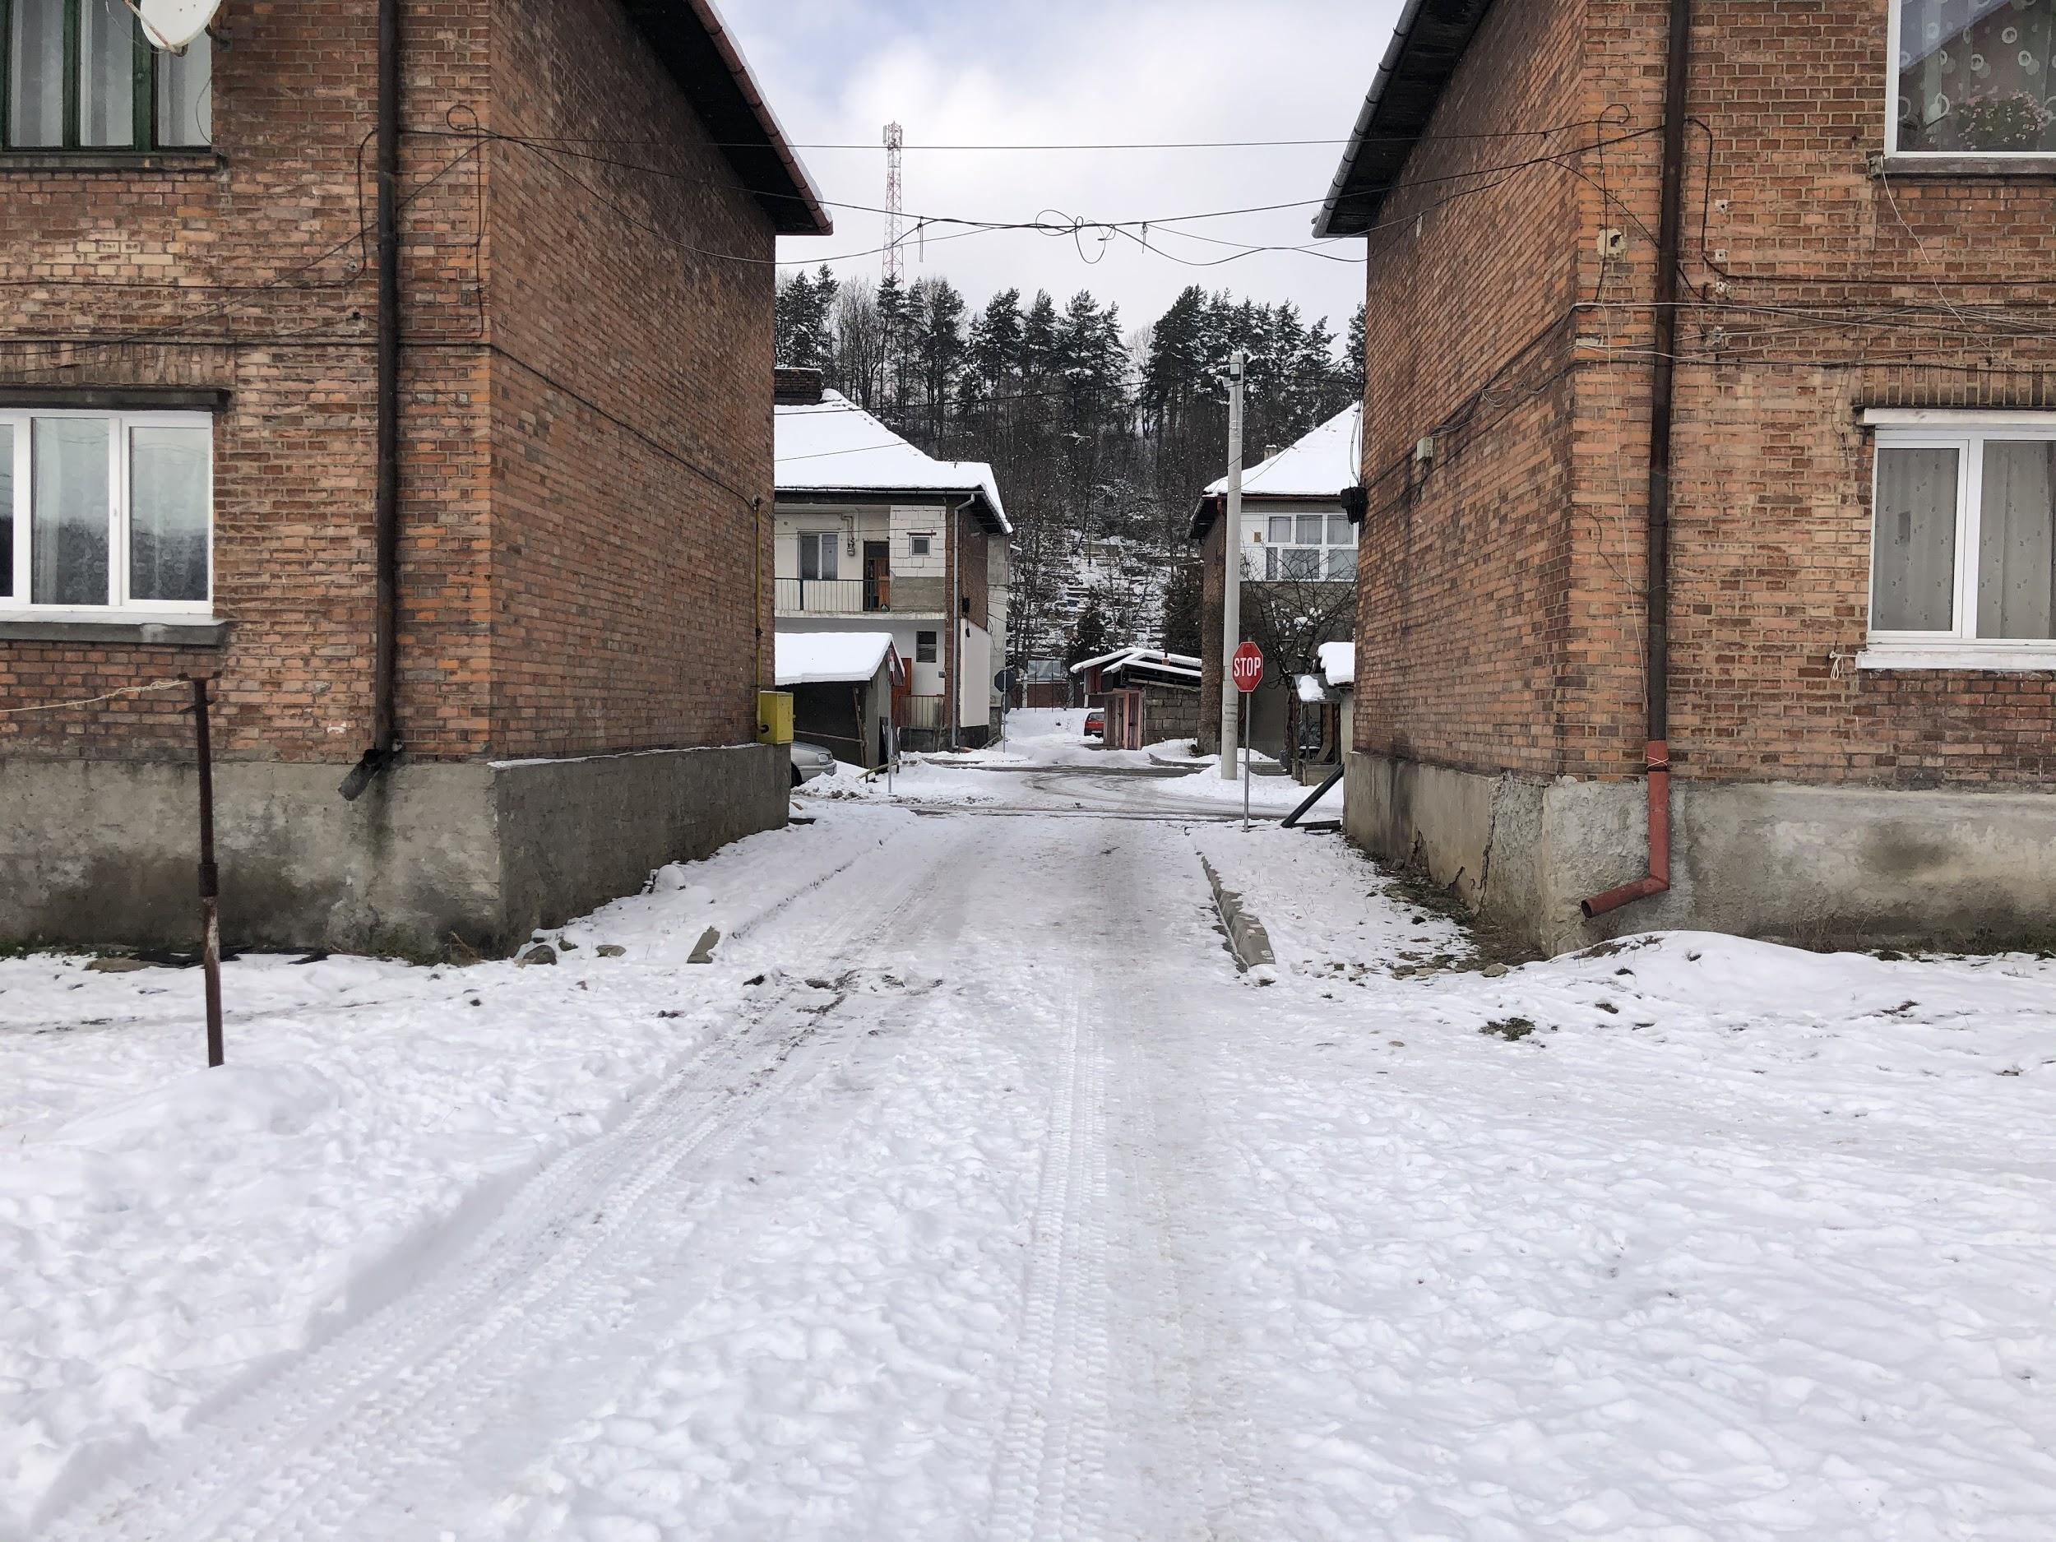
The Workers’ Colony from Petrila in the past
The Workers’ Colony from Petrila at present

Slide 10
Housing construction continued after the First World War, due to the effort made by the companies "Petroşani" and "Uricani - Valea Jiului" (the future company "Lupeni").

Slide 11
Housing construction continued after the First World War, due to the effort made by the companies "Petroşani" and "Uricani - Valea Jiului" (the future company "Lupeni").

Slide 12
After the Second World War and nationalization in 1948, the workers' colonies and mines served by their inhabitants became the property of the newly formed state, the People's Republic of Romania, which preceded only what would later become the Socialist Republic of Romania.

Slide 13
Although theoretically the inhabitants of these colonies should have done better in the new socialist state, this was not the case, many of the rights provided in the collective labor agreements being modified or canceled, especially those concerning payment in kind.

Slide 14
The information included in this presentation is used for non-profit educational purposes.
The photos were taken by Alexandra Mihai, Georgiana Pitec, Erika Soo and Sergio Ionasc as part of the ERASMUS+ KA229 PROJECT: ​PRomotion Of Identity, European Culture and Tradition​ (2018-2021).

Slide 15
The European Commission support for the production of this publication does not constitute an endorsement of the contents which reflects the views only of the authors, and the Commission cannot be held responsible for any use which may be made of the information contained therein.

