Slide 1
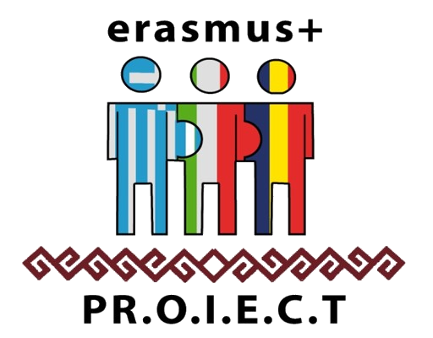
EASTER TRADITIONS IN ROMANIA
ERASMUS+ PRomotion Of Identity, European Culture and Tradition nr. ref. 2018-1-IT02-KA229-047925_3 KA2 – Cooperation for innovation and the exchange of good practices KA229 - School Exchange Partnerships

Slide 2
Easter in Romania
Around 86% of Romanians are of Orthodox confession and Easter (or the Resurrection) is one of the most important religious holidays in the country.
Easter in Romania has a sacred quality, as it is firmly rooted in religion, with most of the associated traditions being of Orthodox origin.
The traditions surrounding Easter are pretty complex and hold special meaning in the hearts of most Romanians.

Slide 3
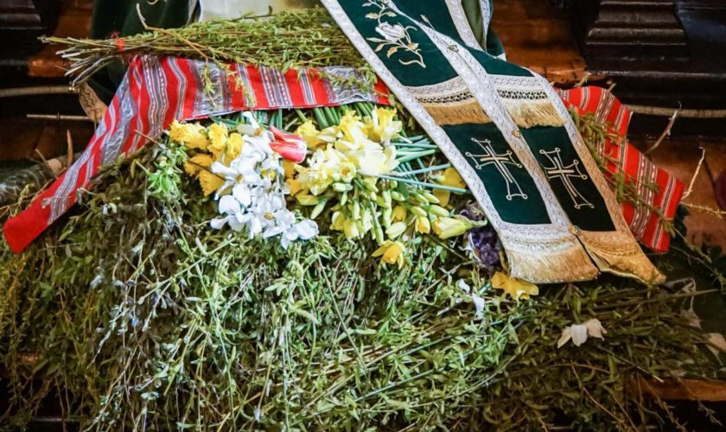
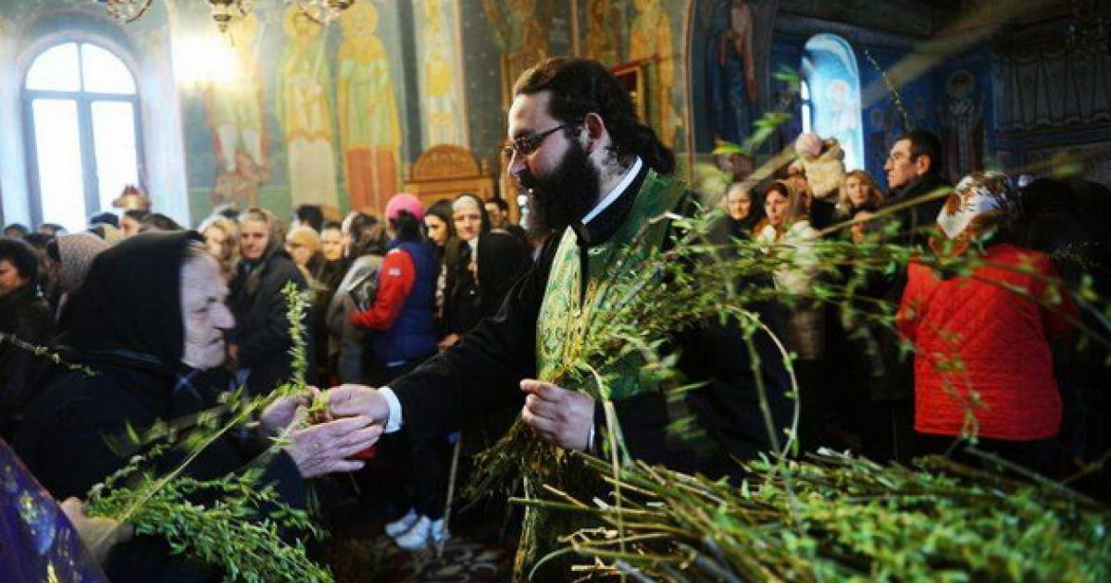
Florii (Palm Sunday)
Initially dedicated to the Roman goddess Flora, Palm Day is a feast celebrated a week before the Romanian Easter in the memory of Jesus’ entrance to Jerusalem.
People with flower names are celebrated (the English equivalent of Florii is Flower Day).
During this day, willow branches (that symbolize the palm fronds) are taken into the church to be blessed. Then, people put them in front of icons and above doors to ward off evil spirits and protect them all year long.

Slide 4
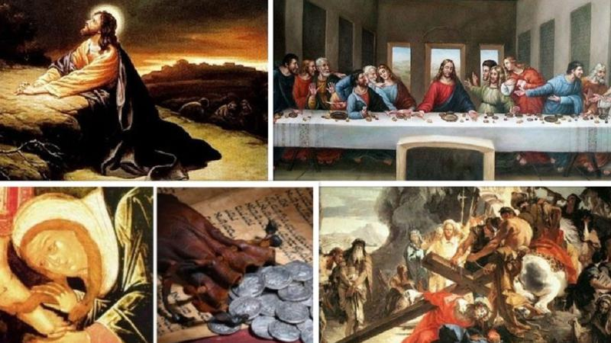
THE HOLY WEEK
is also called the Passion Week
people stop working starting with Thursday;
- women start cleaning houses for Easter on Holy Monday (they remove all out, vent the house to get out all the evils of the winter, they white the house and wash everything);

Slide 5
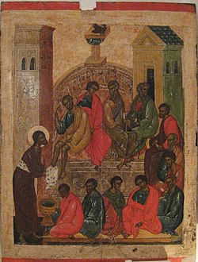
Holy Thursday
Or Maundy Thursday (the fifth day of the Holy Week) commemorates the moment when Jesus Christ washed the feet of the Apostles. The Washing of the Feet is a traditional custom often celebrated in many Christian churches.
In the Romanian orthodox tradition, Maundy Thursday is the day when the last memorial service for the dead takes place in the Lent.
They also say that the dead came back to their old home, where they dwelt until the Saturday before Whit Sunday (=Rusalii). The living light candles in churches or to the graves of their deceased, praying for the salvation of their souls.
In western Romania, people make the bread for Easter and bring it to the church together with wine and candles and the bread stays in the church until Easter.

Slide 6
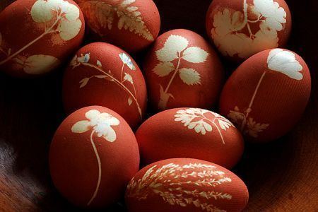
Painting Boiled eggs
This takes place on the Thursday before Easter. It has its origin in a pre-Christian tradition. It was present with European as well as Asian people. “The egg is supposed to represent the Creator of the world…it was the symbol of the Universe, the creation of the supreme divinity.”
The traditional colour to dye the eggs with is red which symbolizes Jesus’ blood when he was crucified. However, nowadays, a wide range of colors and decorations are used. Yet, natural coloring methods, such as boiling the eggs in water with red onion skins or beetroot, are still being used, mostly in rural Romania.

Slide 7
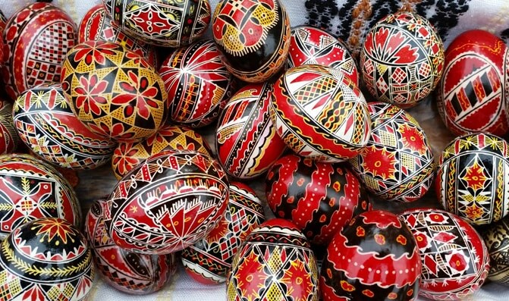
Decorating the Eggs with Incredible Craftsmanship
Romania is famous for its artists who hand-paint empty eggshells in different geometrical and floral motives, an art form that has been passed down from generation to generation.
Although the ornamental details vary from one region to another, all of the elements on the decorated eggs have meaning. Here's the interpretation for some of them:
- the vertical line means life
- the horizontal line means death
- the double line means eternity
- the line with rectangular symbols means knowledge
- the curved line means water
- the spiral means time, eternity
- the double spiral means the bond between life and death.

Slide 8
Decorating the Eggs

Slide 9
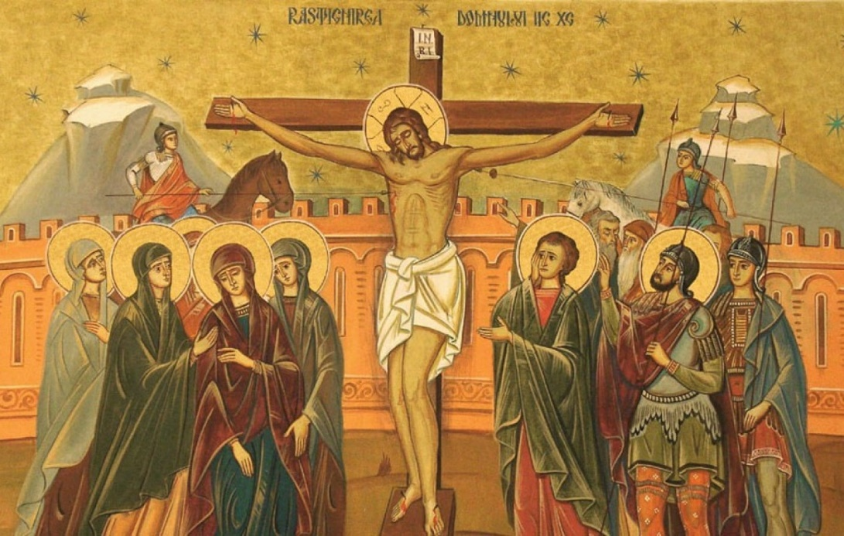
Good Friday
or Black Friday (the sixth day of the Holy Week) comme-morates the crucifixion of Jesus and his death at Calvary. On this day of mourning, Romanian people abstain from all food and drinks the entire day and in the evening, they eat Holy bread from the church.
On this day, there’s no religious service and the only ceremony is removing the Holy Epitaph from the altar and placing it on a table in the middle of the church, which symbolizes Jesus’ descent from the cross and the following steps for his funeral.

Slide 10
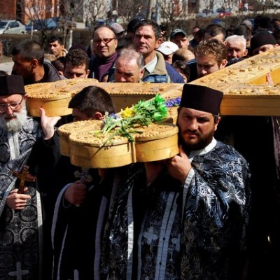
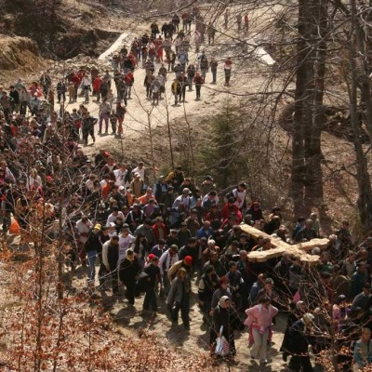
The Way of the Cross- Straja

Slide 11
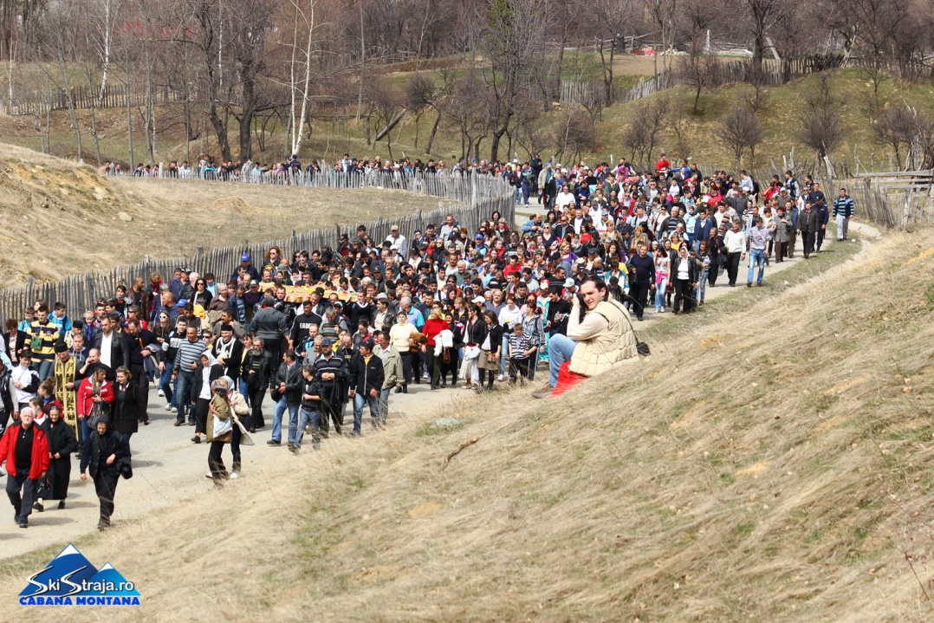
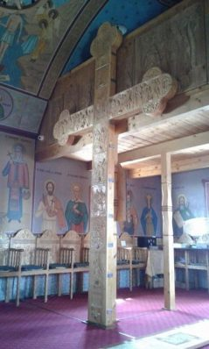
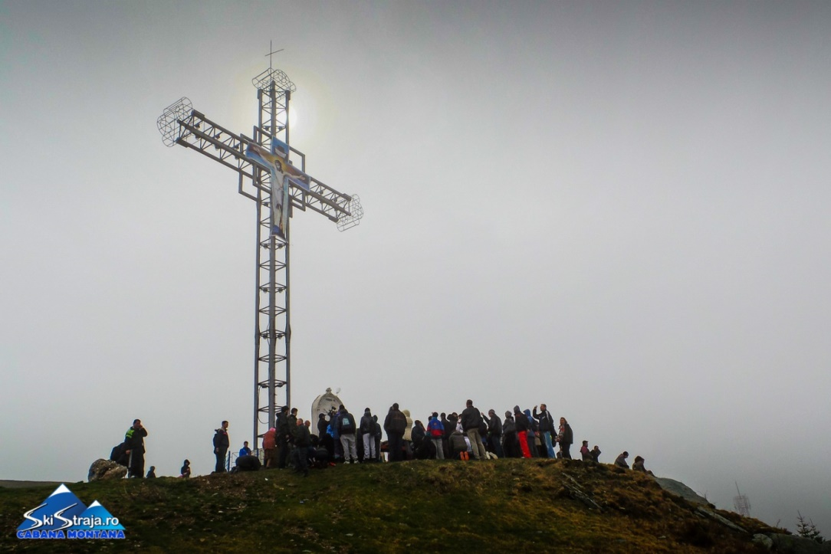

Slide 12
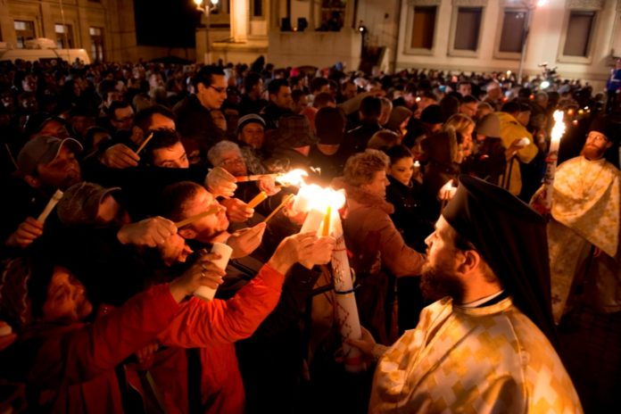
Easter Saturday
Millions of Romanians put on festive clothes and attend the midnight service at the church. A few minutes after the clock strikes midnight, all the lights in the Church are turned off.

Slide 13
Easter Saturday

Slide 14
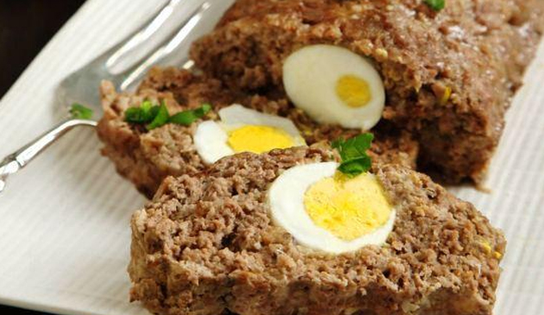
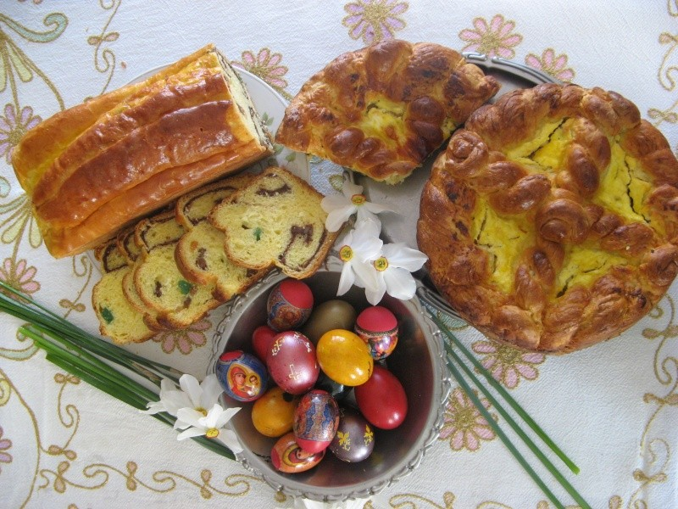
Easter Day
On the first day of Easter, children and adults alike wash their face and hands with fresh water, in which they put a red egg and basil. It is said that those who follow this tradition will be forever beautiful and healthy.

Slide 15
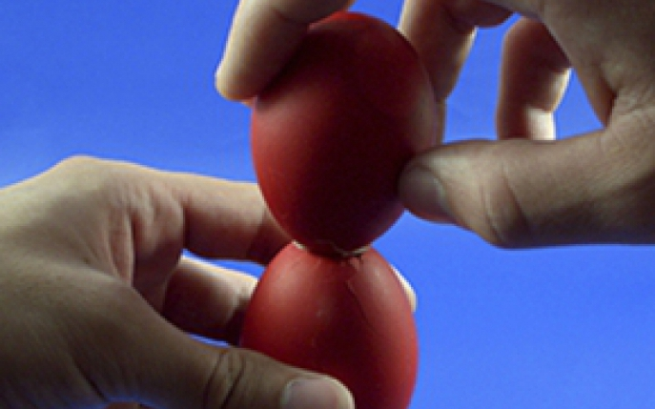
Knocking Dyed Eggs Together End-to-End
It is customary for people to knock eggs during Easter. While the two eggs are cracked together, one person says “Christ is risen” to which the other person responds with “Indeed is risen“. The person who manages to crack the other person’s egg on both ends is considered to be the winner.

Slide 16
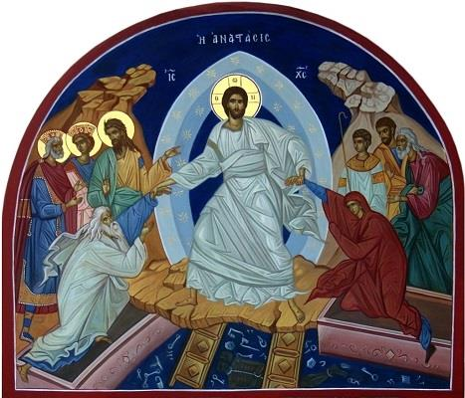
THANK YOU FOR YOUR ATTENTION!

