Slide 1
ERASMUS+ PRomotion Of Identity, European Culture and Tradition nr. ref. 2018-1-IT02-KA229-047925_3 KA2 – Cooperation for innovation and the exchange of good practices KA229 - School Exchange Partnerships

Slide 2
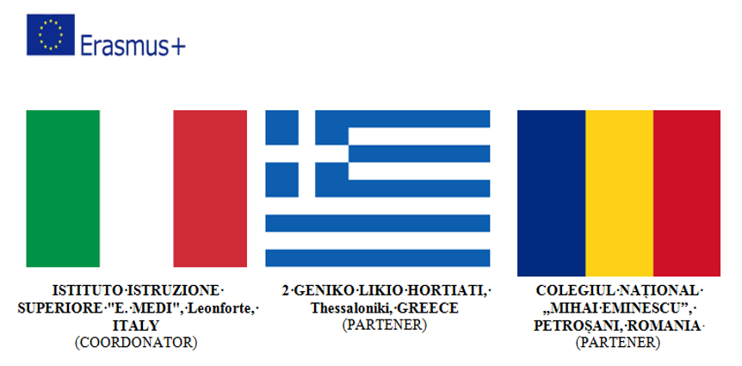
Duration: 2 Years: 01.09.2018-31.08.2020

Slide 3
Conducted activities during the project

Slide 4
1. EXHIBITIONS

Slide 5
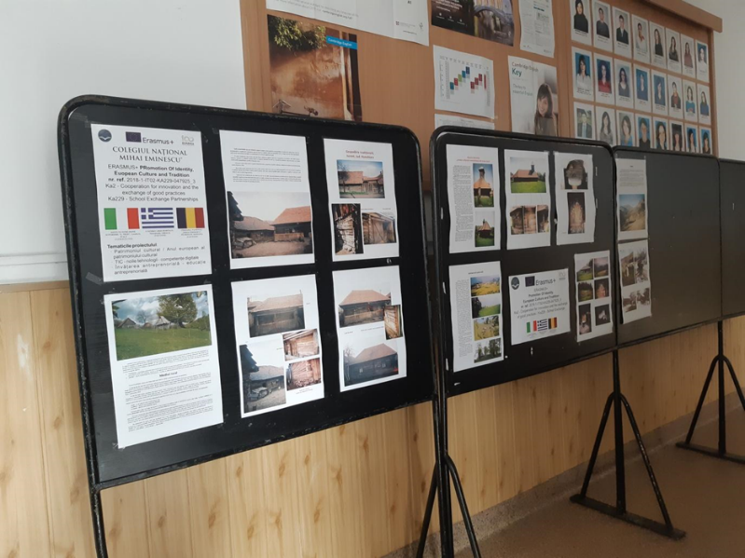
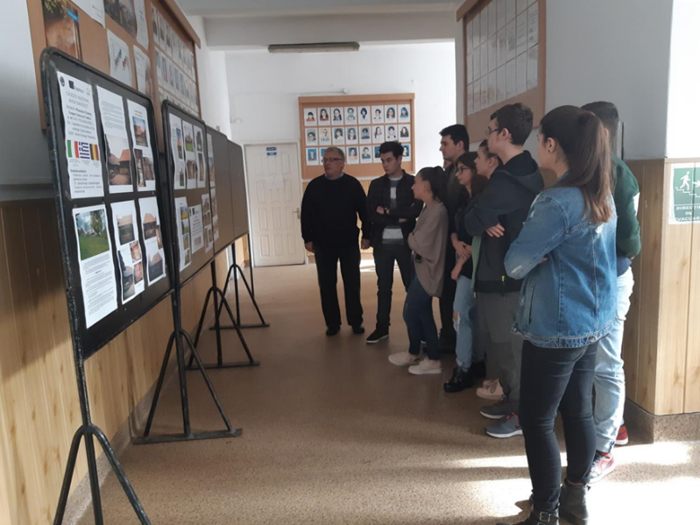
Local Traditional Architecture (November 2019)
(Data Collection, Translation, PowerPoint Presentation)

Slide 6
2. Data Collection, Translation Activity, Videos

Slide 7
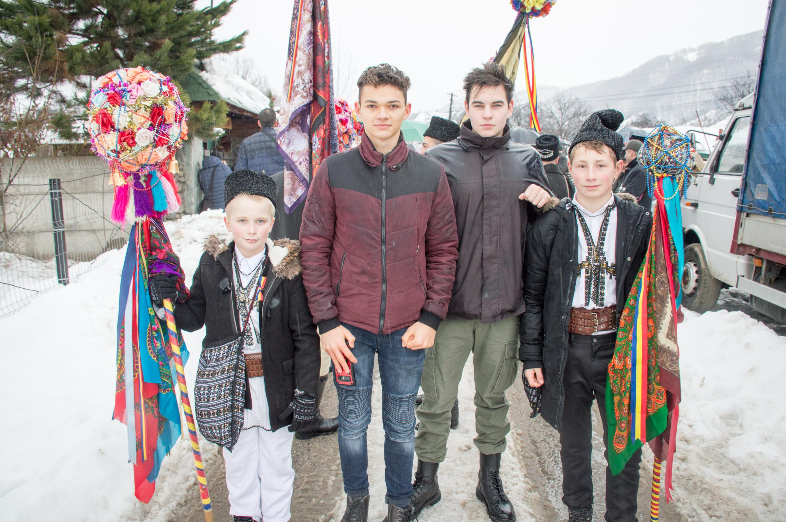
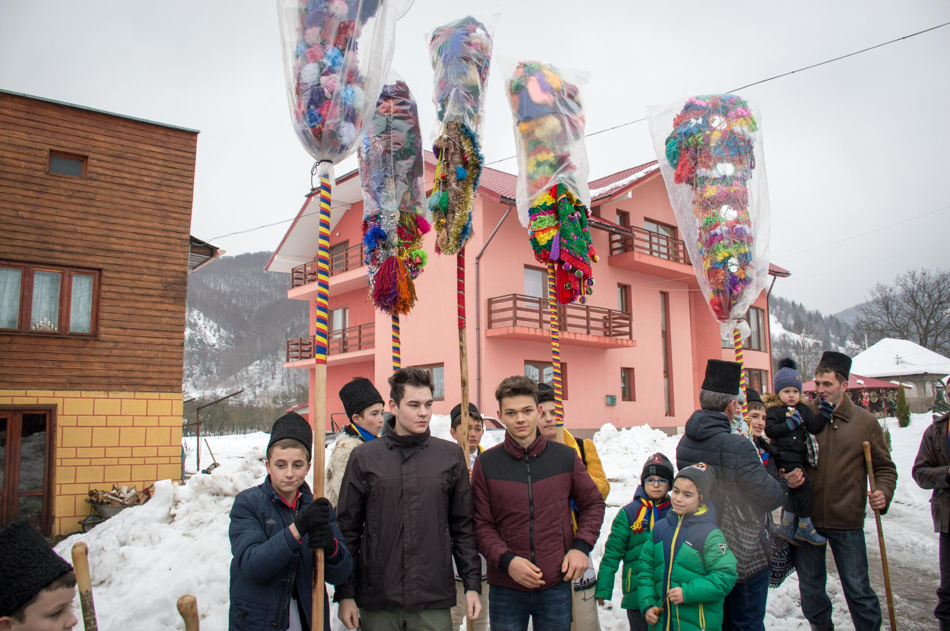
2.1. CHRISTMAS CUSTOMS AND TRADITIONS
Pițărăii”- Jieț (24 December 2018)

Slide 8
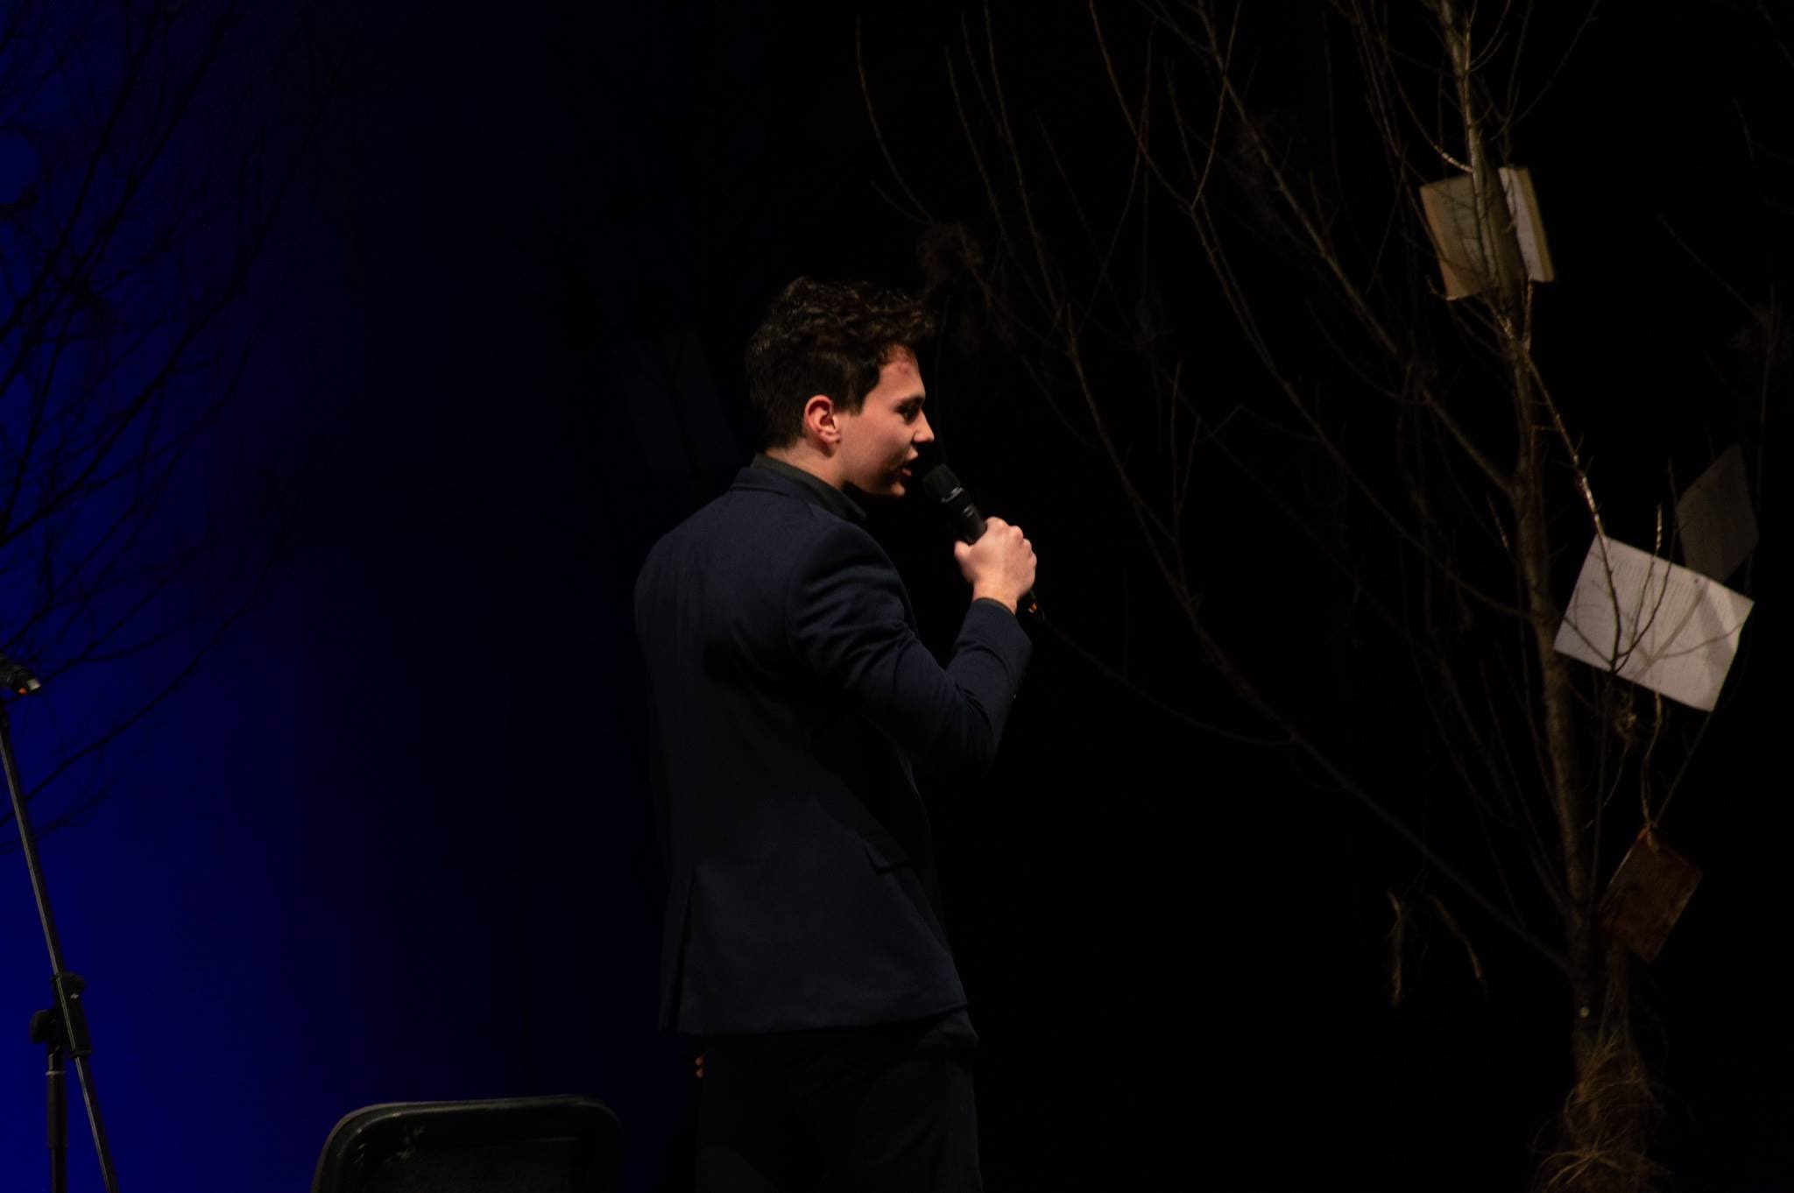
2.2. 15 January 2019- Mihai Eminescu- National Poet

Slide 9
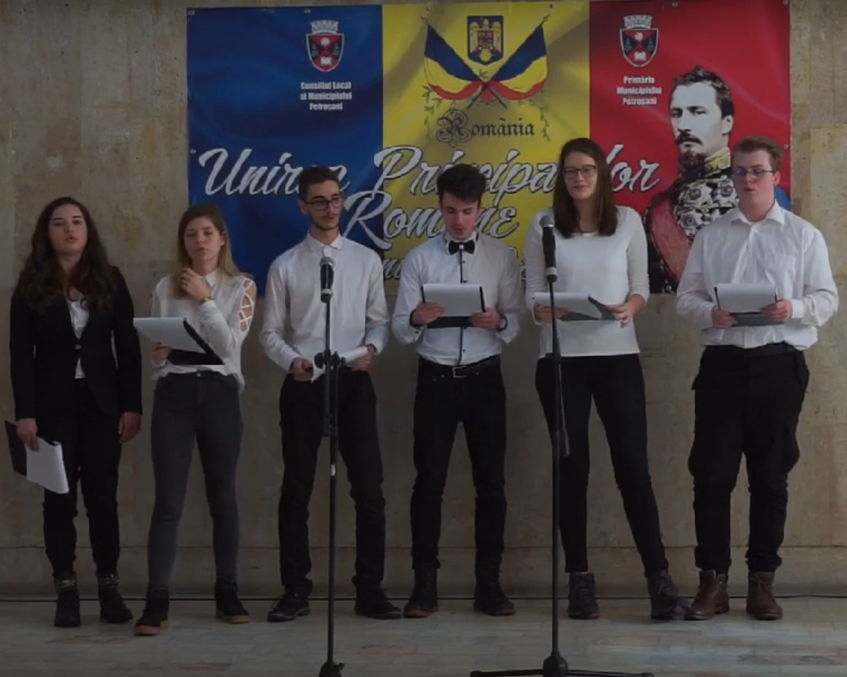
2.3. 24 January 2019- UNION DAY

Slide 10
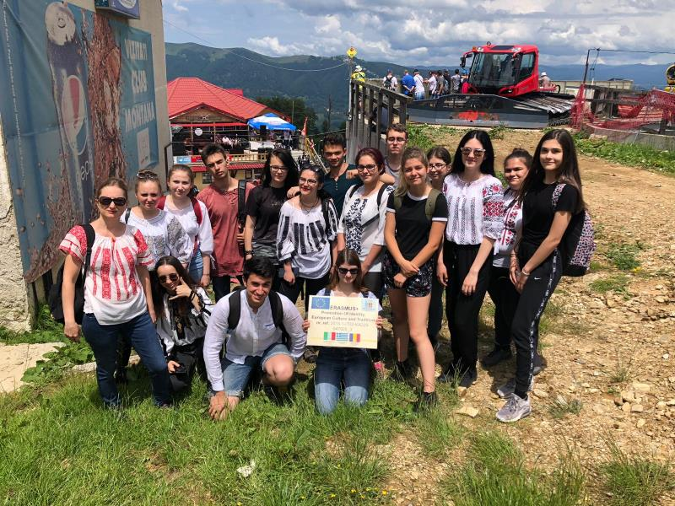
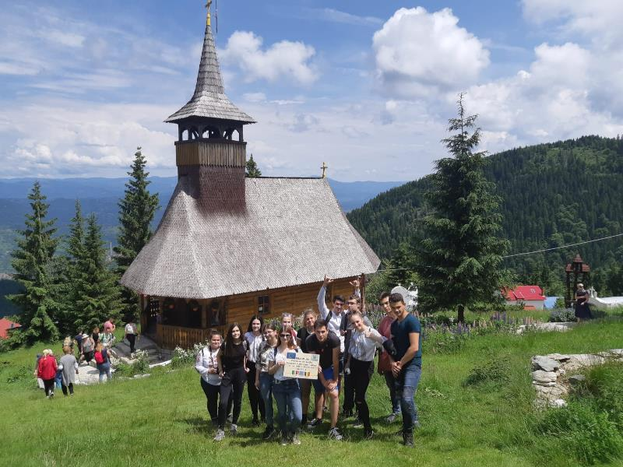
2.4. Nedeia Sânzienelor, Straja (24 June 2019)

Slide 11
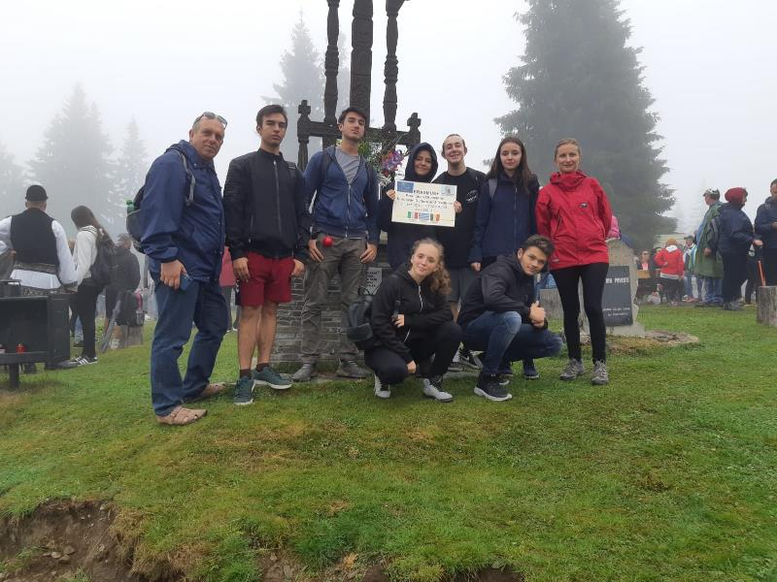
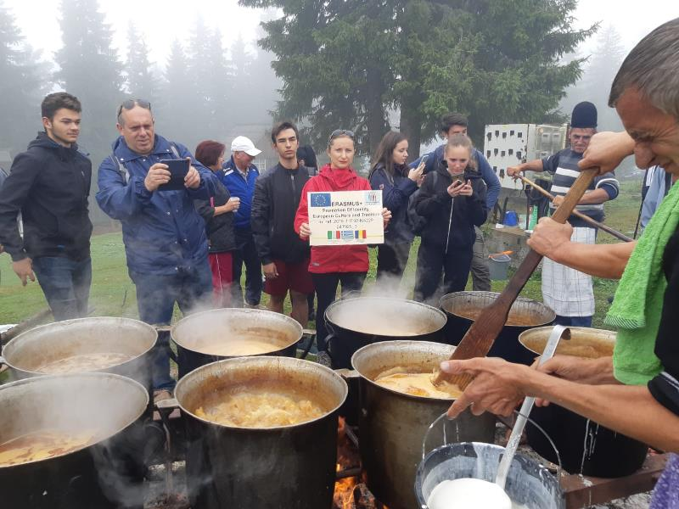
2.5. Nedeia Troiței, Parâng (15 August 2019)

Slide 12
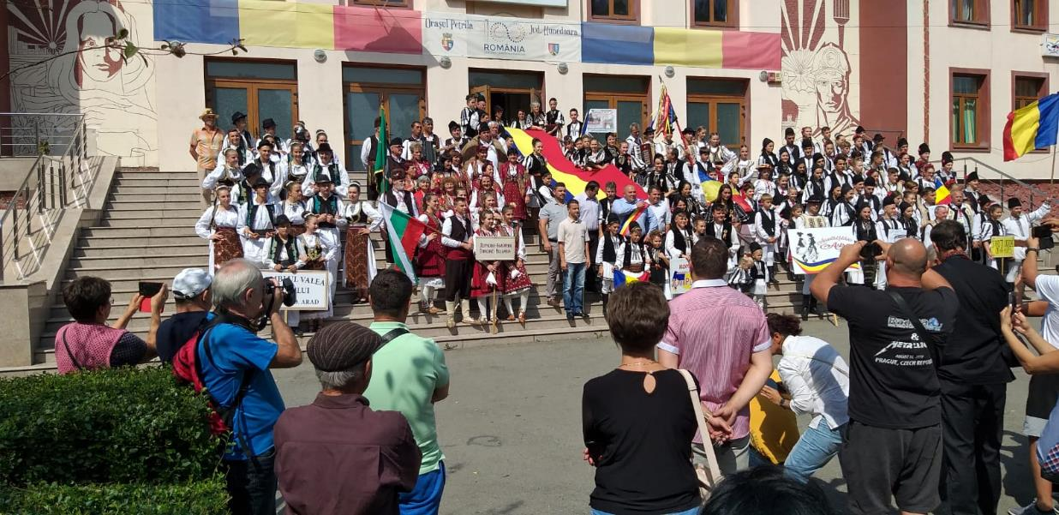
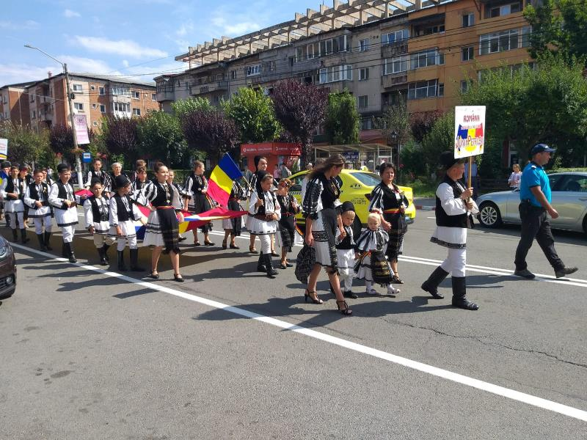
2.6. “Momârlanii, gazde bune” International Festival (8 September 2019)

Slide 13
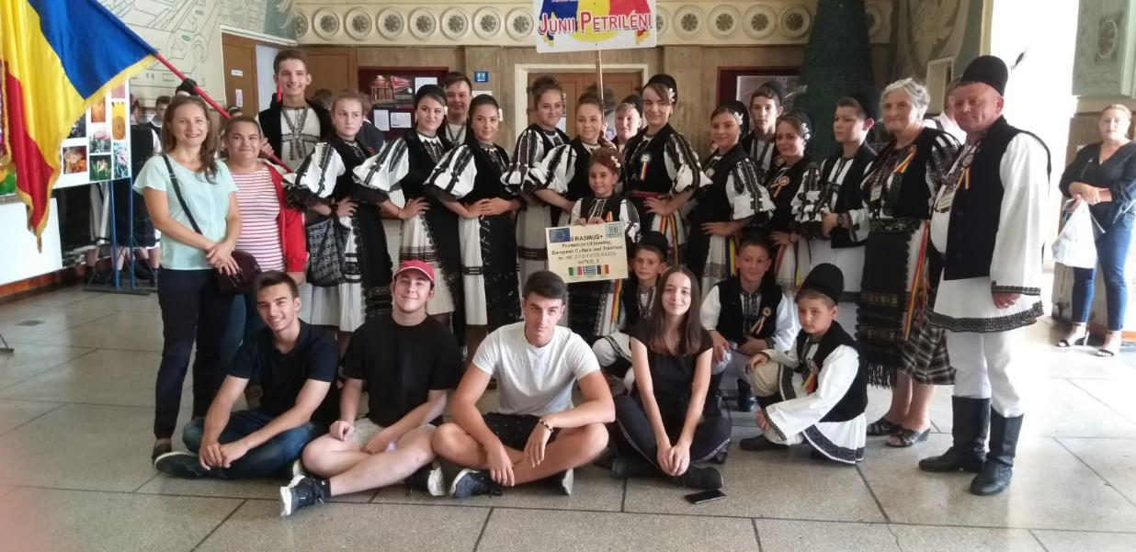

Slide 14
3. VISITS

Slide 15
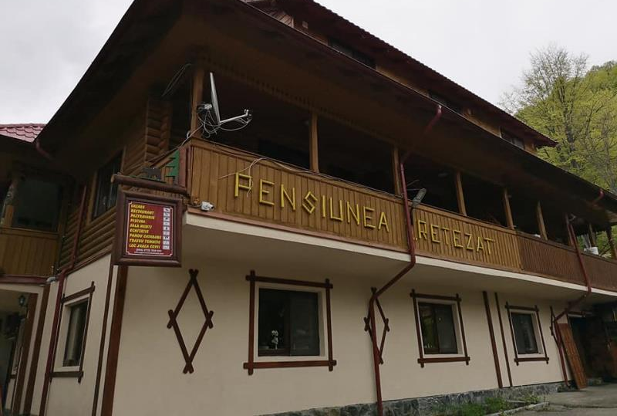
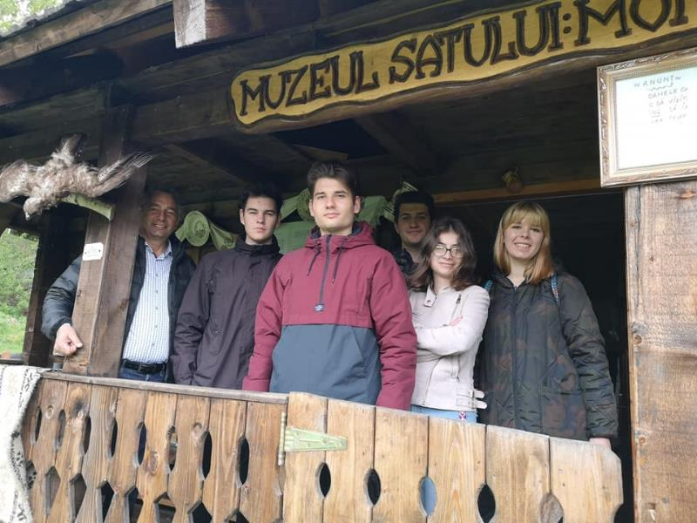
3.1. “Retezat” Guest House (07 May 2019)- Data Collection

Slide 16
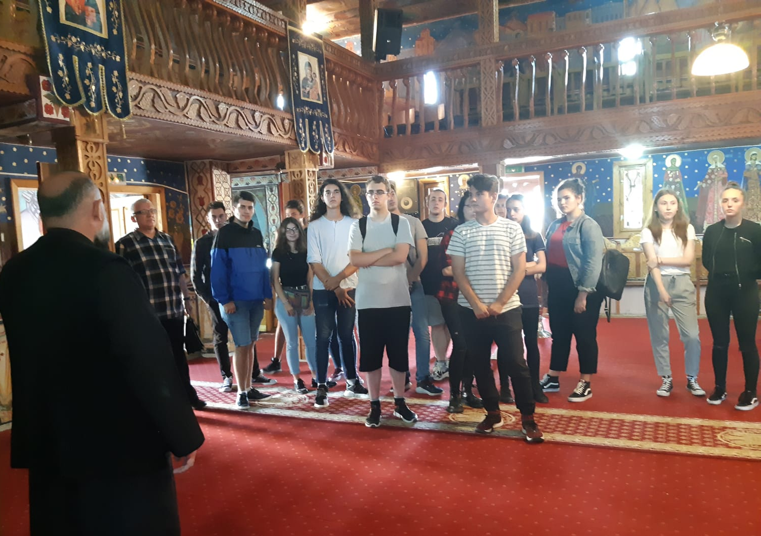
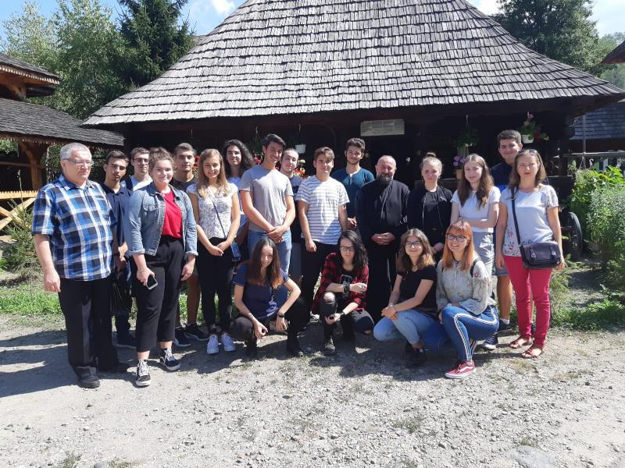
3.2. St. Barbara Church and the St. Barbara Ethnographic Complex (03 September 2019)
Data Collection, Preparation Activities for C3 Mobility

Slide 17
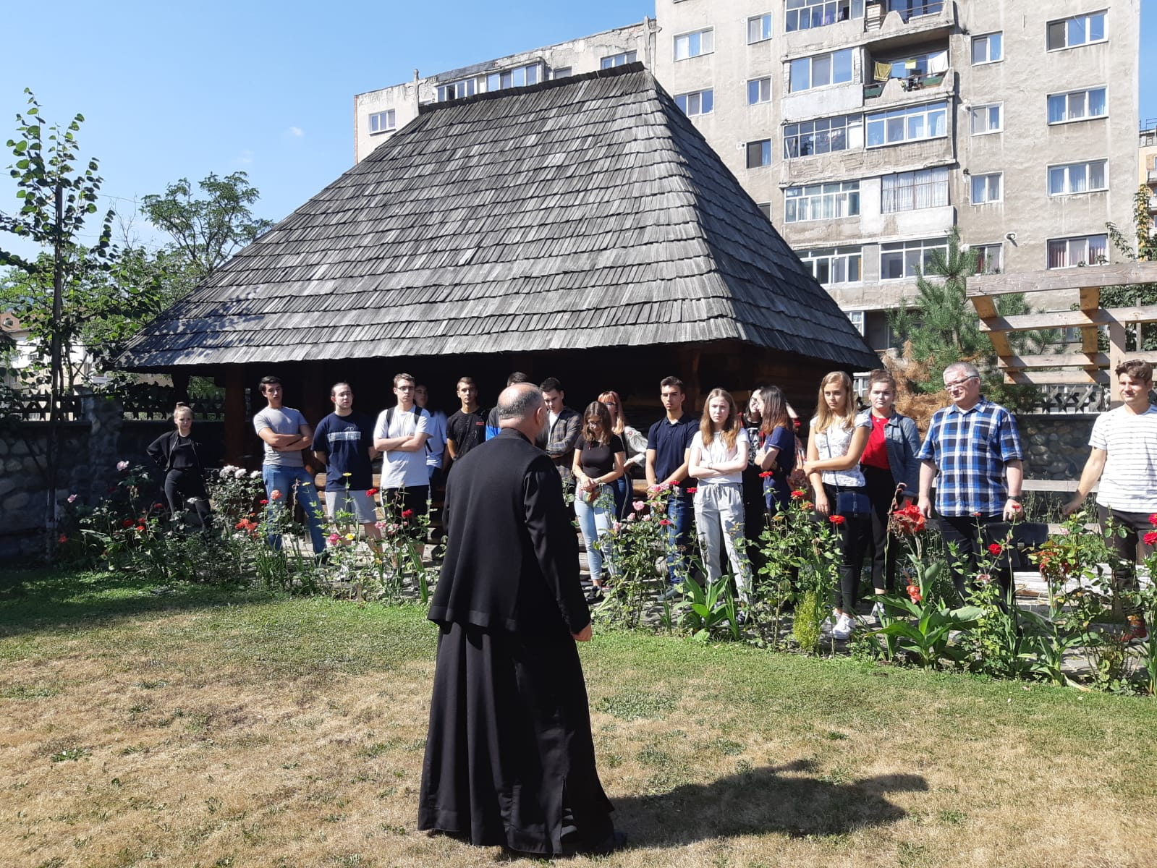
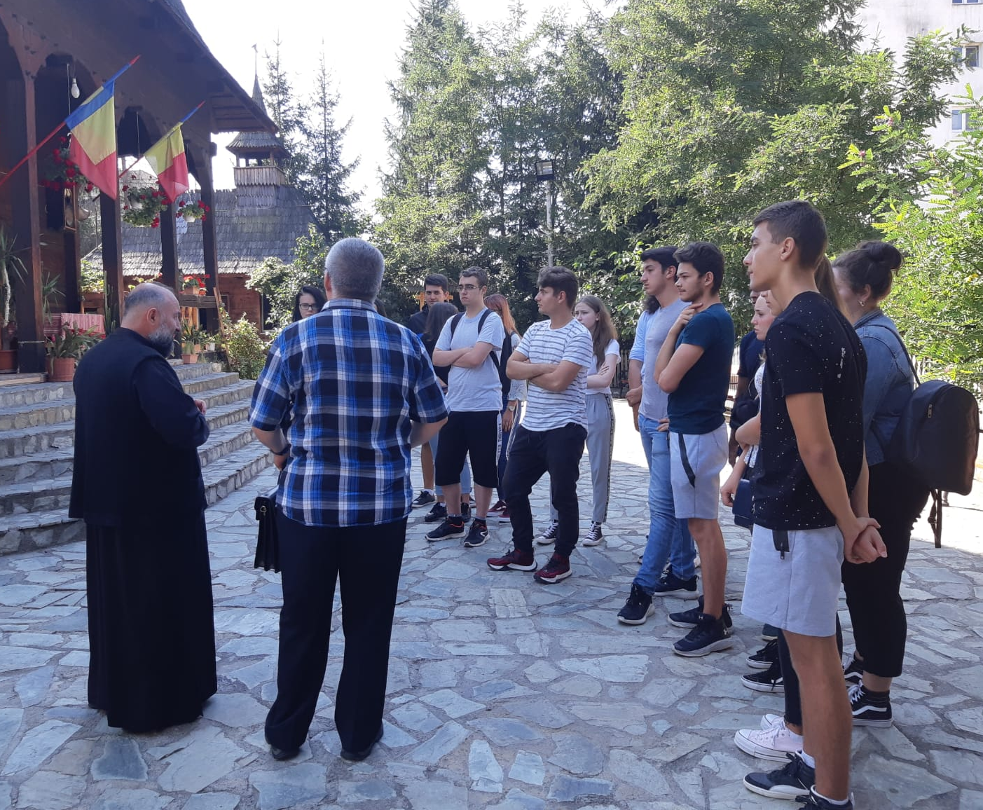

Slide 18
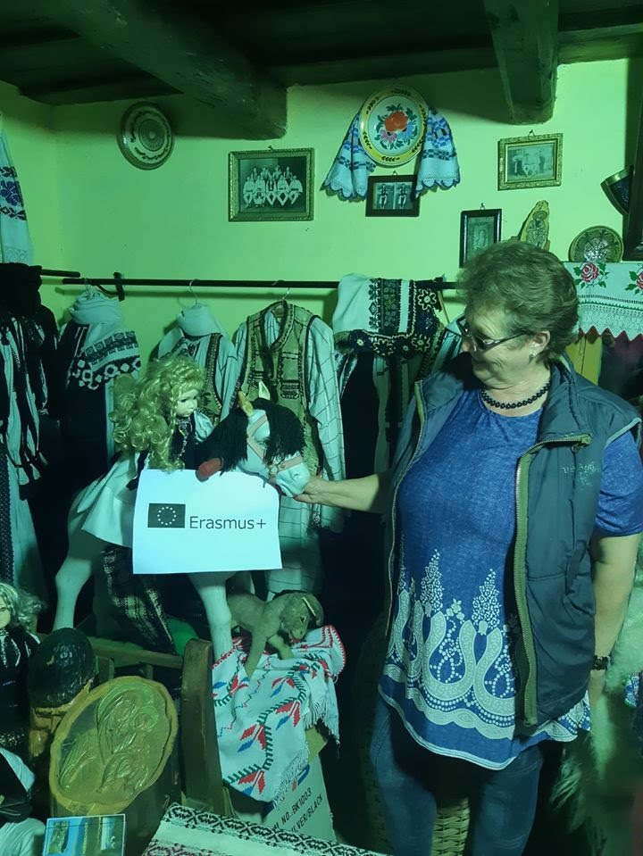
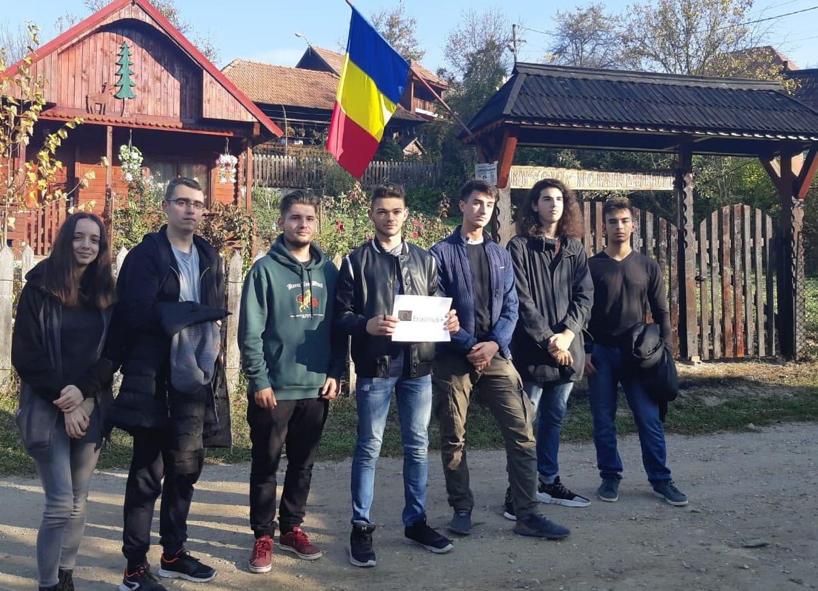
3.3. “Momârlanului” Museum 20 October 2019

Slide 19
4. Handmade Souvenirs

Slide 20
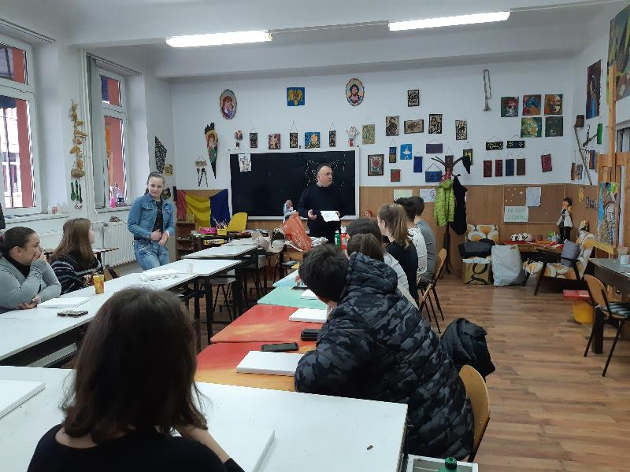
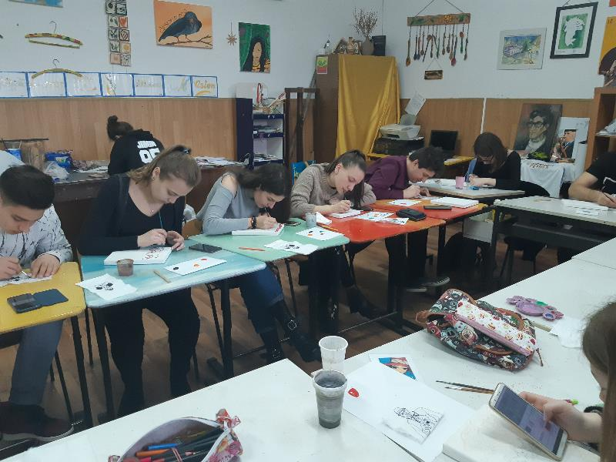
4.1. For the Mobility in Greece
(March 2019- Petrila Children’s Club)

Slide 21
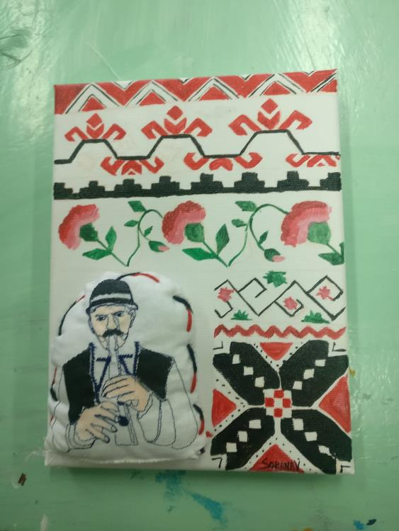

Slide 22
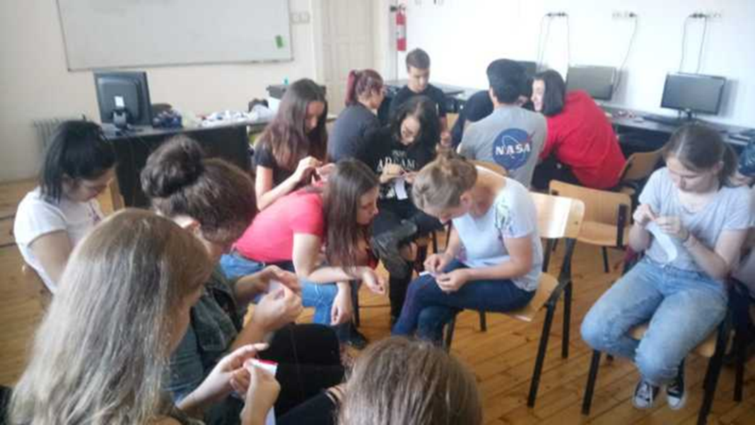
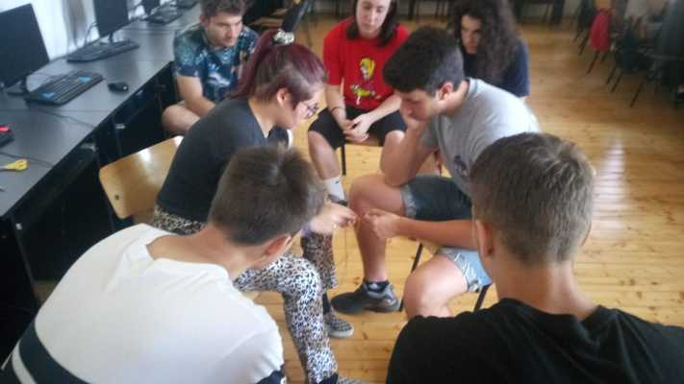
4.2. For the Mobility in Romania (July 2019)

Slide 23
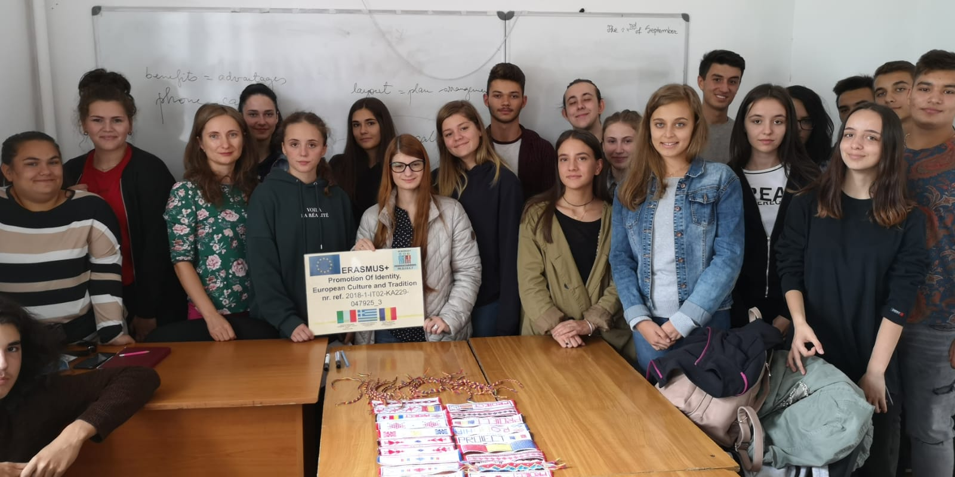

Slide 24
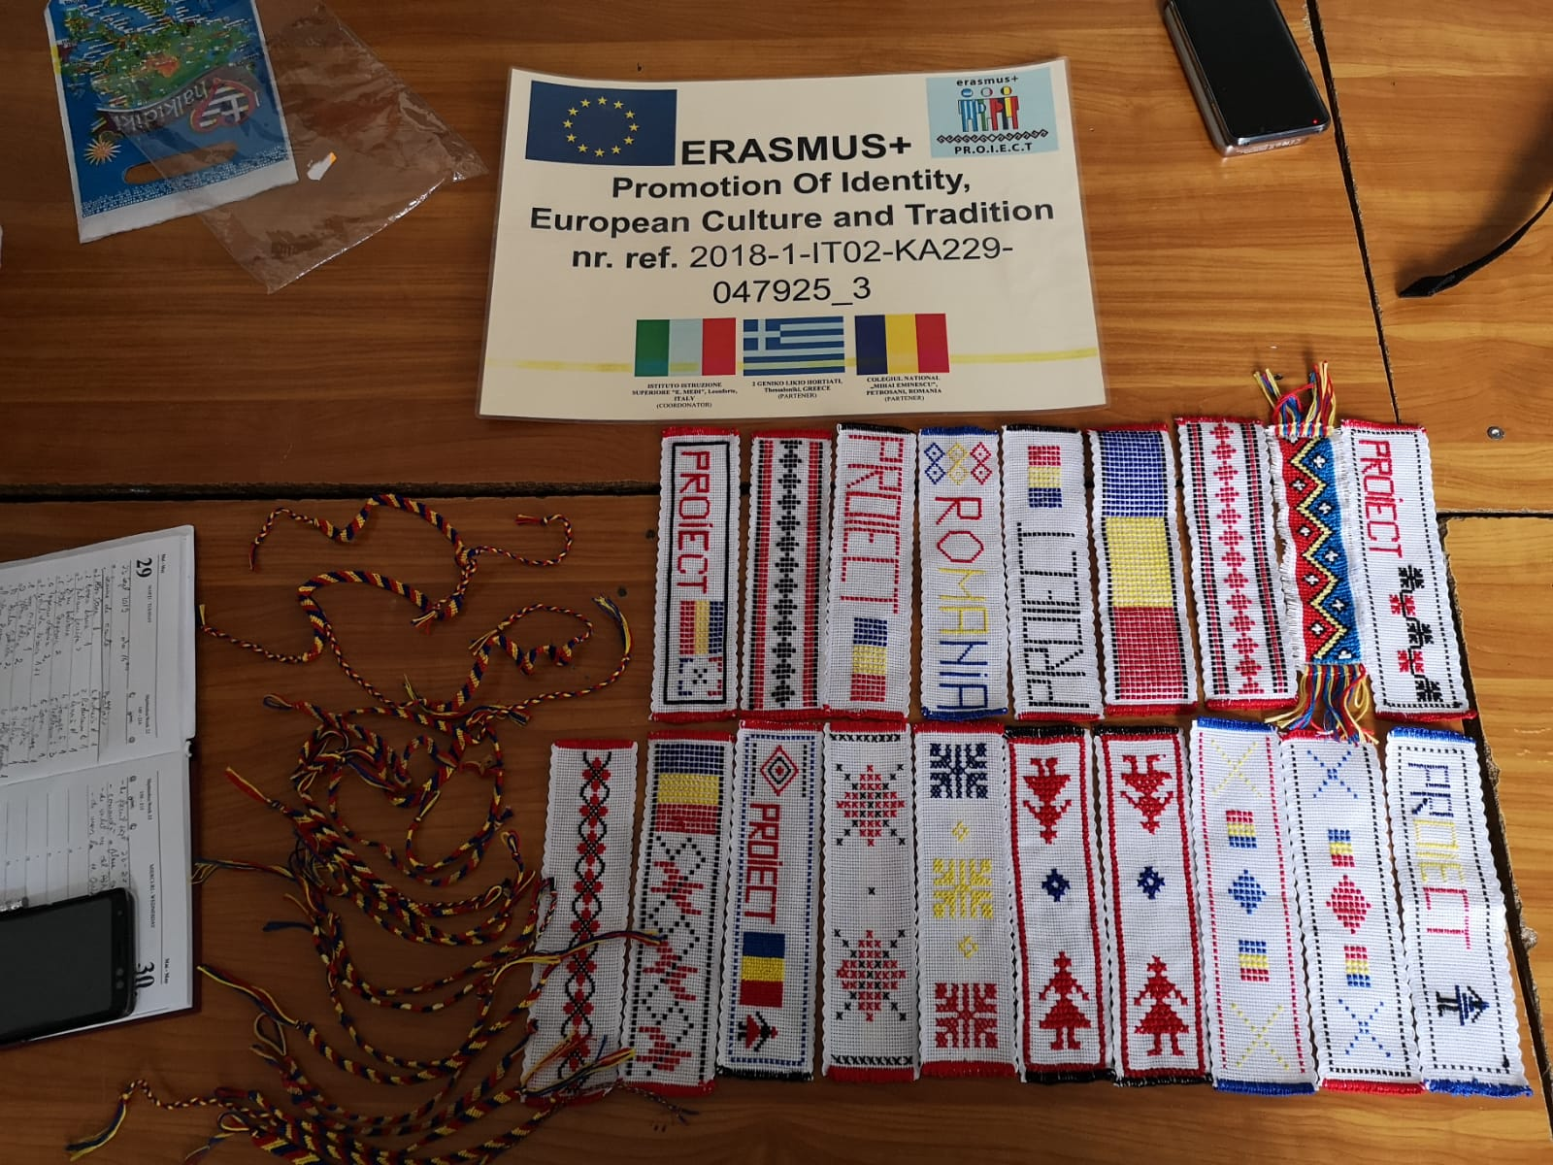

Slide 25
5. Data Collection and Promotion of Traditional Activities and the Local Community

Slide 26
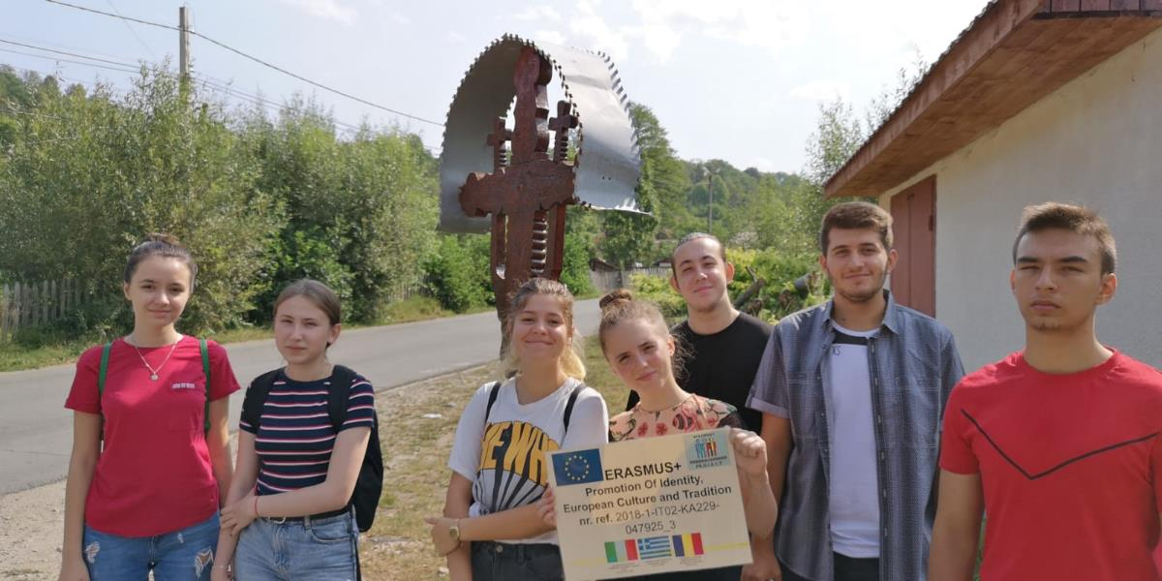
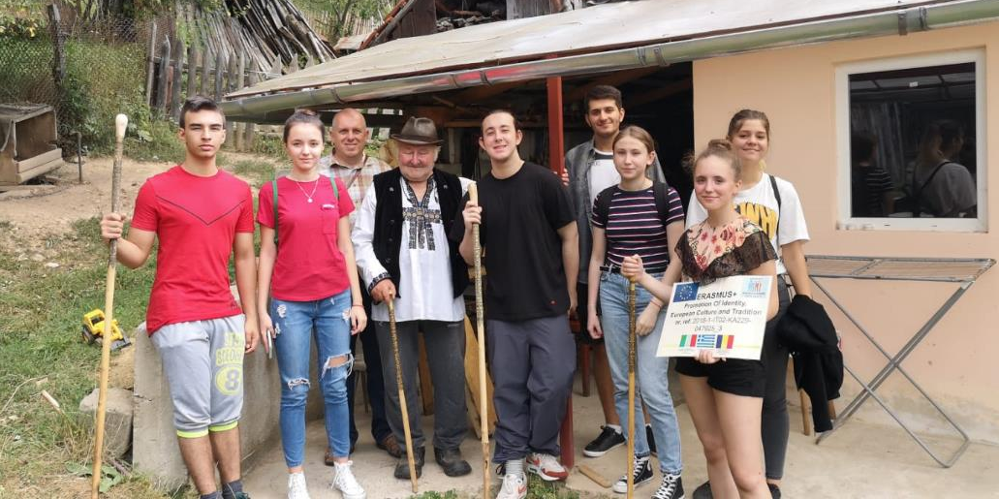
5.1. Wood Carving and Staves Making ( 26 August 2019)

Slide 27
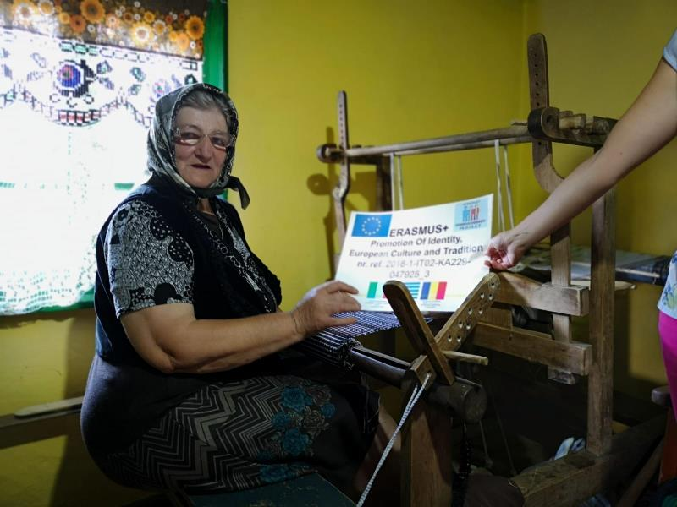
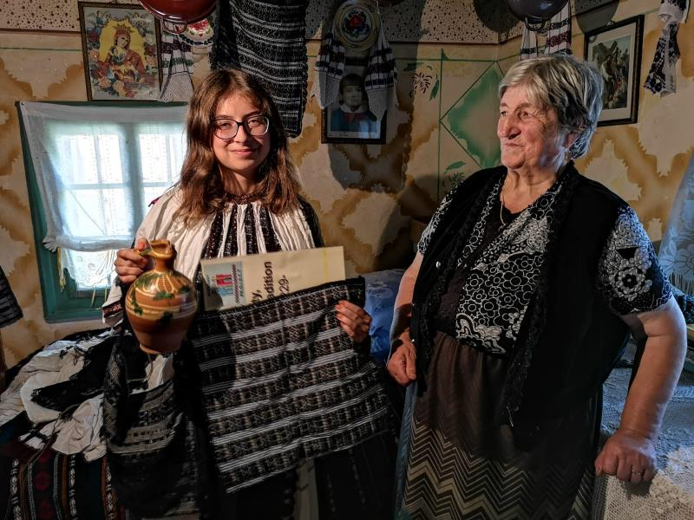
5.2. Bags and Traditional Costumes (03 September 2019)

Slide 28
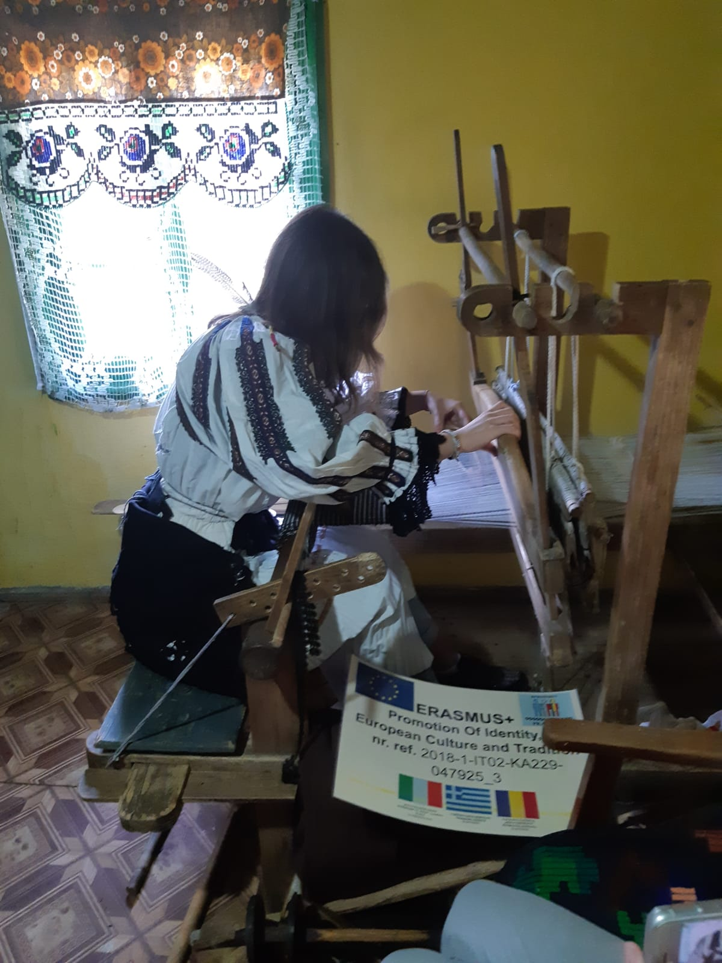
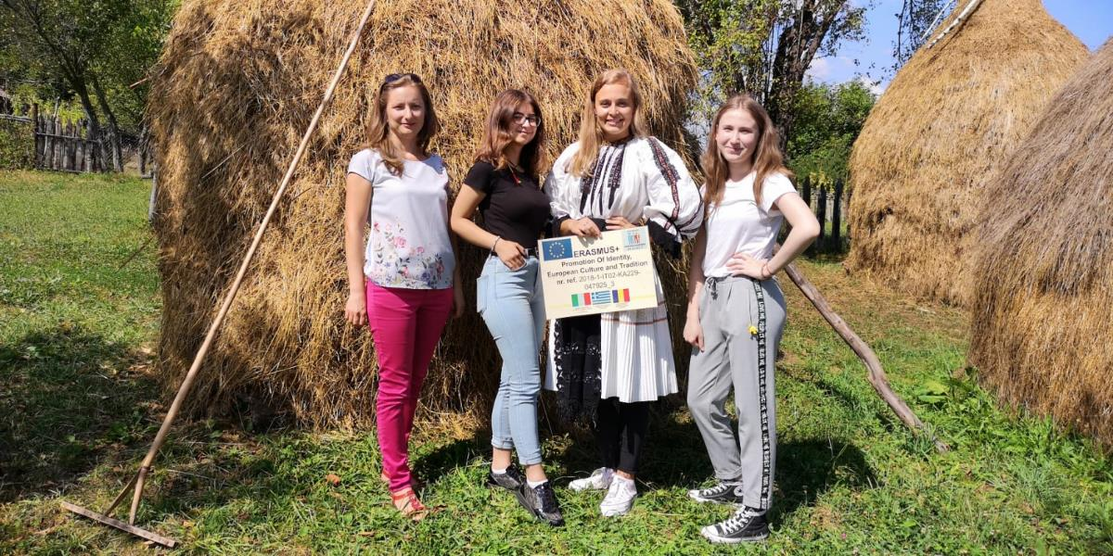

Slide 29
6. Dissemination Activities

Slide 30
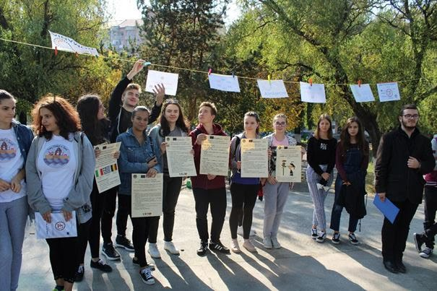
6.1. Erasmus Info Days (11 October 2018)

Slide 31
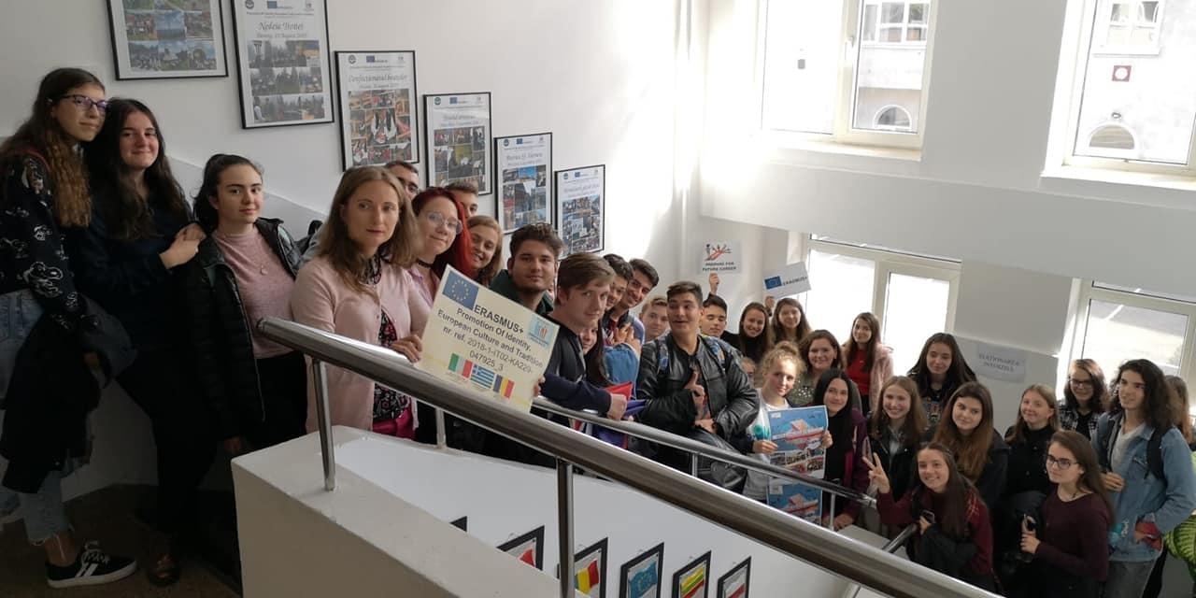
6.2. Erasmus Days 2019 (11 October 2019)

Slide 32
Other Activities

Slide 33
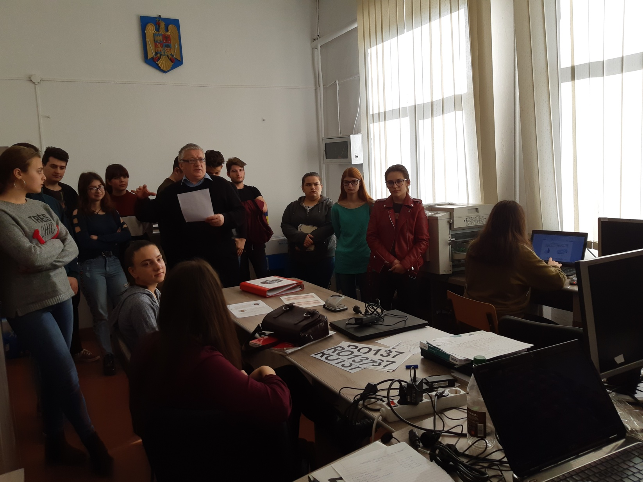
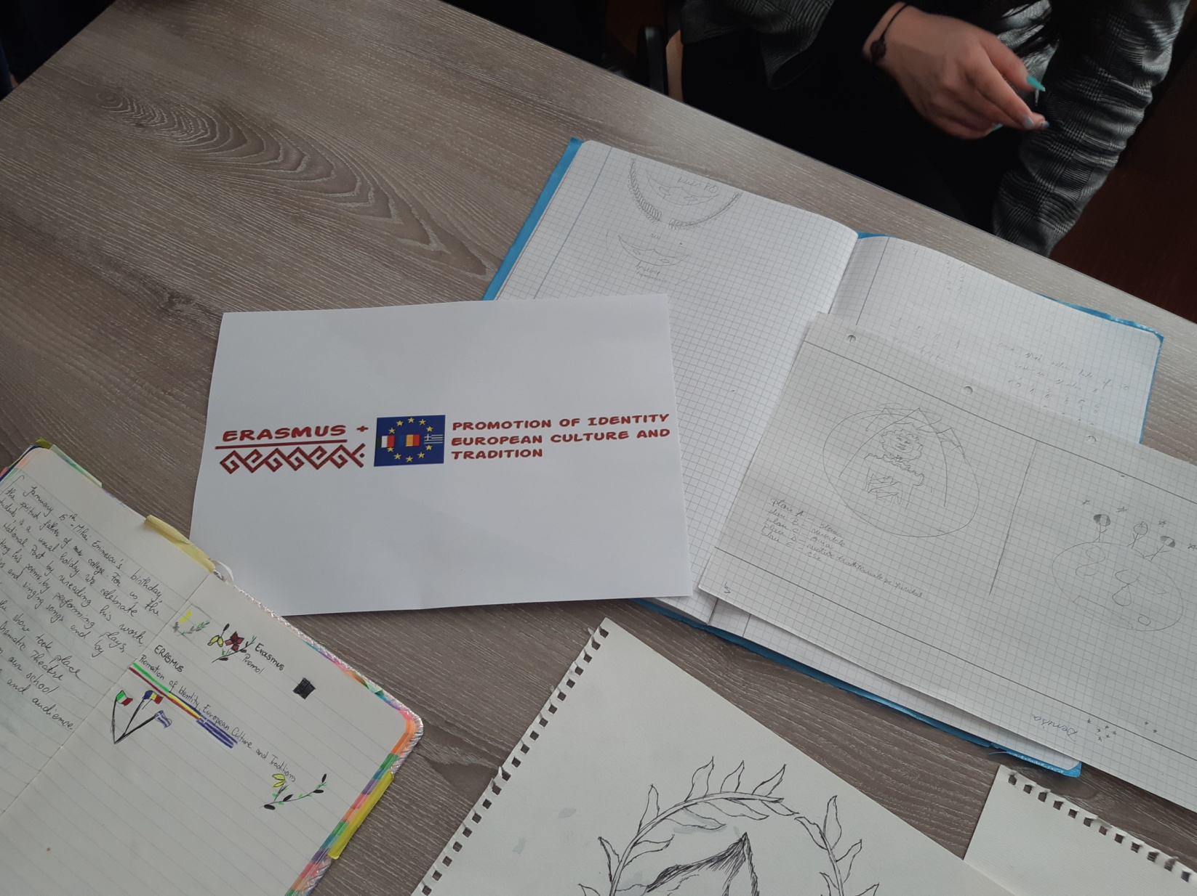
The Logo of the Project

Slide 34
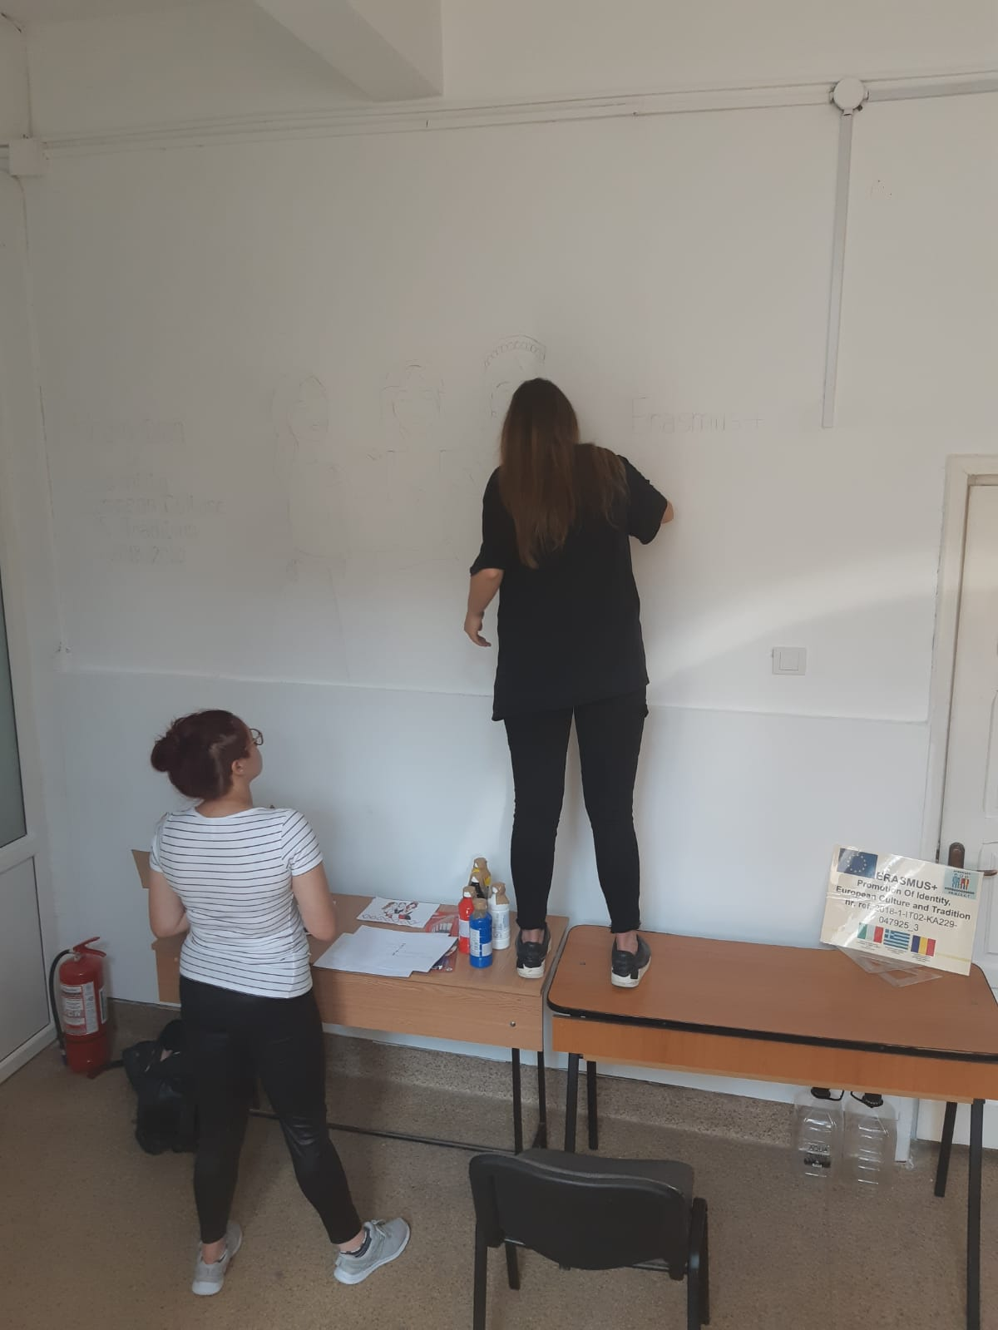
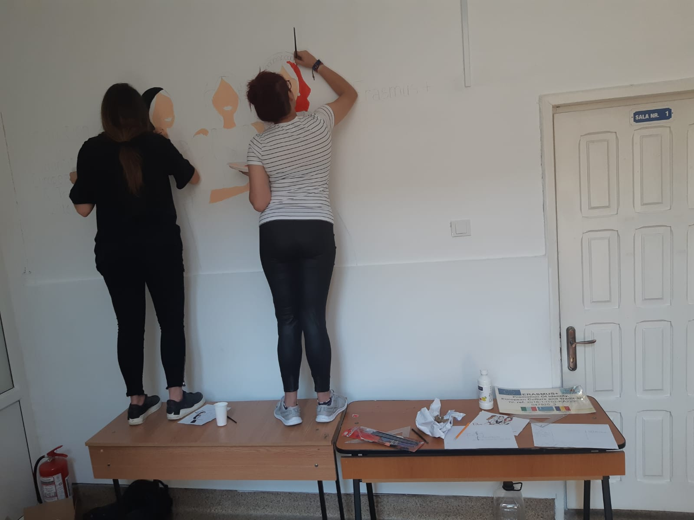
The Erasmus Corner

Slide 35
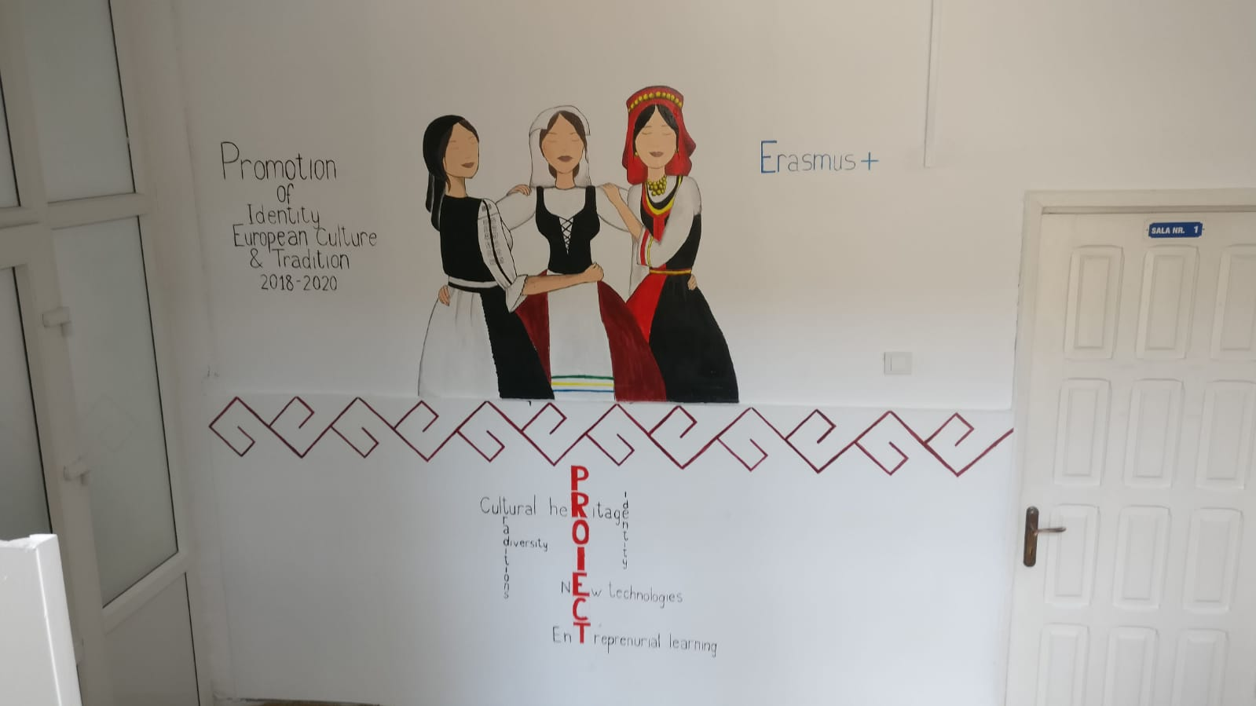

Slide 36
Thank you for your attention!

