Slide 1


PRomotion Of Identity, European Culture and Tradition
ref. no. 2018-1-IT02-KA229-047925_3
KA2 - Cooperation for innovation and the exchange of good practices
KA229 - School Exchange Partnerships
CHRISTMAS
by ALEXANDRA MIHAI

Slide 2
ROMANIAN TRADITIONAL CAROLS
CHRISTMAS - ROMANIA VS. ITALY VS. GREECE

Slide 3
Romanian carols are traditional songs that are sung on Christmas time, carolling having a long history. Carols have been discovered to exist since the First Century, long before our nation was formed.

Slide 4
In our history, carols were transmitted from generation to generation by word of mouth and put together later by the church. Caroling has lost its spell over the years, but it is still practised, being more popular in the rural areas.

Slide 5

Through the history, Christmas in Romania changed a lot. While the communism had power over our country, they banned every aspect related to religion. You could, of course, celebrate it, but it was not an official holiday. In the post- communism Romania, Christmas started being celebrated again more festively.
ROMANIAN
CHRISTMAS

Slide 6


At the beginning of December, the towns are usually lit up with decorations. Until December 24th, the Romanians have different traditions.
They cut pigs to cook for the Christmas Eve dinner, they decorate their houses and their Christmas trees, children usually have special activities at school, such as Christmas charitable events. On December 24th, they start carolling. In rural areas, carolling preparation starts a few weeks earlier.

Slide 7
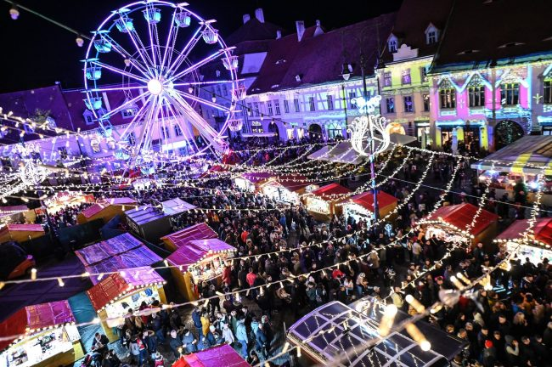
THE CHRISTMAS MARKET FROM SIBIU

Slide 8

ITALIAN
CHRISTMAS
Christmas is a huge holiday in Italy. Italians start their preparations on the Day of the Immaculate Conception, December 8th. During the eight days before Christmas, also known as the Novena, they fill the streets with Christmas songs.

Slide 9
One of the most important ways of celebrating Christmas in Italy is the Nativity crib scene. Using a crib to help tell the Christmas story was made very popular by St. Francis of Assisi in 1223.
Italians also don't eat meat on Christmas Eve to purify their bodies. The idea is to eat lean and a lot of fish, but the next day they have a big lunch with their whole family. After the family dinner, many Italians head to midnight Mass at their local churches.

Slide 10
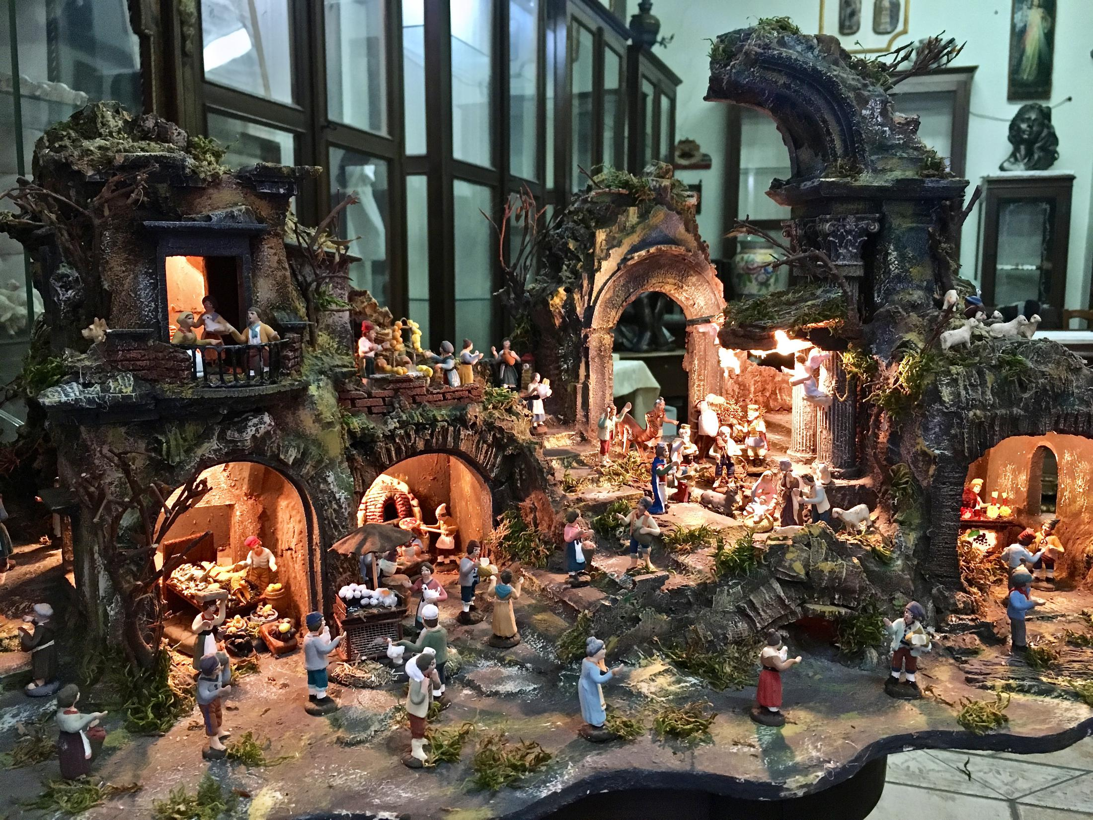
N
A
T
I
V
I
T
Y
S
C
E
N
E

Slide 11
On Christmas Eve, children, especially boys, often go out singing 'kalanda' (carols) in the streets. Sometimes they will also carry model boats decorated with nuts which are painted gold. The main Christmas meal is often lamb or pork, roasted in an oven or over an open spit. It's often served with a spinach and cheese pie and various salads and vegetables.
GREEK CHRISTMAS

Slide 12
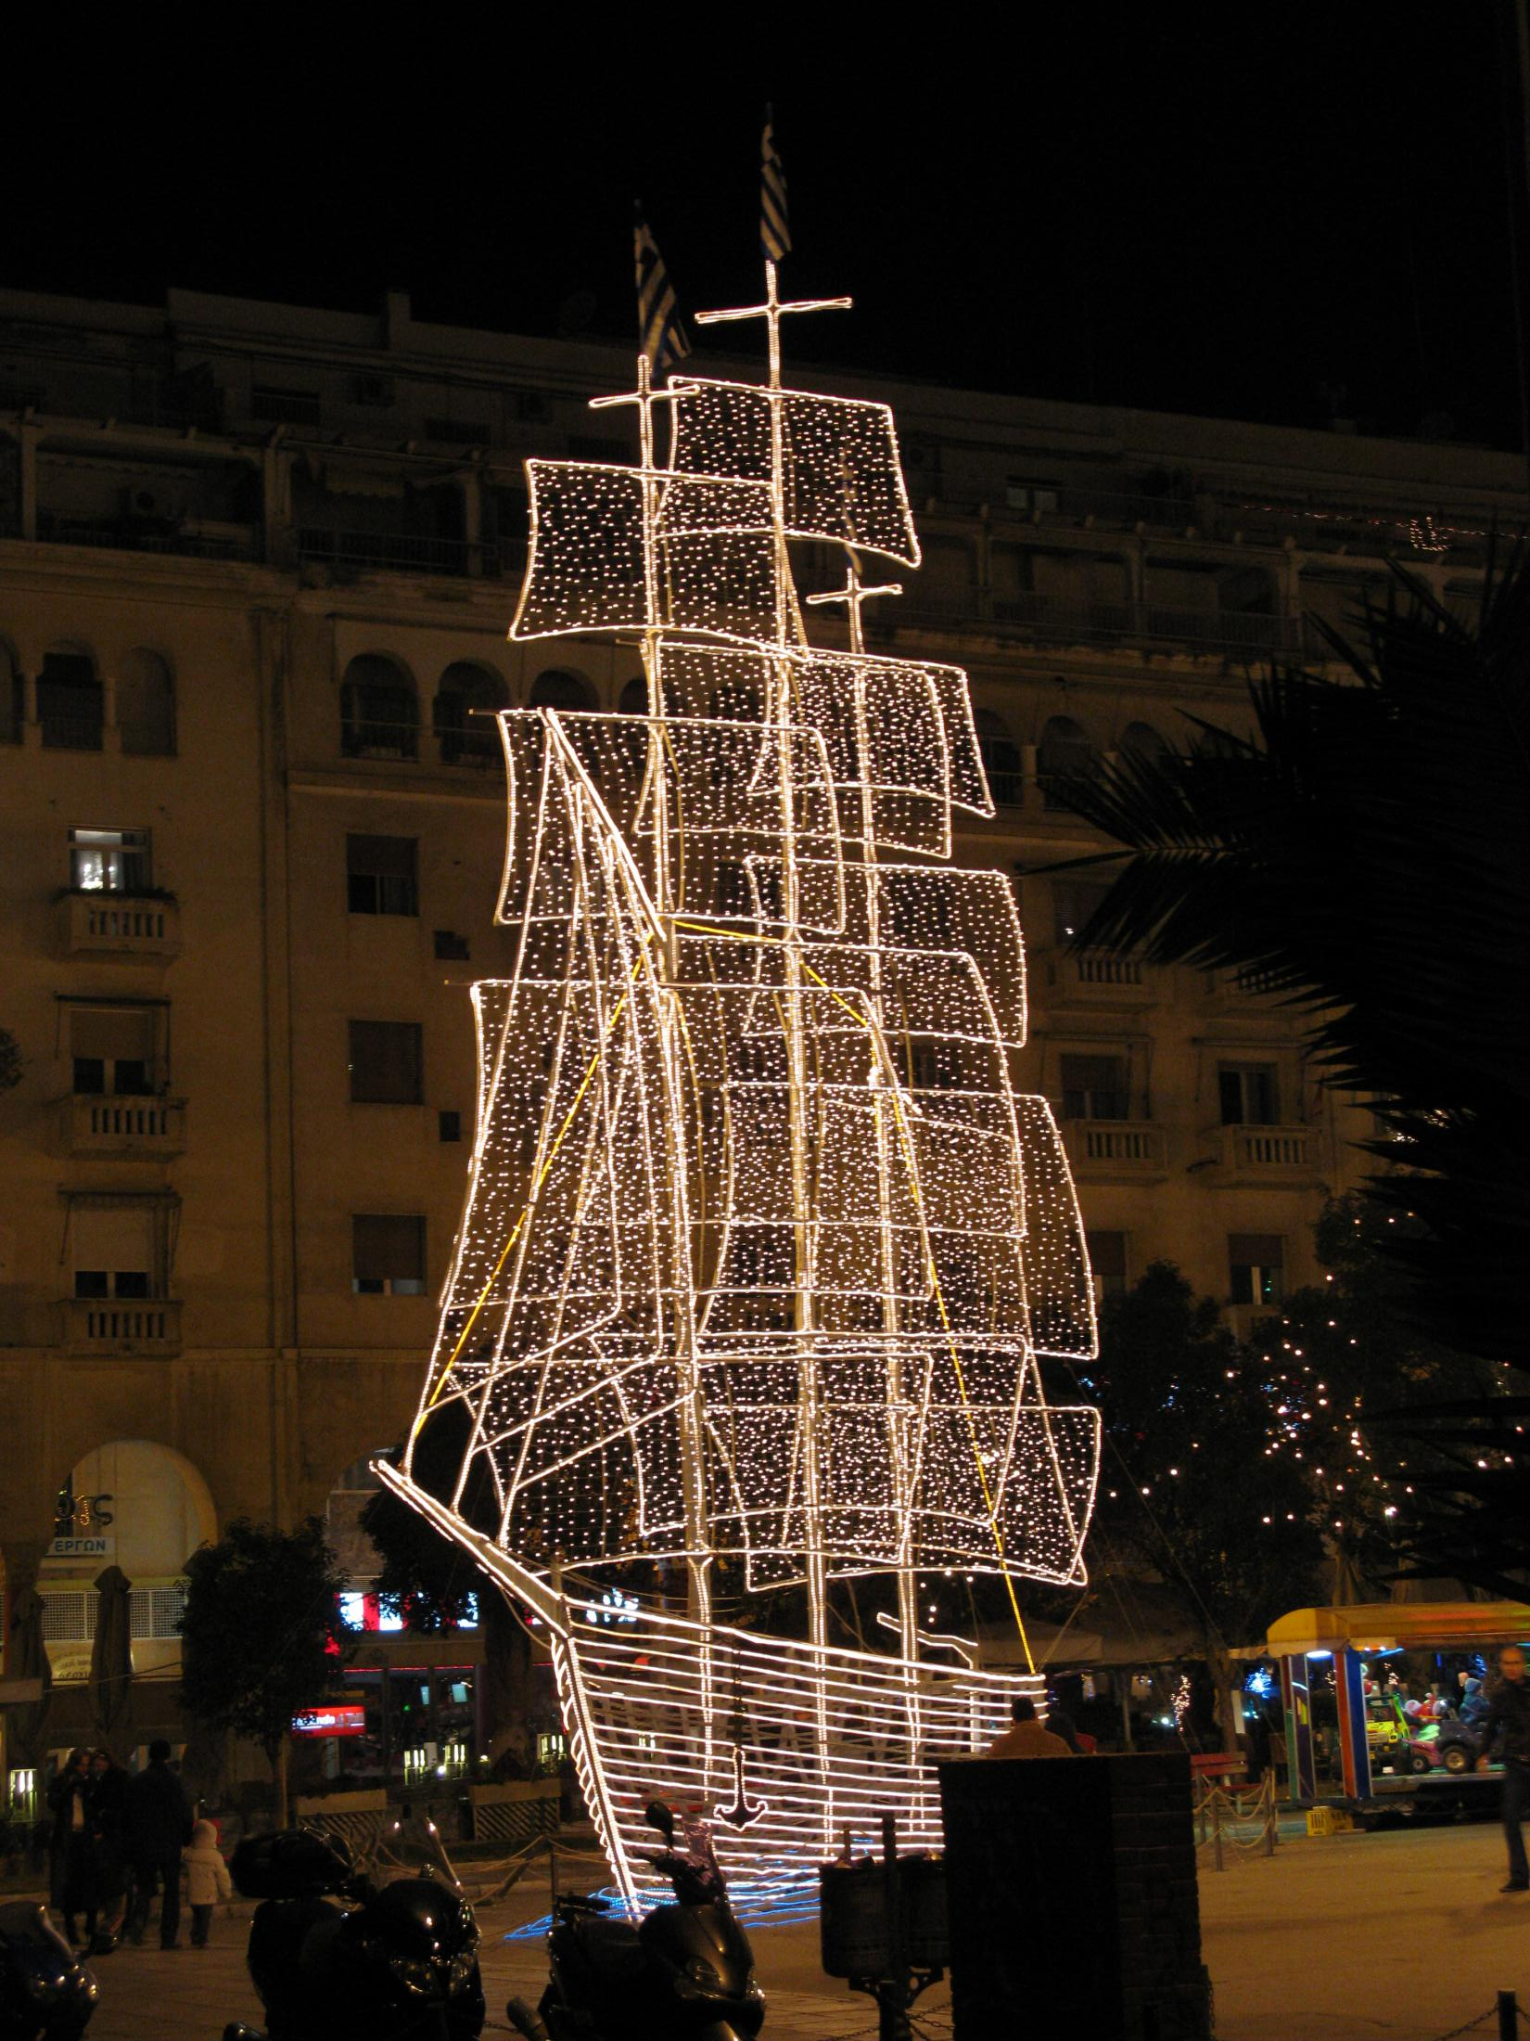
Carrying a boat is a very old custom in the Greek Islands.
An old and very traditional decoration is a shallow wooden bowl with a piece of wire suspended across the rim. A sprig of basil wrapped around a wooden cross and hangs from the wire.
Every December, in Aristotelous Square in the city of Thessaloniki, a huge Christmas Tree and three masted sailing ship are put up.

Slide 13

A COMPARISON BETWEEN THE THREE
As you could tell, each country has its own traditions. However, they all have things in common, for instance, the Christmas tree, waiting for Santa, the carolling and the most important, they all celebrate the true meaning of Christmas. The three of them eat Christmas Eve dinner with their families, they carol, the air is invaded by happiness. The customs may differ, but essentially we all do the same things.

