Slide 1
Petrosani

Slide 2
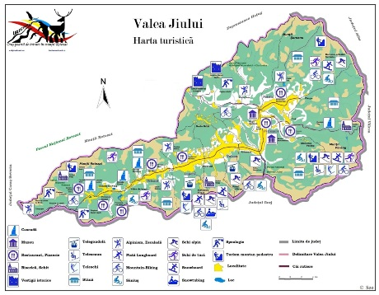
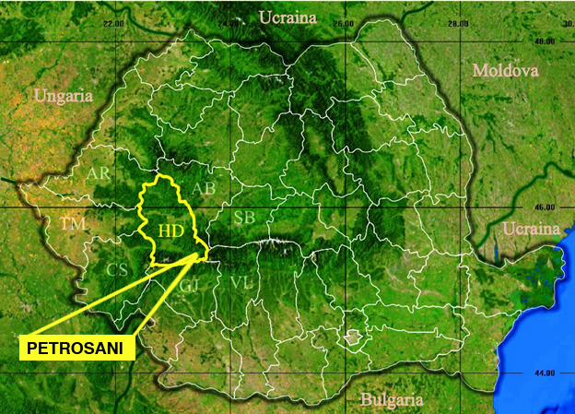
www.google.com
www.google.com

Slide 3
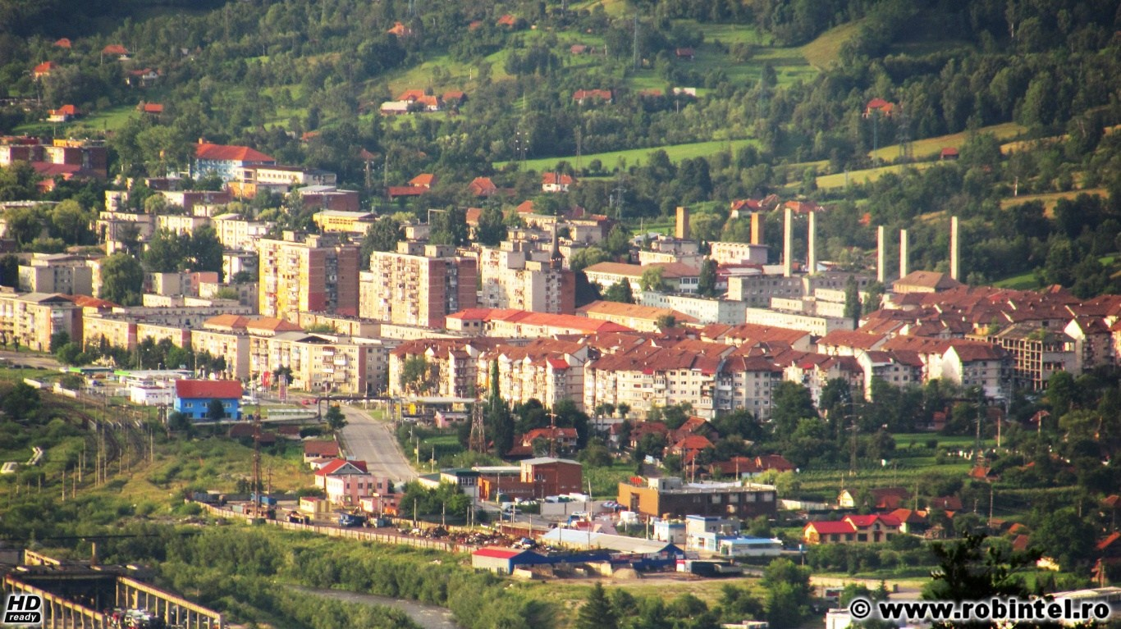
Petrosani is the main town from the Petrosani Depression. Dating back to the 17th century. It is known as a mining town.

Slide 4
The “I. D. Sirbu” Dramatic Theatre has 2 auditoriums: one with 370 seats and another one with 80 seats.

Slide 5
The Mining Museum is the only one
in Romania with a technical mining profile.

Slide 6
The Momarlanului Museum
The Momarlanului Museum is a private initiative that shows the traditions of our local people.

Slide 7
The Plumber Museum
The Plumber Museum has a different approach displaying a combination of industrial tools, artistic vision and humour.

Slide 8
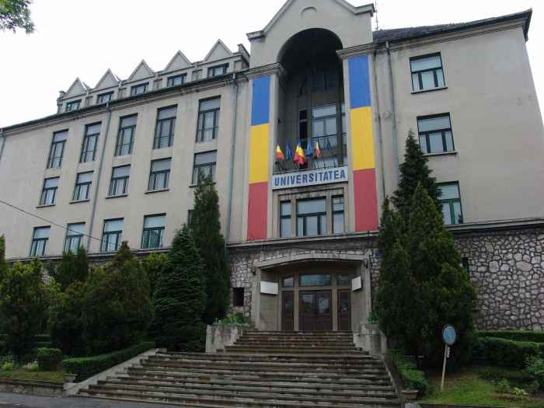
The University of Petrosani is an institution in the field of mining exploitation.

Slide 9
Saint Martyr Varvara Church

Slide 10
The Roman- Catholic Church

Slide 11
St. Trinity Church

Slide 12
The Unitarian Church

Slide 13
The Unitarian Church

Slide 14
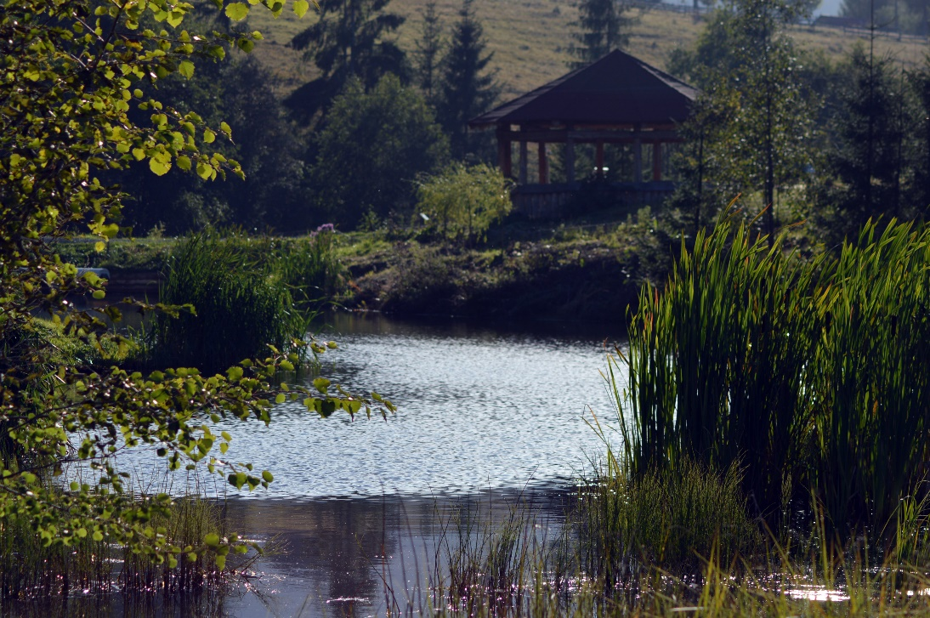
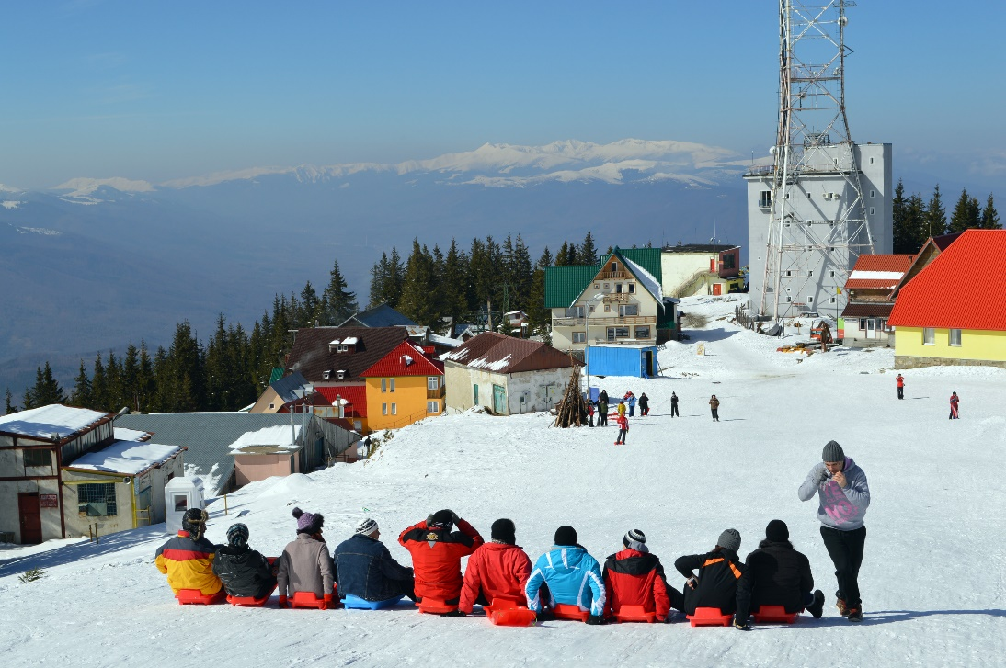
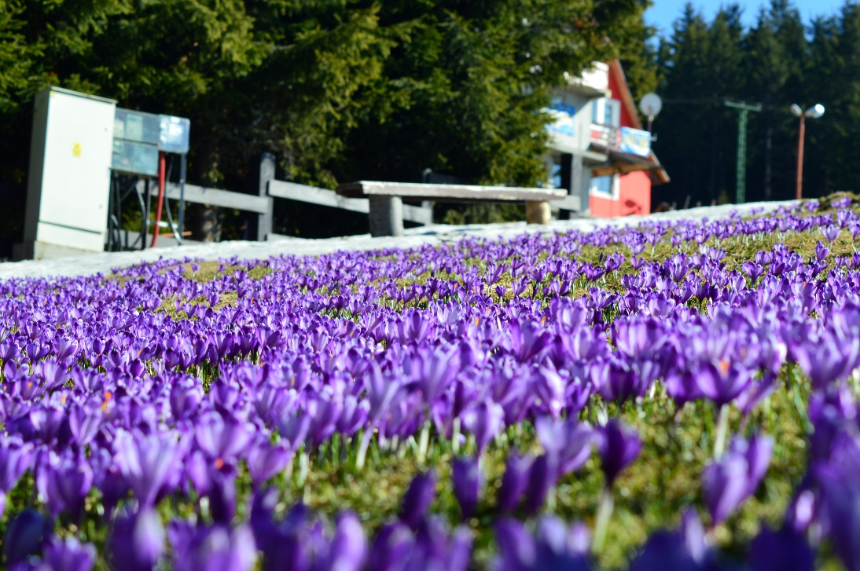
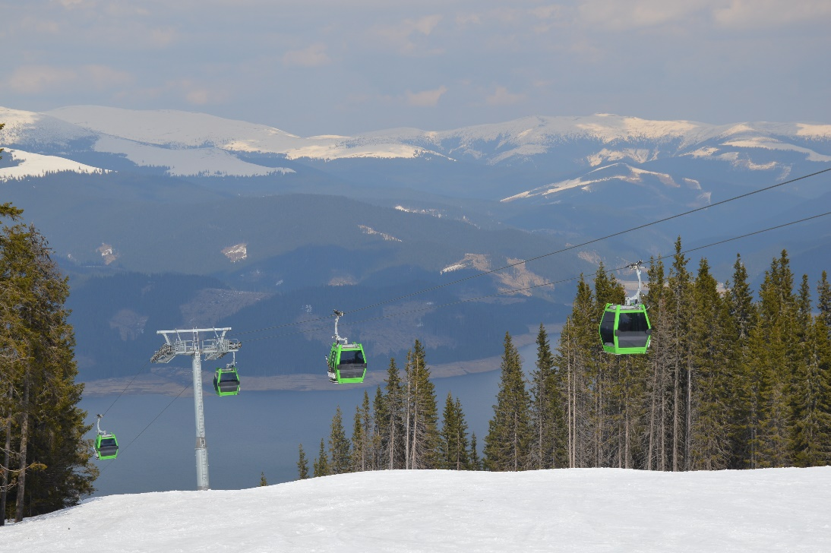
The Parang Mountains

Slide 15
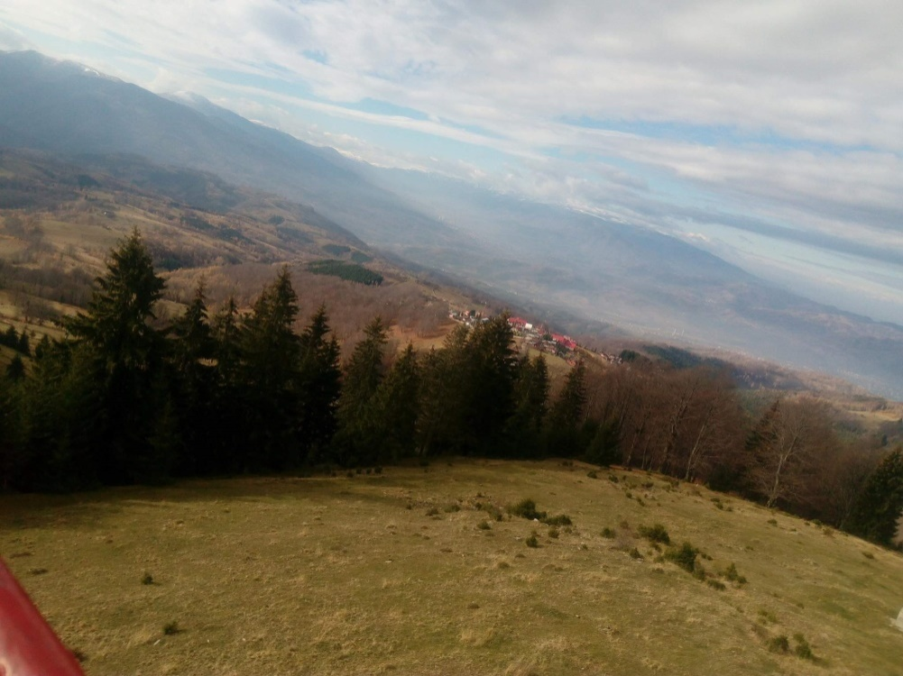
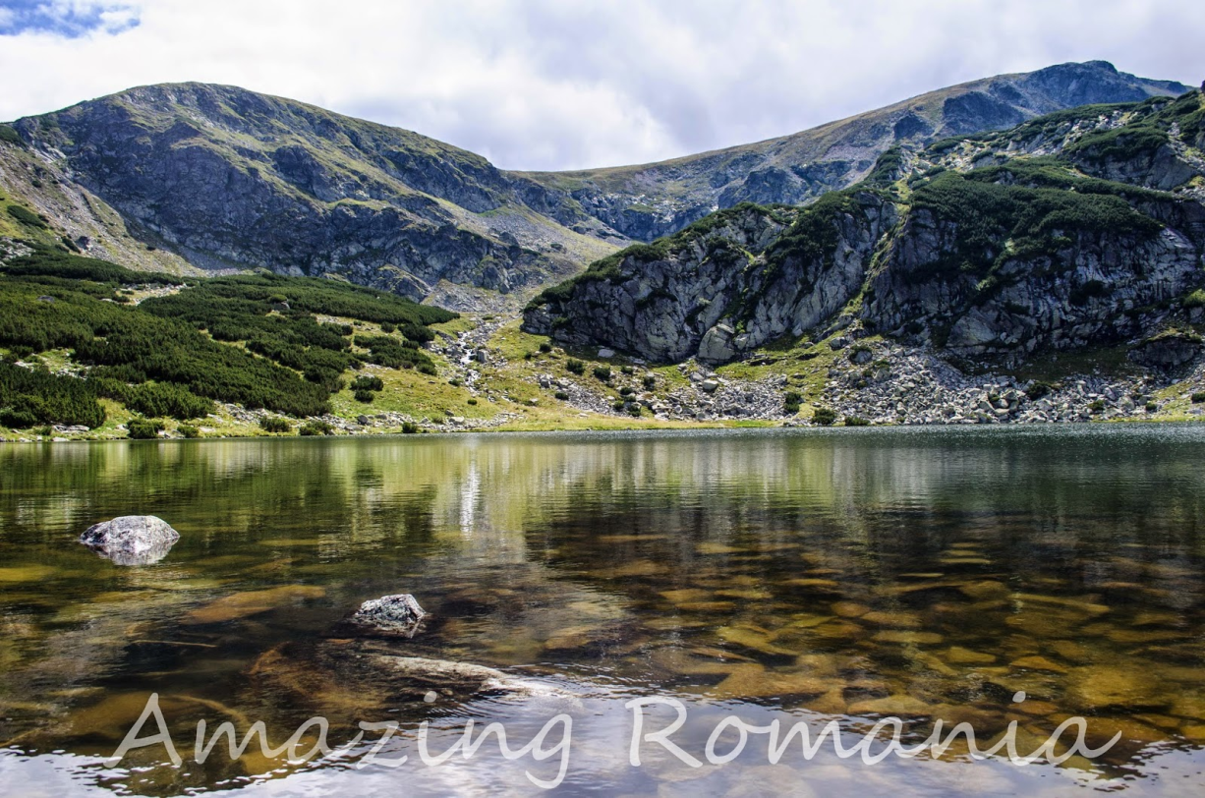
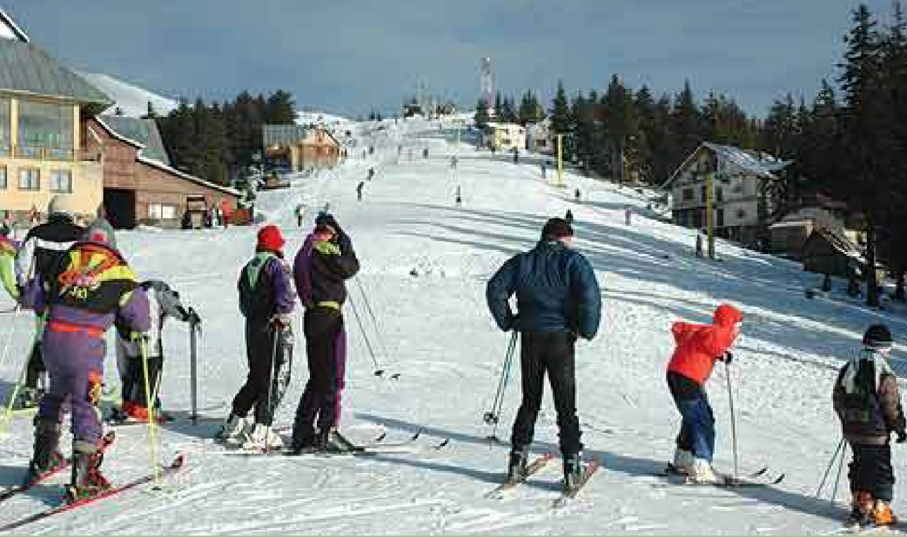
Views from mountains
The Muierii Cave
Galcescu Lake
Parang Mountains

Slide 16
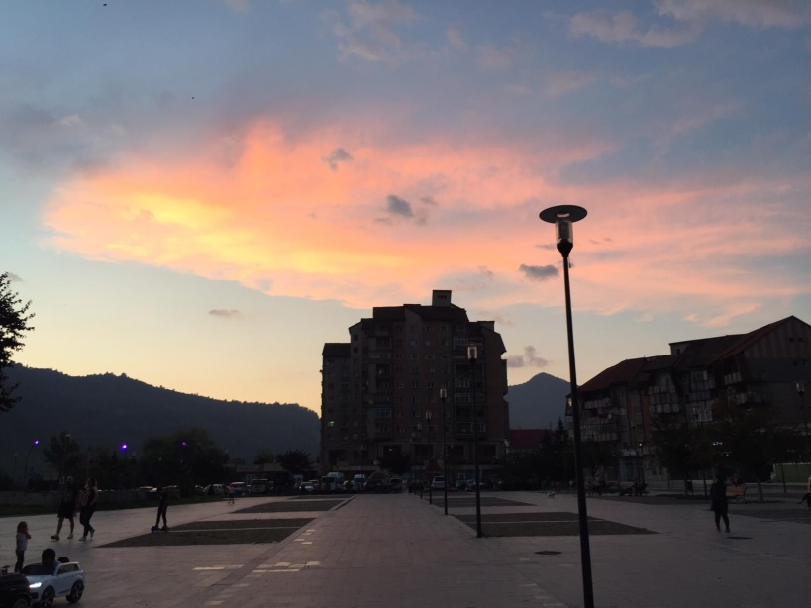
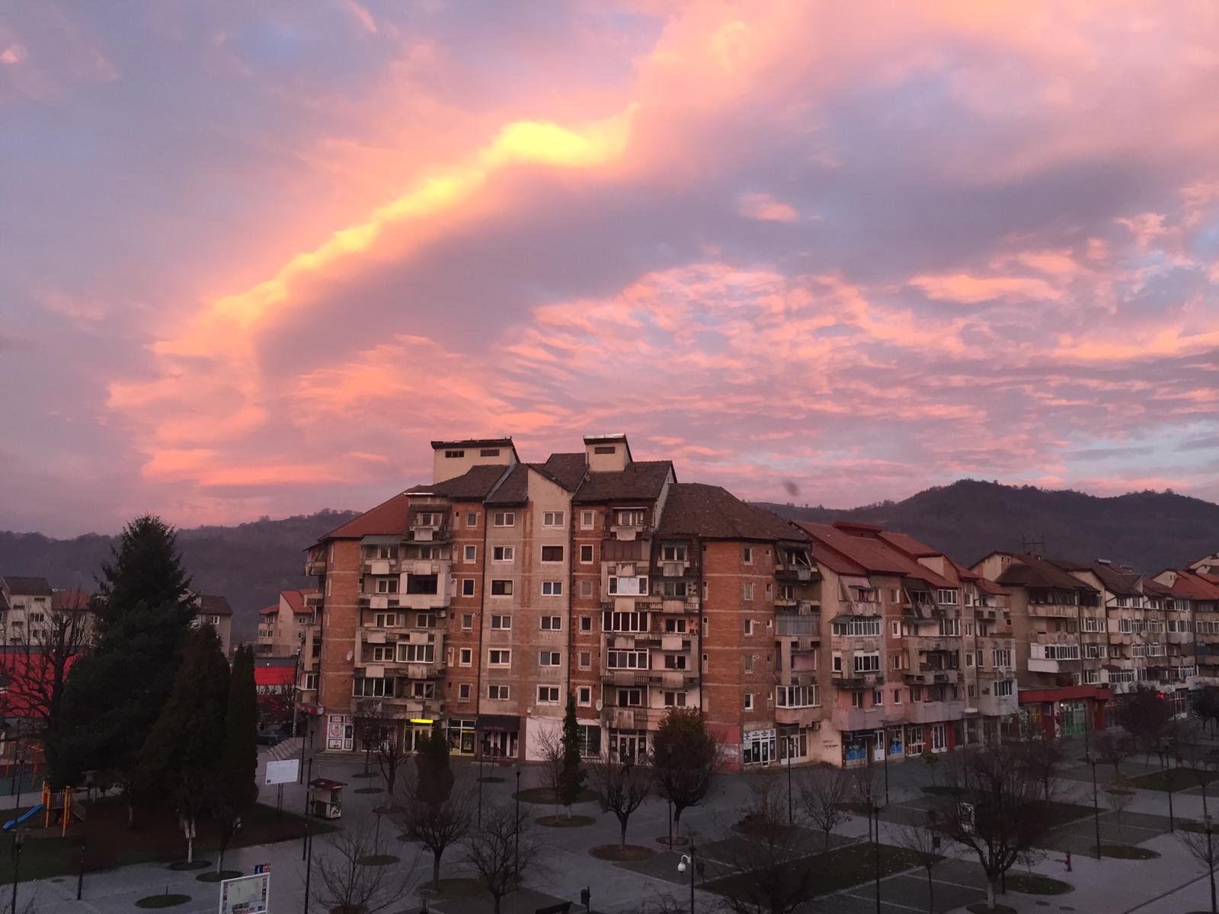
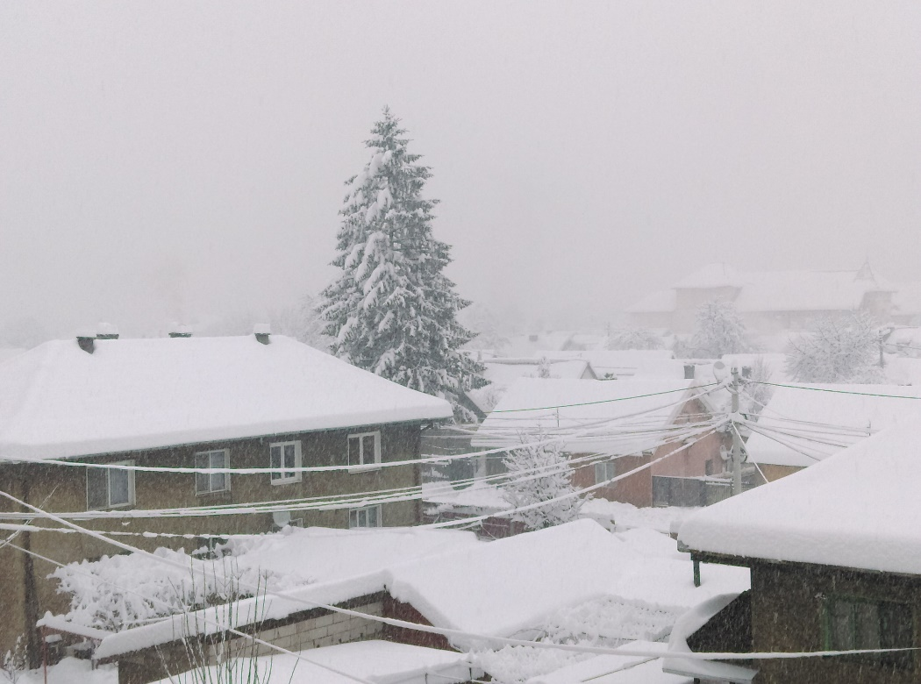
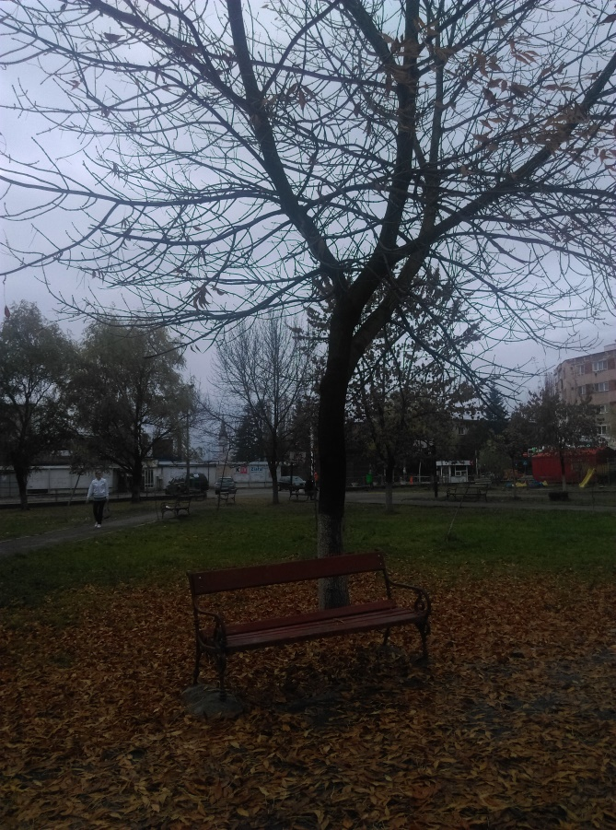
Spring
Summer
P
E
T
R
O
S
A
N
I
Winter
Autumn

Slide 17
Bibliography
https://www.google.com/url?sa=i&source=images&cd=&cad=rja&uact=8&ved=2ahUKEwjgttbG2KvgAhUGExoKHSVkAlkQjRx6BAgBEAU&url=https%3A%2F%2Fcniptpetrosani.ro%2Fmuzeul-momarlanului%2F&psig=AOvVaw11pfCbahLkn06XCcUd-JoN&ust=1549700004001888
https://www.google.com/url?sa=i&source=images&cd=&cad=rja&uact=8&ved=2ahUKEwj2ne3k2KvgAhWIz4UKHWB5A78QjRx6BAgBEAU&url=https%3A%2F%2Fzigzagprinromania.com%2Fblog%2Fmuzeul-instalatorului%2F&psig=AOvVaw0jNfjY_ChHTa4EznrcbLs6&ust=1549700070578489
https://www.google.com/url?sa=i&source=images&cd=&cad=rja&uact=8&ved=2ahUKEwj6jpP62KvgAhVSQhoKHaCWCn8QjRx6BAgBEAU&url=https%3A%2F%2Fgddhd.ro%2Factualitate%2Fexamene-cu-scandal-la-universitatea-
https://www.facebook.com/cnme.petrosani/
https://www.google.com/search?q=pestera+muierii&source
https://www.google.com/search?q=lacul+galcescu&source

Slide 18
The information included in this presentation is used for non-profit educational purposes and was collected by ALBU OANA and IFTENE ADINA, students, from COLEGIUL NATIONAL „MIHAI EMINESCU”, PETROSANI, ROMANIA during the ERASMUS+ KA229 PROJECT: PRomotion Of Identity, Euopean Culture and Tradition (2018-2020), coordinated by Mr DORIN MINEL RADUTI, History teacher. The translation activity was coordinated by Mrs STEFANIA MANEA, English teacher, and the ICT activity was coordinated by Mr ROLLAND SZEDLACSEK, IT Engineer. Some of the photos included in this presentation were taken by ALBU OANA and IFTENE ADINA, or were taken from various internet sources cited in the bibliography.

Slide 19
The European Commission support for the production of this publication does not constitute an endorsement of the contents which reflects the views only of the authors, and the Commission cannot be held responsible for any use which may be made of the information contained therein.

