Slide 1
Romania
Tourist attractions

Slide 2
AIRPORTS
Main airports:
Bucharest, Otopeni
Timisoara
Constanta
Cluj Napoca

Slide 3
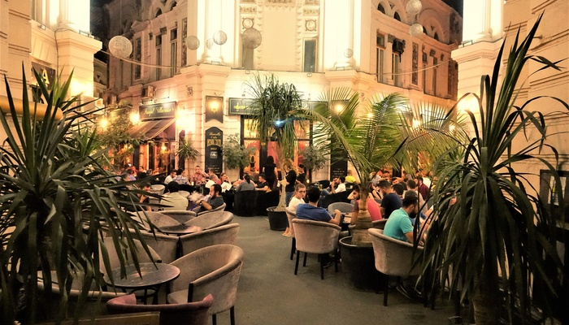
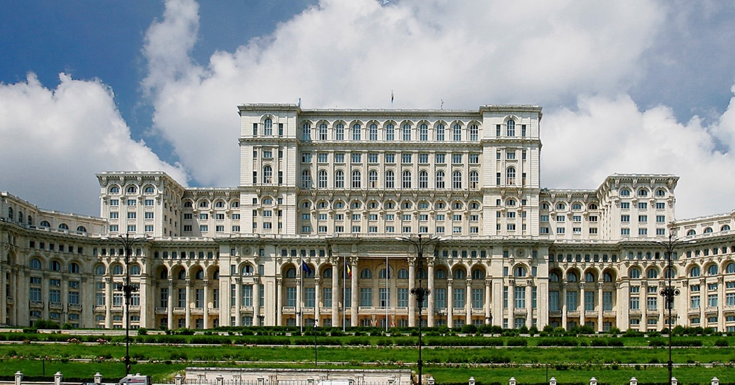
BUCHAREST
Things to do:
Experience the Romanian nightlife in the Old Town
Take a stroll in parks like Cismigiu or Youth Park
Go shopping in malls like Cotroceni or Bucharest mall
Cultural attractions:
The Palace of Parliament
The Arch of Triumph
The Romanian Athenaeum
The Village Museum
Revolution Square

Slide 4
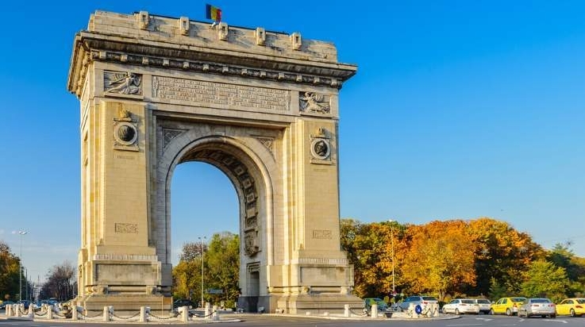
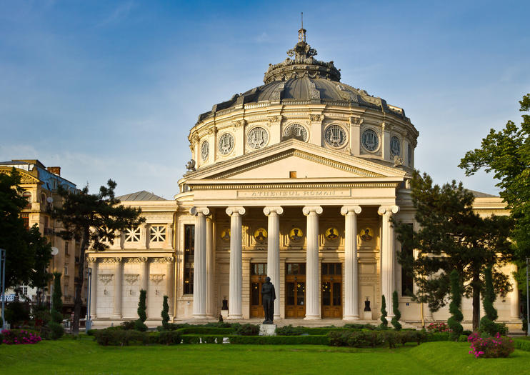
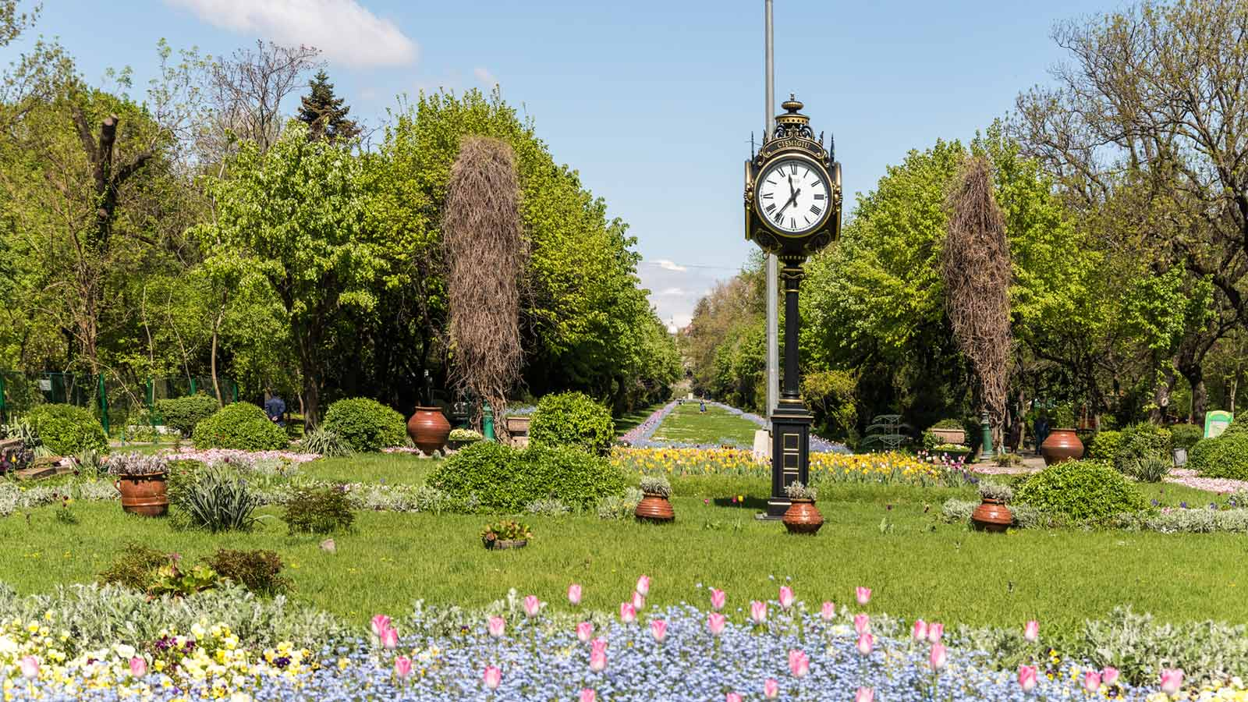
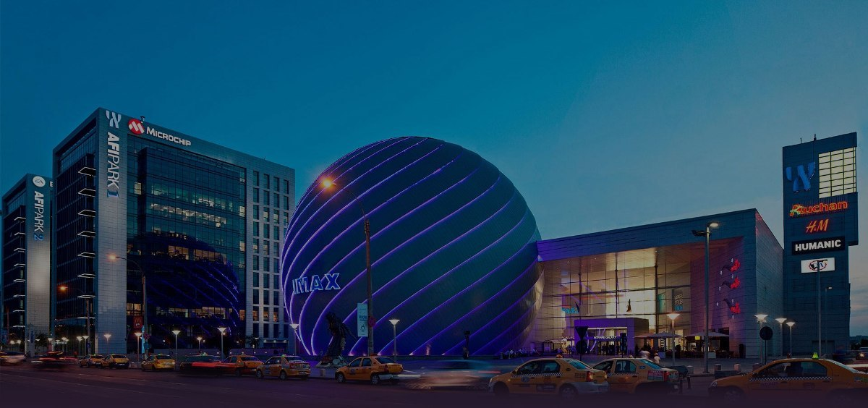

Slide 5
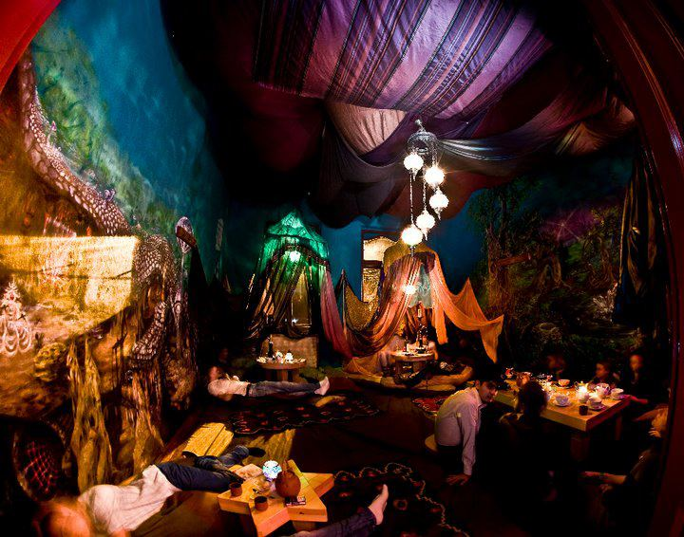
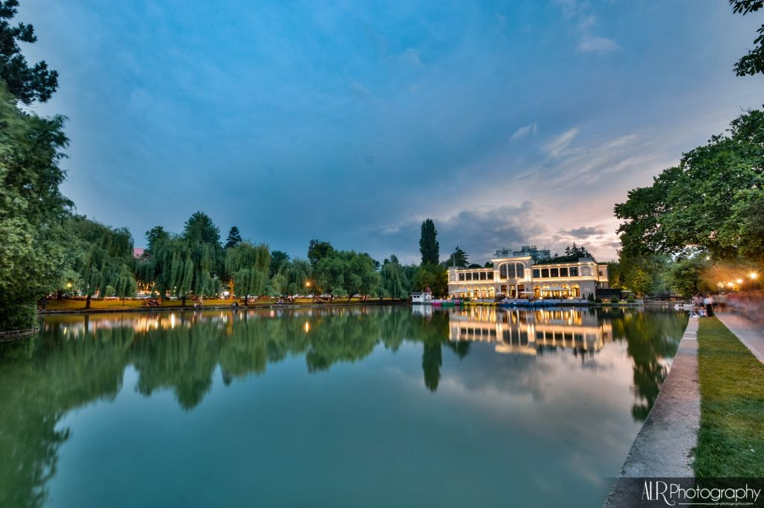
CLUJ NAPOCA
Tourist attractions:
Central Park
Botanical Garden
Cetatuia Hill
Museum Square
Things to do:
Enjoy a cup of tea at magical Samsara Teahouse
Take part in music festivals: Untold, Electric Castle
Shopping: Iulius Mall

Slide 6
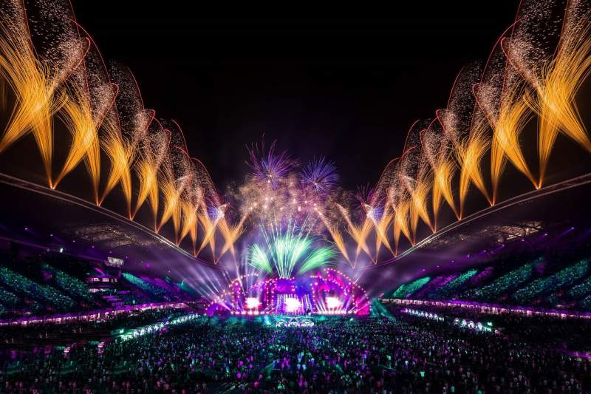
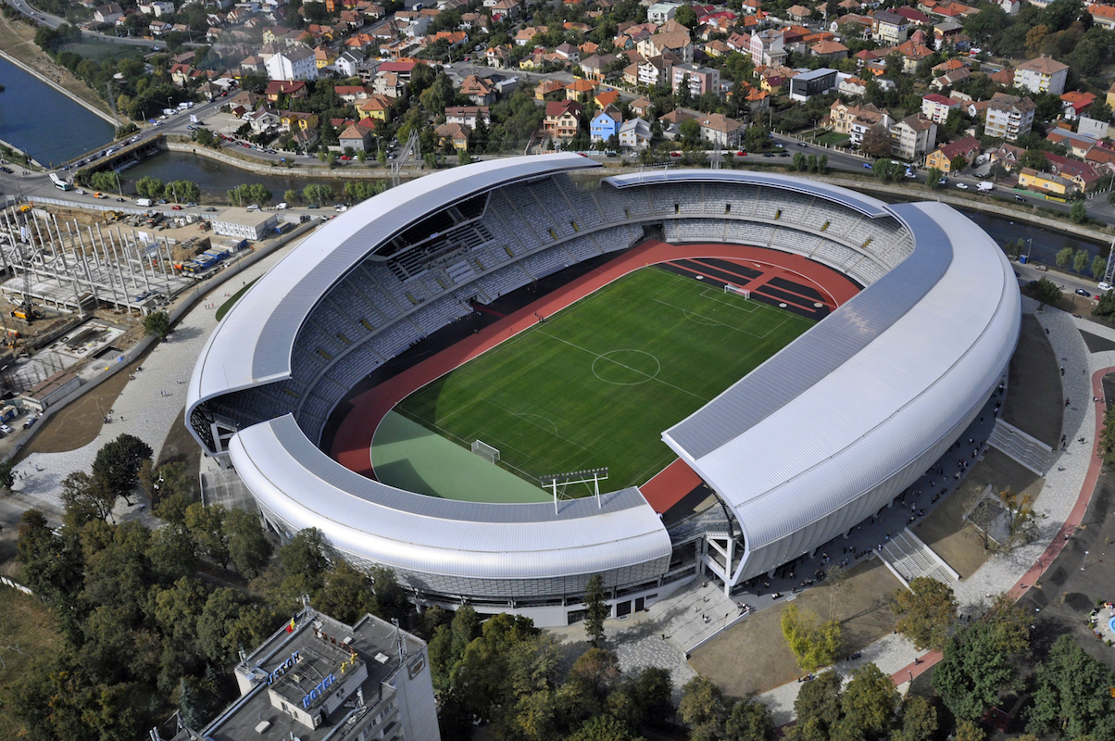
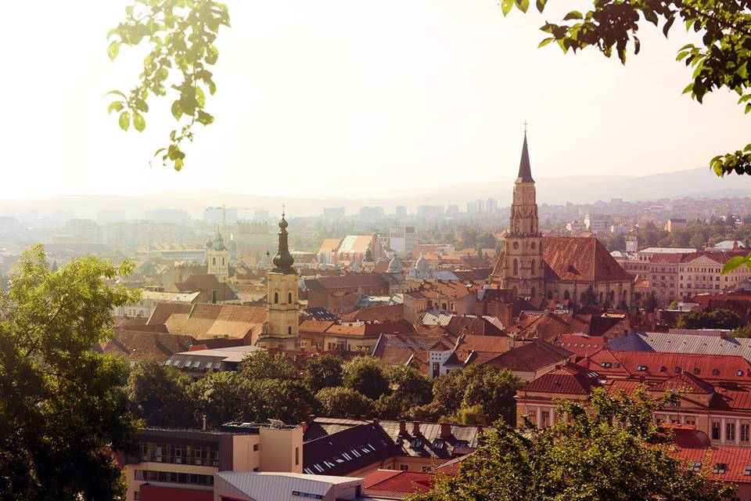
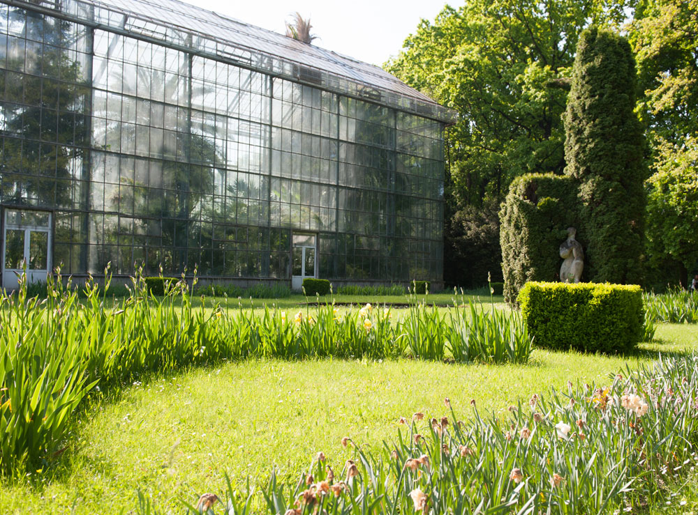

Slide 7
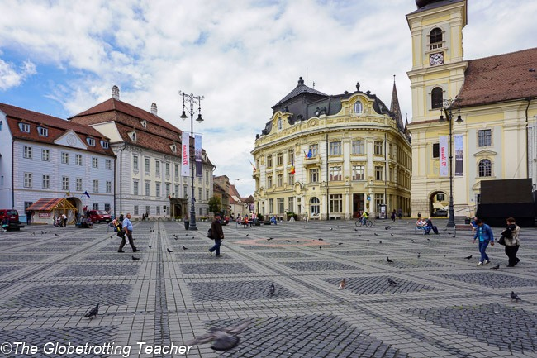
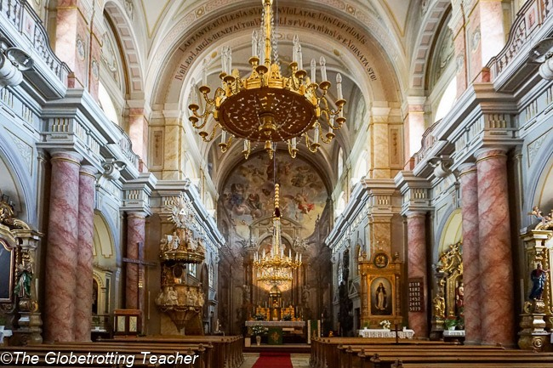
SIBIU
Things to do:
Visit the Catholic Basilica
Climb the Council Tower for the best landscapes
Visit the Pharmacy Museum
Wander through Sibiu’s Lower Town
Stare back at the houses with eyes
Tourist attractions:
Brukenthal Palace
The Bridge of Lies
ASTRA Open Air Museum
The Great Square

Slide 8
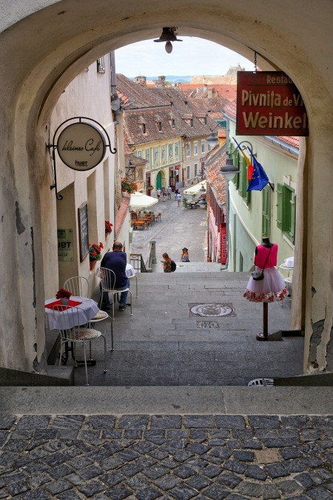
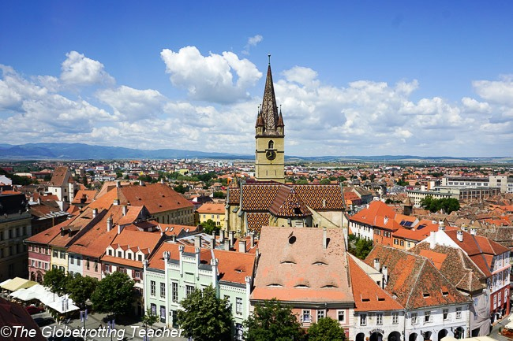
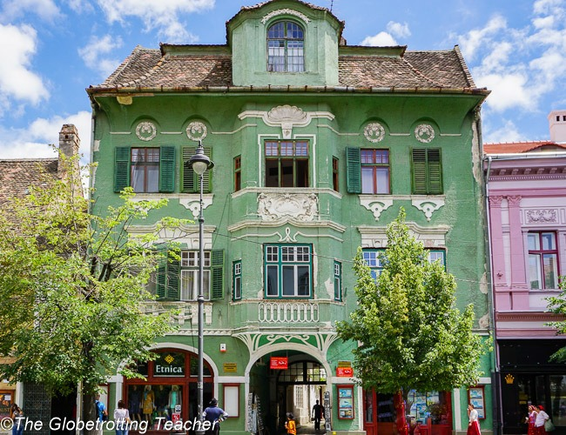
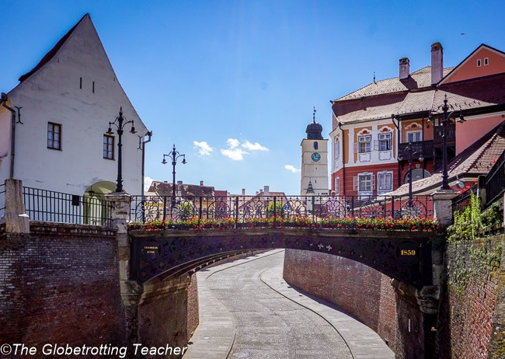
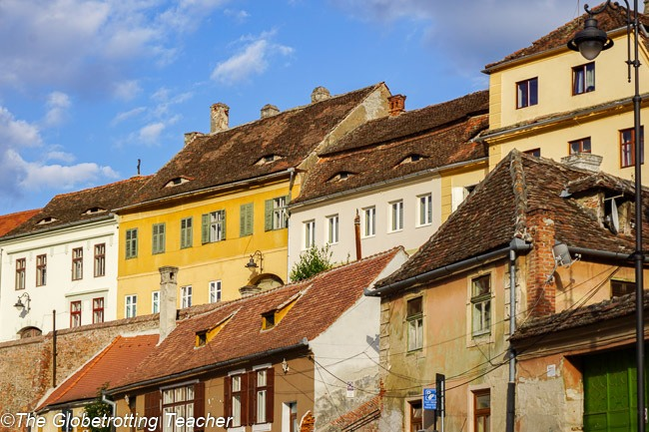

Slide 9
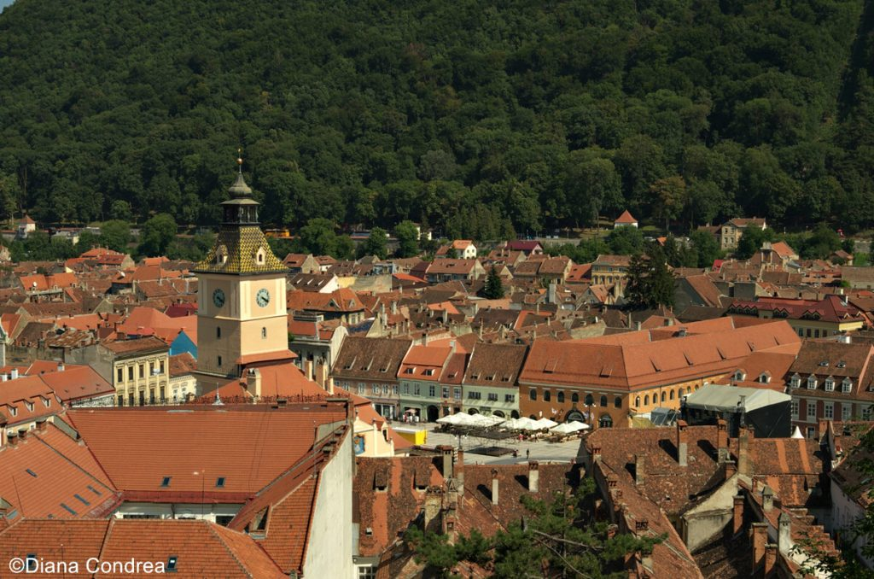
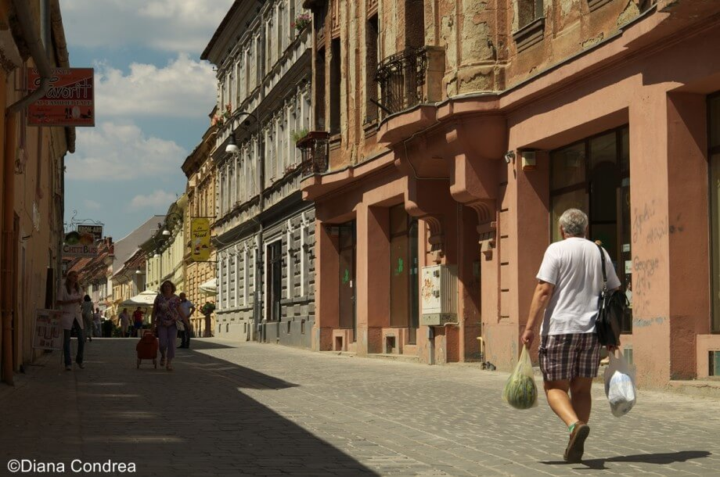
BRAȘOV
Tourist attractions:
Peles Castle
Bran Castle (Dracula’s Castle)
The Black Church
The Bear Sanctuary
Things to do:
Walk in the Old Town and enjoy the Medieval architecture and the narrowest street in Europe (90 cm wide)
Hike on Mount Tâmpa
Have lunch in one of the restaurants/pubs from Council Square

Slide 10
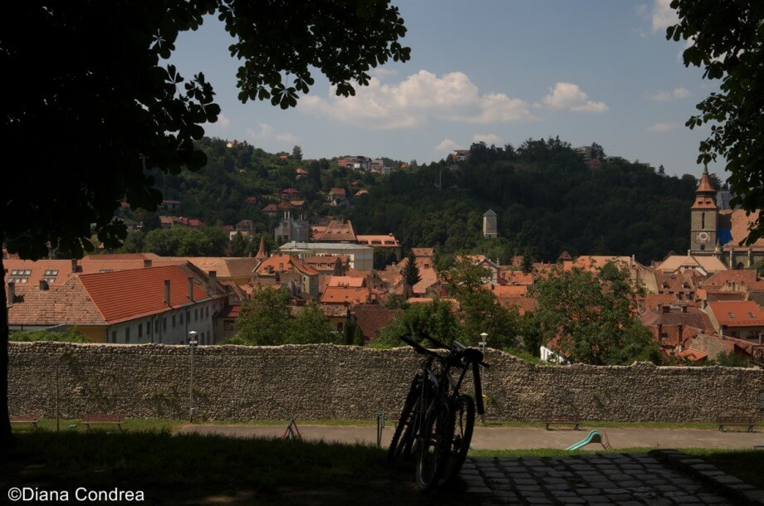
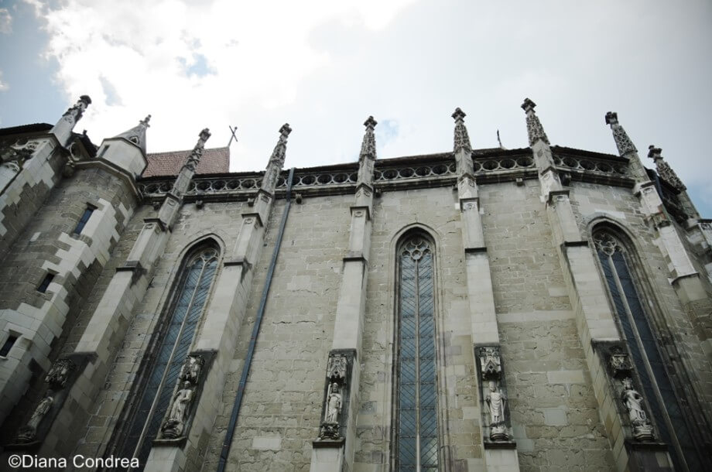
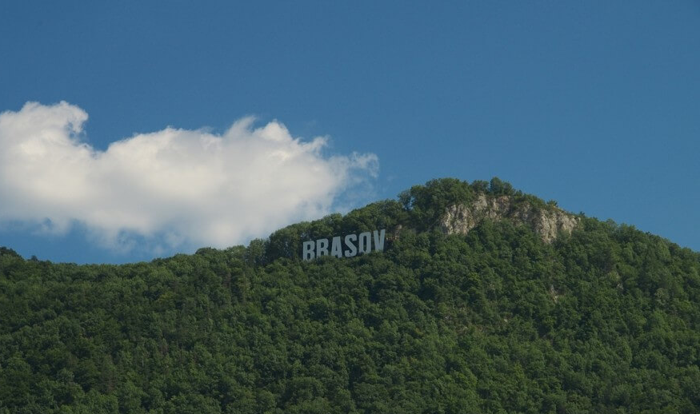
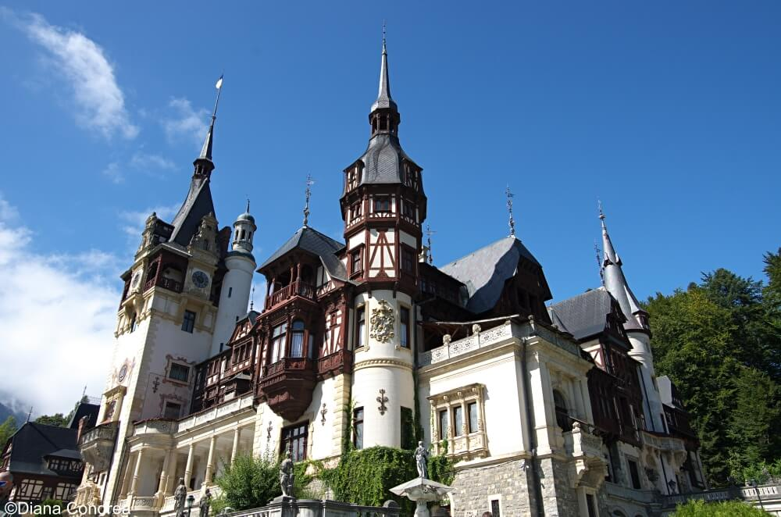

Slide 11
IMPORTANT LANDMARKS
and
ICONIC PLACES
Constanța Casino, Constanța, CT
The Endless Column, Tg Jiu, GJ (around 60 km from Petrosani)
Turda Salt Mine, Turda, CJ
Sarmizegetusa Regia, Sarmizegetusa, HD
The Palace of Parliment, Bucharest, B
The Sphynx and the ”Babe”, Bucegi Mountains, BV
Romanian Atheneum, Bucharest, B
The Merry Cemetary, Săpânța, MM
Palace of Culture, Iași, IS
Bigăr Waterfall, Anina, CS
Neamț Monastery, Vânători-Neamt, NT
The painted monasteries in Bucovina
The wooden monasteries in Maramureș

Slide 13
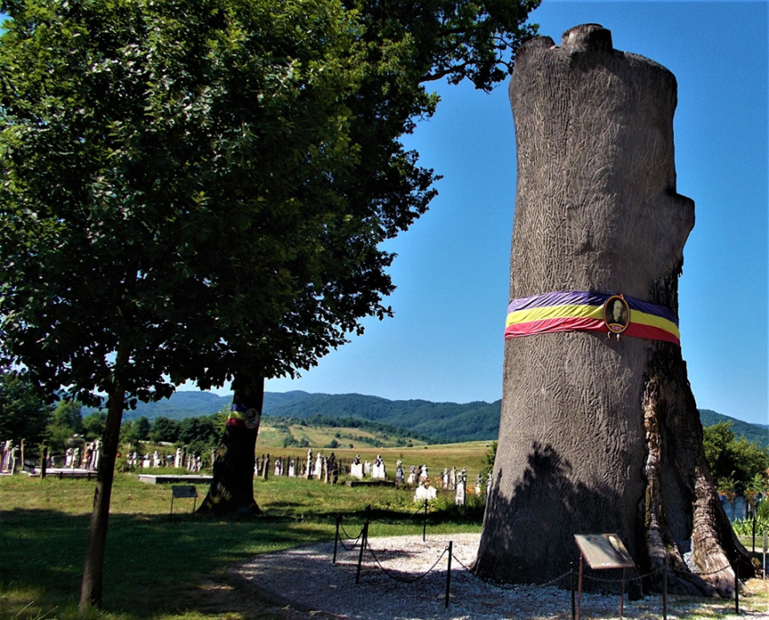
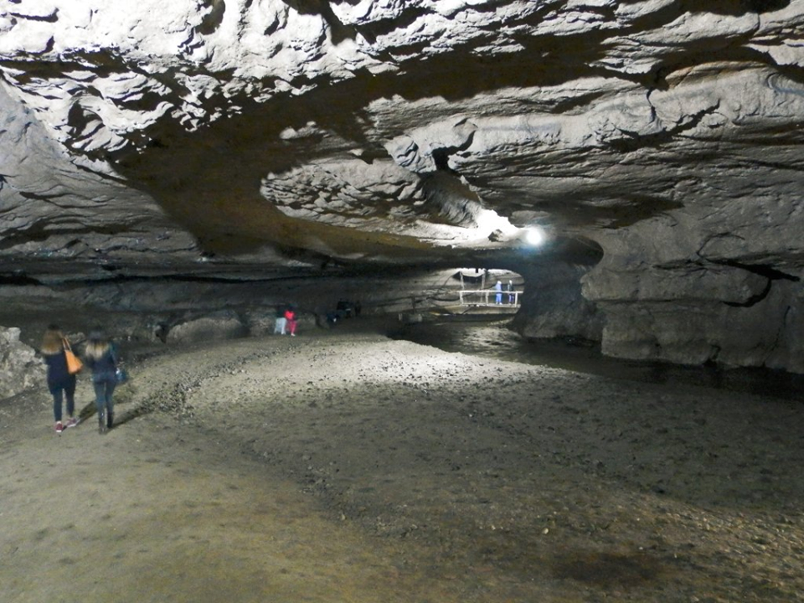
HUNEDOARA COUNTY
Nature & Parks in Hunedoara County‎
Cincis Lake
Bolii Cave
Clocota Waterfalls
Parângul Mic Peak
Hațeg Buffalo Reservation
Retezat National Park
Churches and monasteries
Prislop Monastery
St. George Orthodox Church
Wooden Church Bratesti
Other places of interest
Dinosaur Geopark Hațeg
House of Volcanoes

Slide 14
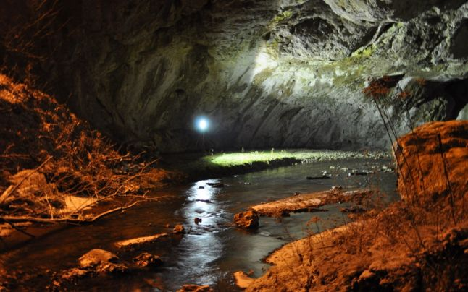
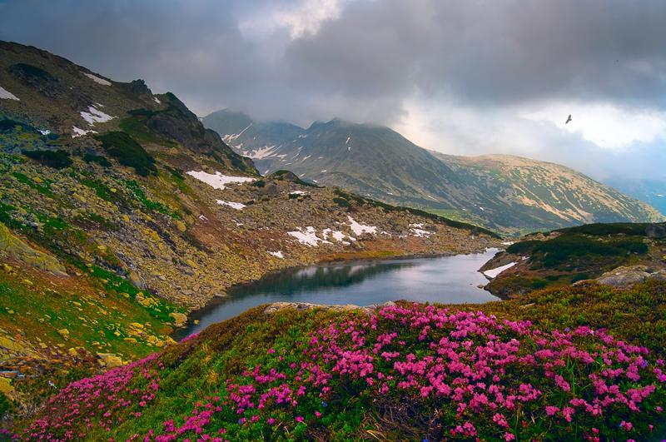
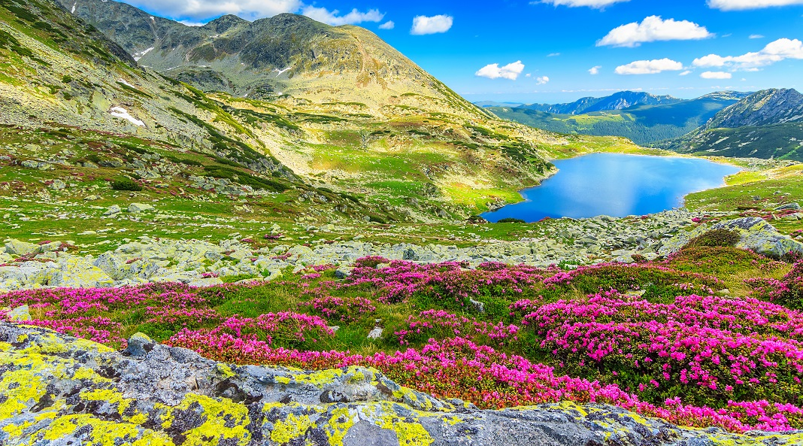
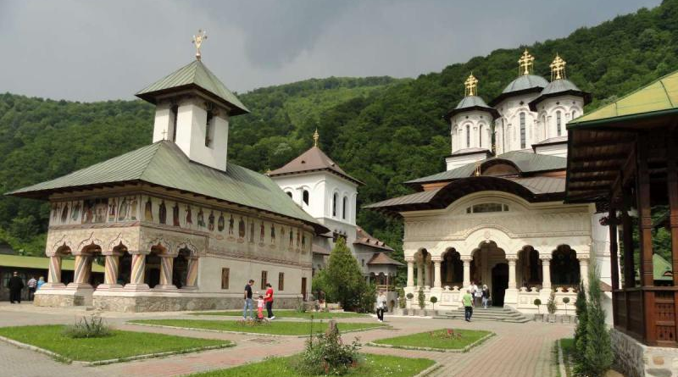

Slide 15
The information included in this presentation is used for non-profit educational purposes and was collected by DIANA BOZEA and DENISA PETRARU, students, from COLEGIUL NATIONAL „MIHAI EMINESCU”, PETROSANI, ROMANIA during the ERASMUS+ KA229 PROJECT: PRomotion Of Identity, Euopean Culture and Tradition (2018-2020), coordinated by Mr DORIN MINEL RADUTI, History teacher. The translation activity was coordinated by Mrs STEFANIA MANEA, English teacher, and the ICT activity was coordinated by
Mr ROLLAND SZEDLACSEK, IT Engineer.

Slide 16
The European Commission support for the production of this publication does not constitute an endorsement of the contents which reflects the views only of the authors, and the Commission cannot be held responsible for any use which may be made of the information contained therein.

