Slide 1
Martisorul- a romanian spring celebration
ERASMUS+ PRomotion Of Identity, European Culture and Tradition nr. ref. 2018-1-IT02-KA229-047925_3 KA2 - Cooperation for innovation and the exchange of good practices KA229 - School Exchange Partnerships

Slide 2
WHAT IS ‘MARTISOR’?
Martisor is an authentic Romanian celebration that dates back to the time of the Thracians, but also the name given to the little talismans with red and white strings, offered during this holiday.
The word Mărțișor is the diminutive of Marț, the old folk name for March (martie, in modern Romanian), and thus literally means "little March".
Mărțișor, marț and mărțiguș are all names for the red and white string with hanging tassel customarily given on the 1st day of March.
Giving this talisman to people is an old custom, and it is believed that the wearer will be strong and healthy for the year to come. It is also a symbol of the coming spring. Usually, both women and men wear it pinned to their clothes, close to the heart, until the last day of March, when they tie it to a fruit-tree twig. In some regions, a gold or silver coin hangs on the string and is worn around the neck. After wearing it for a certain length of time, they buy red wine and sweet cheese with the coin, according to a belief that their faces would remain beautiful and white as cheese and rubicund as the wine, all year.

Slide 3
WHEN IS IT CELEBRATED?
1 st of March

Slide 4
What does it symbolize?
The Mărțișor is the thread of the days in the year, spun by Baba Dochia (the Old Dochia), or the thread of one's life, spun at birth by the Fates (Ursitoare). White symbolises purity, the sum of all colours, and light, while black symbolises origins, distinction, fecundation and fertility, being colour of fertile soil. White is the sky, the Father, while black is the mother of all, Earth.

Slide 5
origins
According to archaeological research, the Mărțișor traces its history more than 8,000 years ago. Some ethnologists believe that the Mărțișor celebration has Roman origins, others support the theory that it is an old Dacian tradition.
In ancient Rome, the New Year's was celebrated on the 1st of March. March ('Martius') was named in the honor of the god Mars. Mars was not only the god of war but also the god of agriculture, which contributes to the rebirth of vegetation.
The Dacians also celebrated the New Year's on the first day of March. Ample spring celebrations were consecrated to this event.

Slide 6
origins
Others believe it has a Daco-Thracian origin.
The Thracians also celebrated New Year's Eve on the first of March, a month named after the god Marsyas Silen, the inventor of the pipe ( traditional musical instrument), whose cult was related to the land and vegetation. Thracian spring celebrations, connected to fertility and the rebirth of nature, were consecrated to him.
In some areas, Daco-Romanians still celebrate the agrarian New Year in spring, where the first days of March are considered days of a new beginning. Before March 1, women choose one of the first nine days of March; the weather on that day would predict how year will go for them.
In other areas, young men similarly find out what their wives will be like. The first nine days of March are called Baba Dochia's Days, Baba Dochia being an image of the Great Earth Goddess.

Slide 7
The colours used to make ‘martisoare’
Initially, the "Mărțișor" string was called the Year's Rope (funia anului, in Romanian), made by black and white wool threads, representing the 365 days of the year. The Year's Rope was the link between summer and winter, black and white representing the opposition and the unity of opposites: light and dark, warm and cold, life and death.
According to ancient Roman tradition, the ides of March was the perfect time to embark on military campaigns. In this context, it is believed that the red string of Mărțișor symbolises vitality, while white symbolises victory.
Red is the colour of fire, blood, and a symbol of life, associated with the passion of women.
Meanwhile, white is the colour of snow, clouds, and the wisdom of men.
In this interpretation, the thread of a Mărțișor represents the union of the feminine and the masculine principles, the vital forces which give birth to the eternal cycle of the nature. Red and white are also complementary colours present in many key traditions of Daco-Romanian folklore.

Slide 8
Modern celebration
In modern times, and especially in urban areas, the Mărțișor lost most of its talisman properties and became more a symbol of friendship, love, appreciation and respect. The black threads were replaced by red, but the delicate wool string is still a ‘cottage industry’ among people in the countryside, who comb out the wool, dye the floss, and twist it into thousands of tassels. In some areas, the amulets are still made with black and white string, to ward off evil. Related to Martisor and also symbol for spring in Romania is the snowdrop flower.

Slide 9
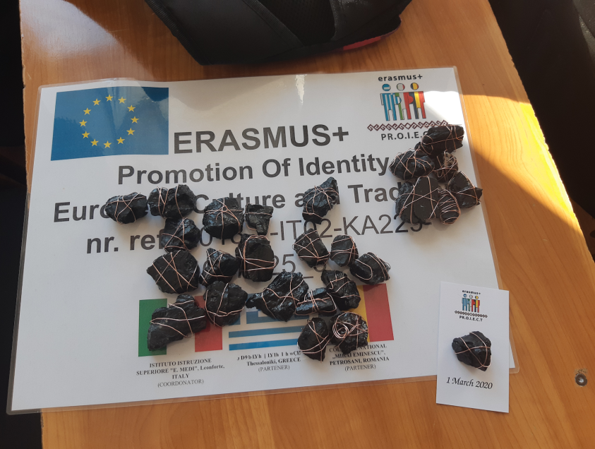
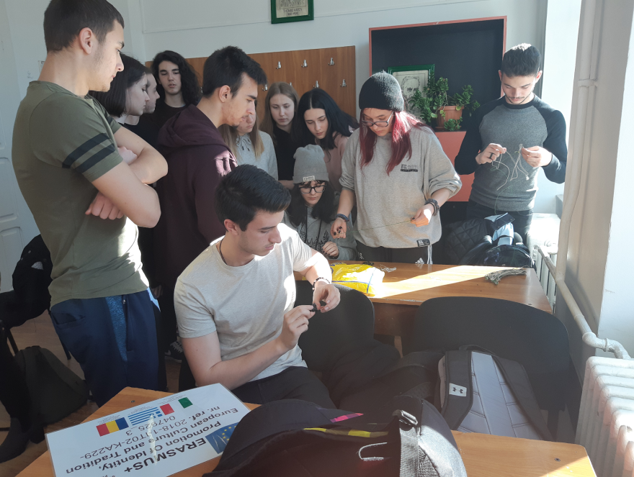
Making ‘martisoare’- pr.o.i.e.c.t.
The Romanian students from the target group of the Erasmus+ project:
“PRomotion Of Identity, European Culture and Tradition”, made ‘Martisoare’
for their Italian colleagues and teachers .
They used local traditional materials: coal and wire.

Slide 10
references
https://en.wikipedia.org/wiki/M%C4%83r%C8%9Bi%C8%99or
http://romaniatourism.com/martisor.html
https://travelaway.me/1st-march-martisor-romania/
https://www.romaniajournal.ro/spare-time/martisor-and-babele-two-romanian-popular-traditions-fighting-winter-conjuring-spring/
https://www.romania-insider.com/romanian-traditions-the-martisor-as-a-symbol-of-spring-and-respect-and-admiration-for-women
https://www.verbling.com/discussion/romanian-spring-traditions-martisor

Slide 11
The information included in this presentation is used for non-profit educational purposes and was collected by the students from COLEGIUL NATIONAL „MIHAI EMINESCU”, PETROSANI, ROMANIA during the ERASMUS+ KA229 PROJECT: PRomotion Of Identity, EuRopean Culture and Tradition (2018-2020), coordinated by Mrs. STEFANIA MANEA, coordinator of the project.

Slide 12
The European Commission support for the production of this publication does not constitute an endorsement of the contents which reflects the views only of the authors, and the Commission cannot be held responsible for any use which may be made of the information contained therein.

