Slide 1
OUR HOMETOWN JASTREBARSKO

Slide 2
CROATIA
Croatia is a European country.
It is placed in the southern part of central Europe and in the northern part of the Mediterranean.
In the north it borders with Slovenia and Hungary, in the east with Serbia and Bosnia and Herzegovina, in the south with Montenegro while in the west with Italy has a sea border.

Slide 3
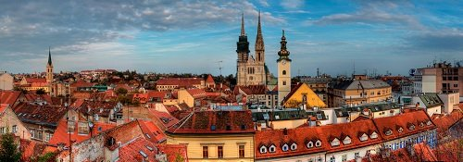
zAGREB
Zagreb is the capital and largest city in Croatia.
Zagreb has about 790.017 (seven hundred and ninety thousand and seventeen) citizens.

Slide 4
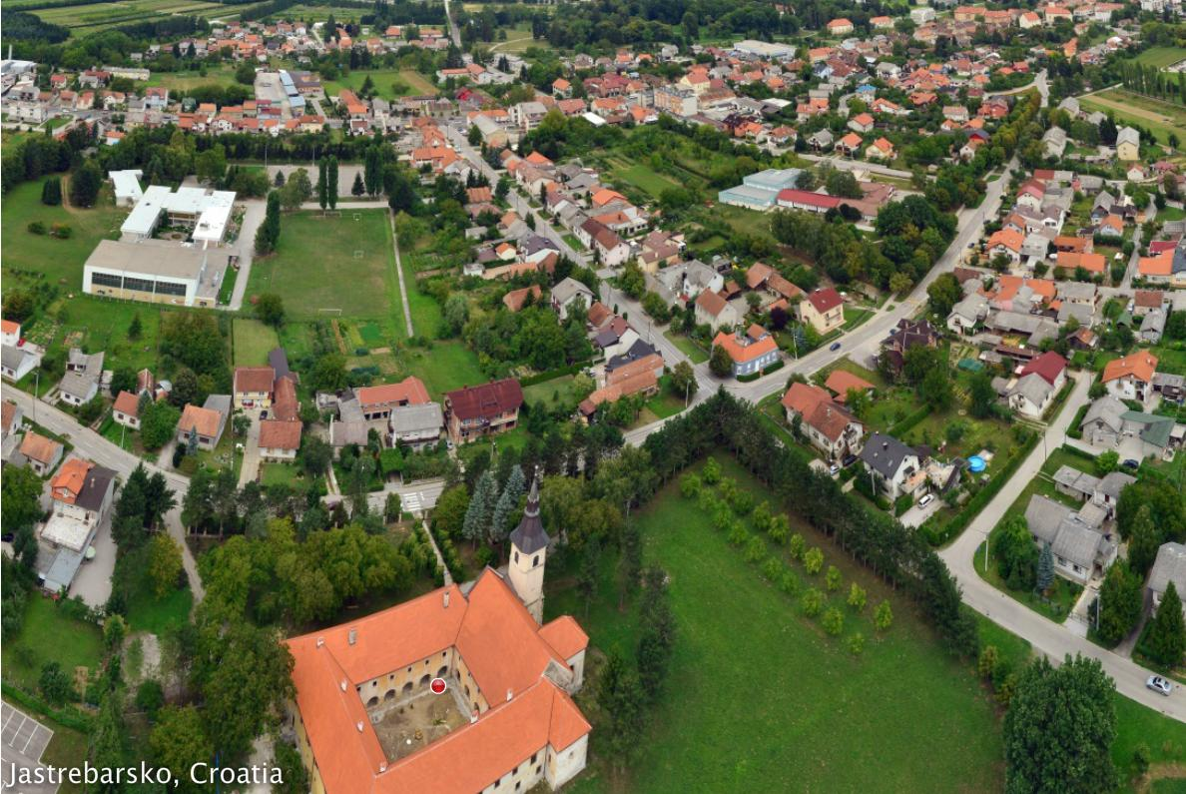
JASTREBARSKO
Little further from the city of Zagreb there is the town of Jastrebarsko.
This area is the most significant wine growing area of central Croatia and also the significant economic, commercial and tourist center. The surrounding areas of Jastrebarsko includes 60 (sixty) urban settlments. Some of them are Novaki Petrovinski , Izimje, Čeglje, Plešivica, Domagović, Gornja Kupčina, Sveta Jana, Gornji Desinec, Donji Desinec .

Slide 5
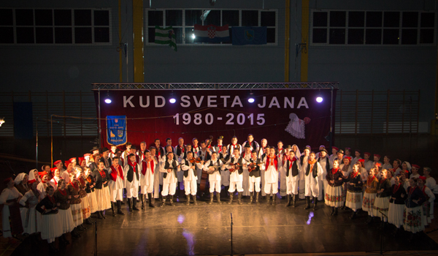
Cultural societies
In Jastrebarsko there is a large number of cultural societies. Their goal is to preserve the tradition, customs and cultural heritage of the Jastrebarsko region. Cultural societies besides folklor also have tamburitza, singing and drama groups. One of the most successful and most famous cultural societies is folklor association Sveta Jana which is present since the nineteen eghty.

Slide 6
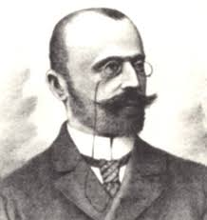
ELEMENTARY SCHOOL „LJUBO BABIĆ”
In Jastrebarsko there is an Elemenary school ‘’Ljubo Babić”.
Our school is named after the Croatian painter, art historian, educator, illustrator and scenographer - Ljubo Babić who was born on the fourteenth of June 1890 in Jastrebarsko.

Slide 7
ELEMENTARY SCHOOL „LJUBO BABIĆ”
Our school has about of one thousand and three hundred students. It is the only primary school in Jastrebarsko and it is modernly equipped.
The school has a neat environment and a comfortable interior. Since May 2006 the school has the status of an International Eco – school.

Slide 8
The end
Presented by: Lucija Gojšić , 6. a
Čeglje, 9th September 2016

