Slide 1
CITY JASTREBARSKO
Made by: Stipe Rukavina, Marija Matijević, Ana Kišan i Gabrijela Burjan

Slide 2
About museum:
he was built in 1826.
it has archaeological, cultural, historical and ethnographic heritage
in the gallery space are regularly organized exhibition of Croatian artists

Slide 3
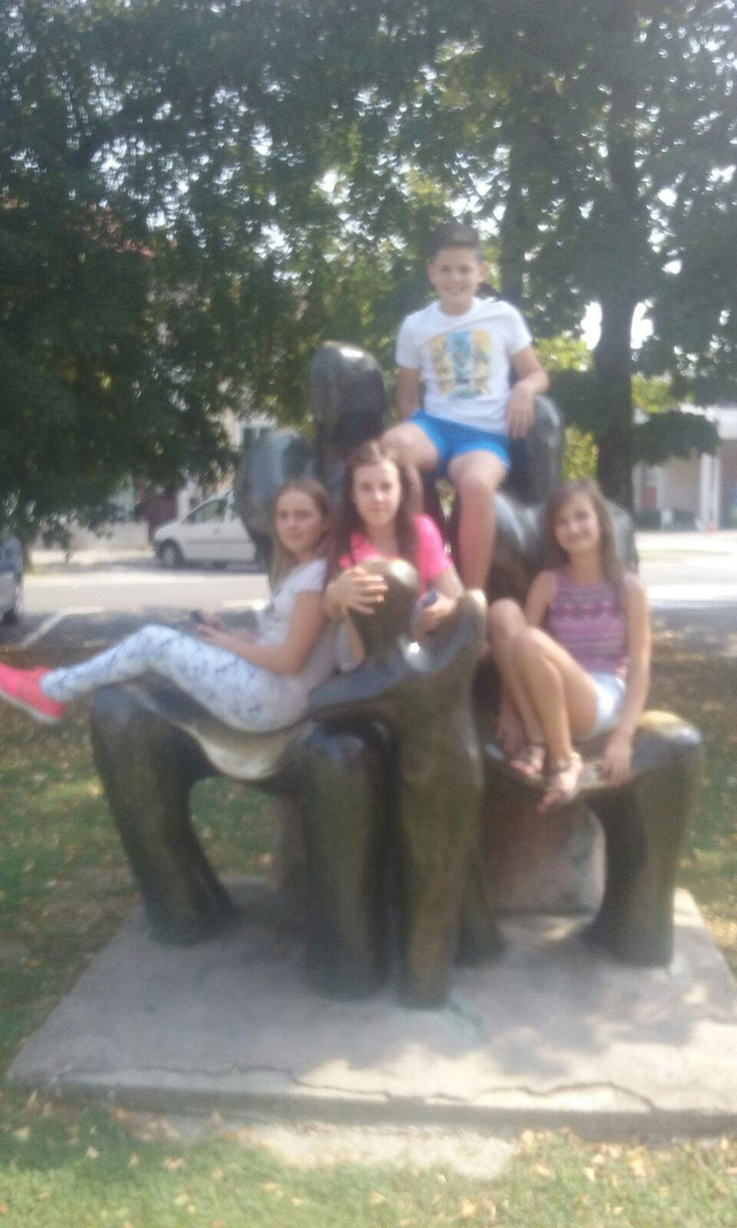
Stross:
he is a center of Jaska
it was named by strossmyer

Slide 4
Church st Nikole:
it was built in 1257.
st Nikola was born around 255.

Slide 5
Monastery:
it was built in 16. century by Petar Erdody
in the center of monastery is solar watch

Slide 6
Music school:

Slide 7
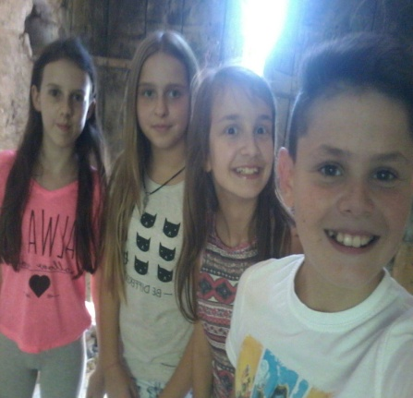
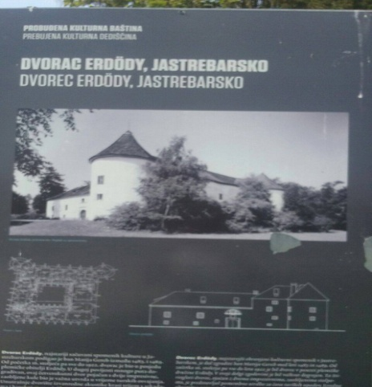
Castle Erdody:
it is placed in beautiful old park
it was built by Matija Gereb in 1483.- 1489.

Slide 8
Bridge of love:

Slide 9
Lake:

Slide 10
THE END

