Slide 1
INTRODUCTION Hi, nice to meet you ☺
Sára Tachovská
Project FORCES AROUND US
Doctrina - Podještědské gymnázium, Liberec, Czech Republic

Slide 2
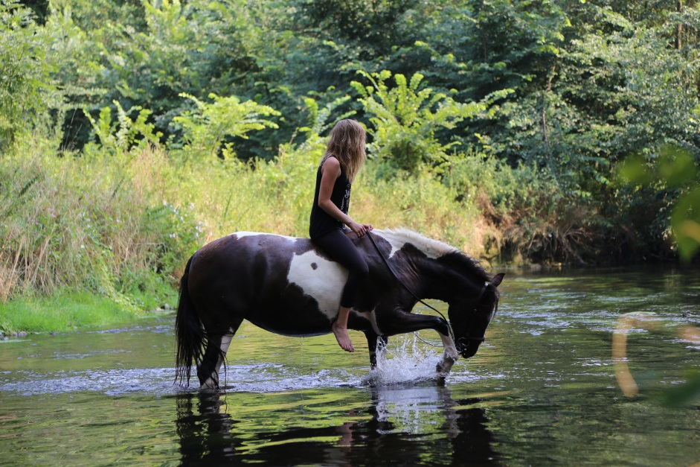
My name is Sára
I am 16 year old student from the Czech republic
I live in Liberec, which is the town in the north of the Czech republic
My favorites are english and history but I enjoy quite all of the school subjects.
I love being outside and spending my time with horses.

Slide 3
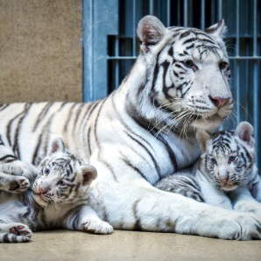
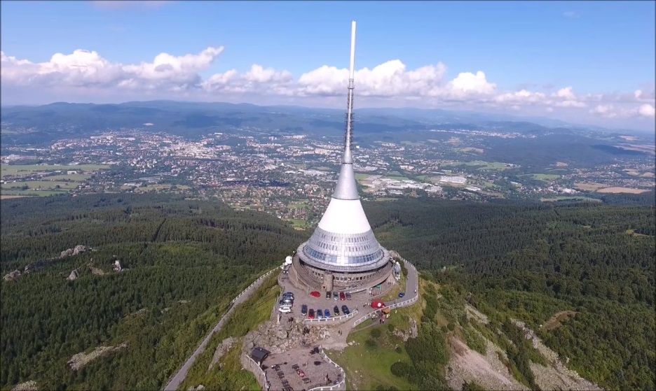
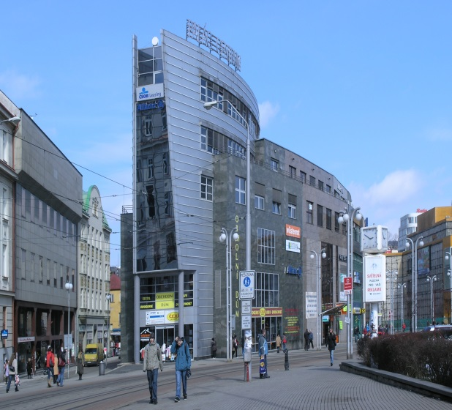
And this is my hometown, Liberec

Slide 4
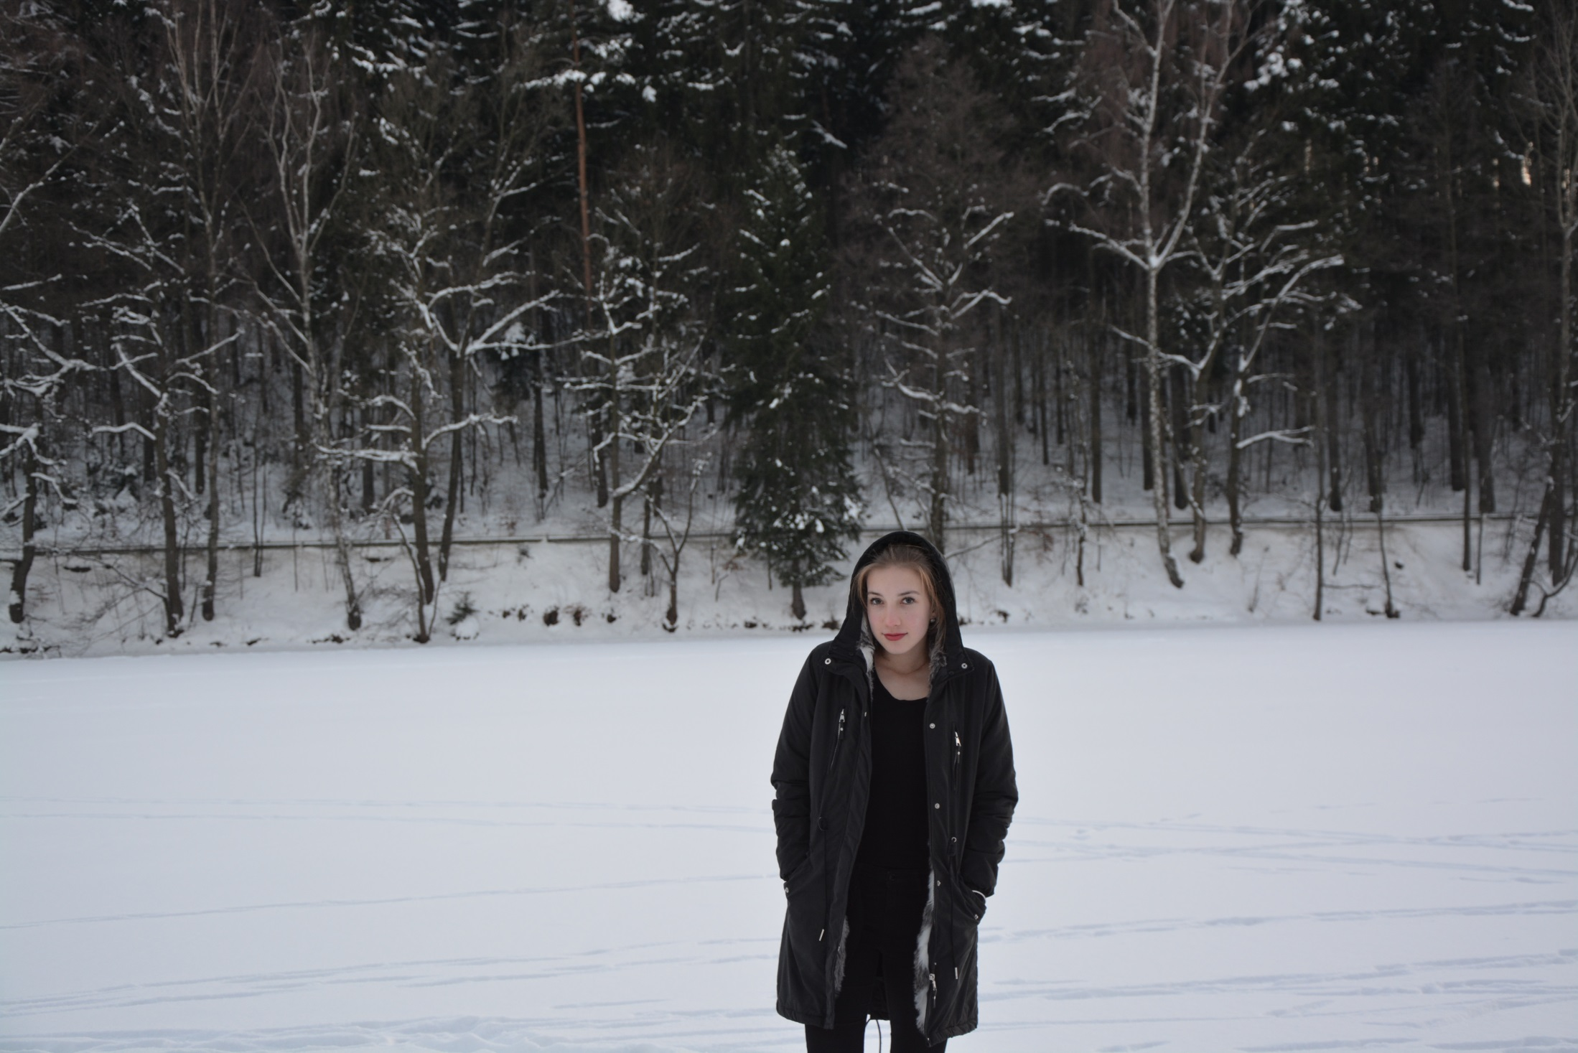
I am looking forward to work with you

