Slide 1
STUDENT FROM THE CZECH REPUBLIC
JAROSLAV VŠETIČKA

Slide 2
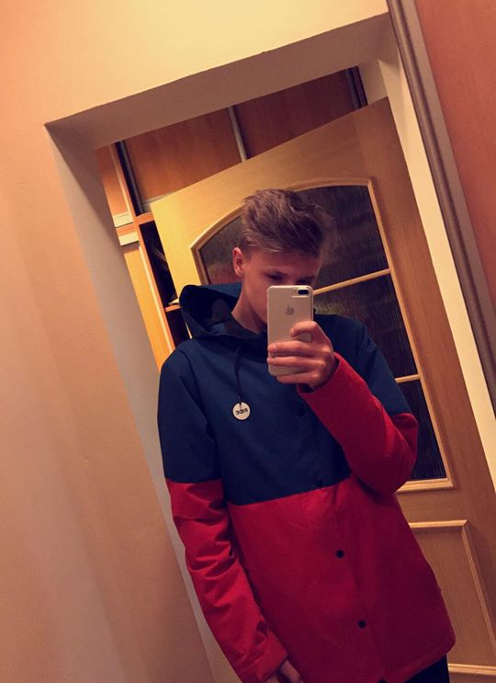
I am 15 years old and I live in Liberec.
I have been doing triatlon for 9 years now.
I am also watching football like others do.
My most favorite subject is PE, of course.
I don't like physics so much, but i don't mind.

