Slide 1
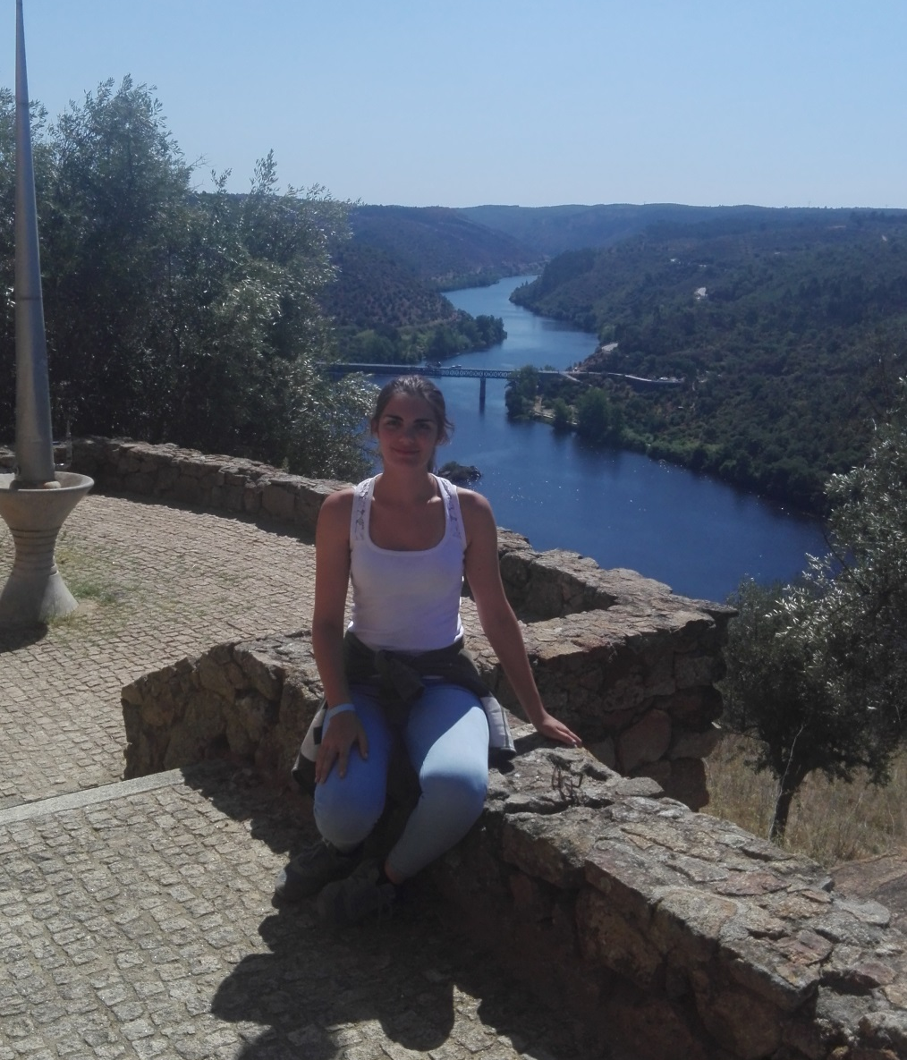
Beatriz Filipe
I´m a 17 years old student, from Portugal.
I live in Almodôvar, a small town in Alentejo.
In my free time i enjoy:
Watching series;
Playing accordeon;
Listening to music;
Playing cards;
Going for a walk in the nature.

