Slide 1
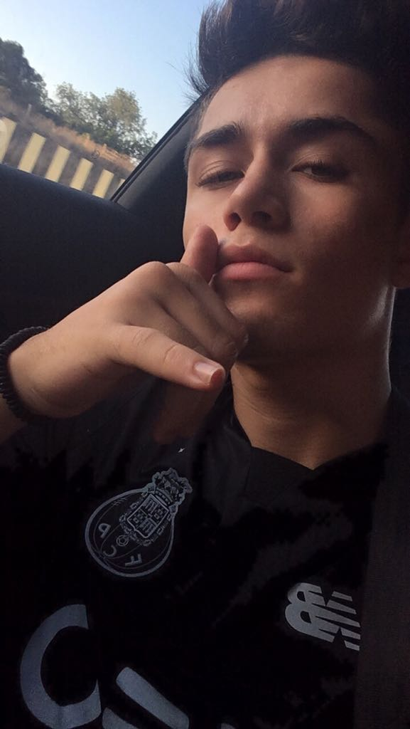
My name is Carlos Dias.
I´m 17 years old.
I live in Portugal.
I like to play football and listen to music.

