Slide 1
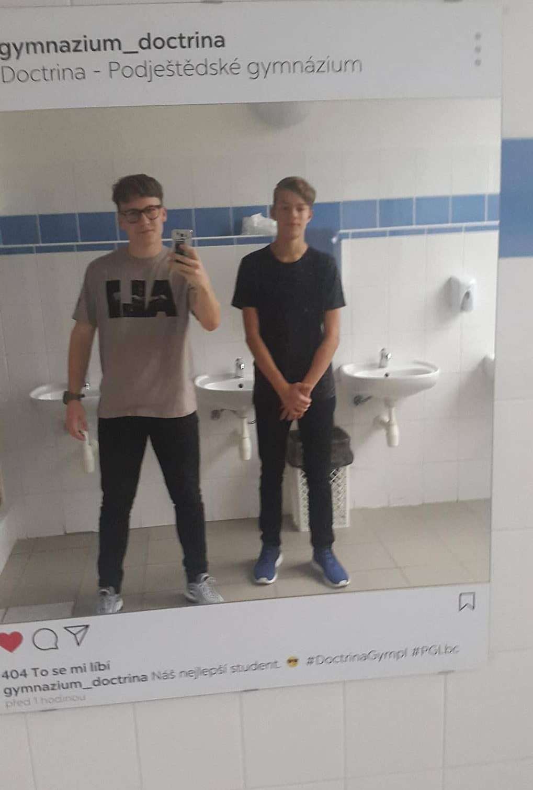
Martin Stasak, Filip Radostny
Doctrína – podještědské gymnázium
Kvinta 2017/18

Slide 2
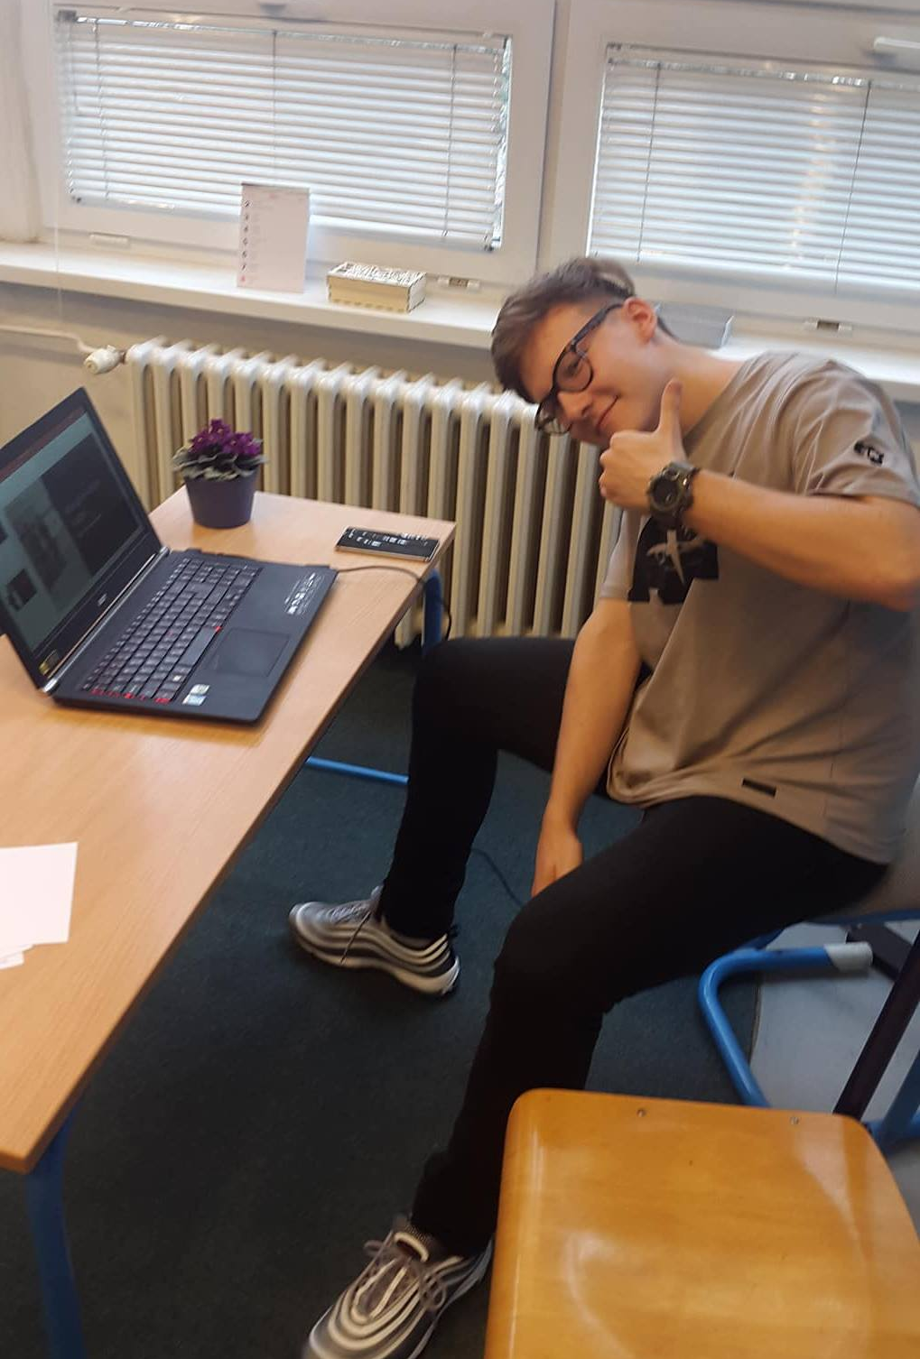
Martin Stašák
I live in Proseč nad Nisou
I am 16 years old
My hobbies are scouting and drama
I support football teams Lech Poznań, S. L. Benfica and FC Steaua Bukurest
My favourite subjects are latin, germany and geography

Slide 3
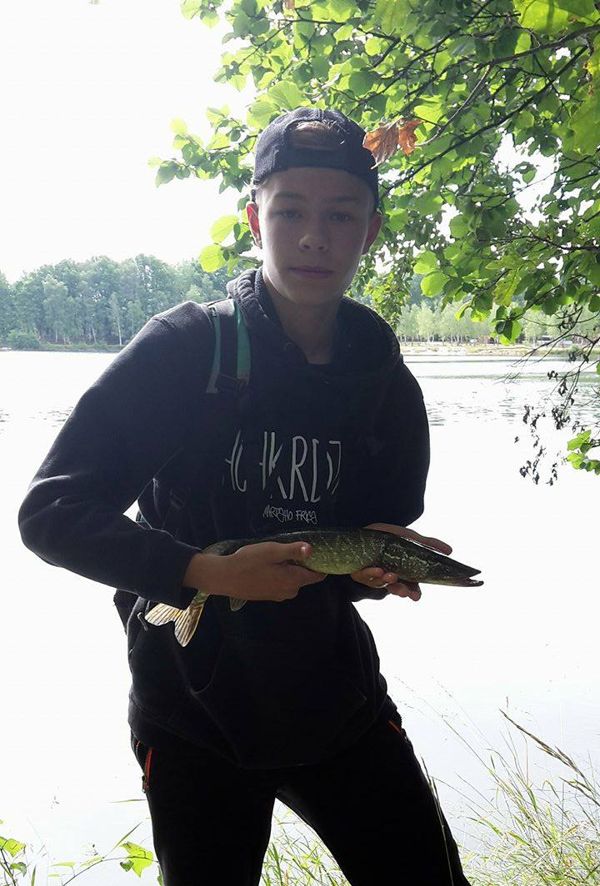
Filip Radostný
I live in Liberec
I am 15 years old
My hobbies are fishing and floorball
I like hockey and football
I play PC games
My favourite subject is biology
My favourite fish is pike

