Slide 1
Forces around us
Lucie Vlčková
Michal Pekař

Slide 2
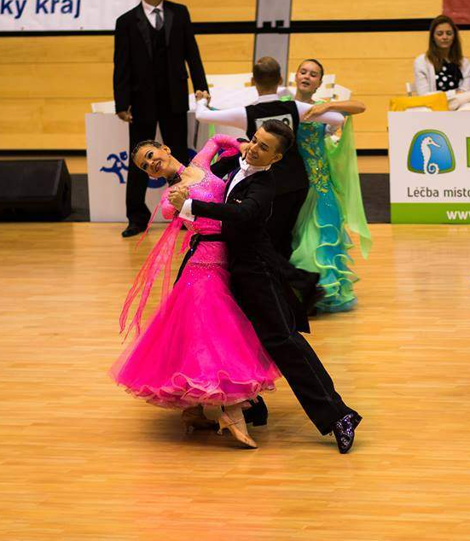
Hi, I‘m Lucka
I’m 16 years old
I study at Doctrina- Podještědské gymnázium
I was born in Liberec and I’ve lived here whole my life
I’m ballroom and latin dancer and I dance for 10 years
My favorite subjects are Math and PE

Slide 3
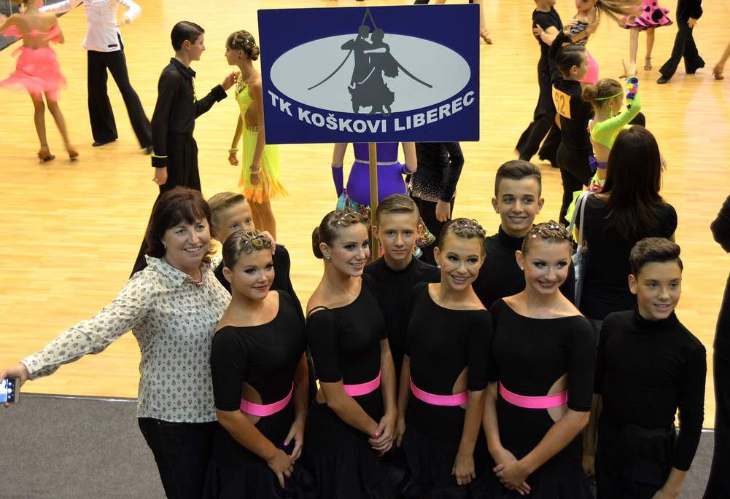
My sport
My dancing group

Slide 4
Hi, I‘m Michal.
I‘m 16 years old
I study at Doctrina- Podještědské gymnázium
I was born in Liberec and I’ve lived here whole my life
I like history and books
And about physics I primarily like practical experiments

Slide 5
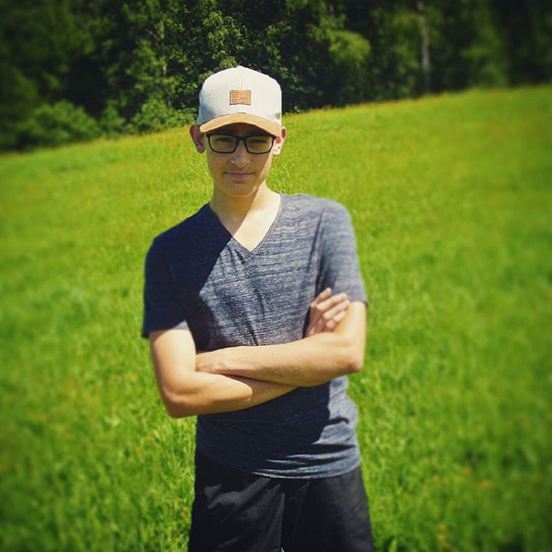
And this is me….

Slide 6
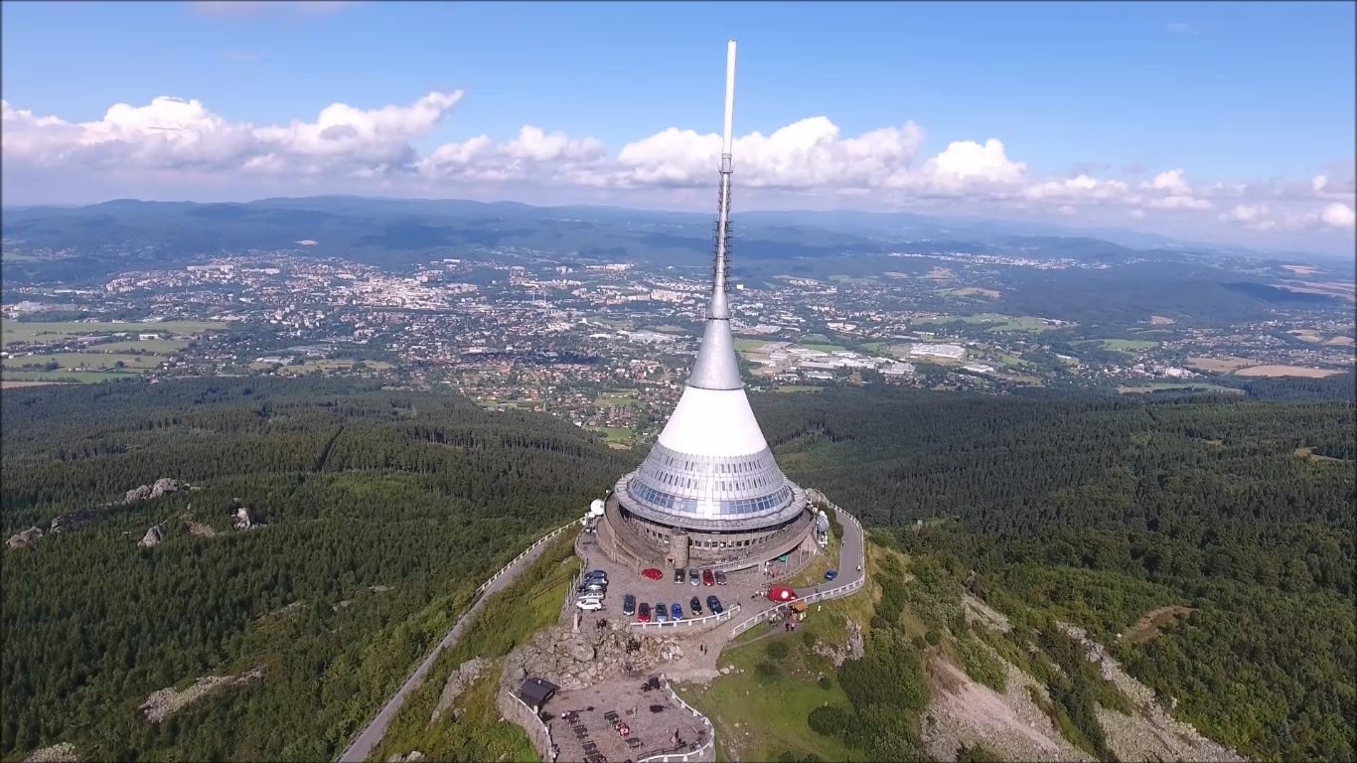
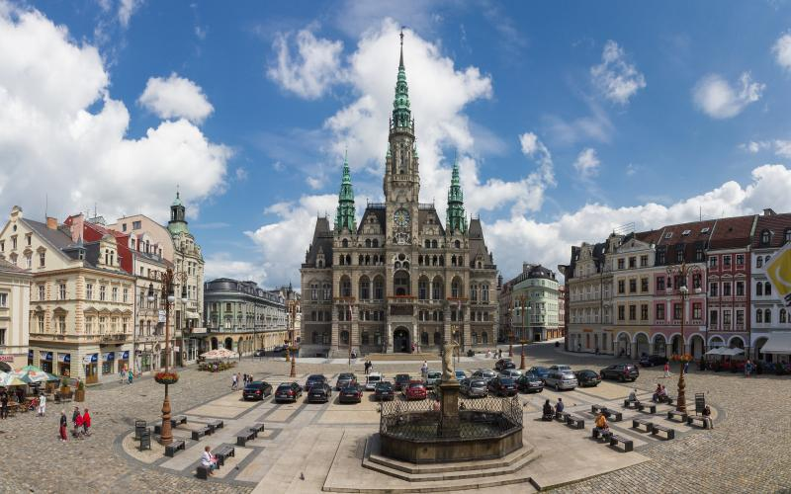
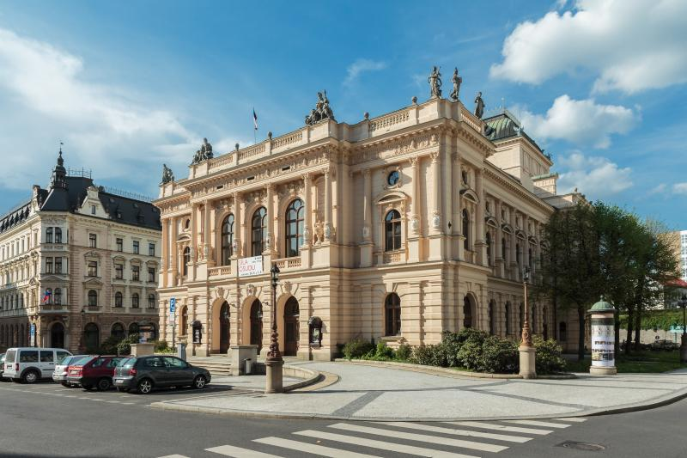
Liberec

