Slide 1
Forces Around US

Slide 2
Introduction
Hello, I‘m Miriam Drapáková
I‘m 16 years old
My birthday is 3rd of June
I have three siblings (Older and younger brother, and younger sister)
I play the guitar for 9 years
I like English, P.E., chemisty and our native language, Czech
I like dogs

Slide 3
Introduction
Hi, I‘m Kačka Třísková
I‘m 16 years old
My birthday is 23rd of August
I might have no siblings, but I have a guinea pig called Eva
I like biology, theoritical physics, English geography
I like to swim in my free time

Slide 4
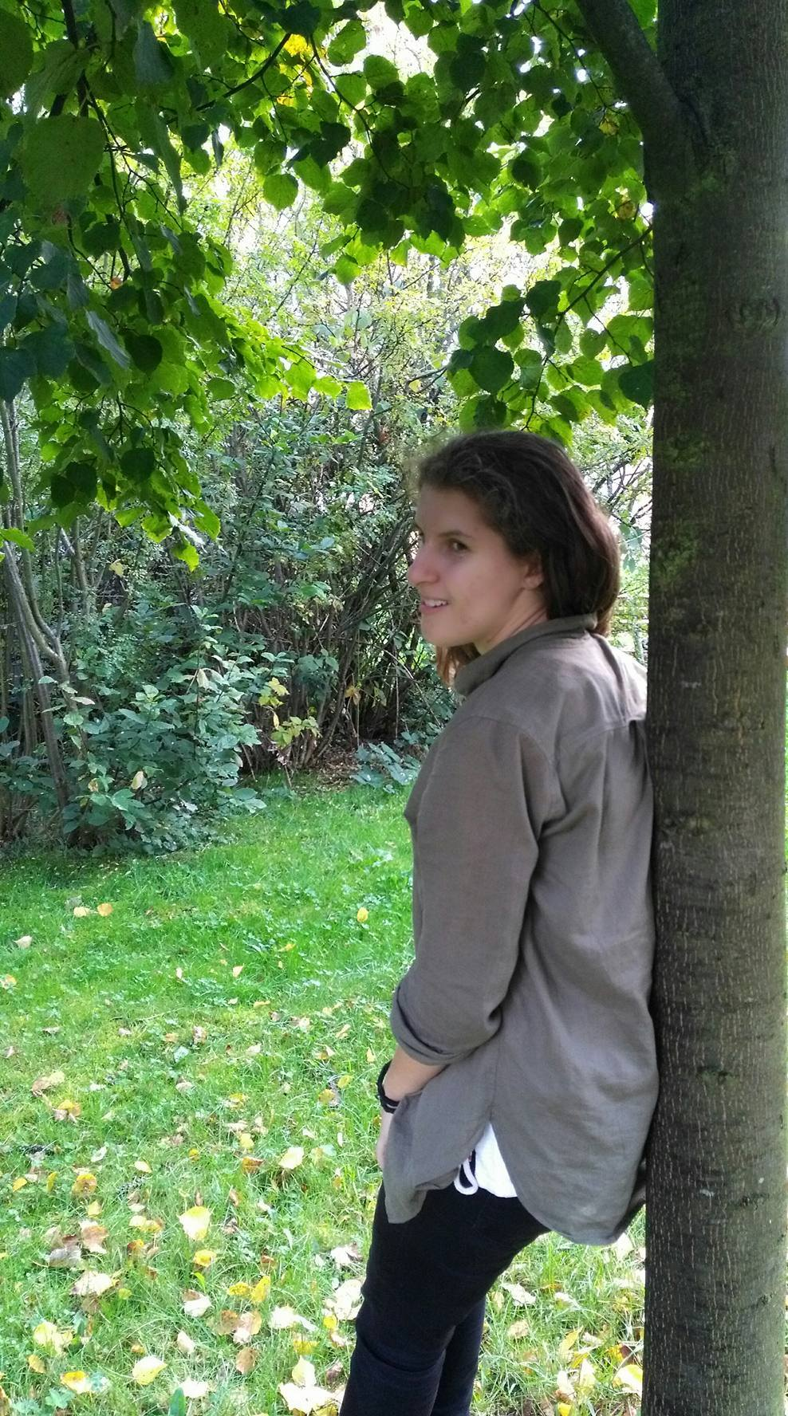
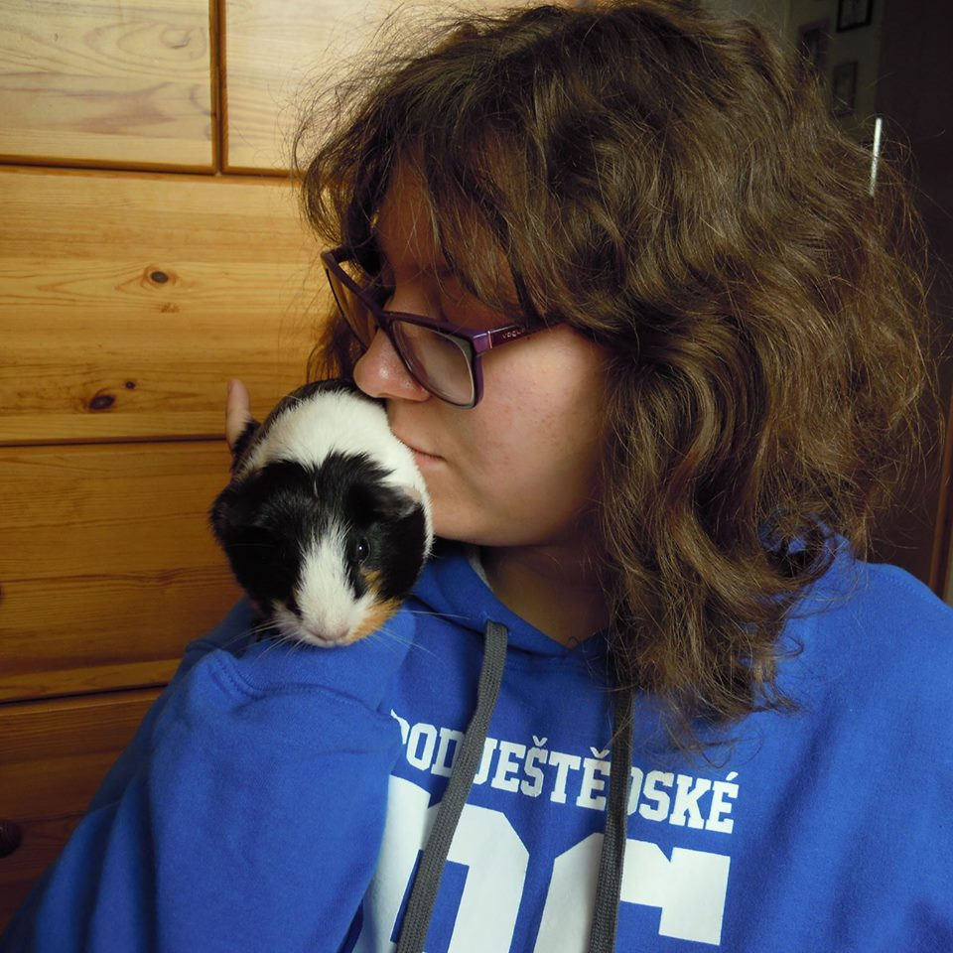
Introduction
Kačka
Miriam

Slide 5
LIberec
Liberec is quite small but cozy city located in the North of The Czech Republic, 100 kilometers from Prague.
It is famous for it‘s ZOO, which was the first to breed white tigers in Europe.
Another noticible thing is Ještěd. It‘s a mountain hotel and a transmitter. It‘s located on a 1012 meters high hill.

Slide 6
We are excited To meet new friend and for our work together

