Slide 1
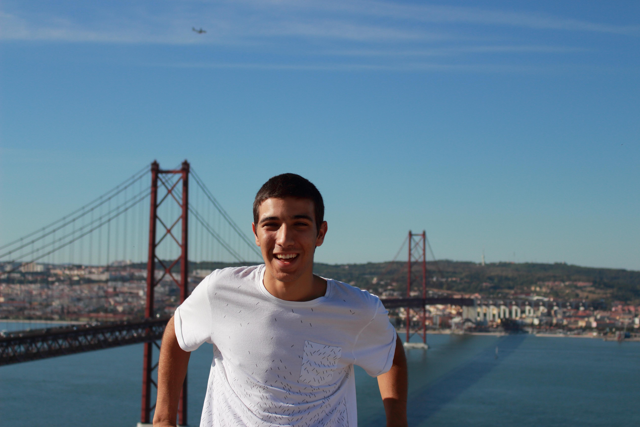
Gabriel Dos Santos
I’m 17 years old and I am an ordinary student from Portugal
I live near Almodôvar, a small town in the south of Portugal
I just love every single subject related to science
I do photography as a hobbie

