Slide 1
FORCES AROUND US
Tina Marijczuková
Czech Republic, Liberec
Doctrina – Podještědské gymnázium

Slide 2
HI, I’M TINA!
I’m a 15 year old student at Doctrina-Podještědské gymnázium
I was born in Liberec and I’ve lived here whole my life
I do a lot of sports but I like lying on my sofa and watching films too
My favourite subject is PE and math
I love dogs and I have a dog called Cassie

Slide 3
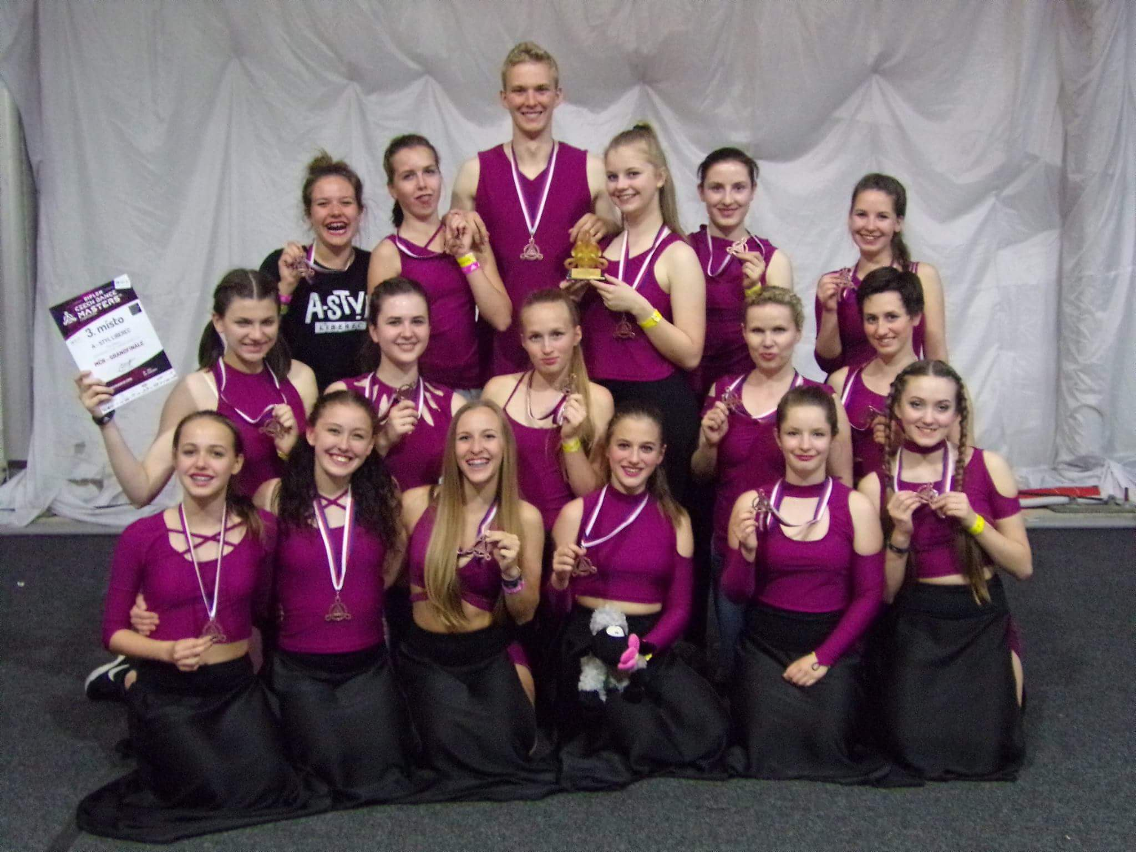
SOME OF MY SPORTS
My favourite sport is cycling
I love skiing in Austria and Italy
ME
My dancing group ‘‘THE OTHERS‘‘

Slide 4
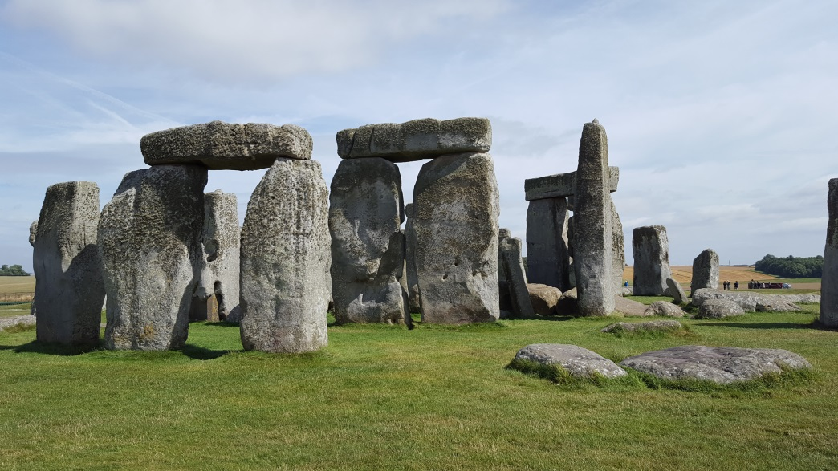
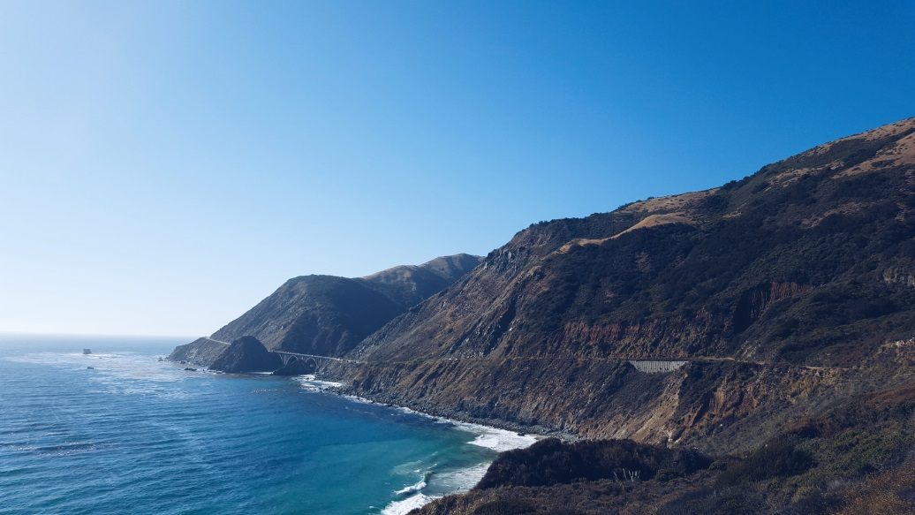
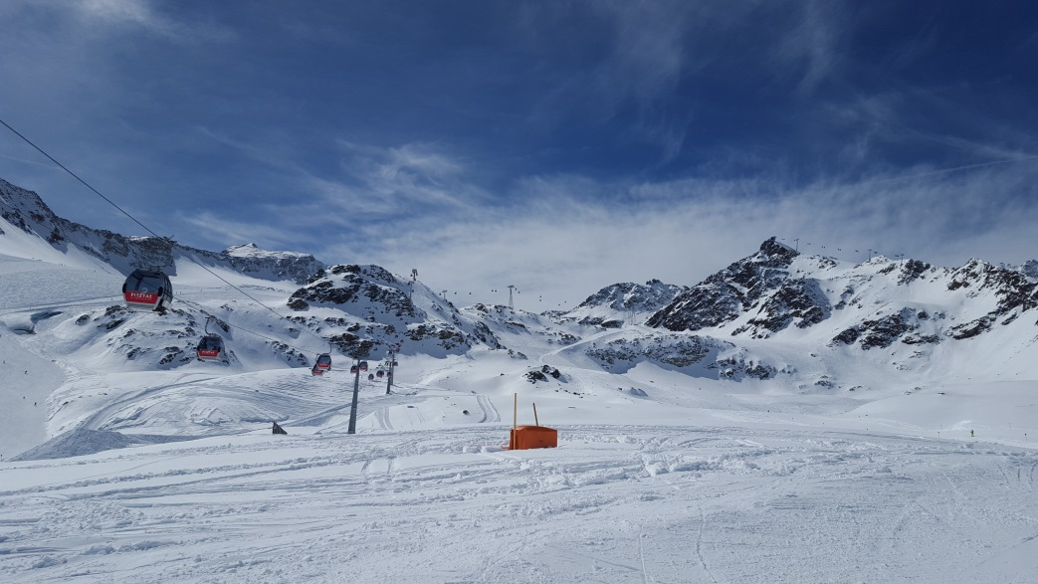
I LOVE TO TRAVEL
England
France
USA
Italy

Slide 5
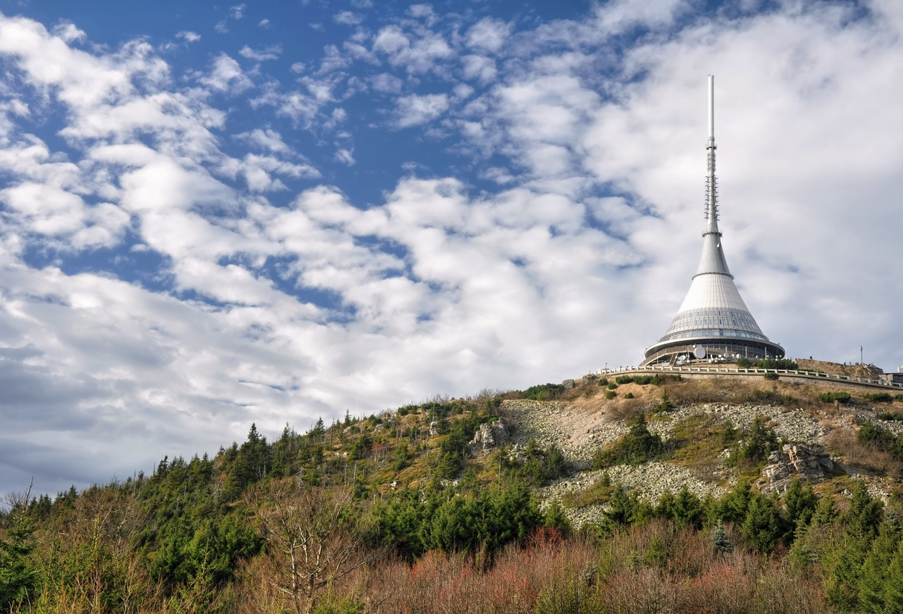
MY HOMETOWN - LIBEREC

Slide 6
I WOULD LIKE TO WORK WITH YOU

