Slide 1
Presentations

Slide 2
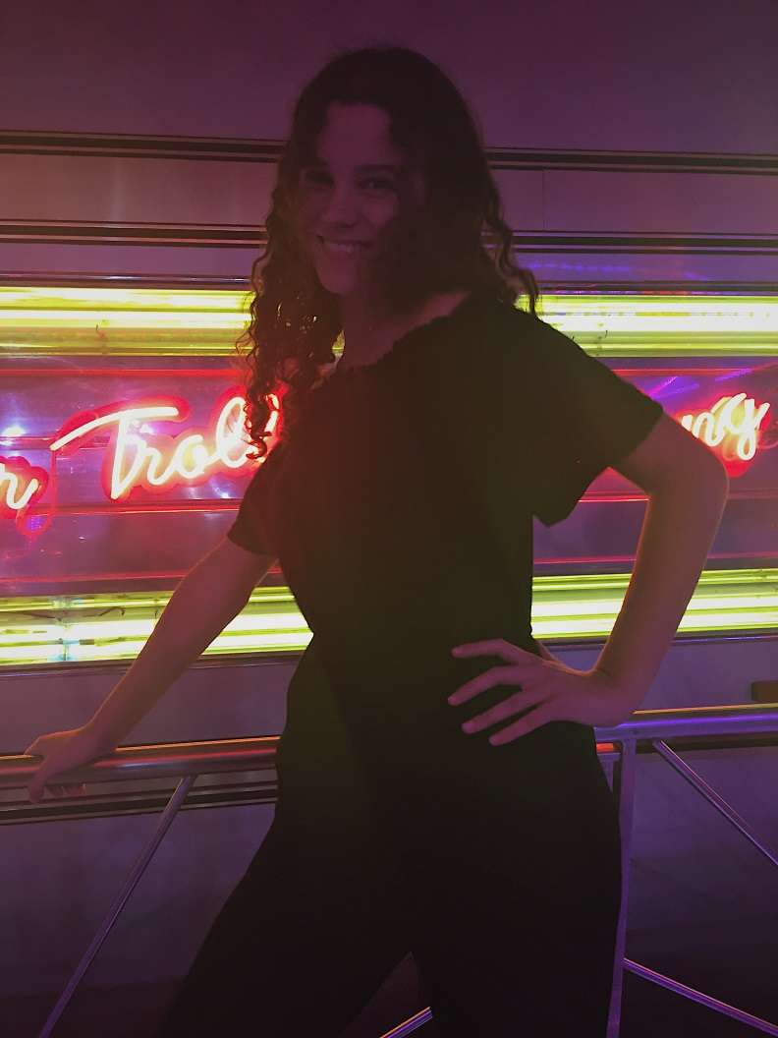
Rita Mendes
I’m 17 years old.
I live in Portugal.
I have 2 dogs and a cat.
I like to watch Tv shows and i like to read.

Slide 3
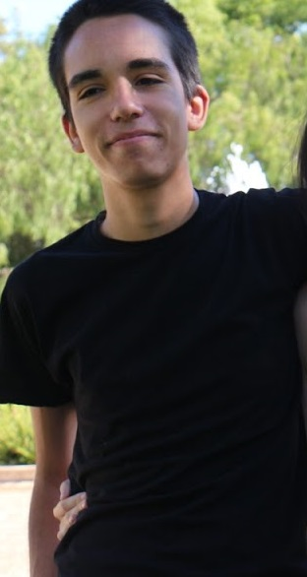
Pedro Rodrigues
Im 17 years old.
From Portugal.
I like sports.
Like to listen to halsey,selena gomez,troye sivan and more.
Woke queen.
Likes to watch tv shows and play videogames.

Slide 4
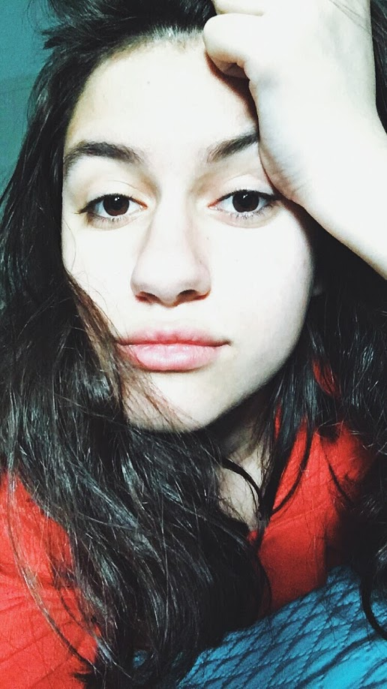
Mariana Vaz
Im 17 years old.
Im from Portugal.
I like to watch tv shows, movies and anime.
I play videogames and volleyball.

Slide 5
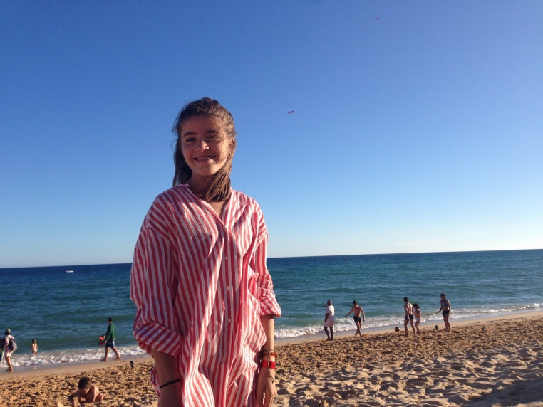
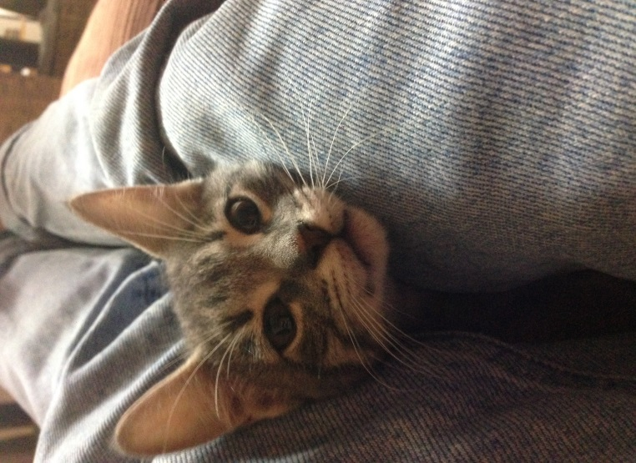
Mariana Mendinhos
Im 17 years old.
I’m from Portugal.
I do Karate.
I have a cat named Chili.
My favourite band is red hot chili peppers.

