Slide 1
Forces Around Us

Slide 2
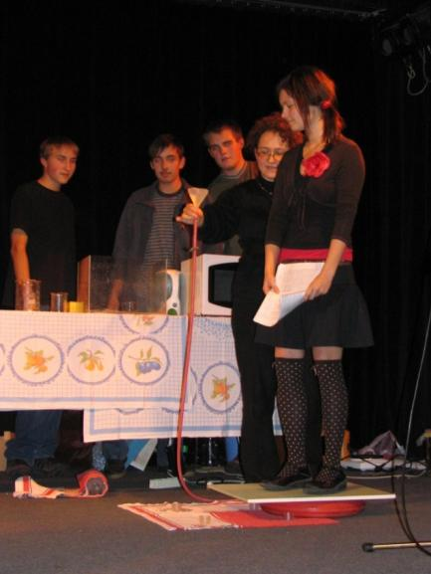
Hi, I´m Vladimíra
I am a math and physics teacher
Water pressure holding a student
Strong Czech eggs
Walking on the Moon

Slide 3
I am a mother and a wife

Slide 4
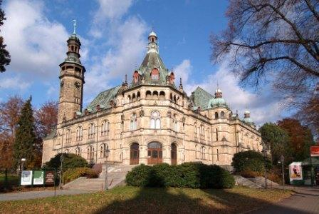
I live in Liberec

Slide 5
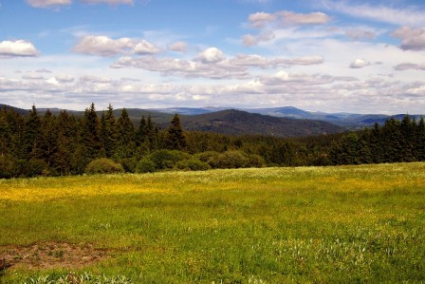
I like hiking and cross-country skiing

