Slide 1
Forces around us
Tereza isabella matějovská
Adéla růžičková
Natálie bergmannová

Slide 2
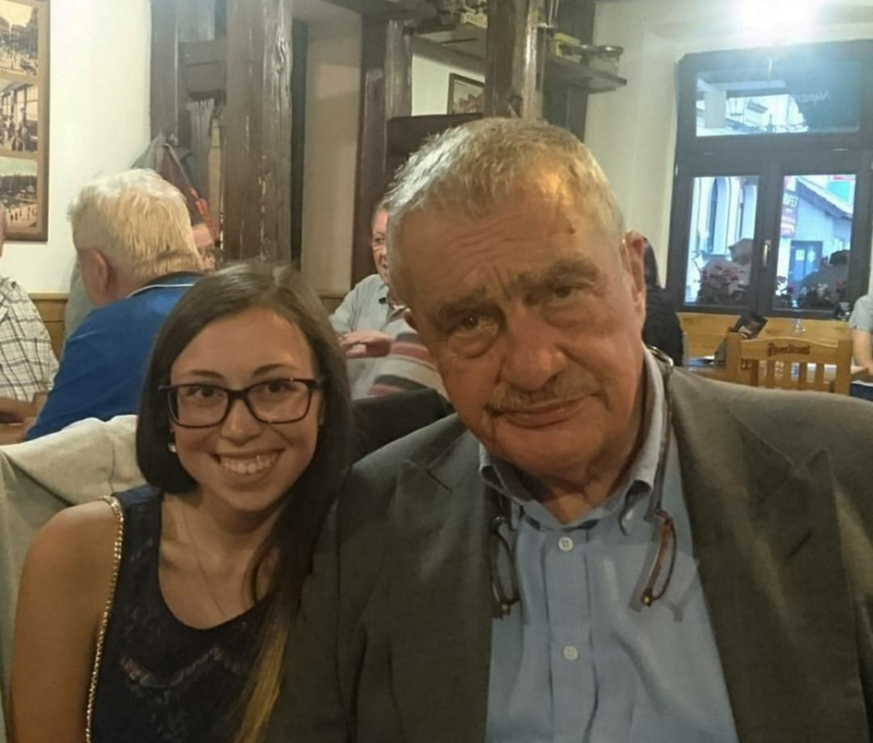
Hi, my name is Tereza Isabella Matějovská. I'm 15 years old. I'm from the Czech Republic exactly Liberec. My favourite subjects are history, geography, Czech with literature and law. I play the piano and I learn Spanish, Russian and English. I like politics and travel. In future, I want to be a politician and I want to study law and political science. I do like Prague, the capital city of the Czech Republic. Nice to meet you. Tereza.

Slide 3
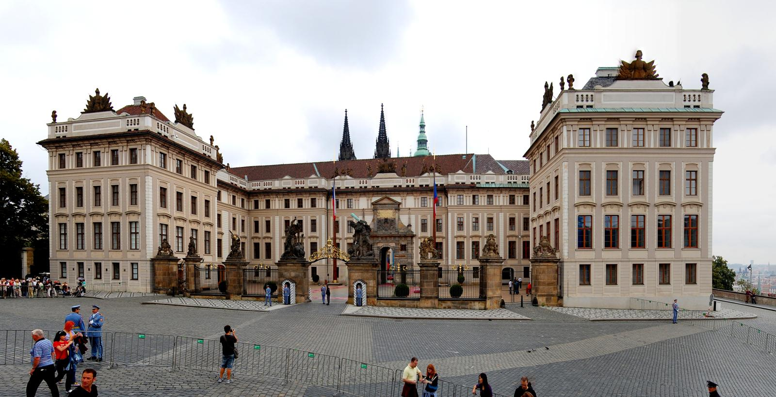
This is THE capital city of the Czech republic

Slide 4
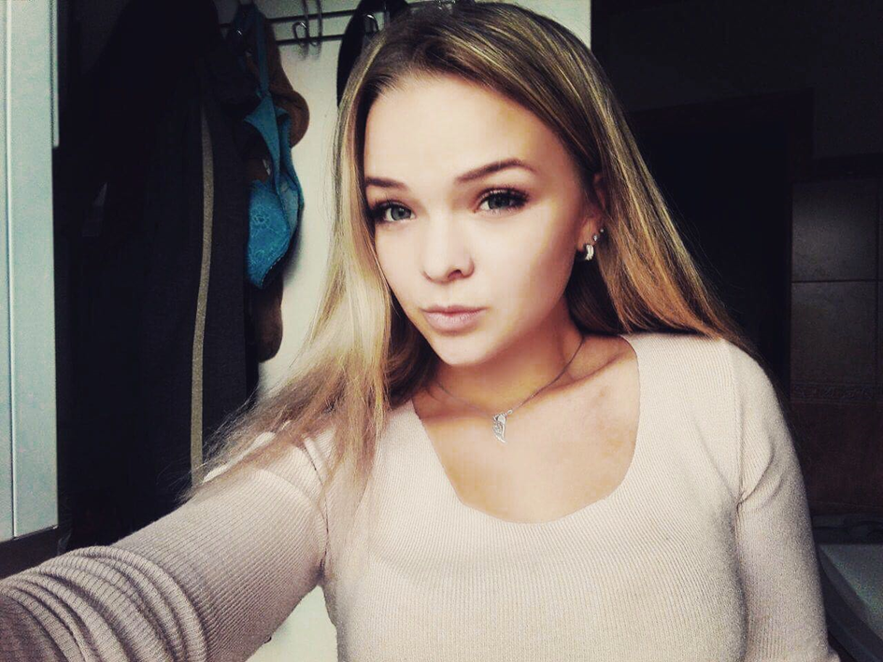
Hello, my name is Adéla Růžičková. I'm 16 years old. I'm from the Czech Republic exactly Hrádek nad Nisou (It's near to Zittau). I like to paint pictures and I like to ride on roller skates. Every Wednesday I go to horses. I really like horses. One day I would like to be a dentist. Nice to meet you. Adéla.

Slide 5
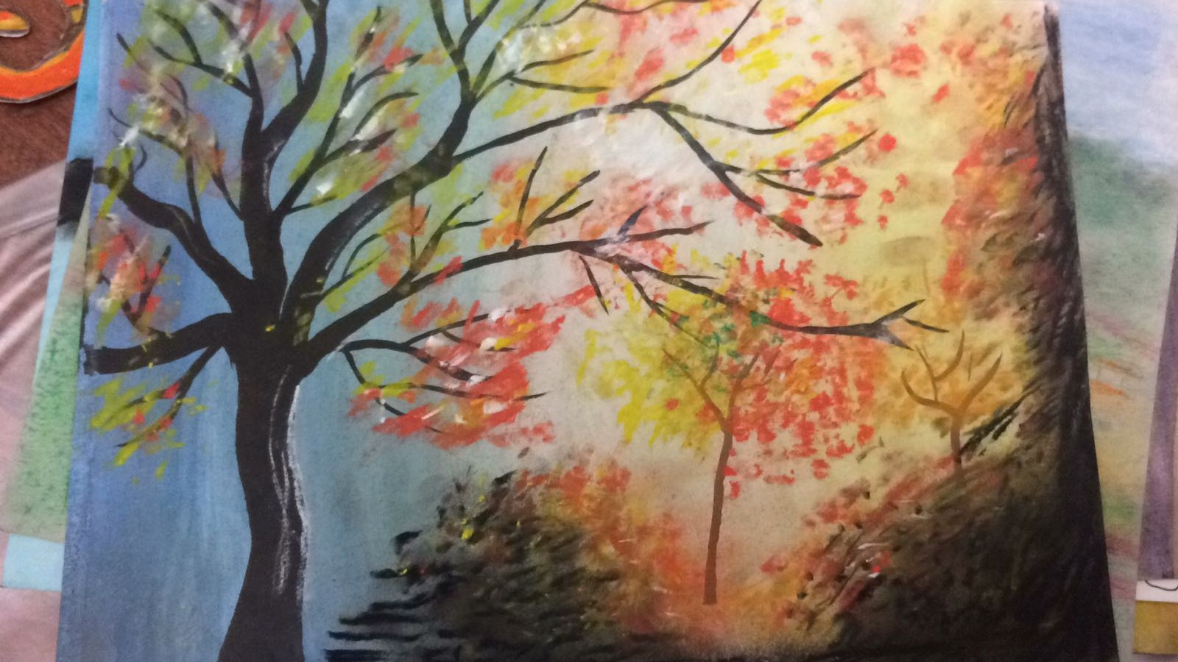
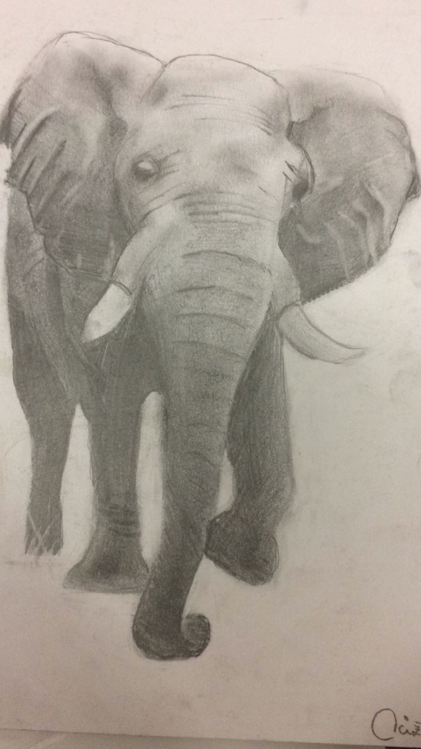
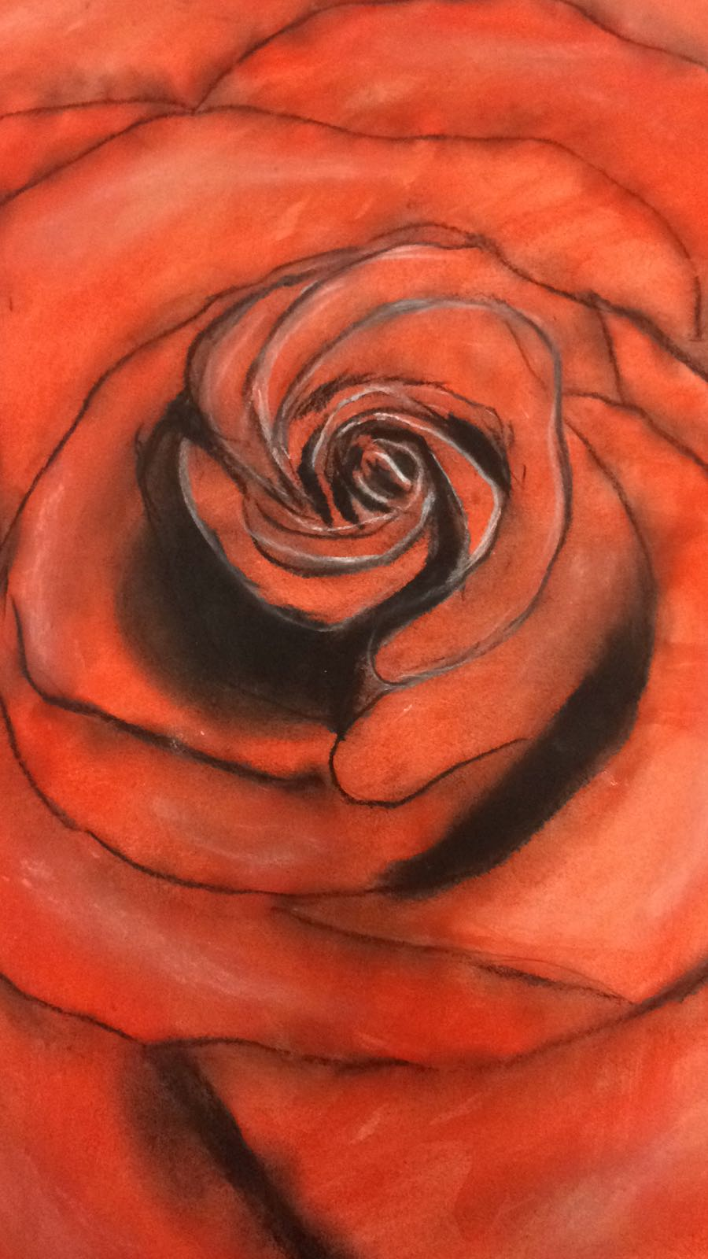
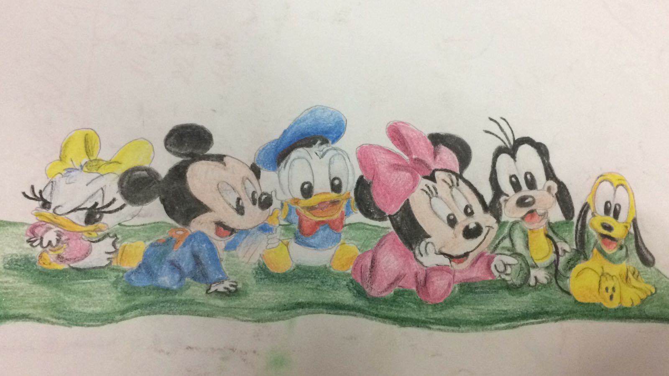
ThEsE ARE my OWN pictures

Slide 6
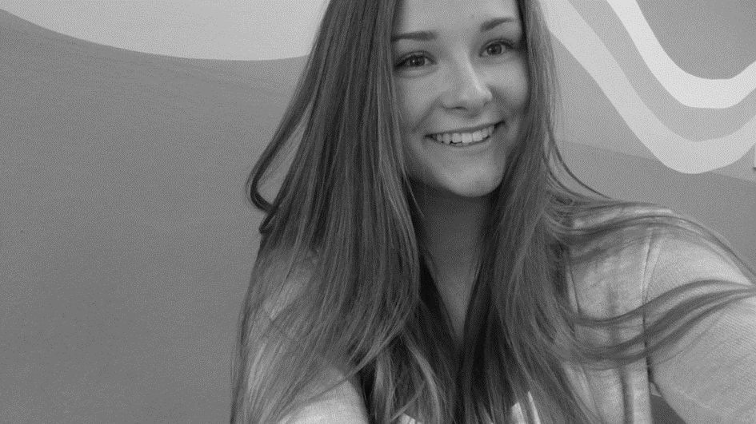
Hello, my name is Natálie Bergmannová. I'm 16 years old. I'm from the Czech Republic too, like my two friends Tereza and Adéla. My favourite subjects are English, Czech with literature and Music. I'm little bit interested in fashion and I like reading books. I have got a dog. I like to go with him for a walk. One day, I want to be English translator or I want to have my own coffee shop. Nice to meet you. Natálie.

Slide 7
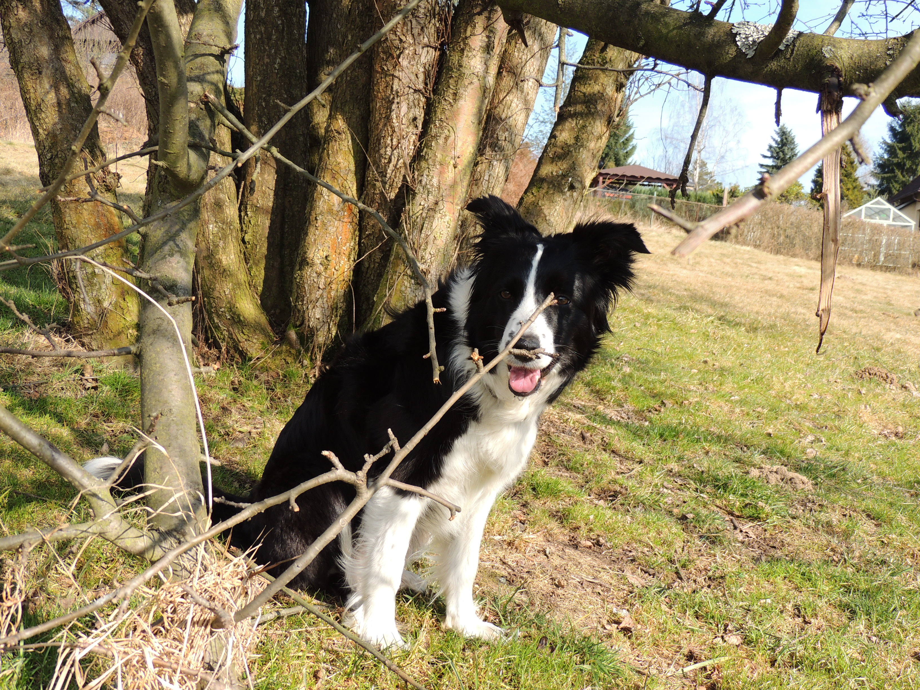
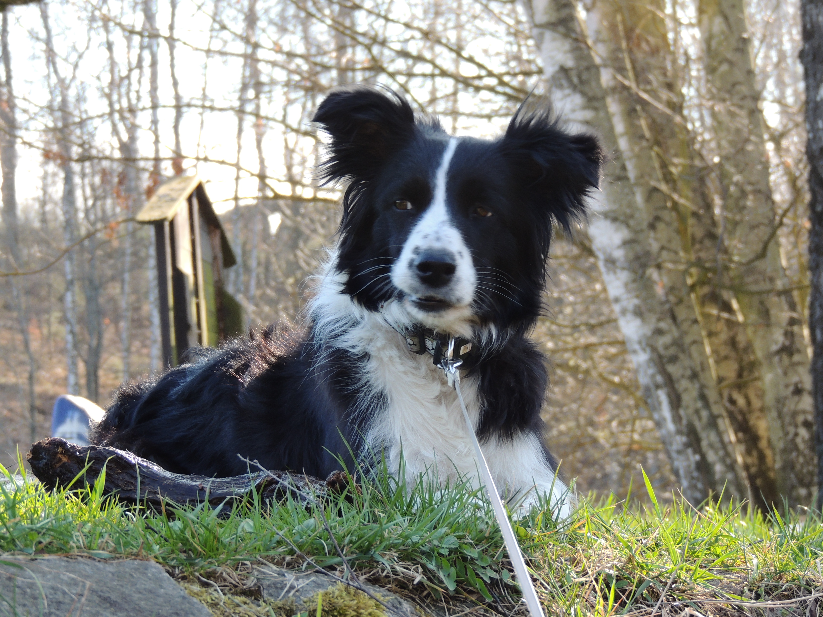
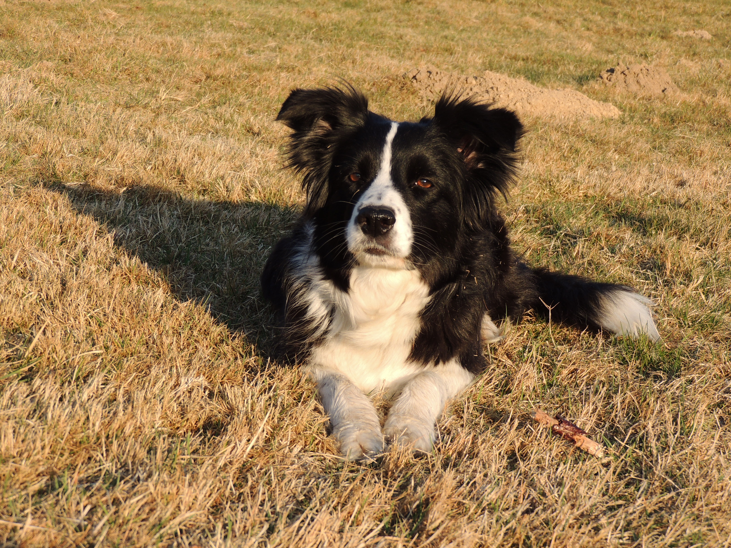
This is my dog

Slide 8
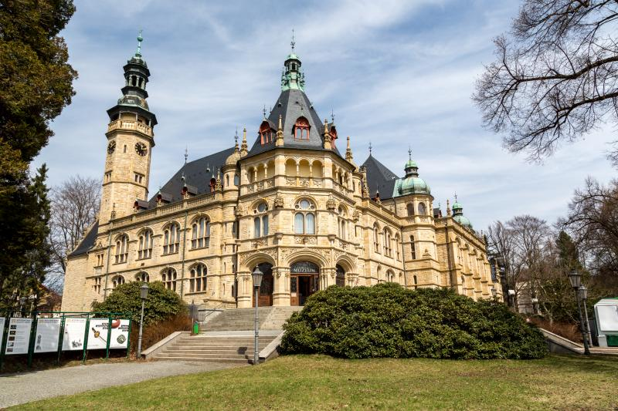
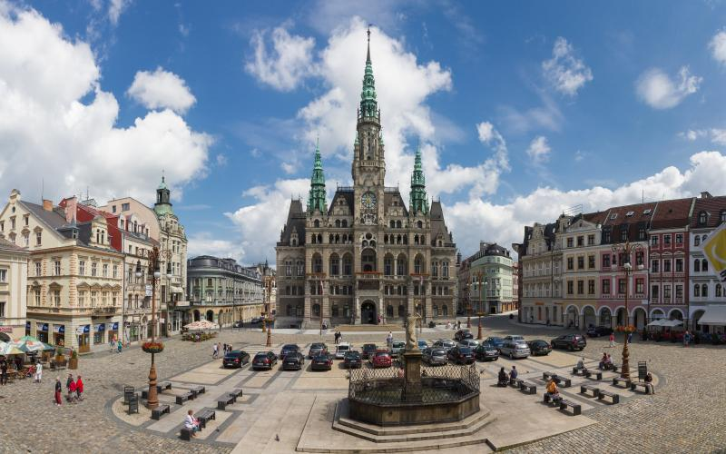
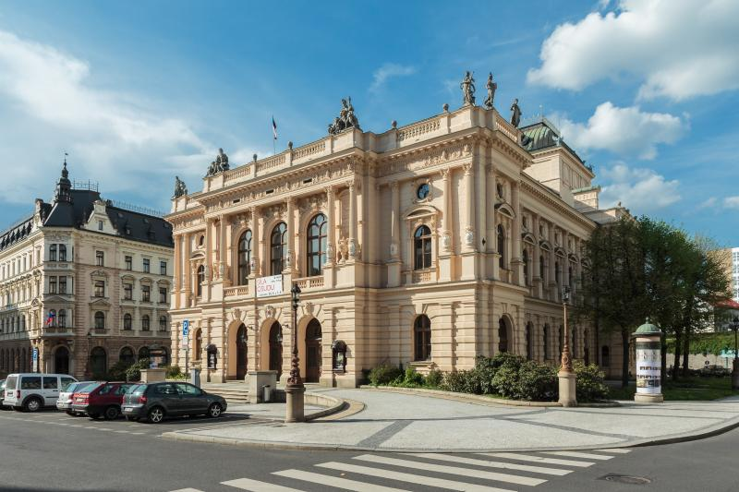
Liberec is our HOME city

