Slide 1
Introduction
Podještědské gymnázium Liberec
Czech Republic

Slide 2
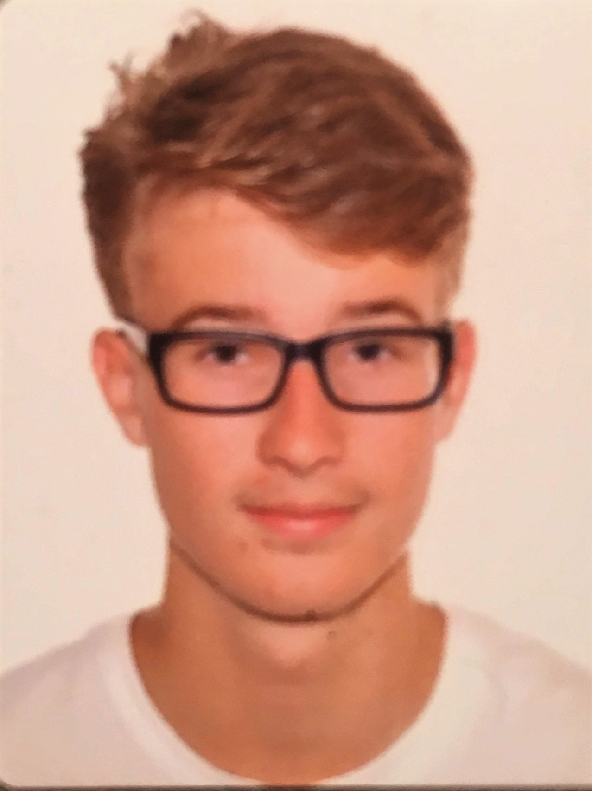
Hi, my name is Štěpán.
I am 16 and I live in Liberec.
My favorite subjects are history, chemistry and languages.
I play tennis and I like reading books.
I am interested in military technology and history.
A part of my free time I spent with PC games.
And I have got guinea pig as a pet.

Slide 3
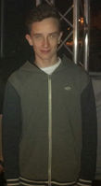
Hi, my name is Lukáš
I am 15 years old
I live in Liberec
I do calisthenics
The only pet I have is guinea-pig
My favorite subjects is English

