Slide 1
FRANCOIS LEGROS SCHOOL

Slide 2
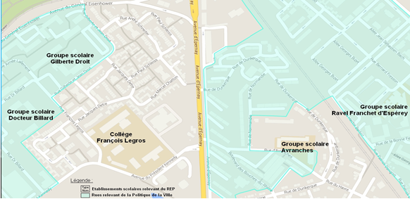
A BIG COLLEGE IN REIMS
MORE THAN 560 STUDENTS
32 DIFFERENT NATIONALITIES
24 DIVISIONS OR CLASSES WITH A MAXIMUM OF 24 STUDIENTS IN EACH.
47 TEACHERS
ULIS ( INTEGRATION OF HARD-OF-HEARING WITH A TEACHER WHO TRANSLATES IN SIGN LANGUAGE)

Slide 3
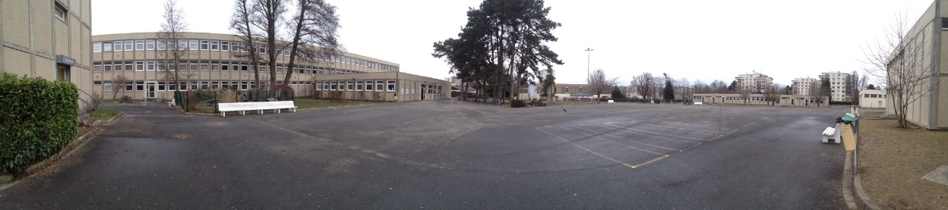
GENERAL VIEW
The playground with view of the class room

Slide 4
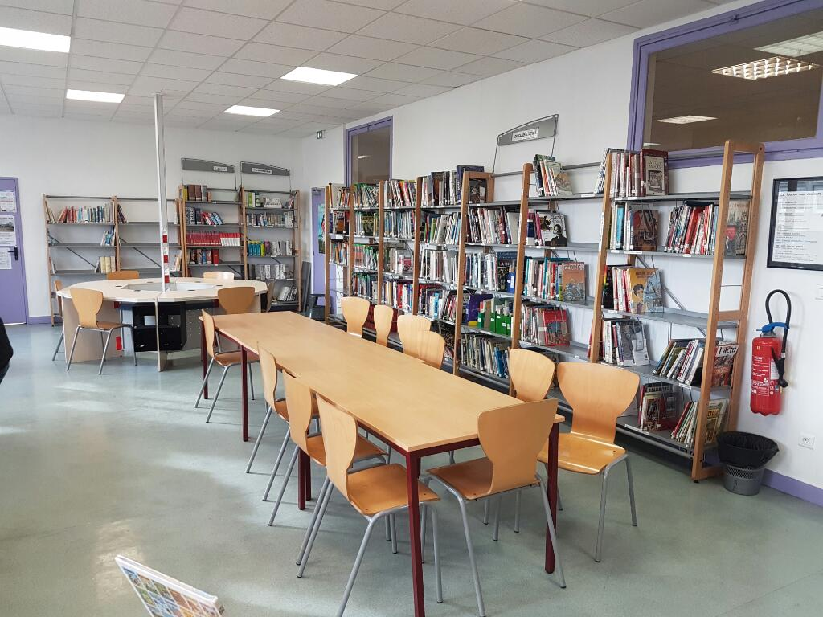
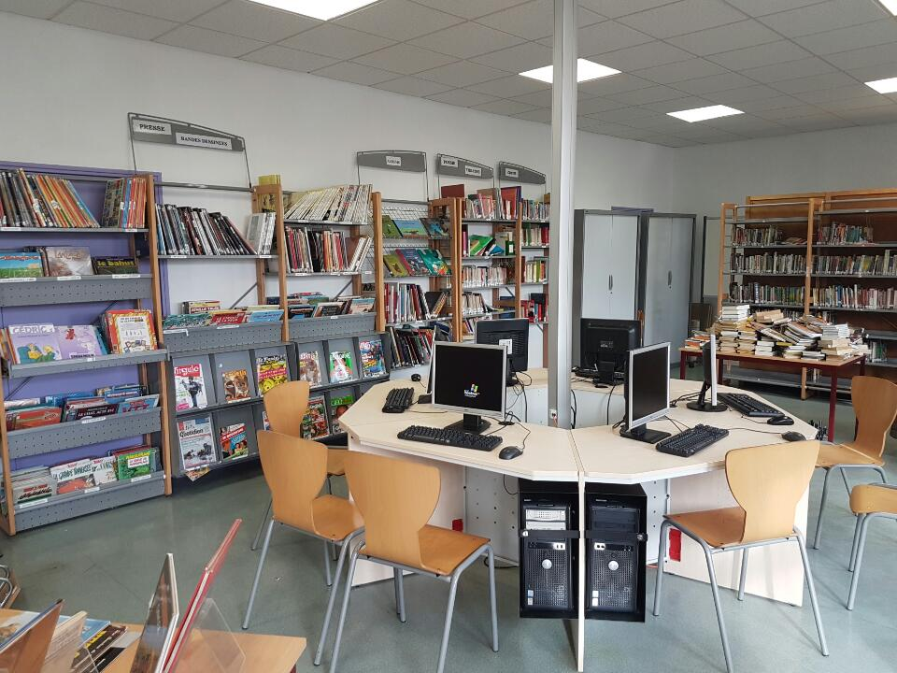
THE LIBRARY

Slide 5
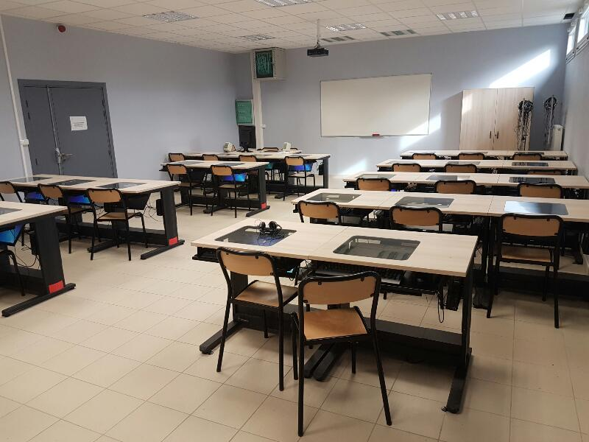
I.T ROOM

Slide 6
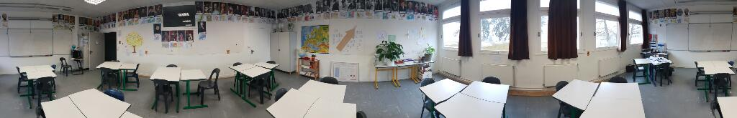
CLASS OF HYSTORY

Slide 7
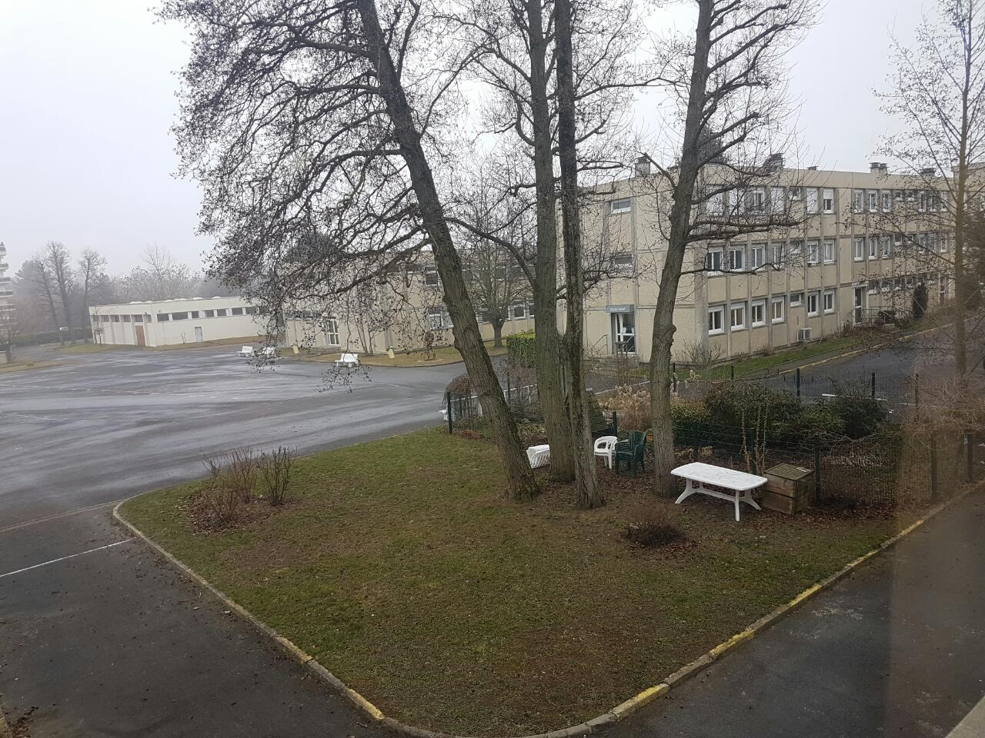
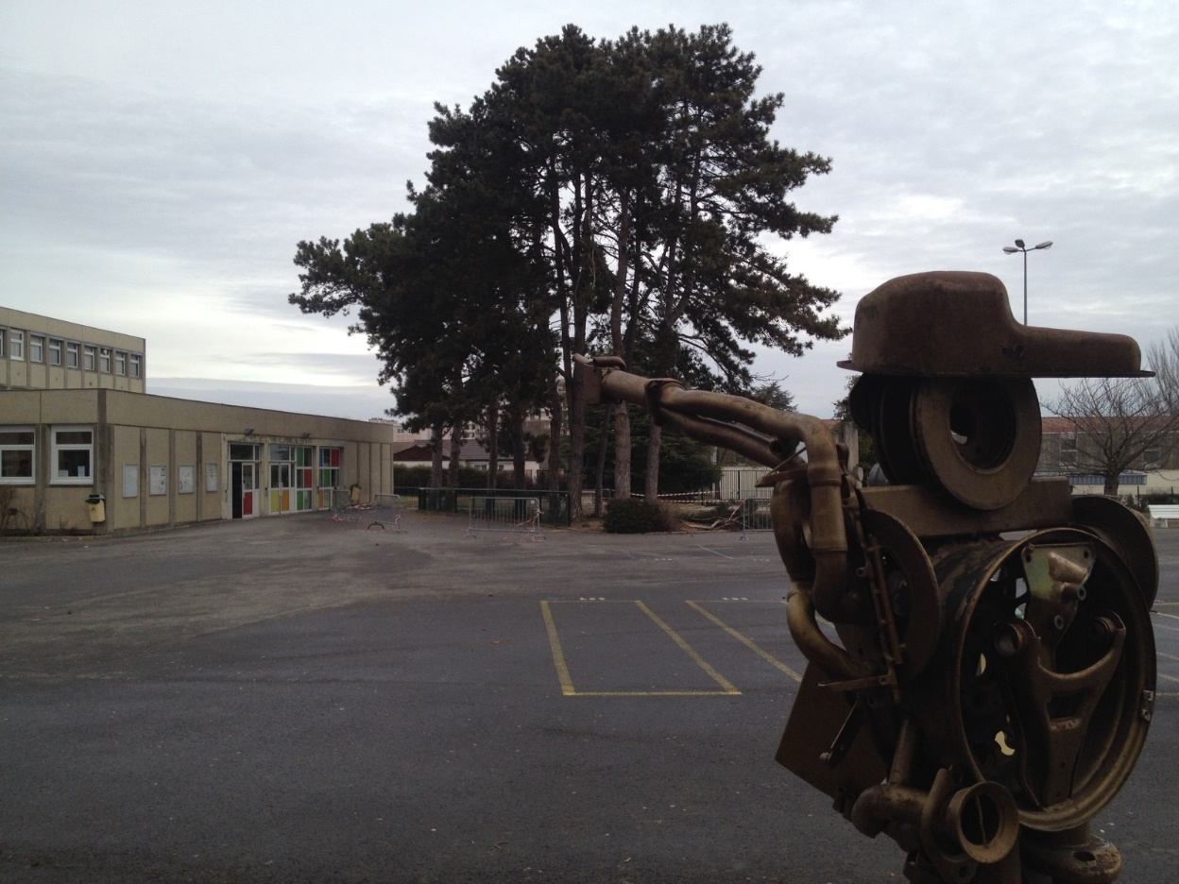
THE PLAYGROUND

Slide 8
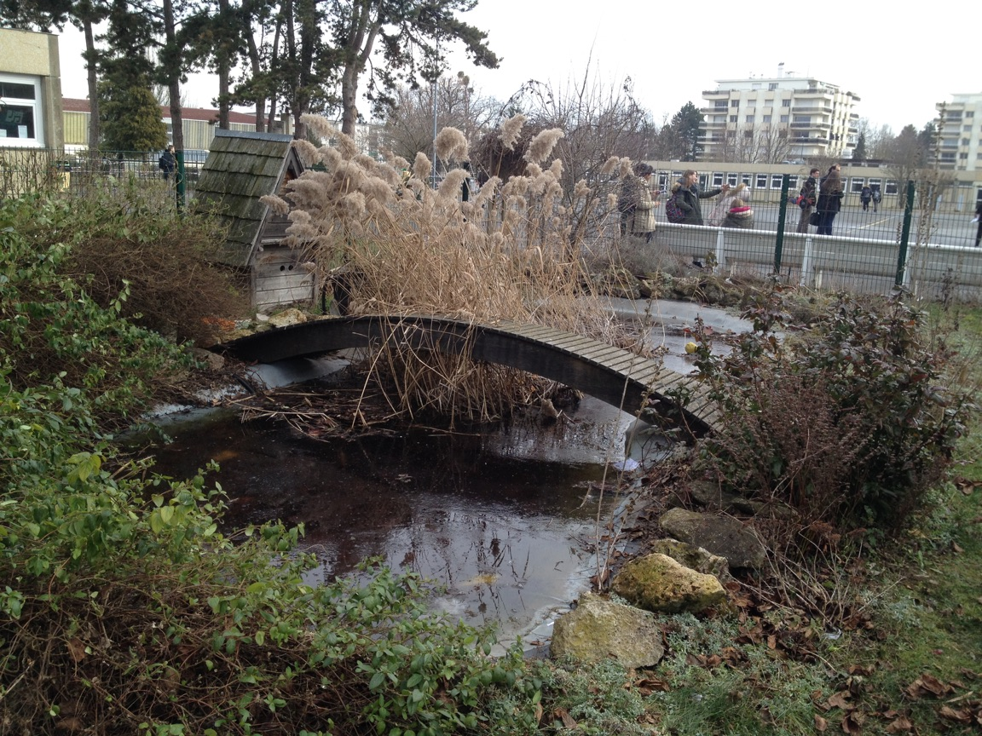
THE POND

