Slide 1
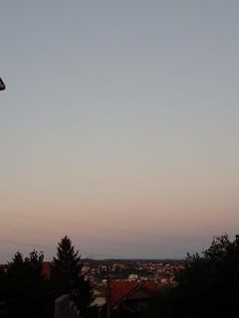
Naselje Klenak
Klenak is located in Serbia, 5 km from Avala. t is very beautiful at least before sunset and at night you can see the whole Kaludjerica, the view is unique. Th is not very populated. The street where I photographed this place has a lot of virtues, especially since there are a lot of plants, and in winter, when I look at it, it all looks kind of magical.

Slide 2
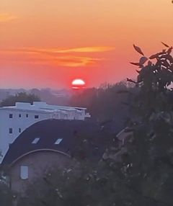
Banovo brdo
Banovo Brdo is an urban settlement and hill in the municipality of Cukarica in Belgrade. It is connected by Požeška Street with the city center, which continues to the south on the Ibar highway. Banovo brdo is bordered by Ada Ciganlija, Košutnjak, Topčider and Žarkovo. There are two settlements on the eastern slopes - "Golf" and "Sunny Slope". It was named after Matija Ban, a Dubrovnik politician and diplomat who lived here in the middle

Slide 3
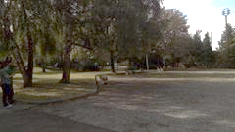
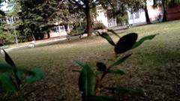
Hemisjko prehrabrena tehnoloska skola
Chemistry school I would be lying when I said it was easy, but I would be lying And if I said it was hard in these two photos you can see some of my favorite parts where I would be with the company while waiting for classes to start or where we sit after class. in the picture y the corner where you can see the school yard at least a part of i sometimes we hide there if we play some board games

