Slide 1
Create Value Out of Surplus Food

Slide 2
WHO AM I?
Graduated from Political Science and International Relations
Project Specialist – works in Whole Surplus for almost 3 years.
Took part in Erasmus projects in high school.

Slide 3
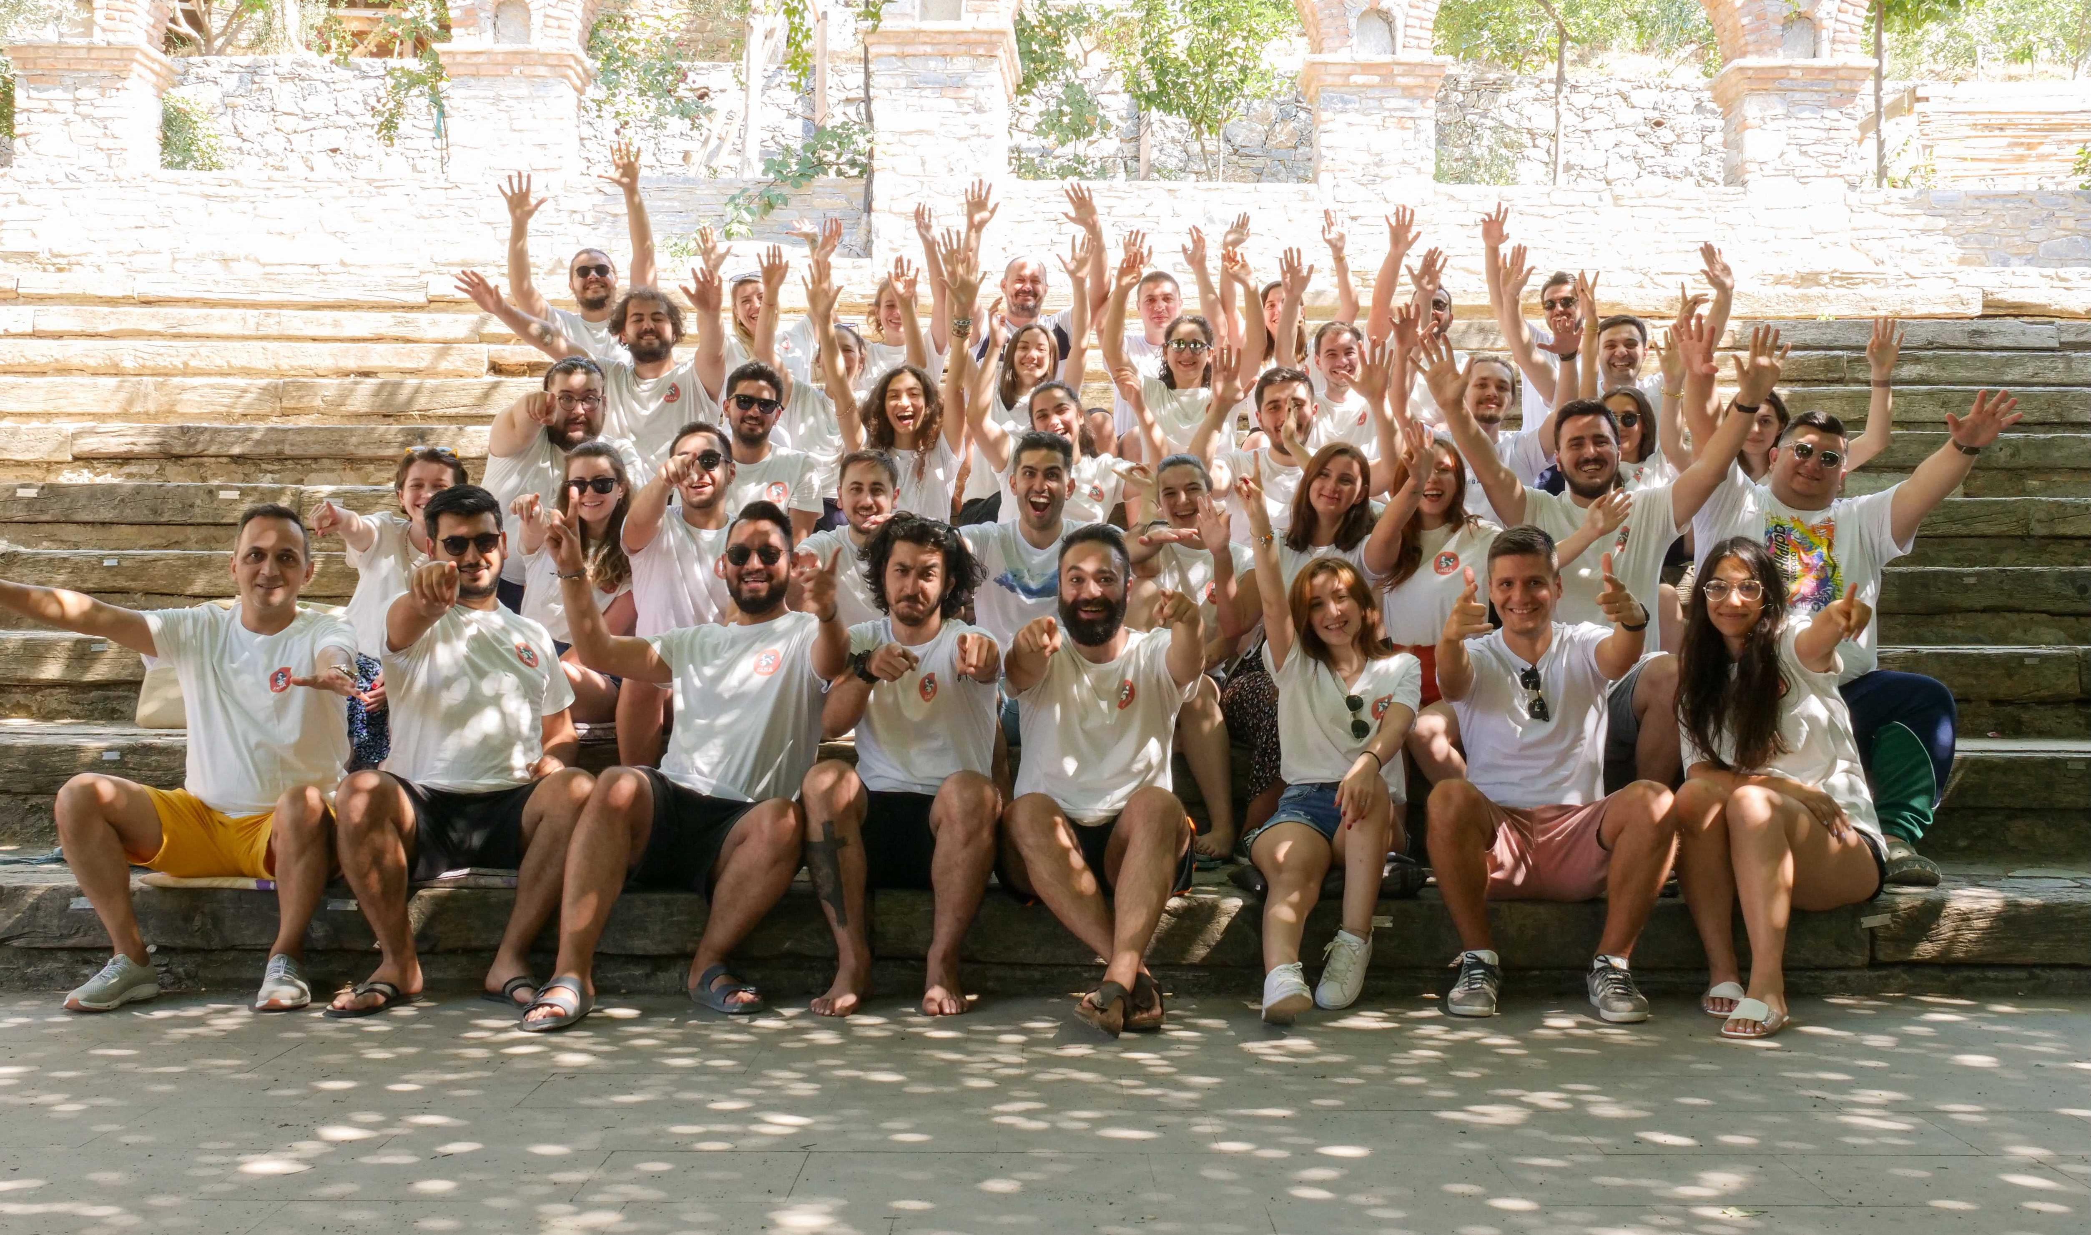
OUR TEAM

Slide 4
LIFE CYCLES IN FOOD SECTOR
Waste Management
Production
Food Services
Processing
Retail
Storage
Logistics

Slide 5
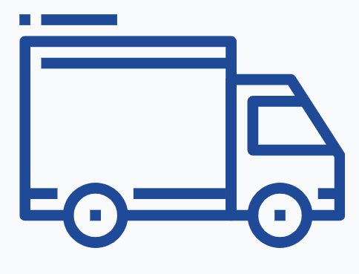
WHAT IS FOOD LOSS AND FOOD WASTE?
Food Loss
The situation where food suitable for consumption is not consumed. It covers food that is often neglected or intentionally thrown away.
Production
Processing
Logistics
Storage
Retail
Food Services
Home Consumption
%11
%15
%4
%3
%5
%12
%50
The food that cannot reach the consumer due to spillage, or wrong actions taken in those stages.
Food Waste

Slide 6
WHAT IS FOOD LOSS AND FOOD WASTE?
Avoidable Food Waste
Unavoidable Food Waste

Slide 7
HOW MUCH FOOD IS WASTED?
Every year,
1.3 Billion tonnes of food goes to waste
Food loss and waste causes 2.6 Trillion $ financial loss.
Food waste is responsible of %8 of carbon emmission.

Slide 8
HOW MUCH FOOD IS WASTED?
Every year,
We bury 1.6 billion tons of unconsumed food in the ground.
We lose %18 of our agricultural fields
Hundreds of liters of oil
%21 of our limited water resources

Slide 9
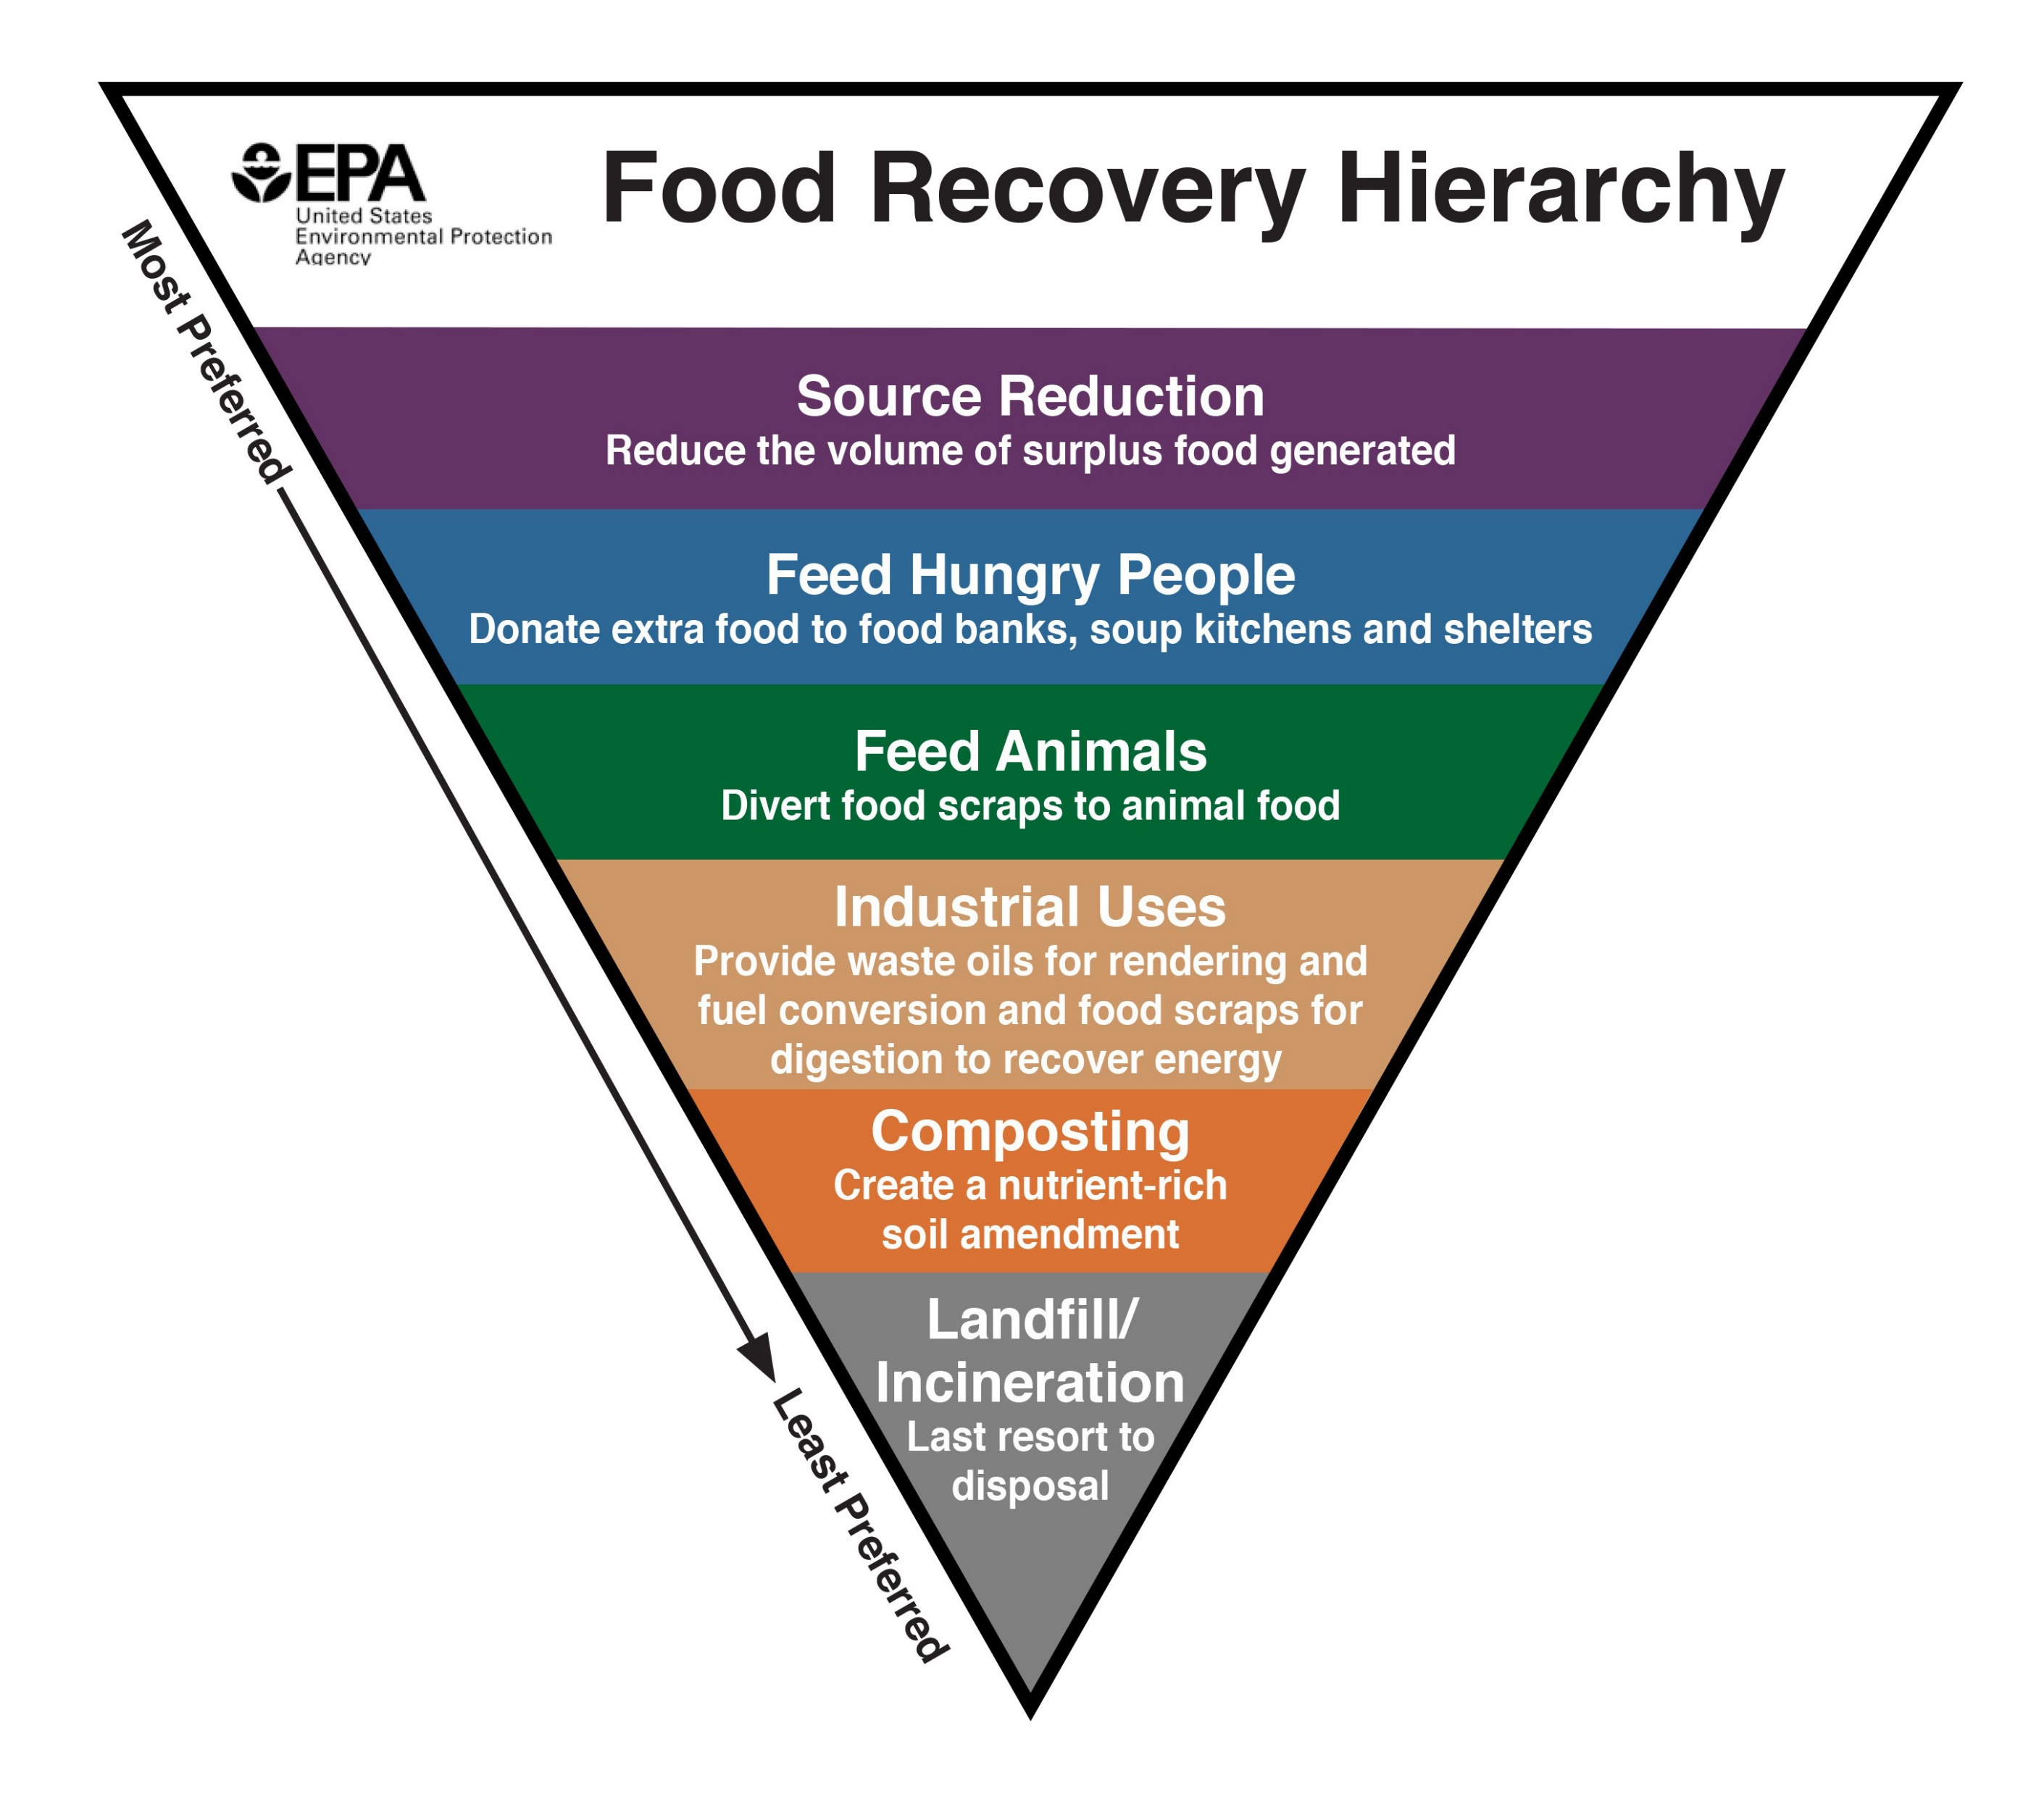
HOW CAN WE REDUCE FOOD WASTE?

Slide 10
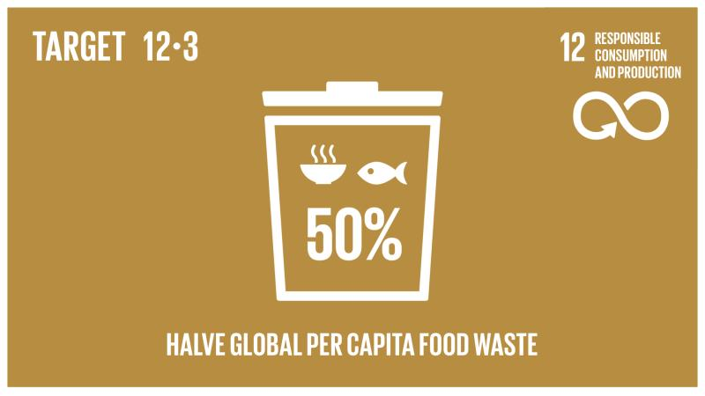
BUT WHY?
Financial Loss Related to Food Waste
Sustainable Food Systems
Climate Change
Limited Resources
Food Donations to People in Need

Slide 11
WHOLE SURPLUS
Food Recovery Hierarchy is in the heart of Whole Surplus Business Model.
Products Suitable For Human Consumption
Products Not Suitable For Human Consumption
Source Reduction
Analytics
Resell
Feed Hungary People
Donation
Feed Animal
Analytics
Donation
Resell
Animal Feed Production
Animal Feed Production
Recycling
Compost and Energy Generation
Biogas

Slide 12
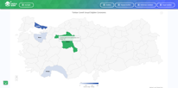
HOW IT WORKS?
AI based SMS (Surplus Management System) let our partners to create maximum financial, environmental and social benefit out of unsold inventory.
1
2
3
4
5
FOOD BANK
AGRICULTURE
Companies upload details and stocks of their surplus food.
SMS decides which module would be the best based on financial, social and environmental benefits.
SMS matches the surplus food with the right partner who offers the highest value.
Logistics support and payment solutions are provided to companies.
All legal documents regarding the operations are kept in e-archive.
HORECA
RETAILER
ANIMAL FEED PRODUCER
PRODUCER
DISTRIBUTOR
RECYCLER
Product and branch based monthly reports
Social and financial metrics based on operations

Slide 13
COLD CHAIN TRACKING SYSTEM – SENSA S
Temperature Measurement
Alarm Notification
%4
Fazla Gıda
Sensa S
Data Logging
Data Tracking

Slide 14
FOOD SERVICES
Every year 22,6 tonnes of food is wasted.
This food is cost 229.849 TL.
This food can feed 5 family in a year.
We can grant scholarship to 25 students with this money.

Slide 15
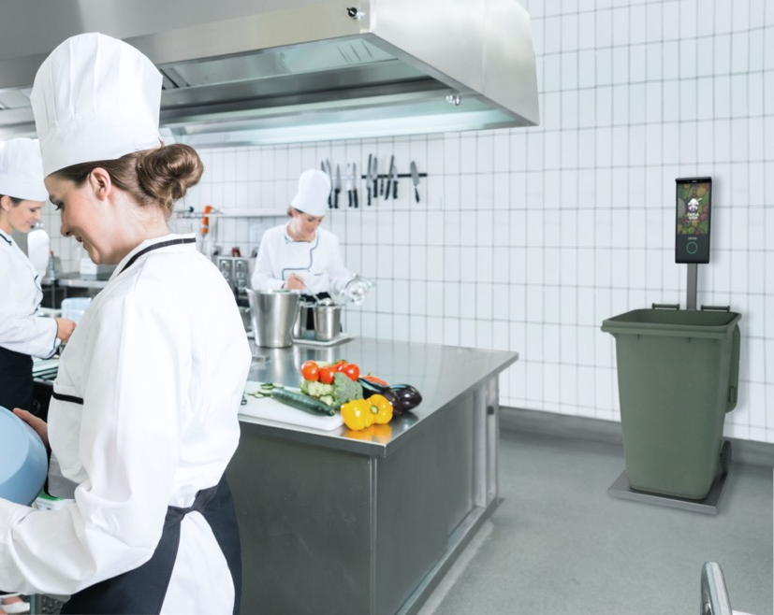
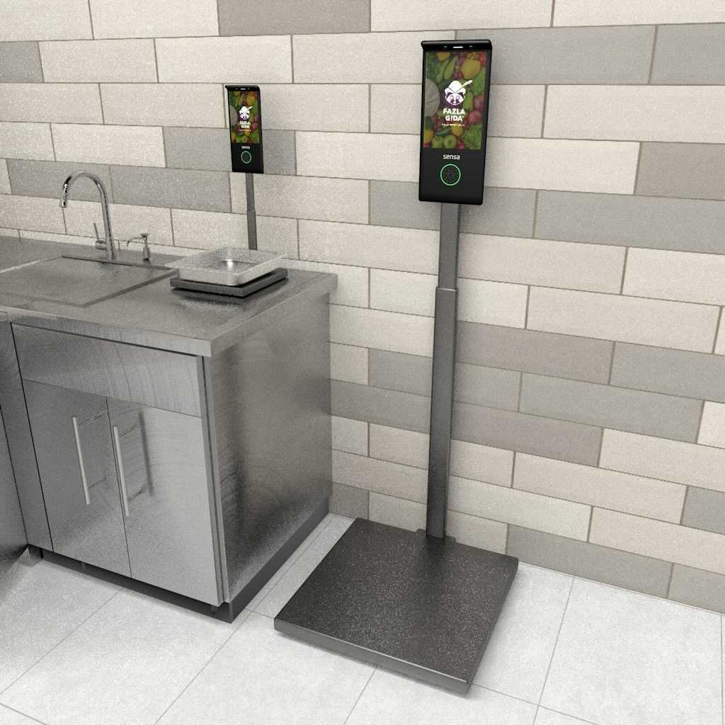
DIGITAL WASTE MEASUREMENT AND TRACKING SYSTEM – SENSA T
%12

Slide 16
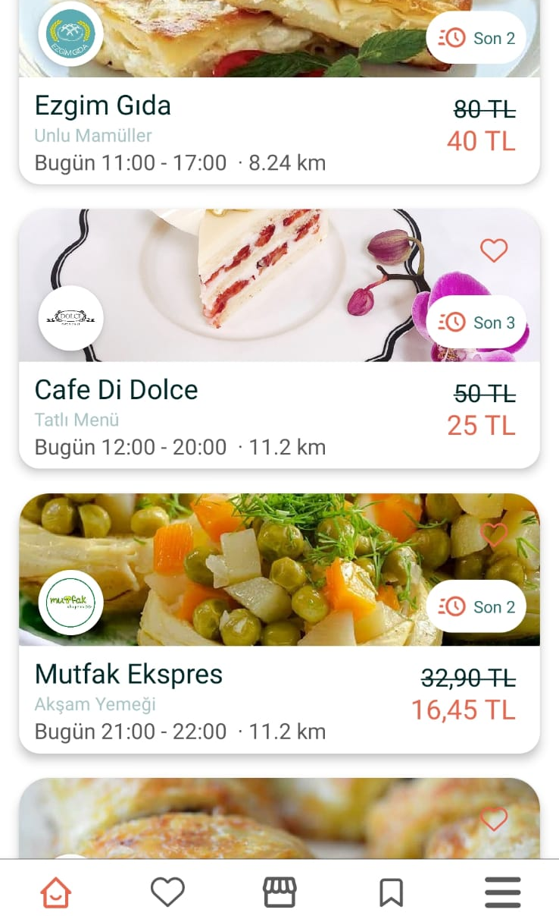
FOOD SERVICES - FAZLA
%12

Slide 17
OUR SUCCESS
Saved 19.000 tonnes of food.
Prevented 63.000 tonnes of carbon emission.
Provided food donations to 1.100.000 people in need monthly
300 Million TL worth surplus food brought back to economy.
Awarded by:
Saved 72 Billion
liters of water.
All operations are accomplished through 75.000 transactions.

Slide 18
SOME SUGGESTIONS
Plan before you go shopping.
If you are not so hungry, as for smaller portions.
If you can’t finish, ask for doggy bags.
Create a ‘Eat Me First’ basket in your fridge.

Slide 19
Create Value Out of Unsold Inventory
Kübra Orak
Project Specialist
kubra.orak@fazlagida.com

