Slide 1
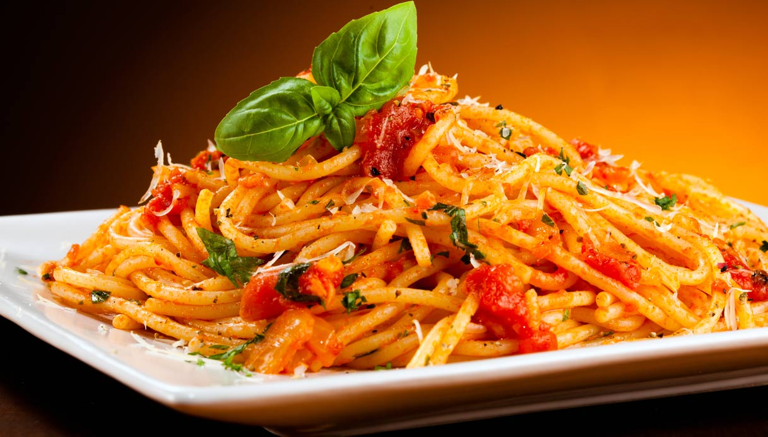
Food’s Item Path related to PASTA

Slide 2
Which are its ingredients?
Pasta is made of:
flour
eggs
salt
water.
Most pasta is made with semolina or durum, a type of wheat flour, but other grains, such as corn, rice, quinoa, spelt and kamut can also be used.

Slide 3
What activities are involved in getting flour?
Flour is the product of obtained by grinding whole wheat kernels.
A wheat kernel consist of 3 parts the bran, germ and endosperm.
During the milling process, these 3 parts are separated and recombined to make different types of flour.

Slide 4
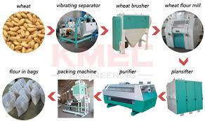
Which processes are involved so as wheat is transformed into flour?

Slide 5
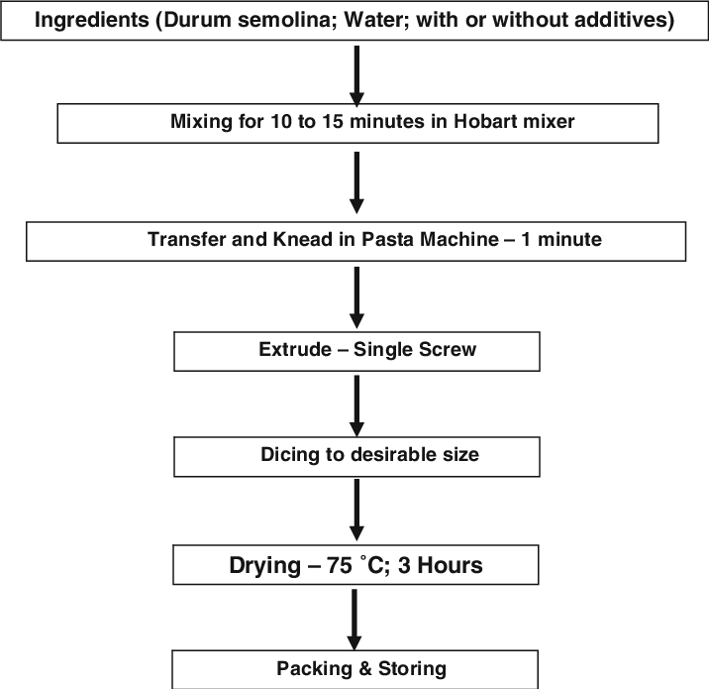
Which processes are involved so as flour is transformed into pasta?

