Slide 1
Turkish Team from İzmir

Slide 2
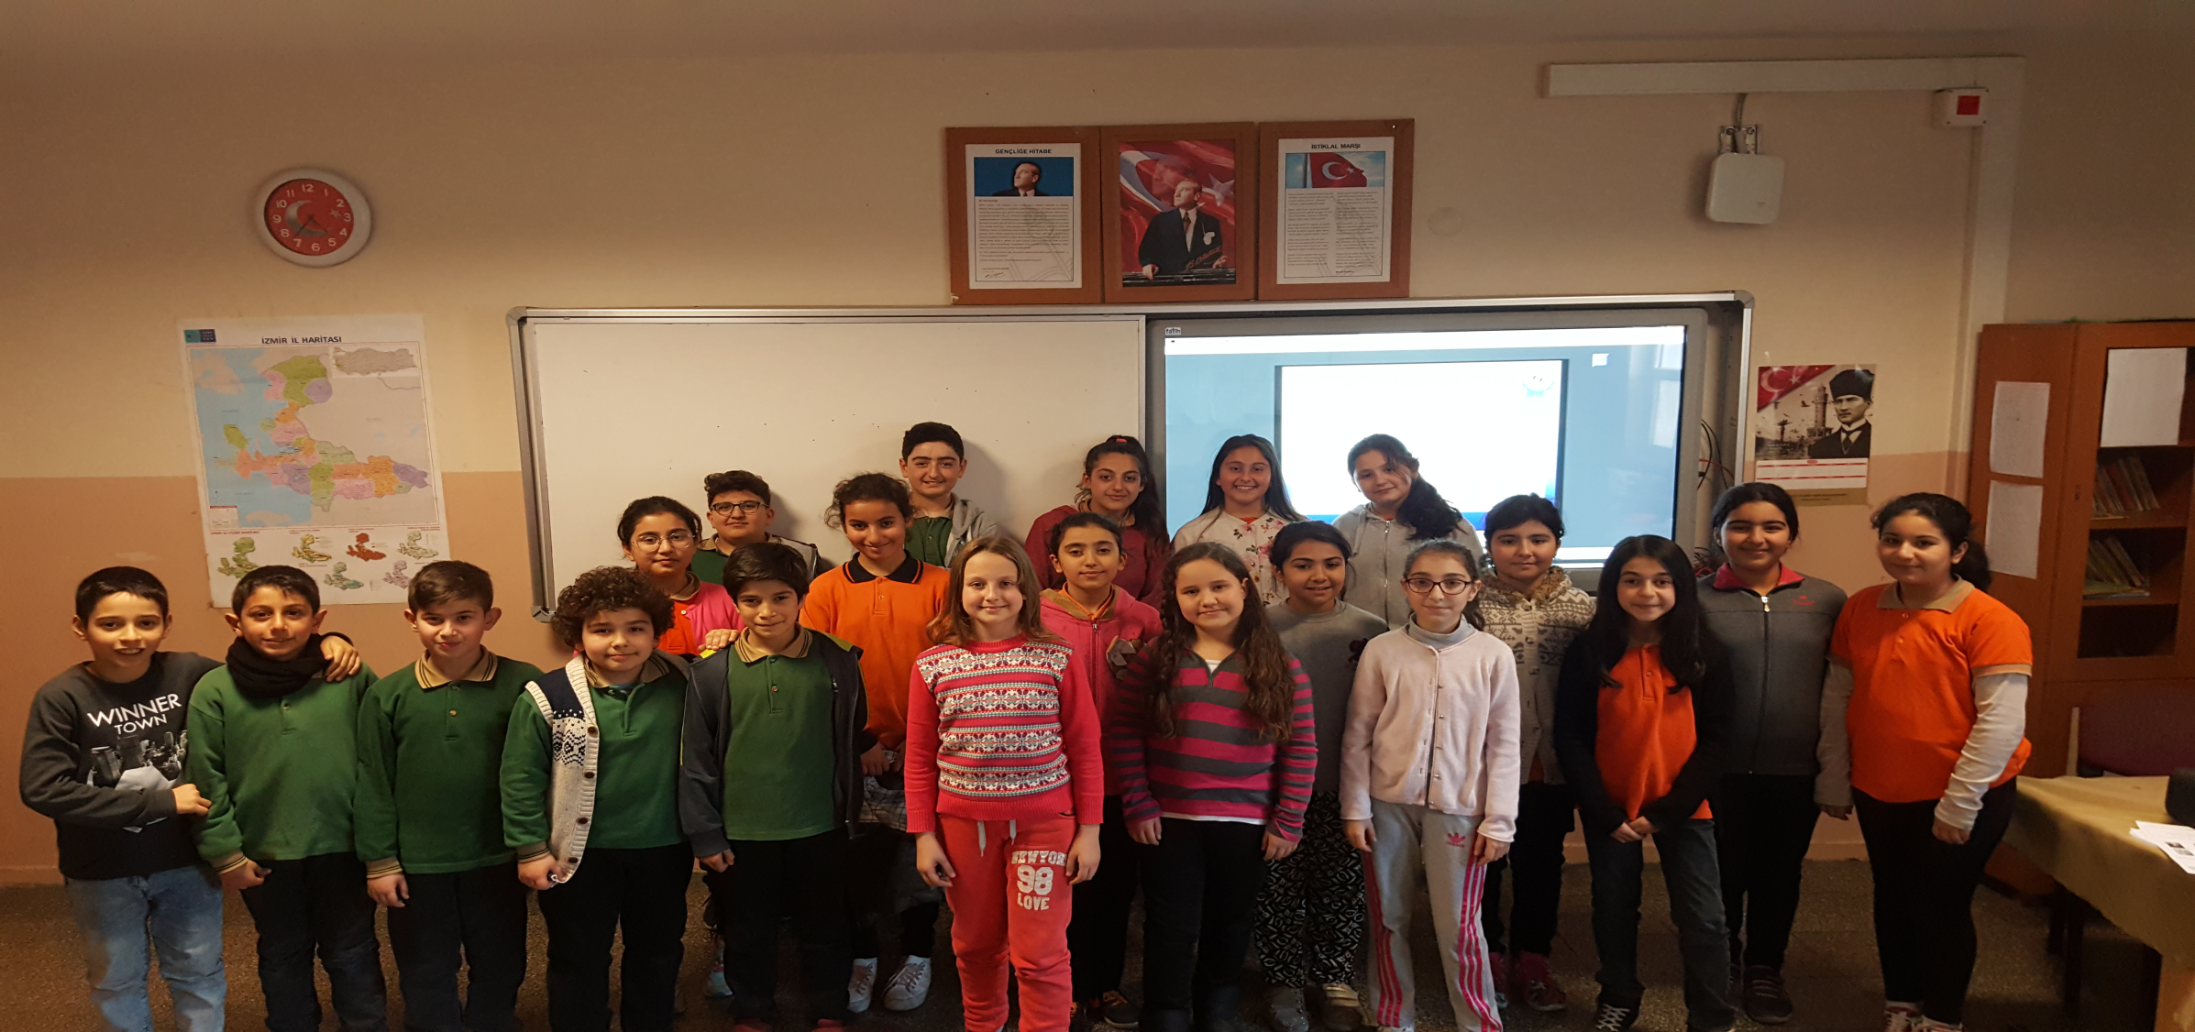
This is us ☺

Slide 3
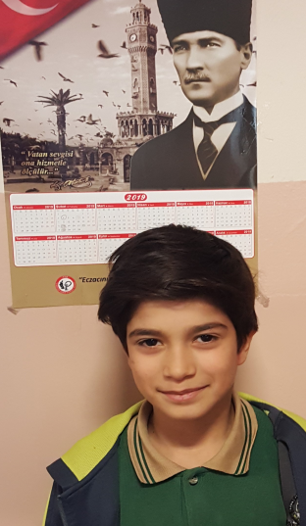
Hello! My name is Ela. I’m from Turkey. I’m Turkish. I’m ten years old. I speak Turkish and English. My favourite classes are English, Science, Maths and Music. I like volleyball and hide and seek. Nice to meet you.
Hello! My name is Ulaş. I’m eleven years old. I speak Turkish and a little English. My favourite classes are Art and English.
Hello! My name is Merve. I’m ten years old. I’m from Turkey. I’m Turkish. I speak English and Turkish. My favourite classes are English and Maths. I like playing hide and seek, volleyball and basketball. Good bye!

Slide 4
Hi! My name is Akasya. I’m eleven years old. I’m Turkish. My favourite class is English. I like playing soccer. I speak English and Turkish. Nice to meet you! ☺
Hi! My name is Şaziye. I’m twelve years old. I speak Turkish, Kurdish and English. My favourite classes are English and Science. Good bye ☺
Hello! My name is Zeynep. I’m ten years old. I’m from İzmir/ Turkey. I’m Turkish. I speak Turkish and a little English. My favourite classes are English and Science.
Hello! My name is Azra. I’m ten years old. I’m from Turkey. I’m Turkish. My favourite classes are Maths, Science, P.E. and Turkish. I like playing hangman, dodgeball,tag,hopscotch and skipping rope.
Hello! My name is Sıla. I’m eleven years old. I’m from İzmir, Turkey. My favourite classes are English, Turkish, Music and Maths. I like football. Nice to meet you.

Slide 5
Hello! My name is Elvan. I’m from Turkey. I’m Turkish. My favourite classes are English, Turkish and Social Studies. I can do origami, play dodgeball but I can’t do magic. My favourite movie is Cinderella. I have got two sisters. I need to have friends. Can you be my friend? ☺
Hello! My name is Hasan. I’m eleven years old. I’m from Turkey. My favourite classes are English and P.E. I like soccer. I can speak Turkish and English. I like Spy Kids movie but I don’t like Cinderella. Nice to meet you. ☺
Hello! I’m İrem. I’m from Turkey. I’m Turkish. I’m eleven years old. I have got a sister. I also have a bird. My favourite classes are English, Maths, Science, Social Studies, Art and Music. My favourite games are hide and seek,tag. My hobbie is listening to music.
Hello! My name is Ali. I’m eleven years old. My favourite class is English. I like playing basketball. I speak Turkish. I like horror movies. My favourite games are hide and seek, tic tac toe and blind man’s buff. Nice to meet you.
Hello! My name is Tuğba. I’m from Turkey. I’m Turkish.I’m eleven years old. My favourite class is English. I dislike P.E. class. Good bye ☺

Slide 6
Hello! My name is Nehir. I’m from Turkey. I’m Turkish. I’m eleven years old. I have got a sister. I have a fish. My favourite classes are English, Maths, Social Studies,Science, Music and Art. My favourite games are hide and seek, hopscotch and tag. My hobbies are listening to music and drawing pictures.
Hi! I’m Emirhan. I’m ten years old. I like Science, Maths and English. I like playing hide and seek but I don’t like playing tic tac toe. I’m from İzmir, Turkey.
Hi! My name is Ecemsu. I’m eleven years old. I speak Turkish, English and a little German. I like football and hide and seek. My favourite classes are English and Science. I hope to see you my new friends from far away. Good bye ☺
Hi! My name is Oğuz. I’m eleven years old. My favourite class is Turkish. I like playing football. I like action and science fiction movies.

Slide 7
Hello! My name is Dilek. I’m eleven years old. I’m from Turkey. I’m Turkish. I speak Turkish and English. I have got a sister and a brother. My favourite classes are Maths, Turkish and English.
Hello! My name is Umutcan. I’m ten years old. My favourite classes are English and Social Studies. I’m from İzmir, Turkey. I like playing soccer and hopscotch. I can speak English and Turkish. I like ‘Recep İvedik’ and ‘Hababam Sınıfı’ movies. Nice to meet you. ☺
Hi! I’m Batuhan. I’m eleven years old. I speak English and Turkish. My favourite classes are English and Turkish.

Slide 8
You can play jigsaw puzzle game here ☺
https://www.jigsawplanet.com/?rc=play&pid=12787134e785

Slide 9
İzmir, the third largest city in Turkey, Is a modern and developed city, as well as an important center of culture, arts, tourism and trade. Atatürk emphasized the importance of the city as "Masters, all world should know that, from now on, Izmir is a sacred land where no longer any dirty feet can step on!", where Aristotle warned Alexander the Great as 'You will not be completed unless you see here", with the history dates back to 8.500 years, the city involves significant historical and cultural richness. The city is the face of Turkey in Europe with its social-cultural structure, which is suitable for the transportation convenience, climate suitable for tourism, cultural activities and artistic activities. 629 km to the sea, city, which is composed of natural beaches of 10“1 km of coastal length, welcomes guests from different parts of the world in four seasons of the year. With care centers like Agamemnon, Asklepion, Allianoi, Karakoç and Çeşme-Şifne, Ilıca etc, Izmir today is a health, culture, religion and thermal tourism center with very high potential that serves healthy life alternatives to visitors from Scandinavian countries and visitors from all over globe.

Slide 10
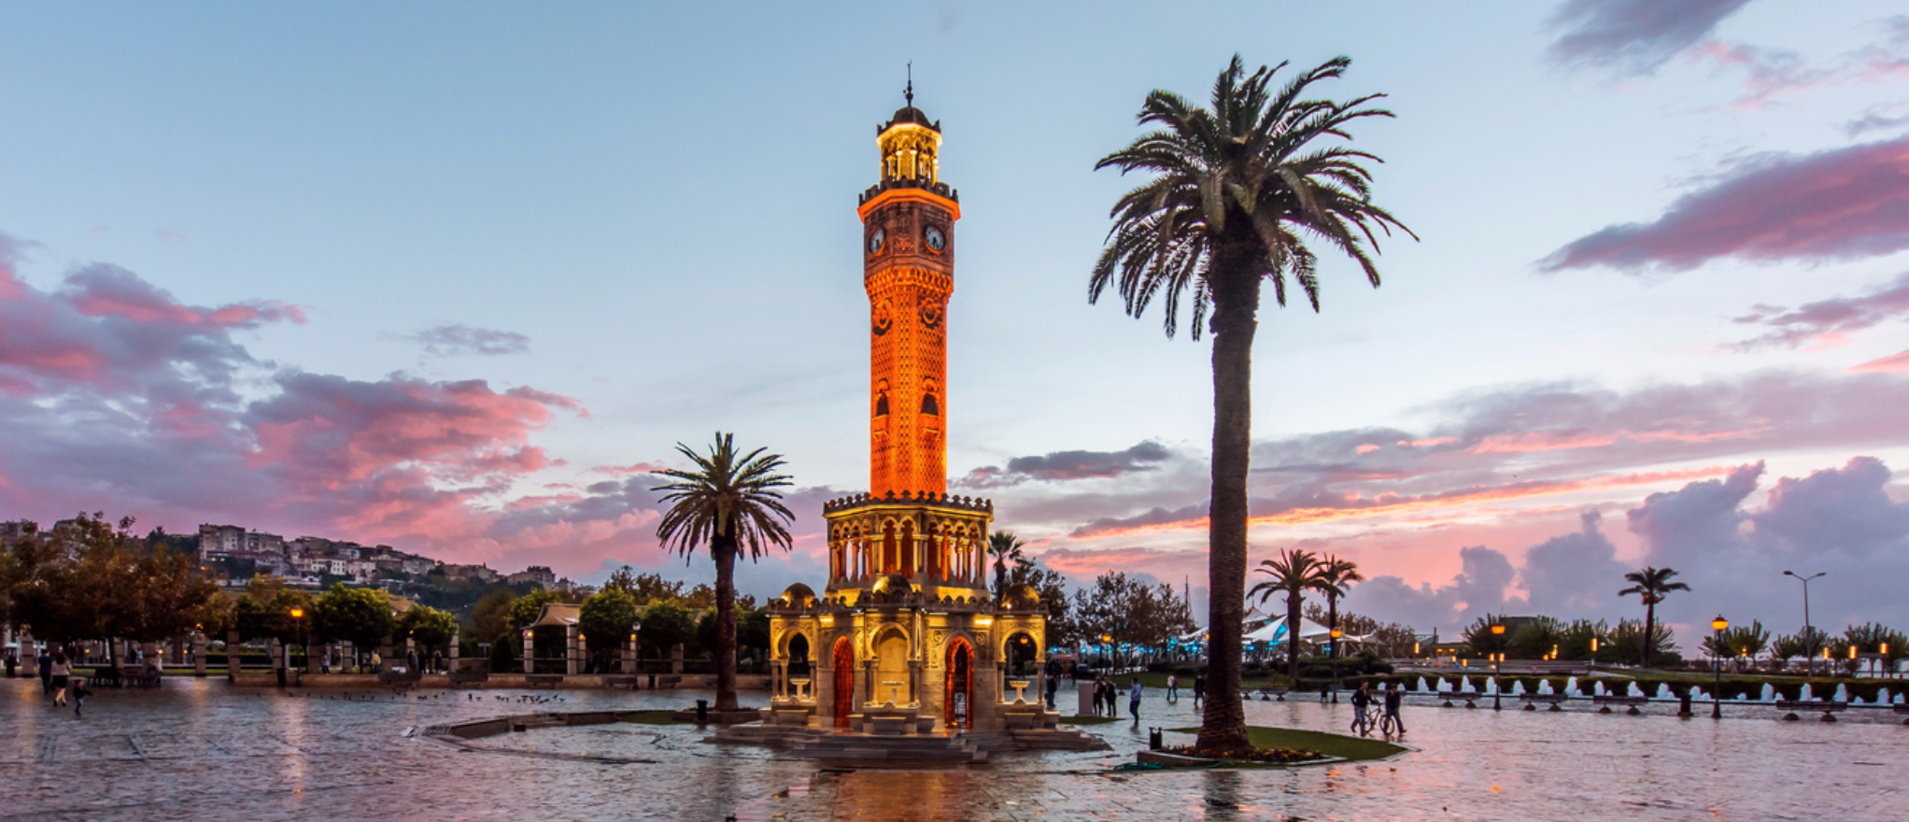
Here are some photos of İzmir ☺ The Clock Tower in Konak where our school is located

Slide 11
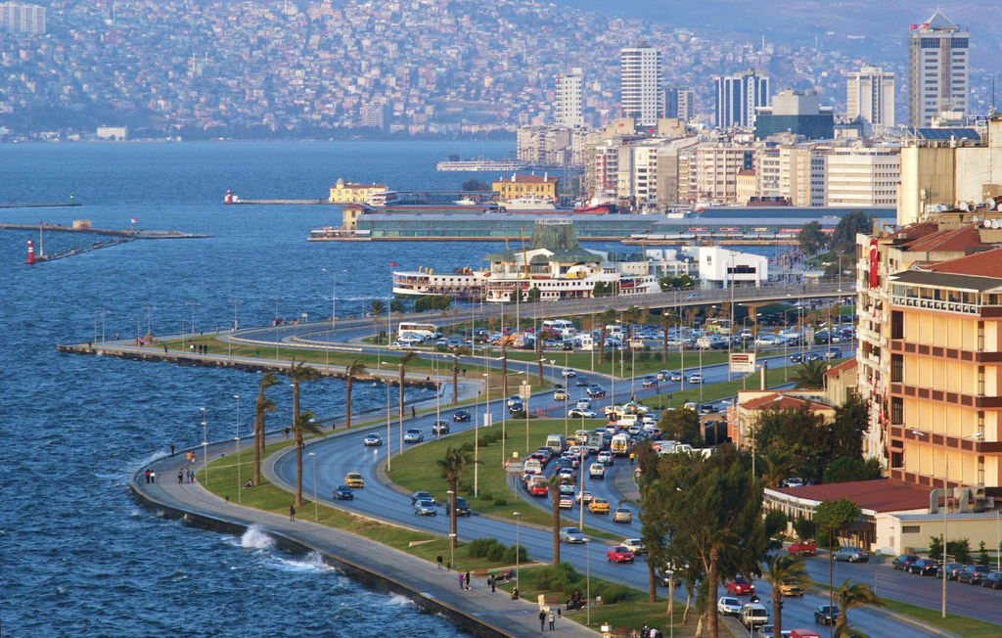
We hope you like our city ☺

