Slide 1
Turkish Team from Amasya

Slide 2
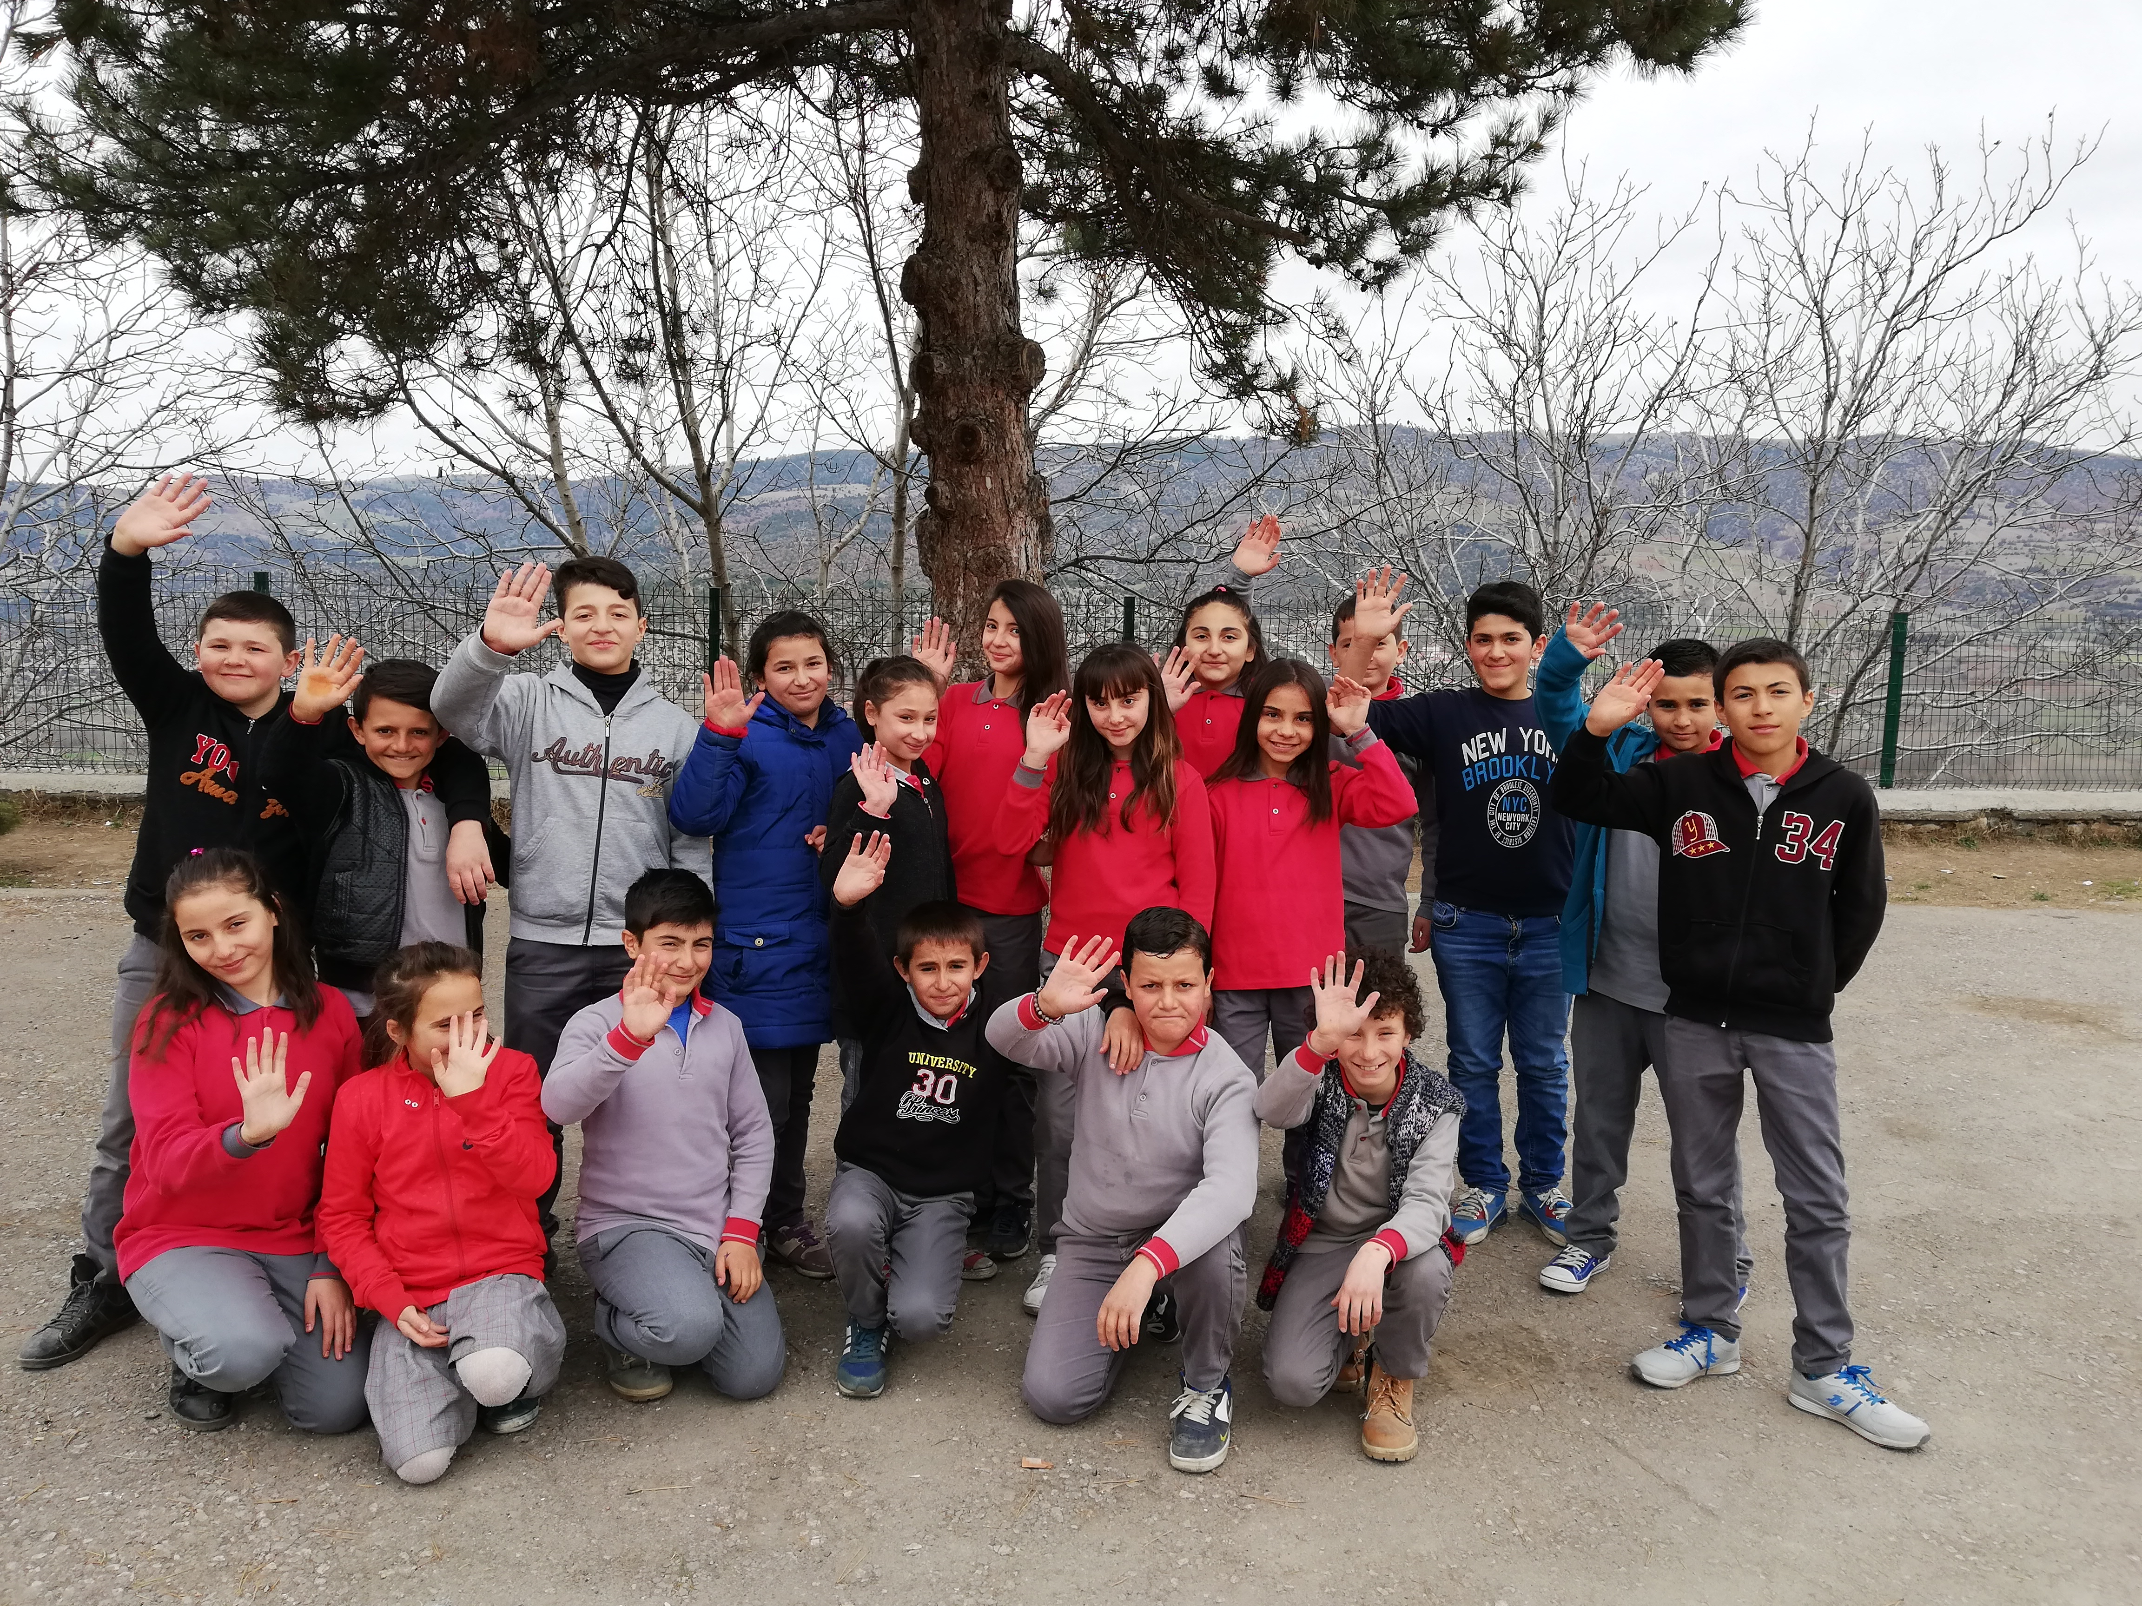
This is us

Slide 3
Hello, my name is Hazal. I am 12 years old. I have got a long black hair. I like sports . My favourite sport is bocce. I like English and Maths.
Hello, my name is Arif. I am 11 years old. I like to hang out with my friends and play soccer with them.
Hi! I´m Eren and I´m 12 years old, I have brown hair and and black eyes. I have a dog. His name is Zeytin. It means ‘olive’. ☺ My favorite sport is bocce.

Slide 4
Hi, I am Rüya. I am 12 years old. I have a sister. Her name is Büşra. My favorite sport is badminton. I love English. I am happy to meet you.
Hello, I’m Dahil. I am 12. I have short brown hair. I have 3 dogs and 3 cats. I like animals a lot. I like cycling. I like being physically active.
Hello I am Aleyna Nur . I´m 12 years old. I have long blond hair.
My name is Sıla. I am twelve. My favourite sport is bocce. I have a cat. Her name is Boncuk. My favorite class is English. See you soon.

Slide 5
Hi Velke Popovice! My name is Serkan. I am 12. I hava short hair. I like sports. My favorite sport is soccer. I am a goalkeeper. I like Petr Cech.
Hello I am Özge. I am 12 years old. I have black hair. I have a cat and her name is Pamuk. I like reading book.
Hi! My name is Mehmet Can. I am 12 years old. I have short brown hair. I have a cat and her name is Boncuk. I like running.

Slide 6
My name is Neriman. I am 12 years old. I have got black hair and brown eyes. I like skipping a rope.
Hello! My name is Metehan. I am 12 years old. I have a long blond hair. I like animals. We have cows. My favorite sports are soccer and bocce. I can teach you Bocce.
Hello I am Hüseyin. I have curly brown hair. I like English and Art.

Slide 7
Enjoy our puzzle ☺
https://www.jigsawplanet.com/?rc=play&pid=347f5eac2401

Slide 8
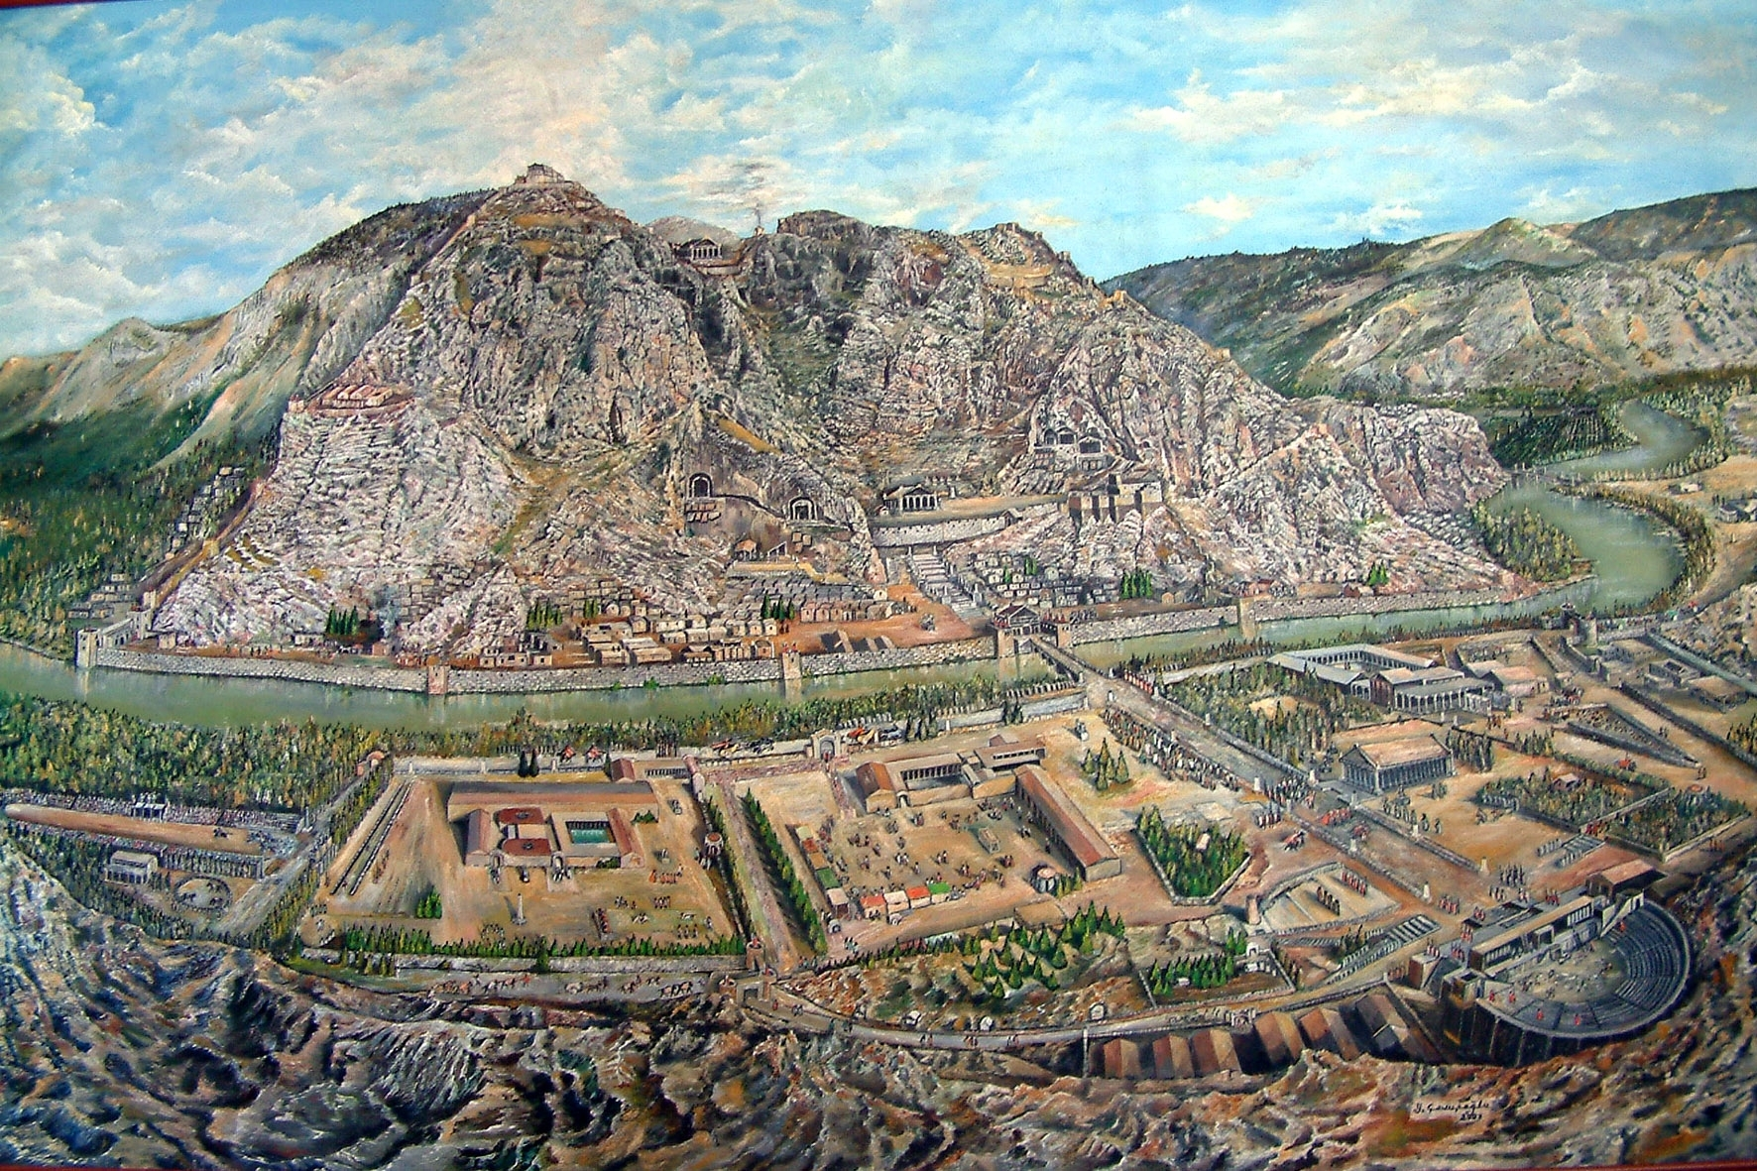
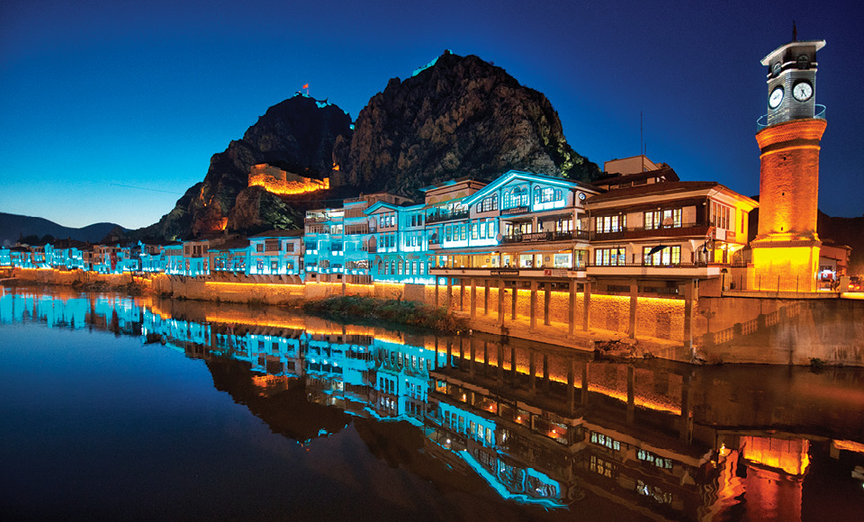
About Amasya
Amasya is a historical and touristic city in Northern Turkey. It’s history is as old as B.C. 4000. Uygur is founded in about 1300. The first settlers were Uygur Turks. Uygur is a small and nice village between mountains. There are nearly 900 people in the village. We have apple and cherry festivals in summer.

