Slide 1
Georgios Koutsoukis Ph.D, M.Ed Headmaster Drama 2018
12th Primary School of Drama
“An active school and a protected monument”

Slide 2
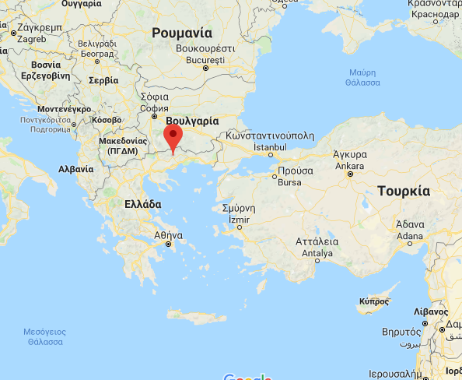
Drama is in Northern Greece
Drama is a city in Northeastern Greece,
-50 Km from the Border with Bulgaria,
-600 Km from the Capital city of Greece Athens
-160 Km from Thessaloniki and
-36 Km from the city of Kavala which is next to the sea.

Slide 3
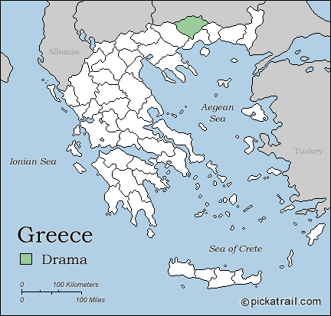
Drama is a regional center
Drama (city) is the capital of the regional unit of Drama which is part of the East Macedonia and Thrace region. The town (pop. 44,823 in 2011) is the economic center of the municipality (pop. 58,944), which in turn comprises 60 percent of the regional unit's population.

Slide 4
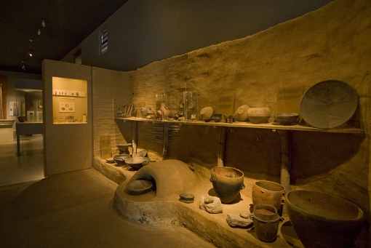
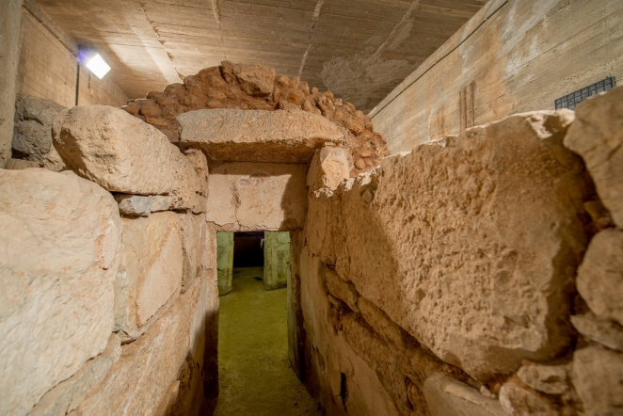
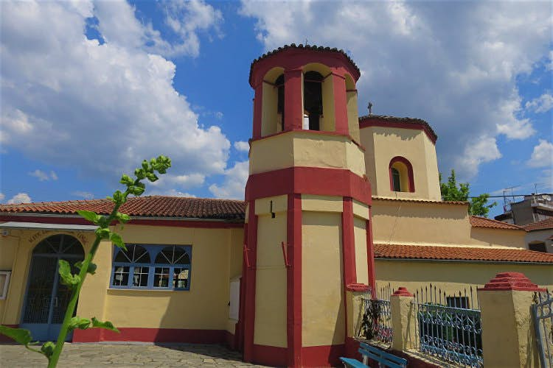
A historical city
The area was inhabited during historic times. The Archaeological Museum includes noteworthy finds from the area, dating from prehistoric until recent years.
A Macedonian Tomb of the Hellenistic years was found in the city.
Agia Sophia Byzantine Church is from the 10th century. Around the Church we can see the ruins of the Byzantine Walls originally built in the 10th century.

Slide 5
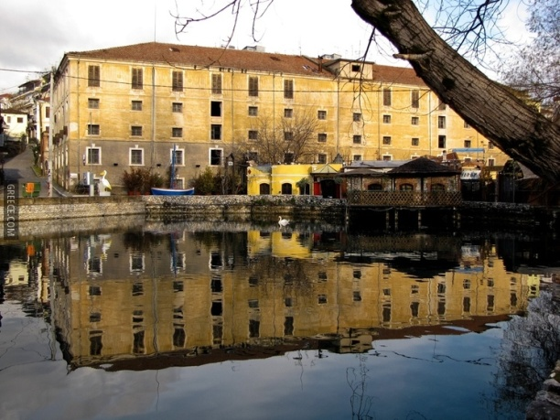
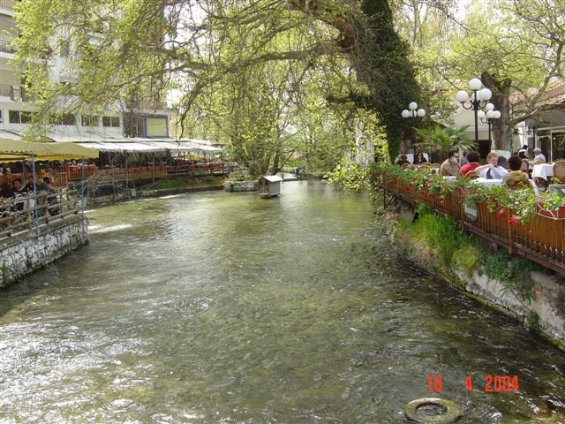
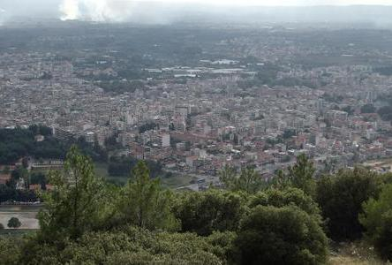
And very beautiful
A walk around Drama is an intriguing mix of old and new, with an array of architectural influences
The most beautiful aspect of the city is the exquisite Agia Varvara springs
Drama is built at the foot of Korylovos Hill covered by pine-trees, with a tourist pavilion, sports facilities and a marvelous view.
https://www.youtube.com/watch?v=QEMKq_ccF0Y

Slide 6
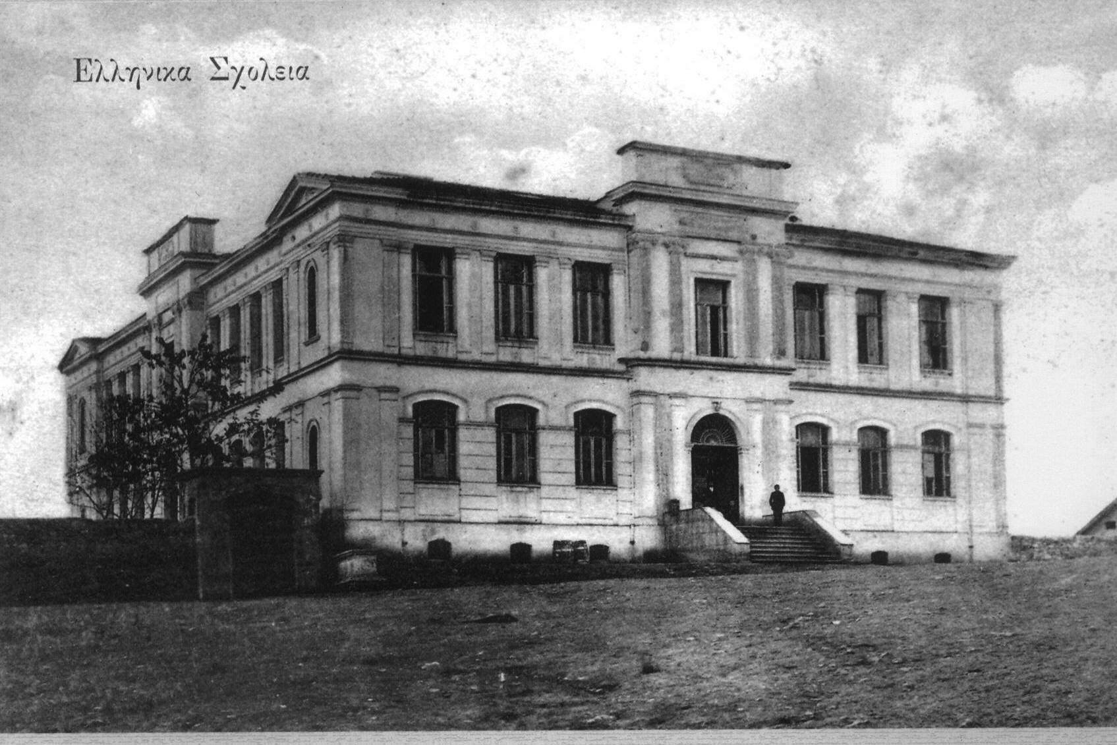
History of the 12th Primary School of Drama
The school has a long history of more than 100 years.
It was founded in 1909 when this part of Greece was under Othoman authority.
The school was built according to the designs of the famous Greek architect Chatzimihalis.

Slide 7
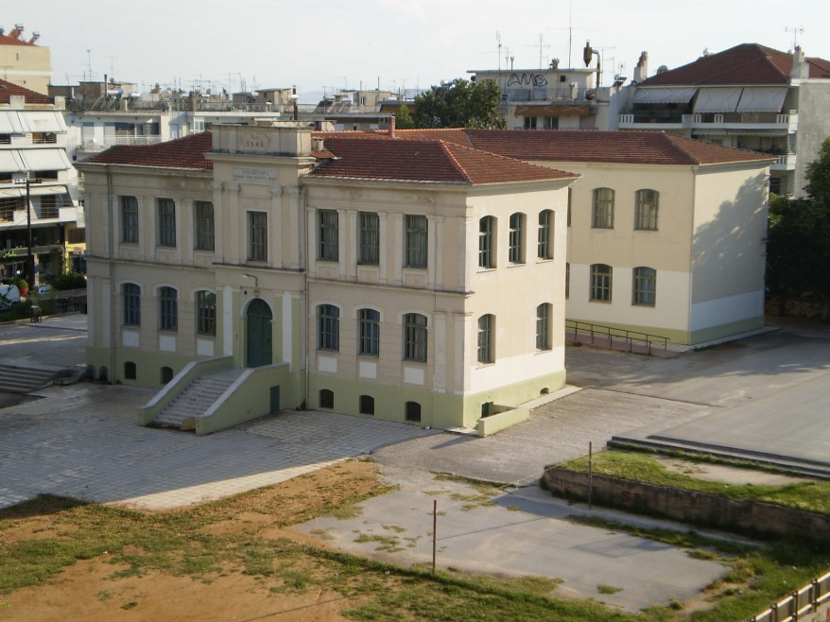
School’s location
The school is situated in the center of Drama in a beautiful environment.
Restoration works were made a few years ago and today although active, the school is a protected monument. During the school year a lot of students from other schools (from Drama or neighboring cities visit us).

Slide 8
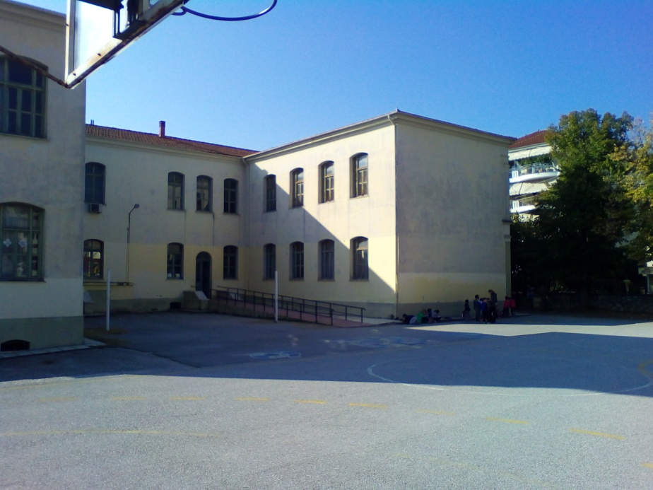
The school building
The main building of the school has 2 floors and all the facilities occupy an area of about 2,000 square meters.
There is a special entrance and a shaped ramp for the service of people with special needs
The two floors are joined by internal stairs.

Slide 9
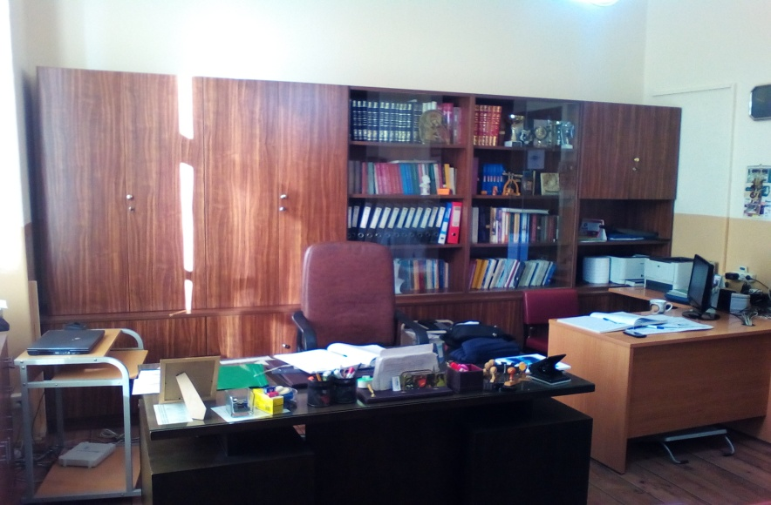
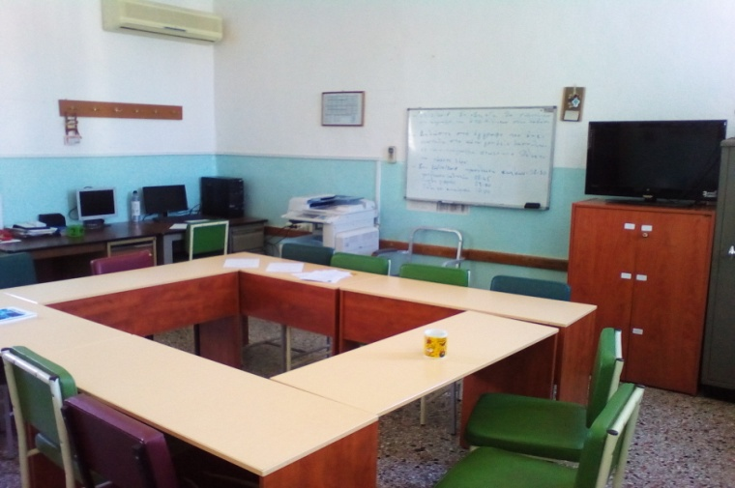
Classrooms
For the needs of the educational process there are 14 classrooms, laboratories, library room, utility rooms, toilets etc.
There are two equipped rooms for the school teachers and a principal's office.

Slide 10
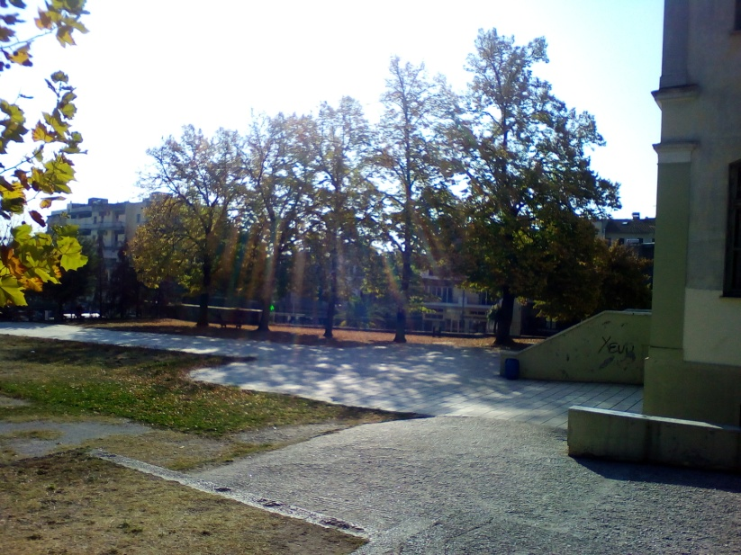
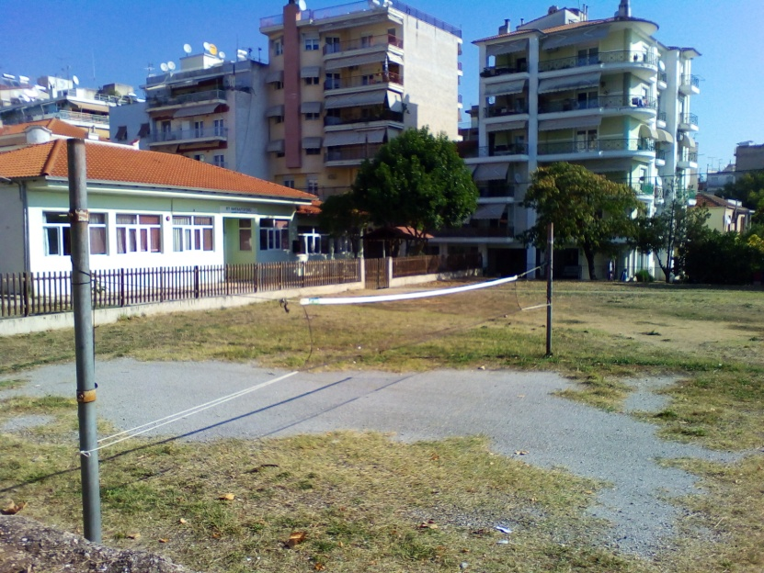
Courtyard area
The courtyard area is quite large.
Within the courtyard area there are outdoor sinks, a small stand for students, two volleyball courts, a football and a basketball field.

Slide 11
School Library
The school library is formed in a special equipped area.
The school library's main goals are:
- To offer the students a learning space, information, knowledge and familiarity with books.
-To provide the teachers with information sources and tools for planning new methodologies in teaching.
Students visit the Library on a daily basis to borrow books, work on their homework, use materials, such as magazines, dictionaries, history books, foreign language books, encyclopedias, CD, DVD etc. available in the library.

Slide 12
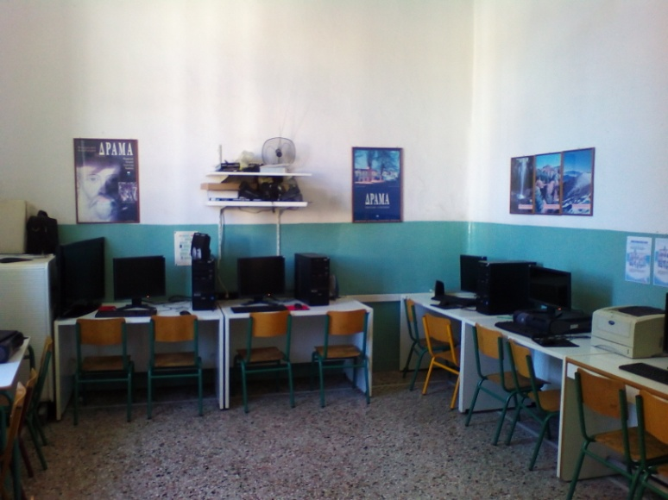
Computer Lab
In a specially equipped school’s room operates a Lab in which IT lessons, the use of PCs and PC applications are being taught.
The pupil’s interest for the New Technologies is particularly high, since the Computer, now plays a very important role on a daily bases.

Slide 13
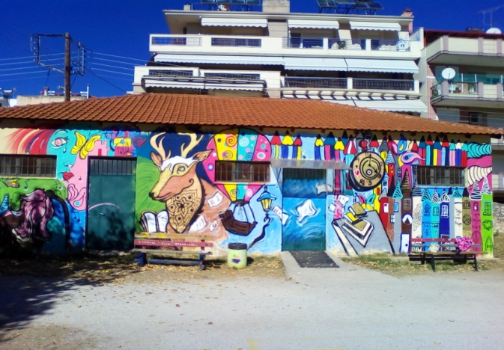
Multipurpose room - Indoor Gym
One of the most important, and loved by the students places is the school’s Multipurpose room, which in winter is used as an indoor gym, where the students have physical education lessons whish are very popular.
With the proper configuration of the room, at times, it is used for organizing musical and cultural events.

Slide 14
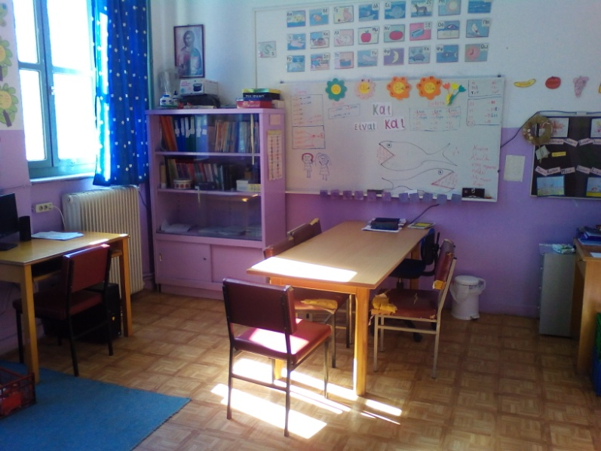
Integration class for pupils with special needs
In the school there is a specially equipped classroom to teach several students with special needs in learning language or mathematics.
Teaching is individualized by a qualified teacher and for this school year there are 16 pupils who attend this class.

Slide 15
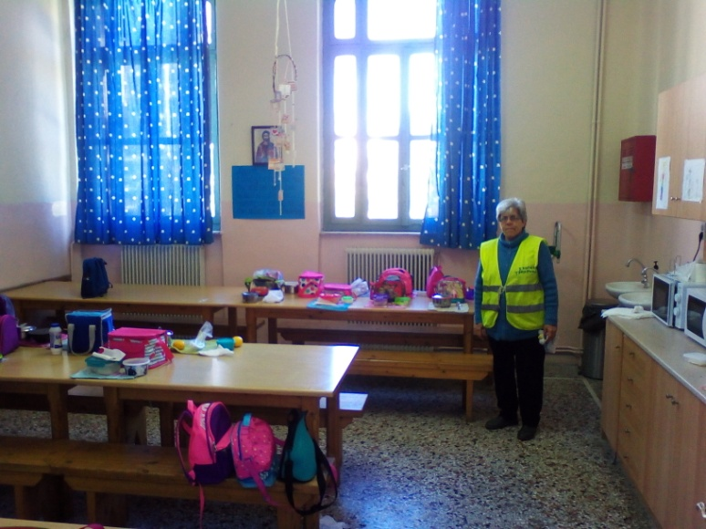
“All-day classes”
After 13:15 some of our students stay in the school for another 3 hours and participate in “all-day classes” that continue until 16:00.
The first hour they take their lunch in the school’s dining area. After this they prepare their homework for the next day and have physical education, English and computer lessons, as well.
State-run schools do not charge tuition fees. Textbooks are provided for free to all students.

Slide 16
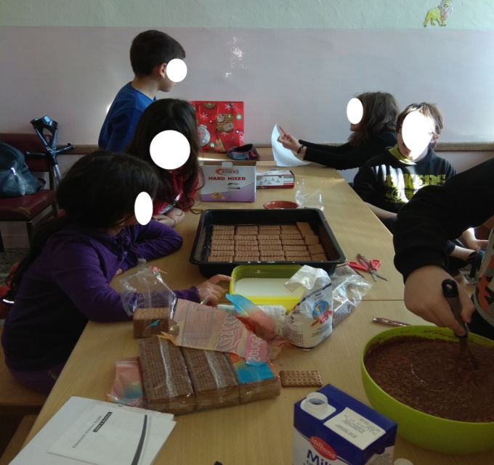
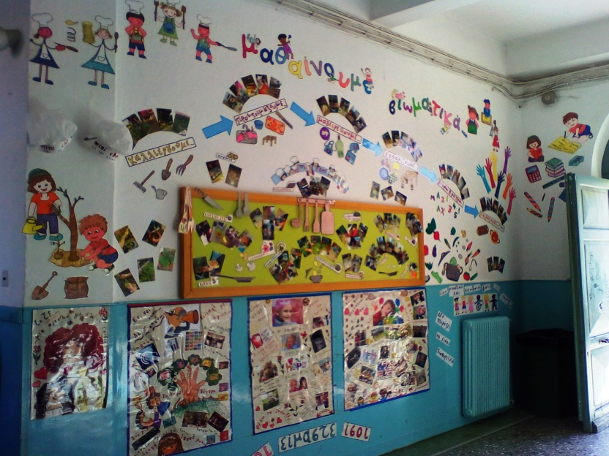
Our garden
There exists a small garden where our students plant vegetables to be used, when ready, for the preparation of healthy food.
The purpose of this endeavor is for the students to feed themselves in a good manner and to learn to respect and love nature.

Slide 17
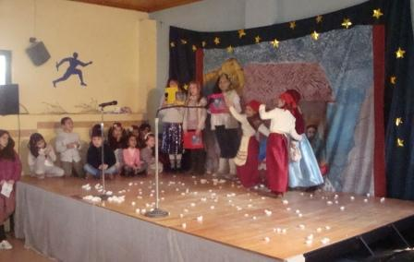
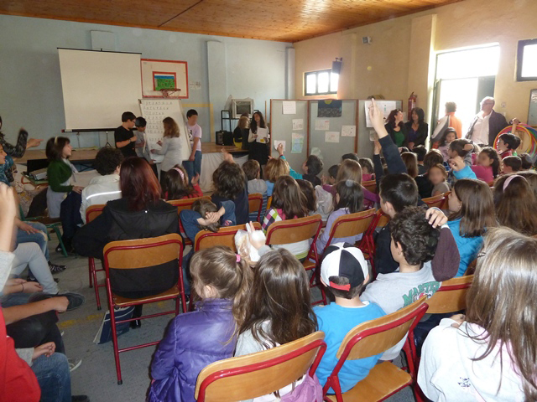
Activities

Slide 18
Activities

Slide 19
Activities

Slide 20
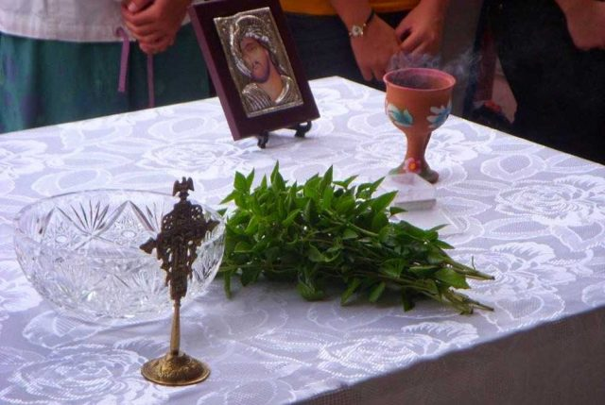
Groups- Students and duration of the school year
During the academic year 2018/2019, 189 students were registered and they are 6-12 years old. The Students are divided into 12 classes. All the subjects are compulsory. Regardless of age, they have a 6 hours a-day course, starting at 8:15 am and ending at 13:15 pm.
The school year, for the students,
begins on September the 11th with the annual Blessing and ends on June the 15th with their performance grades and the traditional school year closing celebration.

Slide 21
Thank you

