Slide 1
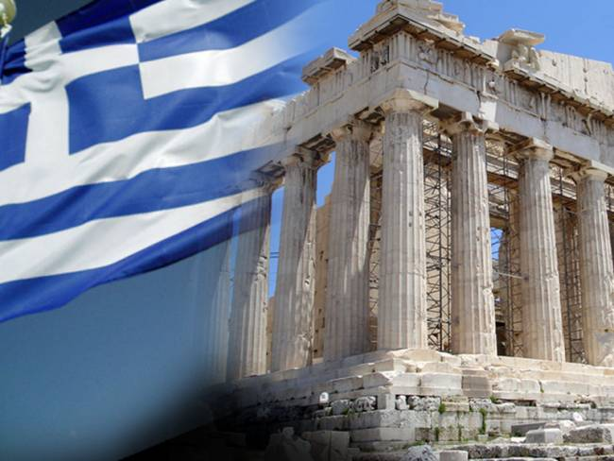
GREECE

Slide 2
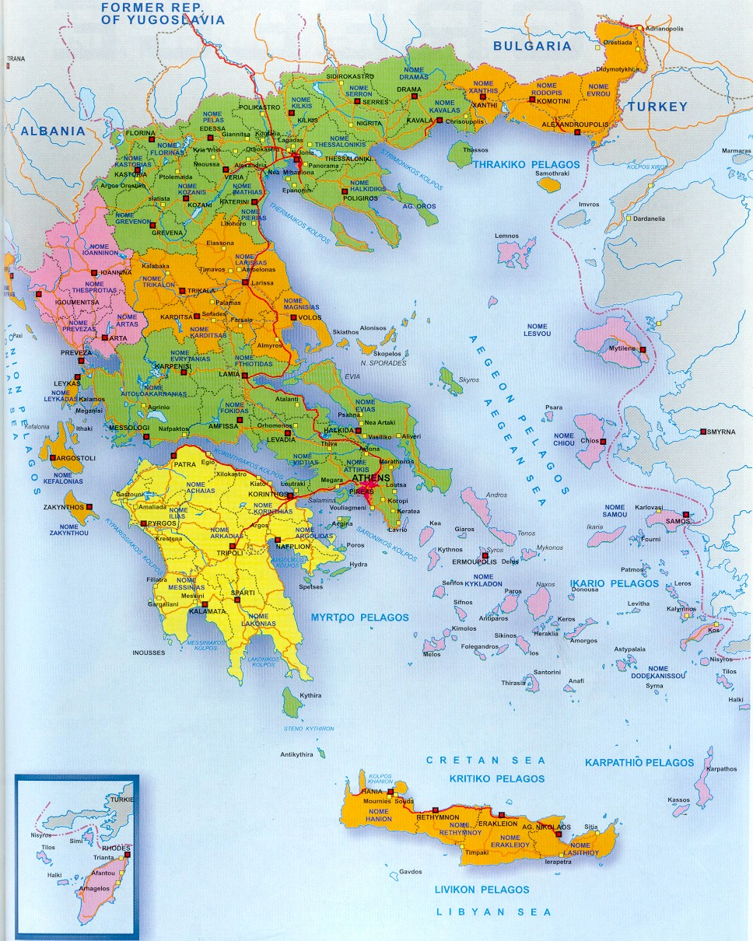
MAP OF GREECE

Slide 3
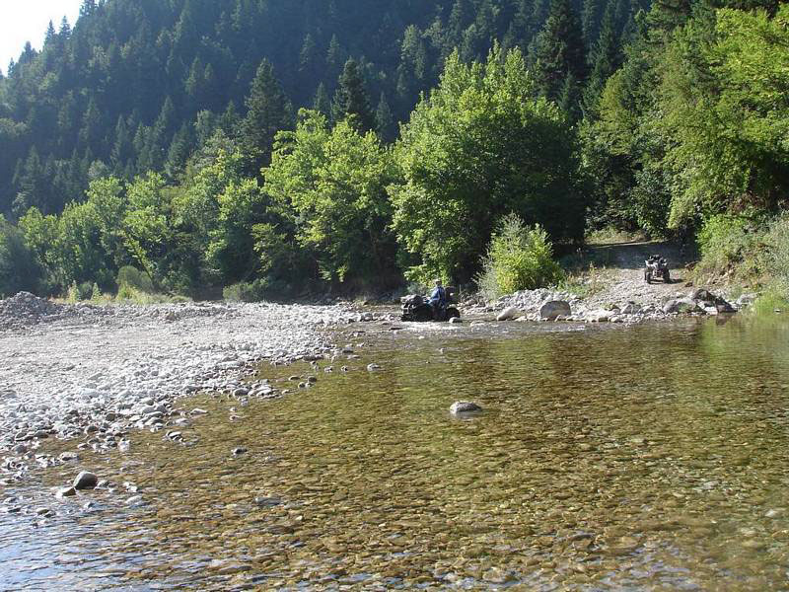
LANDSCAPES IN GREECE
Kozani

Slide 4
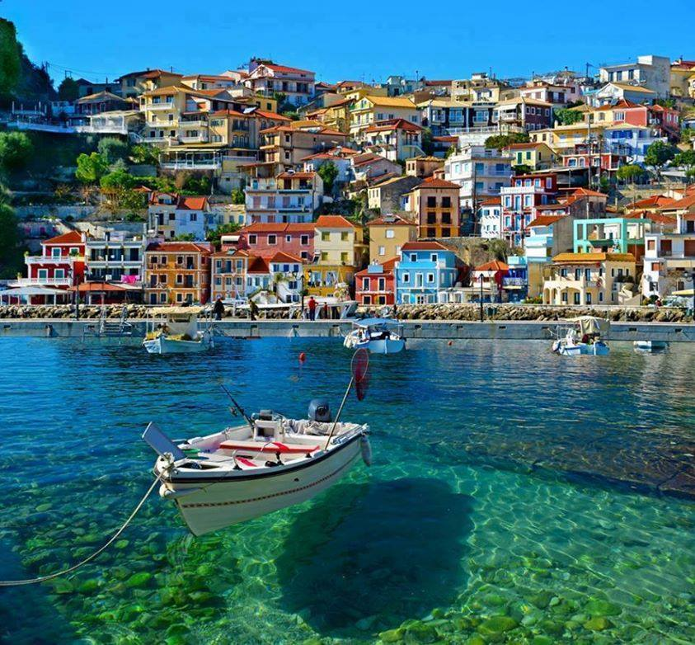
Parga

Slide 5
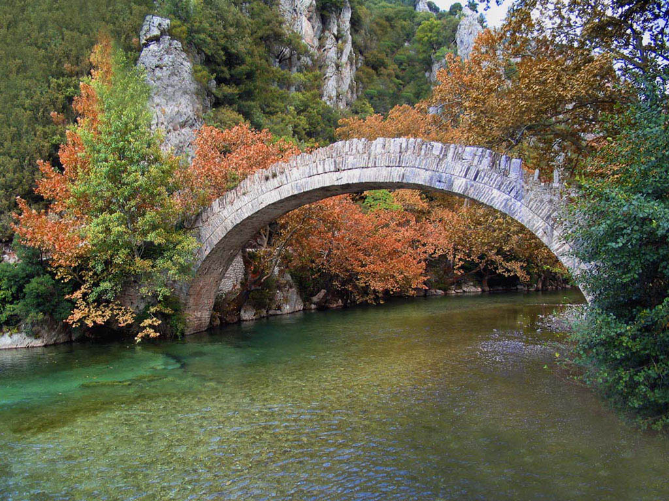
Arta

Slide 6
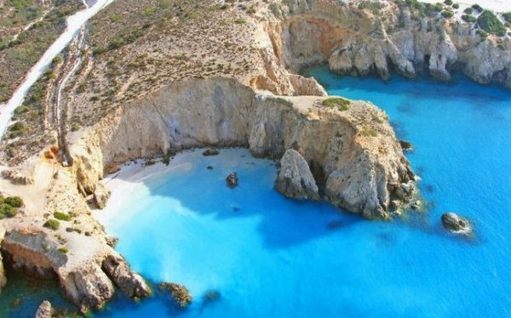
Santorini

Slide 7
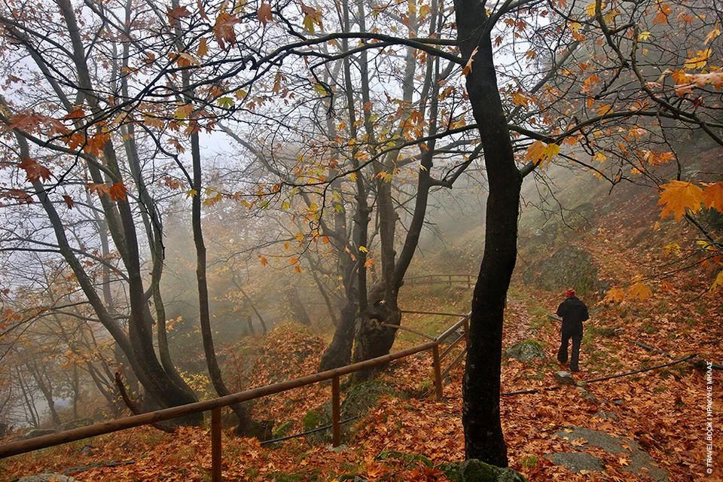
Grevena

Slide 8
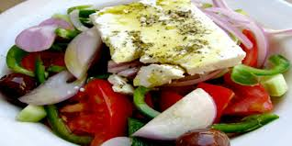
TRADITIONAL FOODS IN GREECE
Greek salad

Slide 9
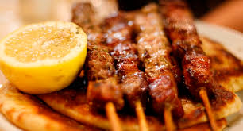
Souvlaki

Slide 10
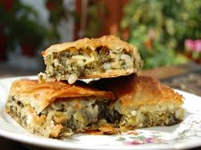
Spanakopita

Slide 11
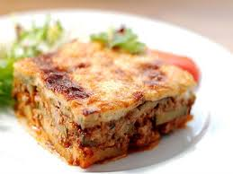
Mousakas

Slide 12
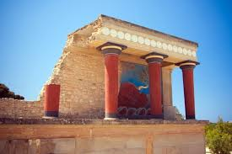
HISTORICAL MONUMENTS IN GREECE
Knossos(Crete)

Slide 13
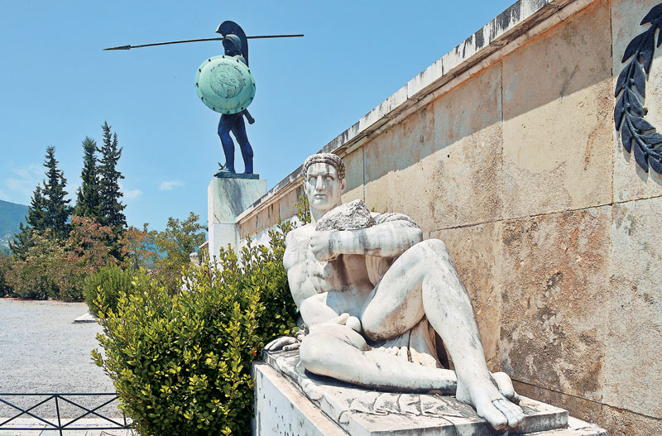
Lamia

Slide 14
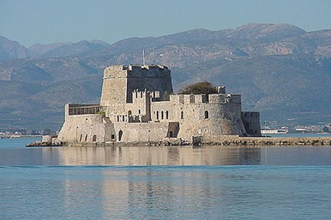
Nafplio

Slide 15
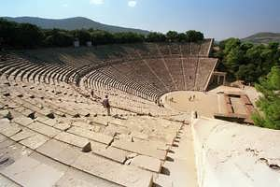
Epidavros

Slide 16
SPORTS IN ANCIENT GREECE

Slide 17
Fight in ancient Greece

Slide 18
Marathon in ancient Greece

Slide 19
SPORTS IN MODERN GREECE
Greece in 1987 won the first European Championship in Basketball

Slide 20
In 2005 Greece won the second European Championship in Basketball

Slide 21
Greece in 2004 won the first European Championship in Football

Slide 22
THE END
CHRISTOS NTERTINIS
FOTIS MANOUSOPOULOS
BASILIS MANOUSOPOULOS
MICHALIS MICHALAKOPOULOS
ILIAS KARANATSIS

