Slide 1
EUROPEAN HEROES
COMPARISON OF GERMAN, POLISH AND SLOVAK HEROES

Slide 2
https://www.welt.de/geschichte/kopf-des-tages/article230569411/Klaus-Stoertebeker-So-loesten-Gewaltunternehmer-ihre-Probleme.html
https://www.geocaching.com/track/details.aspx?id=5770042
KLAUS STÖRTEBEKER
JURAJ JÁNOŠÍK

Slide 3
THE LEGEND OF KLAUS STÖRTEBEKER
VITALIENBRÜDER RAIDED SHIPS IN THE NORTH AND BALTIC SEA
LAIR OF STÖRTEBEKER AND OTHER PIRATES
ARREST OF STÖRTEBEKER AND HIS CREW
PLACE OF EXECUTION

Slide 4
RAIDS IN THE NORTH AND BALTIC SEA
There was no international law in the 15th century, so city councils, for example could declare a feud against their enemies and send out ships to attack them. As a maritime force did not exist either, they commissioned privateers for the battles.
This happened in 1391 when queen Margaret Ⅰ of Denmark besieged Stockholm. The duke of Mecklenburg, a relative of the Swedish king, then commissioned privateers to provide the city with food. Those privateers were called “Vitalienbrüder”. They also had a Right of Reprisal – a government document that enabled them to fall on merchant vessels, taking both ship and cargo.

Slide 5
RAIDS IN THE NORTH AND BALTIC SEA
One of those privateers was Johann Stortebeker who is also believed to be the person behind the pirate legends.
Stortebeker was a merchant of violence offering his ship, his crew and himself to a war party in times of conflict.
He was first hired by the duke of Mecklenburg in 1400 and is believed to be the same person as the „Strotebeker“ mentioned in several complaints filed by Henry of Bolingbroke (later king Henry IV of England) about hijacked English merchant ships.

Slide 6
LAIR ON GOTLAND
1392 Störtebeker and his crew occupied the harbor of Visby on the island. From here they planned their raids.
However, this massively compromised the trade of the German Knightly Order, so in 1398 they sent out a fleet to stop the raids.
Many of the „Vitalienbrüder“ were captured, those who were able to flee fled to Marienhafe, East Frisia, which became their new lair.

Slide 7
IMPRISONMENT ON THE ISLAND OF HELGOLAND
1401 Störtebeker and his crew of 72 men were attacked by a Hamburgian fleet lead by Simon of Utrecht.
Legend has it, they were only caught because of a traitor on board who was disguised as a Frisian fisher sabotaging the ships steering system. Störtebeker is said to have offered a necklace long enough to surround the entire of Hamburg as a last attempt to save himself and his men.
His offer was not enough, though, as they were tried for piracy and eventually sentenced to death.

Slide 8
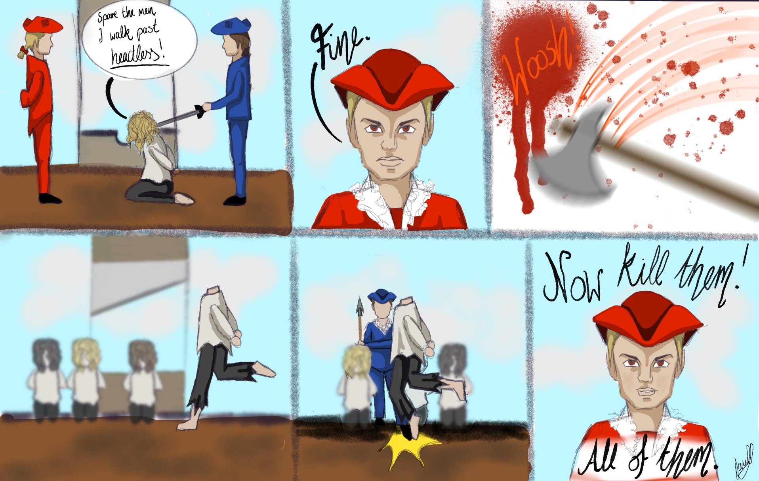
EXECUTION ON THE GRASBROOK

Slide 9
EXECUTION ON THE GRASBROOK
Legend has it that Störtebeker tried to save his crew by striking a deal with the mayor of Hamburg before the execution. Those he could walk past headless should be pardoned.
He walked past 11 men, before the executioner tripped him. The mayor, however, broke his promise and executed all 72 crew members.
Their heads were impaled on spikes along the Elbe river as deterrent to other pirates.

Slide 10
THE LEGEND OF JURAJ JÁNOŠÍK
JÁNOŠÍK AMBUSHED MERCHANTS IN MORAVIA, SOUTHERN POLAND AND NORTHERN SLOVAKIA
BIRTHPLACE
TRIAL & EXECUTION
PRISON SERVICE

Slide 11
BIRTHPLACE TERCHOVÁ
According to the registry office of the parish in Varín, the exact date of Jánošík‘s christening was January 25, 1688. Janosik was most likely born a few days earlier.
When he turned 18, he joined the rebellious army in the uprising against the Habsburgs. His service ended with the battle of Trenčin when the Habsburgs regained dominance over the Slovak territory. Jánošík survived and returned to his native village.

Slide 12
PRISON SERVICE IN BYTČA CASTLE
Soon after returning to his village, Jánošík joined – most likely against his will – the Austrian army. He was placed at Bytča castle, working as a prison guard.
During his service he met Tomas Uhorčíks who was the leader of a band of robbers. Jánošík helped him escape, deserted about a month later and joined the band of robbers.

Slide 13
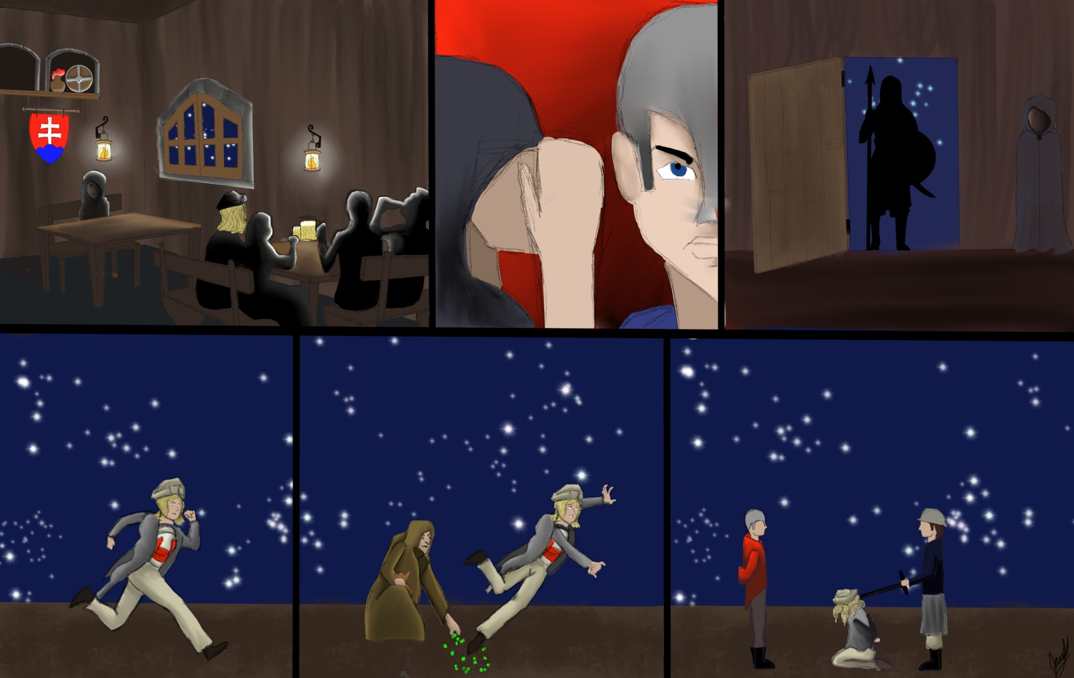
TRIAL AND EXECUTION IN LIPTOVSKÝ MIKULÁŠ

Slide 14
TRIAL AND EXECUTION IN LIPTOVSKÝ MIKULÁŠ
According to popular Slovak legend, Jánošík was only caught because of an evil, old woman who threw peas at his feet causing him to slip.
In reality, he was caught by city guards in Malohont and imprisoned in Vranovo castle. A two-day trial followed and after torture, Jánošík was sentenced to death. On March 17 he was executed by hanging on a hook which went through his side.

Slide 15
AMBUSHES IN MORAVIA, SOUTH POLAND AND NORTH SLOVAKIA
Shortly after Jánošík joined Uhorčíks band of robbers, Uhorčíks got married and appointed Jánošík as the new band leader.
There were about 20 members in the band of robbers from Slovakia, Poland and Moravia. Their targets were mostly wealthy merchants; they mainly split the loot amongst themselves but also gave some of it to peasants in exchange for other things or services.

Slide 16
WHY ARE THEY HEROES?
There are many factors that play a role in the shaping of heroes, though most importantly their image is based on certain values that are different in every culture. Crucial historical events are also a factor, as they are often reflected in the legends.
In Störtebekers case the people on his end faced the oppression of the Hansa to which the pirate repeatedly refused to give into.
As for Jánošík, the population suffered from the oppression of the Austro-Hungarian regime, and Jánošík became a symbol of the people’s desires.

