Slide 1
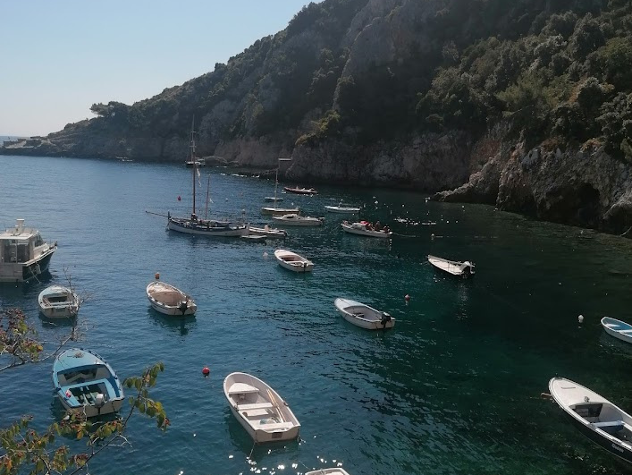
Second A.Li.E.N. mobility
MOBILITY IN CROATIA
FROM 4TH TO 8TH APRIL 2022

Slide 2
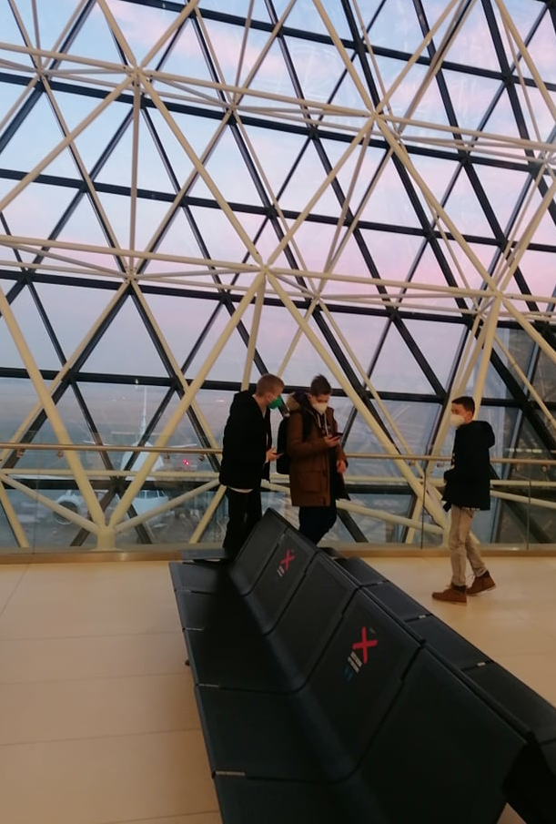
SUNDAY
3TH APRIL ARRIVAL AT ZAGREB AIRPORT FRANJO TUĐMAN

Slide 3
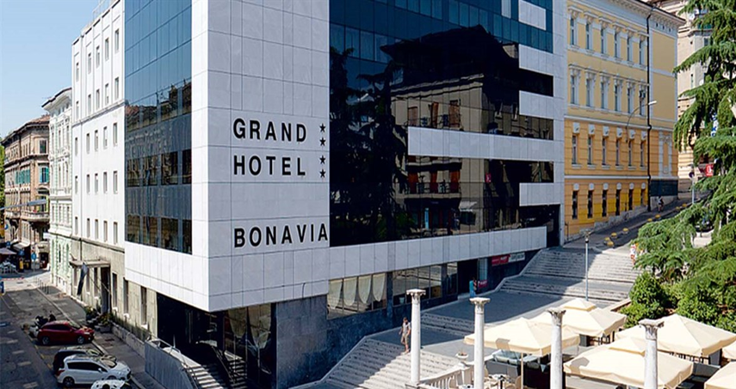
CHECKING INTO HOTEL BONAVIA

Slide 4
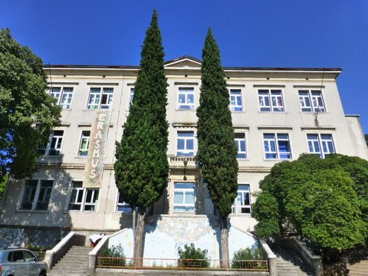
Welcoming!
PODMURVICE ELEMENTARY SCHOOL

Slide 5
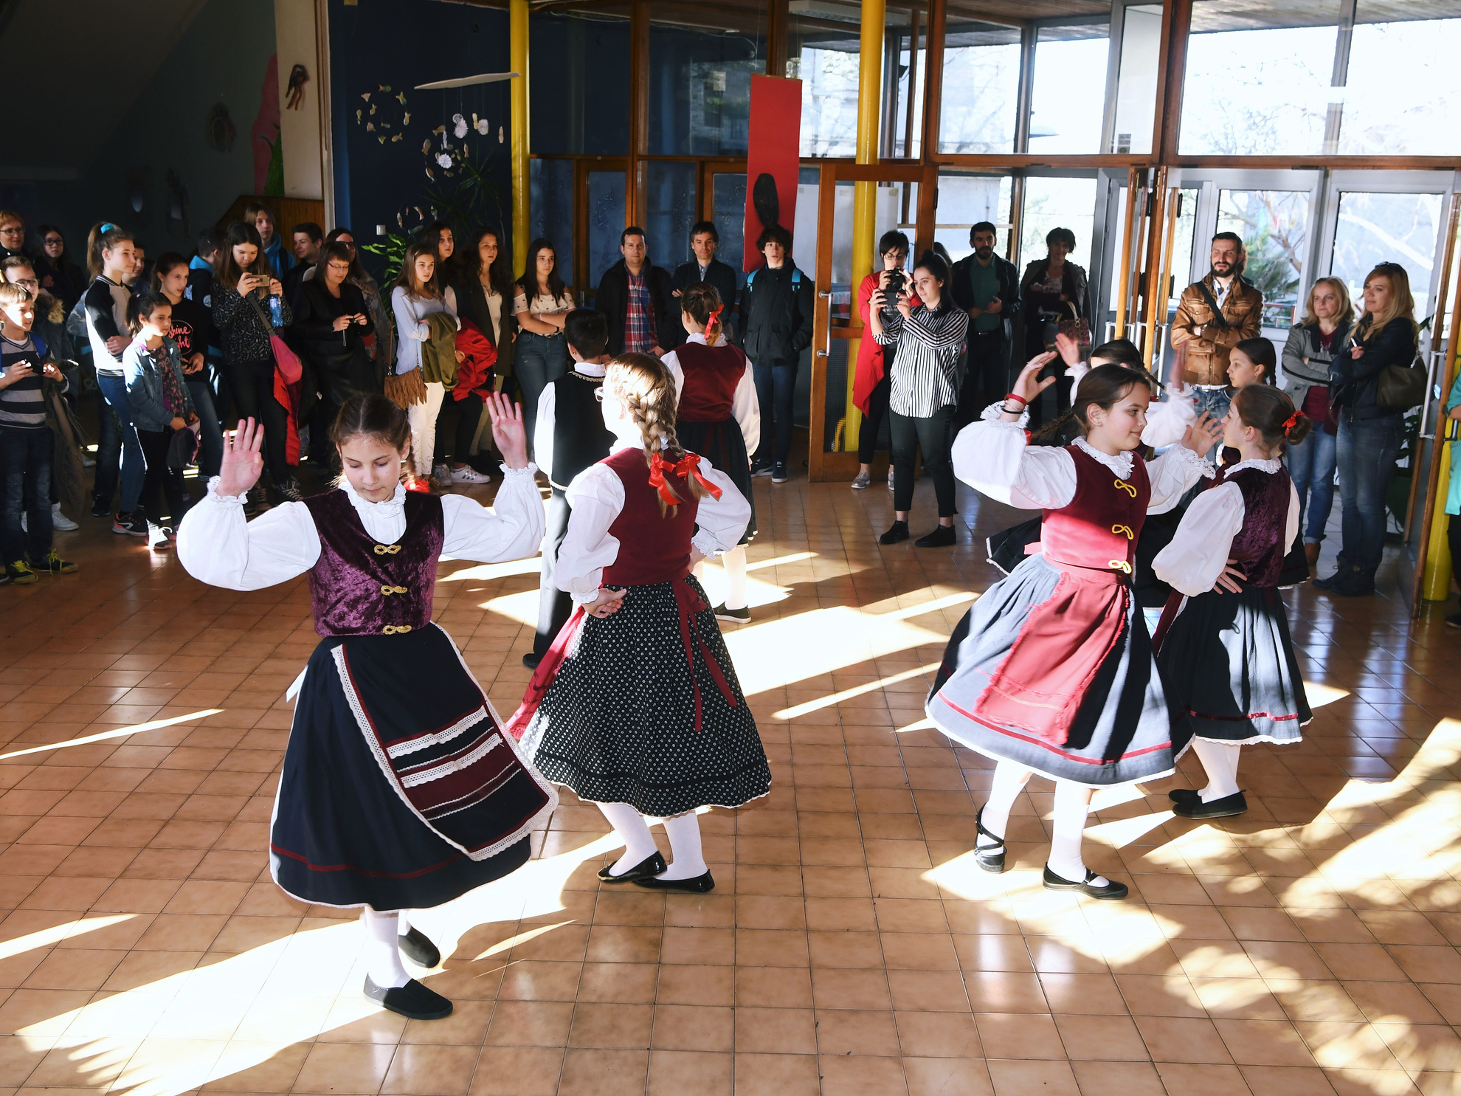
Welcome speech and short performance with surprise guests...
PERFORMANCE

Slide 6
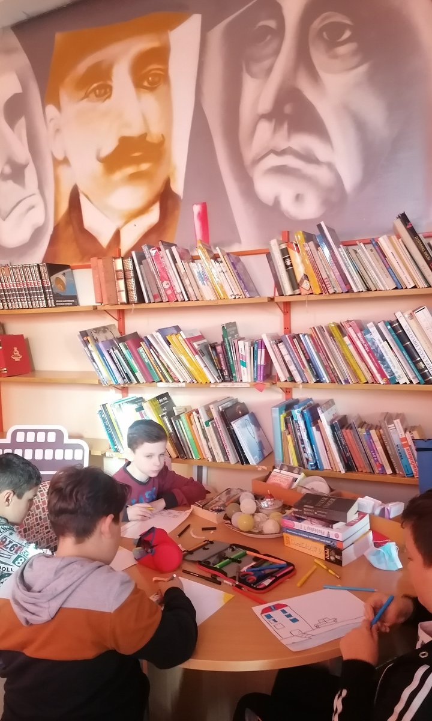
Presentation of the school (group tour of the school guided by Croatian students).

Slide 7
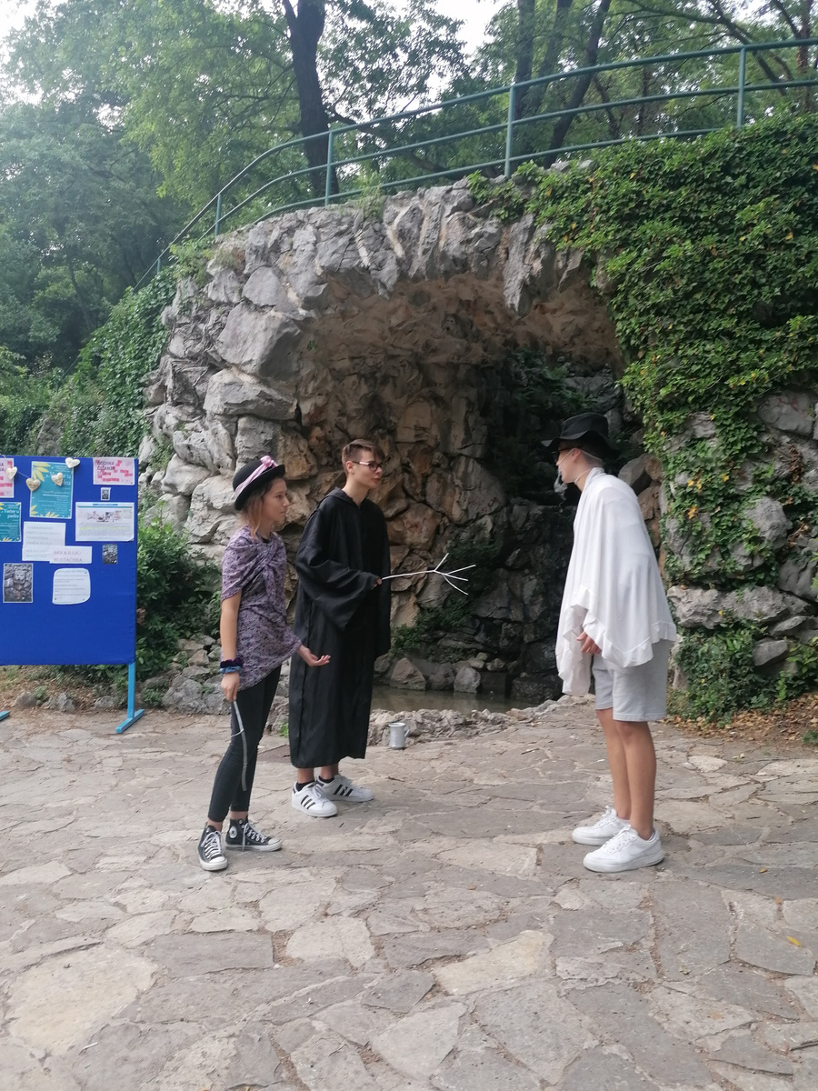
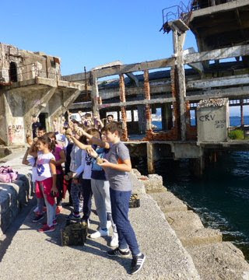
CITY STORIES:
GUIDED TOUR OF MLAKA PARK AND INDUSTRIAL STREET - RIJEKA'S INDUSTRIAL HISTORY

Slide 8
WELCOMING ACTIVITIES FOR TEACHERS:
Presentation of activities
for the week
1
2
Presentation of the Croatian education system
Seminar for teachers about the right procedures to become an eTwinning School, presenter: , Mrs Antonietta Calò, regional eTwinning Ambassador from the Italian Erasmus team
3

Slide 9
1
Reading the Past, Creating the Future
WORKSHOPS FOR STUDENTS
2
Debate in English
3
Knowing each other
4.
Glagolitic alphabet: First Croatian national alphabet
3
Reading under the treetops
5.
1
6.
Media workshop: How to make a film about Croatian mobility

Slide 10
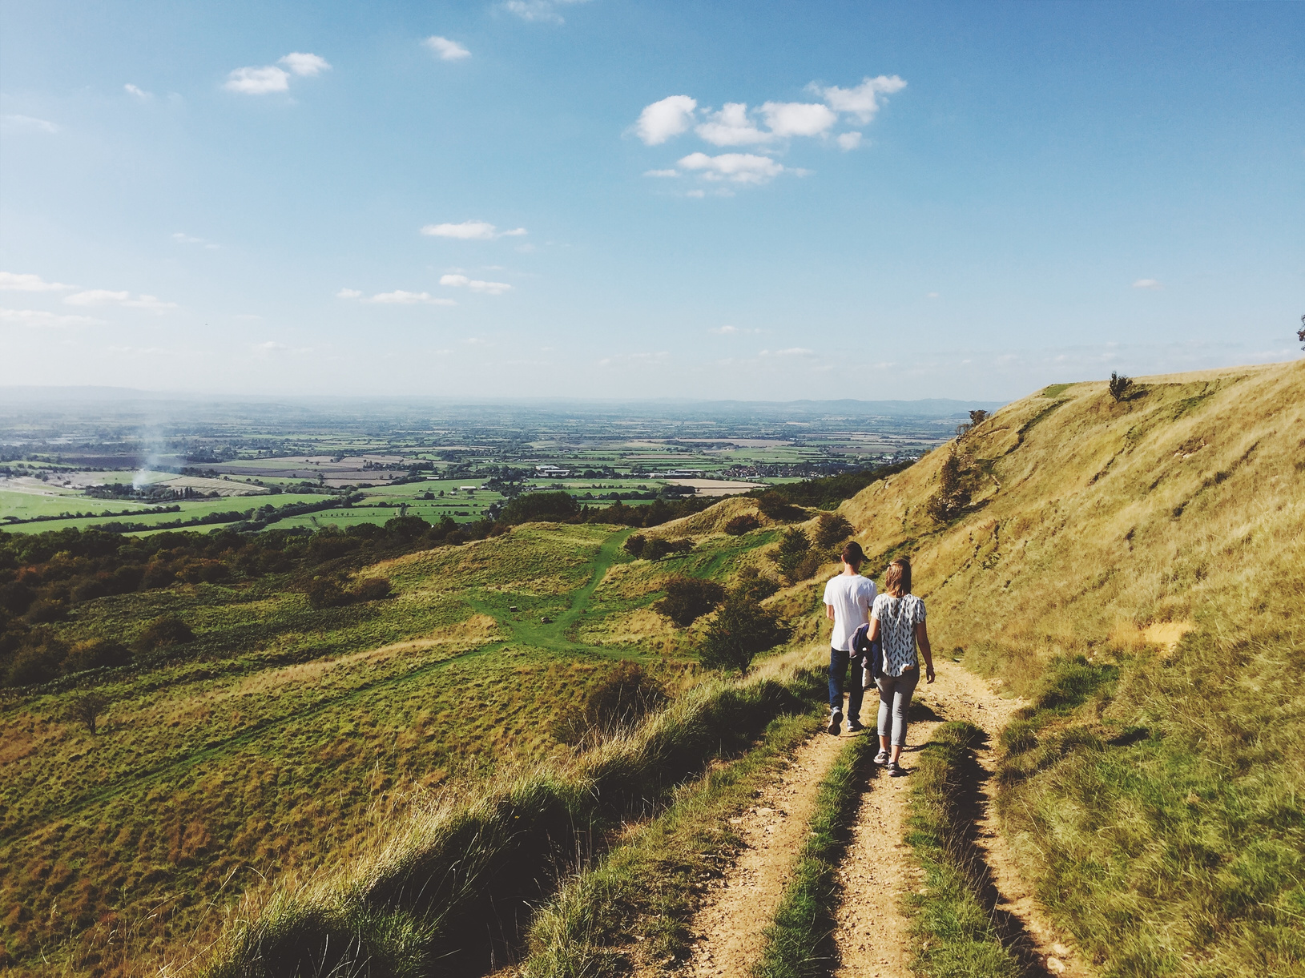
workshop
READING THE PAST, CREATING THE FUTURE

Slide 11
WORKSHOP:
READING THE PAST, CREATING THE FUTURE
Our aim is to emphasize the importance of the past when it comes to growingup and forming our personality, therefore the idea is to record your family stories.
We would like you to bring some very old thing such as an old candlestick, a coffee grinder, or photos, jewelry boxes, etc… Of course, something you can take on a plane.
There will be exhibition in the library. Everyone will write a short story, a few
sentences about how a certain object has got into your family.It would be great if these items stayed with us forever, as part of permanent Reading the Past, Creating the future exhibition.
However, if you are sentimentally attached to your belongings, then we will just exhibit them during your stay, take photos, and return them to you.
We hope that your contribution will enrich our exhibition and remind you of your family past.

Slide 12
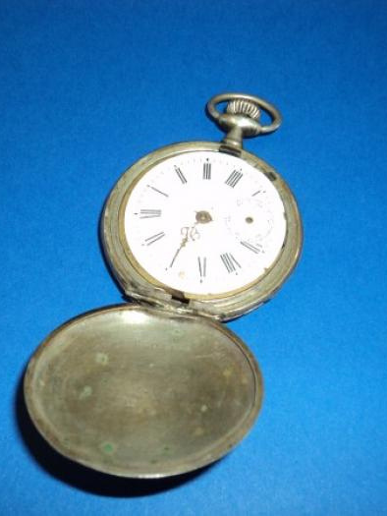
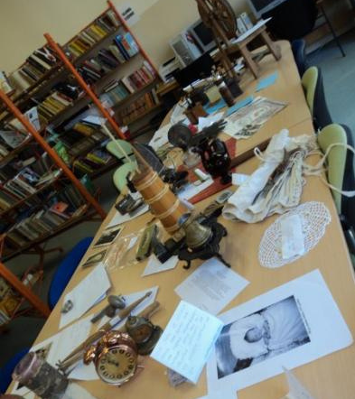
WORKSHOP:
READING THE PAST CREATING THE FUTURE

Slide 13
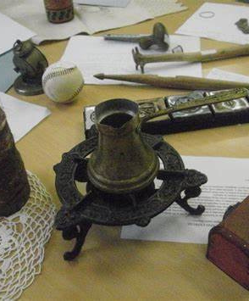
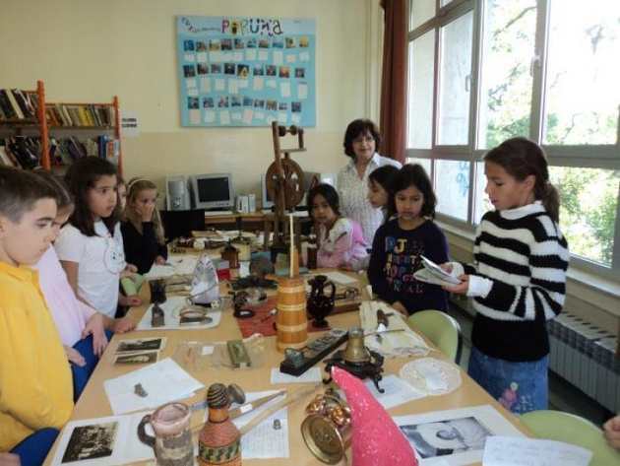
WORKSHOP:
READING THE PAST CREATING THE FUTURE

Slide 14
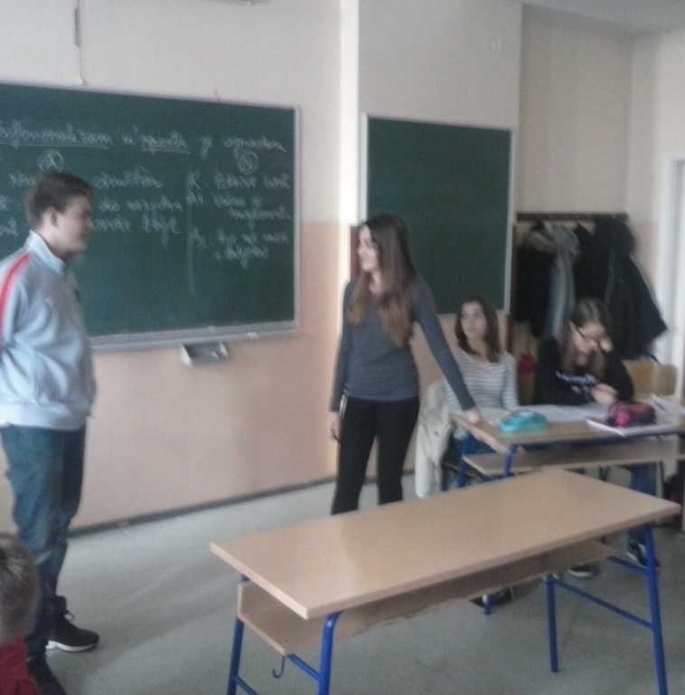
WORKSHOP FOR CHILDREN:
DEBATE IN ENGLISH

Slide 15
PHRASES AND LANGUAGE LEARNING
KNOWING EACH OTHER
The main goal is to learn some simple words/phrases and expressions from
everyday life in the language of the participating country. Even though some
languages are difficult to write, we’ll do our best and try to learn some basics.
Introduction
After a short quiz, participants will present basic information about their country ( language spoken, state capital, customs, traditional food, nature etc…)

Slide 16
READING UNDER THE TREETOPS
READING UNDER THE TREETOPS
Workshop at our school gazebo- reading corner in an open-air classroom called „ Let's Read Together Under the Treetops“.
Students read selected stories in their own languages to help other participiants get toknownits richness in diversity.
Furthermore, each country should prepare and bring both digital and physical poster about the book we are reading in Twinreaders. The poster should include information about the author and the book, as well as how important the work is for national literature. Our idea is to present them at the school in order to familiarize our students and visitors with the books.
Each country will present the posters during the workshop as well.

Slide 17
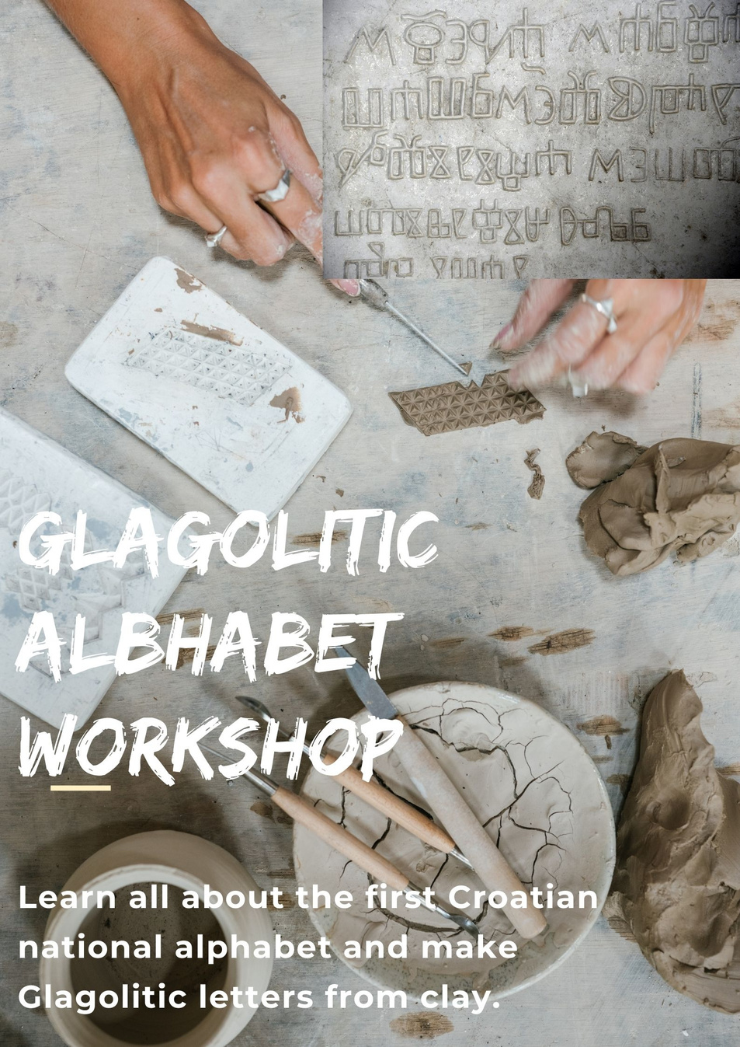

Slide 18
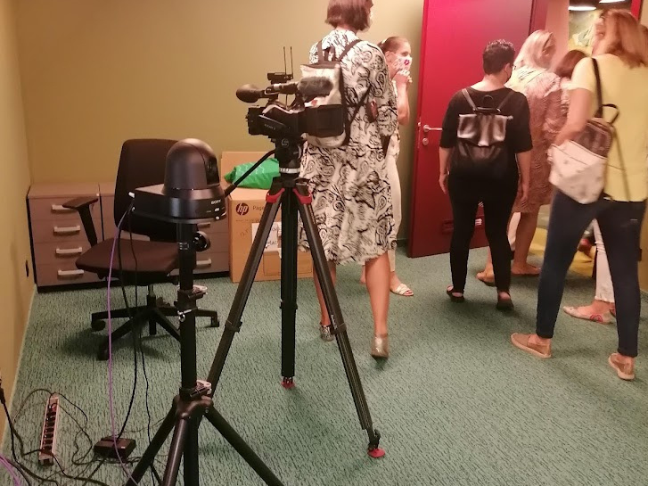
MENTOR: STUDENT TARA VIDOVIĆ
MEDIA WORKSHOP:
HOW TO MAKE A FILM ABOUT CROATIAN MOBILITY

Slide 19
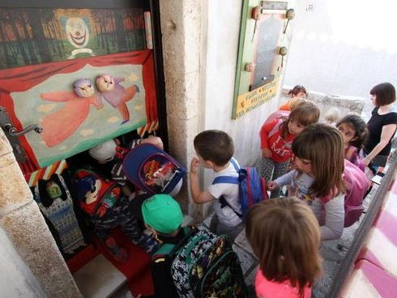
Brseč
Teatar Oz
The smallest theater in the world

Slide 20
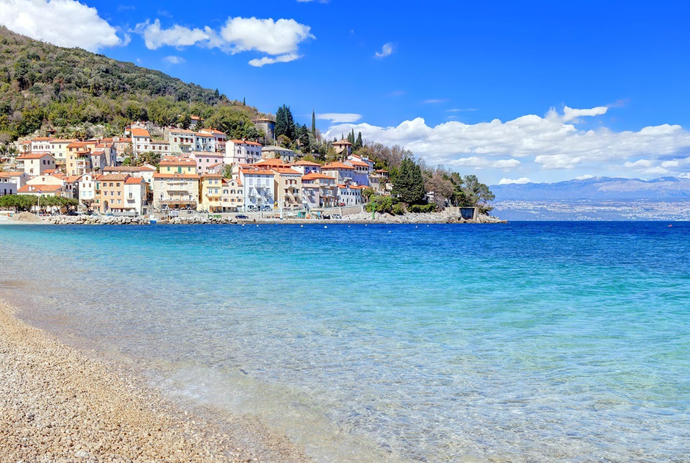
Mošćenička Draga

Slide 21
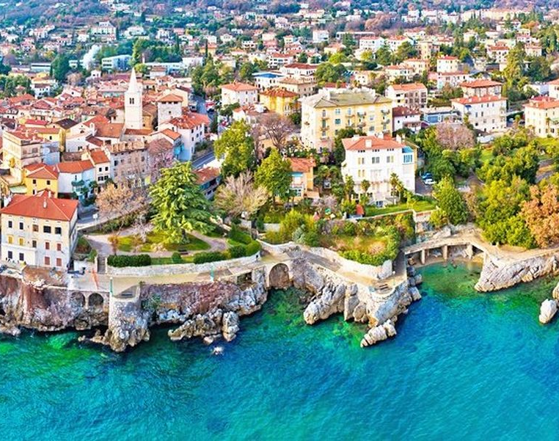
Lovran

Slide 22
Opatija

Slide 23
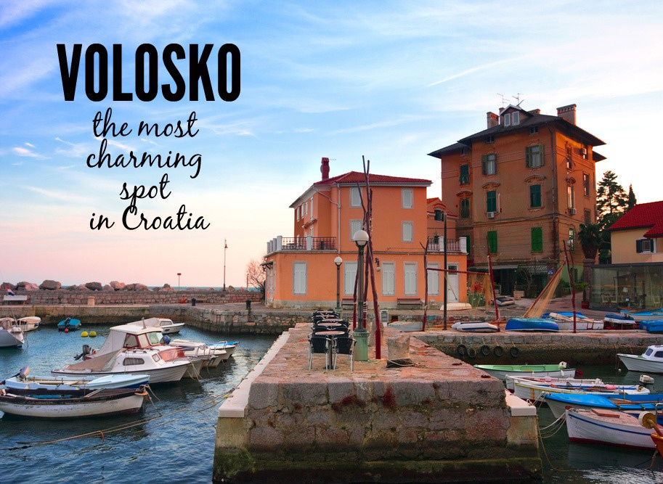

Slide 24
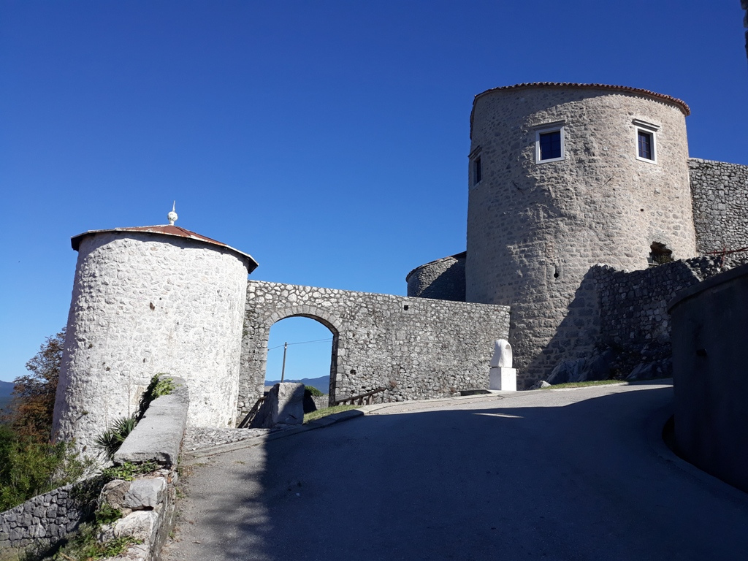
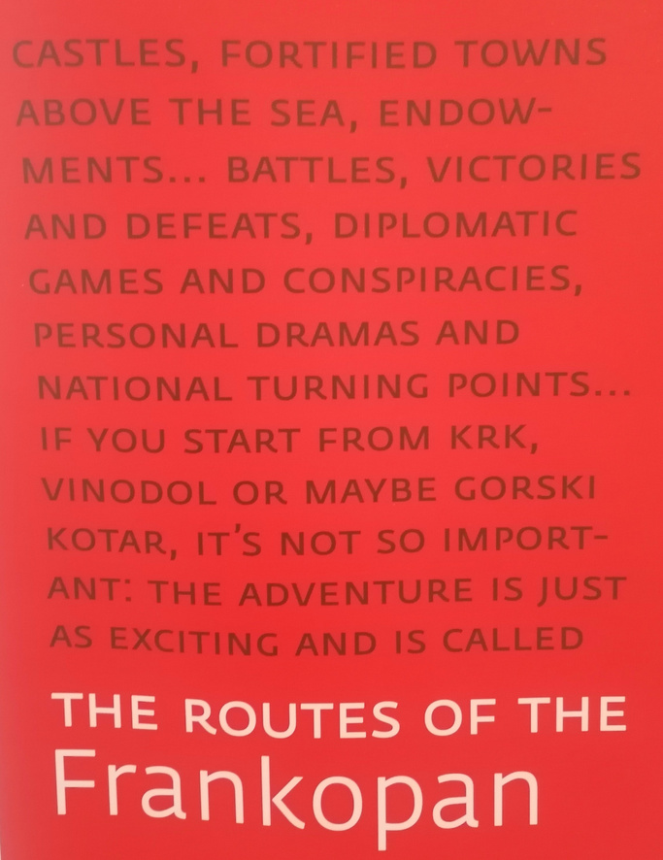

Slide 25
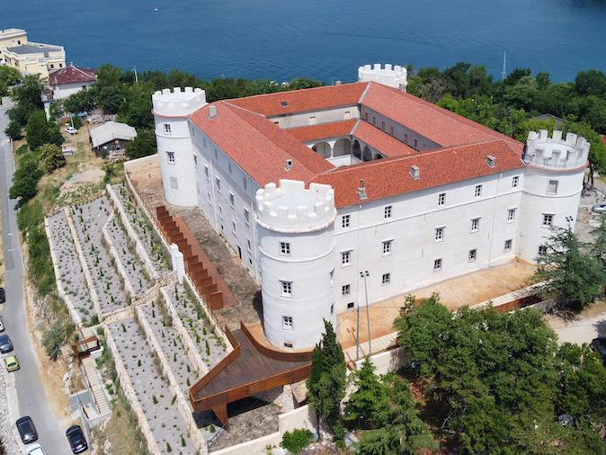
THANK YOU!

