Slide 1
Book of DEDE korkut
By gabriel matijević

Slide 2
What is dede korkut?
The book of Dede Korkut is the most famous among the epic stories of the Oghuz Turks. The stories carry morals and values important to the social lifestyle of the nomadic Turkic peoples and their pre-Islamic beliefs. The book's mythic narrative is part of the cultural heritage of the peoples of Oghuz Turkic origin.

Slide 3
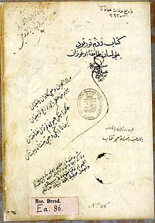
More about dede korkut
Only two manuscripts of this book, Vatican and Dresden, were known until 2018. However, a new epos was added to this book with the discovery of Gonbad manuscript. The language of the Gonbad manuscript is of a mixed character and depicts vivid characteristics of the period of transition from later Old Oghuz Turkic to Early Modern Turkic of Iranian Azerbaijan. However, there are also orthographical, lexical and grammatical structures peculiar to Eastern Turki, which shows that the original work was written in the area between Syrdarya and Anatolia, and later rewritten in SafavidIran in the second half of the 16th century. The epic tales of Dede Korkut are some of the best known Turkic dastans from among a total of well over 1,000 recorded epics among the Mongolian and Turkic language families.

Slide 4
For the Turkic peoples, especially people who identify themselves as Oghuz, it is the principal repository of ethnic identity, history, customs and the value systems of the Turkic peoples throughout history. It commemorates struggles for freedom at a time when the Oghuz Turks were a herding people, although "it is clear that the stories were put into their present form at a time when the Turks of Oghuz descent no longer thought of themselves as Oghuz. Heritage of Dede Korkut is currently under protection of UNESCO.

Slide 5
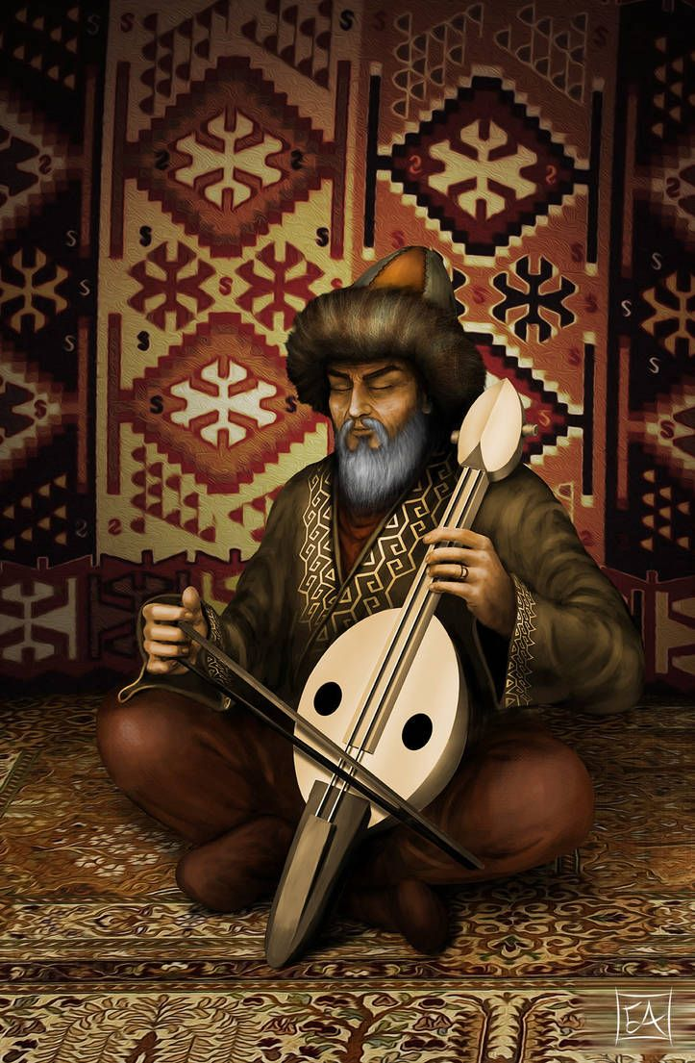
THE END HOPE YOU ENJOYED THE PRESENTATION. ☺

