Slide 1
Art and Literature in Education Nature is it an A.Li.E.N.? CROATIA

Slide 2
TRANSPORTATION FOR 3.4.2022. FROM ZAGREB AIRPORT TO RIJEKA PER PERSON
20 € Per Person
Note: Payment must be done three days before.
Vehicles: Bus, Minibus, Van or Car

Slide 3
TRANSPORTATION FOR 9.4.2022. FROM RIJEKA TO ZAGREB AIRPORT PER PERSON
20 € Per Person
Note: Payment must be done three days.
Vehicles: Bus, Minibus, Van or Car

Slide 4
4.4.2022. 1 DAY
10:00 Welcome and short event at our school
11:00 Orientation around the school
12:00 Guided tour of Park Mlaka and Industrijska Street - Rijeka's industrial history
14:00 Lunch at school
14:30 Reading under the treetops
Working meeting for teachers:
Presentation of the Croatian educational system
Activities all week
16:00 student and teacher activity + Blended activities, Workshops +Reading and talking about Frankopans, Optional: meeting the author of books about the Frankopans
18:00 End of the day/ Going back to the hotel.
All Inclusive Service:
Tour Guide, Entrance Fees, Tour Leader, Lunch

Slide 5
TOUR INFORMATION FOR 2ND, 3RD, 4TH AND 5TH DAYS
75 € Per Person
Note: Payment must be done three days before the tours.
Vehicles: Mercedes Benz Turismo OR Scania Touring OR Setra 415 OR Volvo Bus

Slide 6
5.4.2022. 2 DAY - A one-day trip
10:00 Departure in front of the hotel
11:00 Theater show and workshop in Brseč, walk through the place
13:00 Lunch at the restaurant in Mošćenička Draga
14:00 Walk through the place Mošćenička Draga
15:00 Walk through the place Opatija
16:30 Walk through the place Volosko
18:00 End of the day/ Going back to the hotel.
All Inclusive Service:
Transportation, Tour Guide, Entrance Fees, Tour Leader, Lunch

Slide 7
6.4.2022. 3 DAY - A one-day trip
10:00 Departure in front of the hotel
10:30 The Governor's Palace guided tour and workshop about coats of arms
12:00 City tourist bus
12:30 Lunch at the restaurant in Trsat
14:00 Visit to the church and fortress and workshop about Trsat tresure
16:00 Sightseeing tour of the city Rijeka
18:00 End of the day/ Going back to the hotel.
All Inclusive Service:
City tourist bus, Tour Guide, Entrance Fees, Tour Leader, Lunch

Slide 8
7.4.2022. 3 DAY - A one-day trip
9:00 Departure in front of the hotel
9:30 Grobnik castle guided tour
11:00 Bakar castle and city guided tour
12:30 Lunch at the restaurant in Kraljevica
14:00 Kraljevica castle guided tour
16:00 Krk city guided tour
19:00 End of the day/ Going back to the hotel.
All these castles are connected by the story of Croatian Frankopan nobles
All Inclusive Service:
Transportation, Tour Guide, Entrance Fees, Tour Leader, Lunch

Slide 9
8.4.2022. 3 DAY - A one-day trip
9:00 Departure in front of the hotel
9:30 Children's house – library and other children’ s activities
11:00 Rijeka City Museum
13:00 Lunch at school
15:00 Glagolitic presentation in the university library
16:00 Free time for individual research or some organized ( we can go in mosque,or/and fotball field near the sea or something else…)
18:00 End of the day/ Going back to the hotel.
All Inclusive Service:
Tour Guide, Entrance Fees, Tour Leader, Lunch

Slide 10
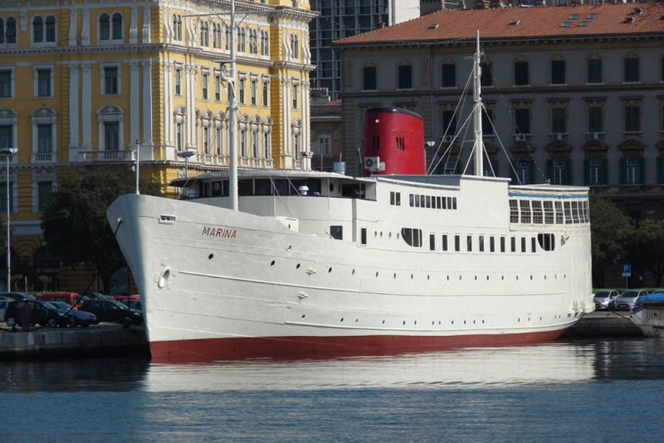
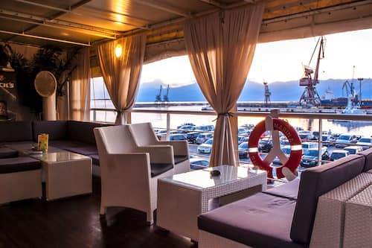
1st Option: BOTEL MARINA RIJEKA PRICE: 66 Euro per person - in a double room, halfboard and all taxes included PRICE: 79 Euro per person - in a single room, halfboard and all taxes included

Slide 11
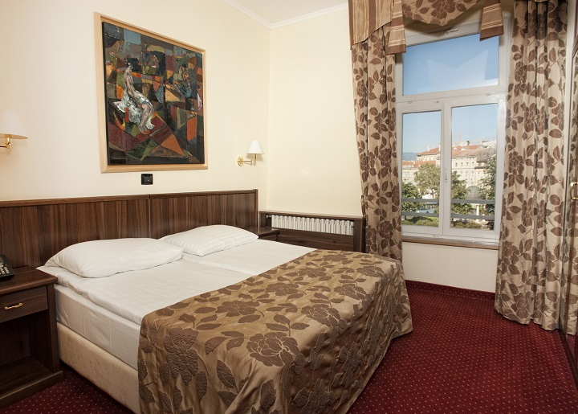
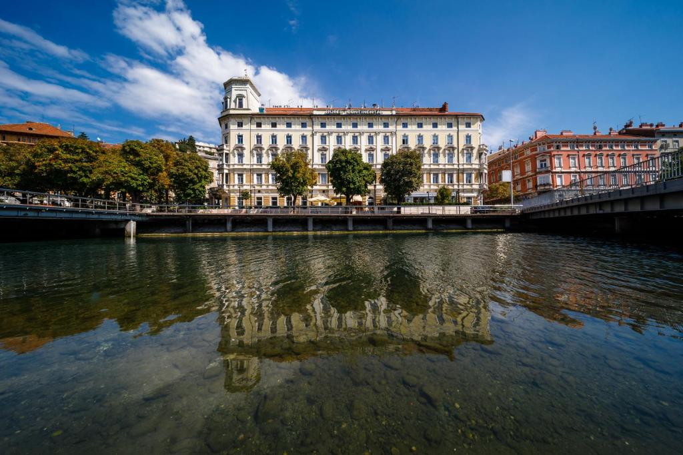
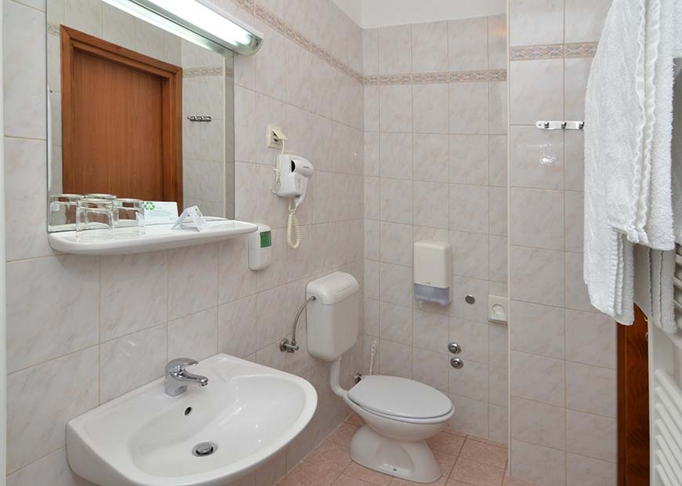
2st Option: HOTEL CONTINENTAL 3* PRICE: 55 Euro per person - in a double room, halfboard and all taxes included PRICE: 65 Euro per person - in a single room, halfboard and all taxes included

Slide 12
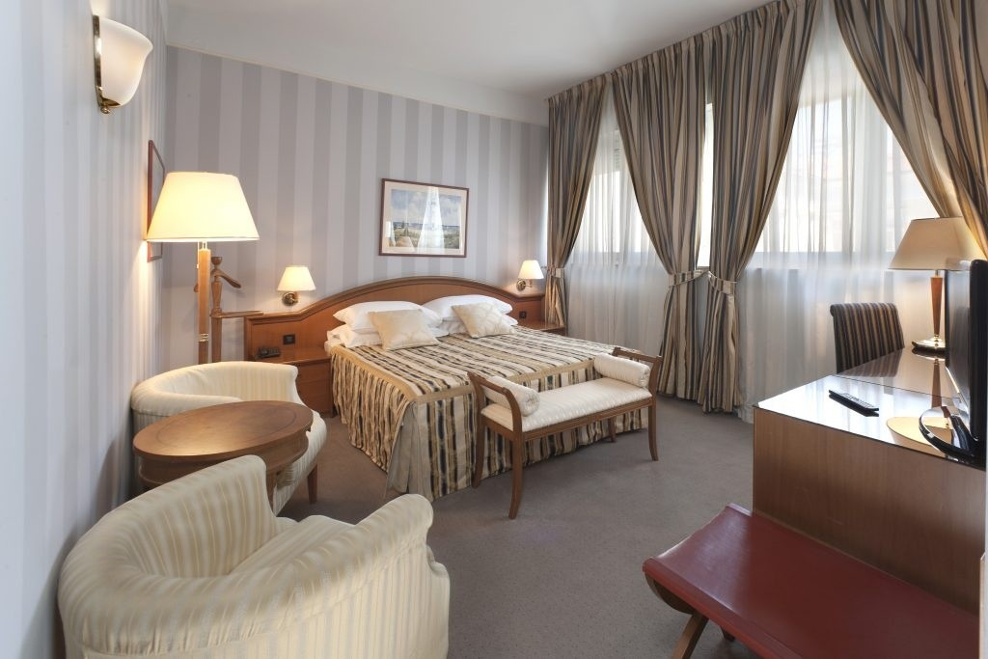
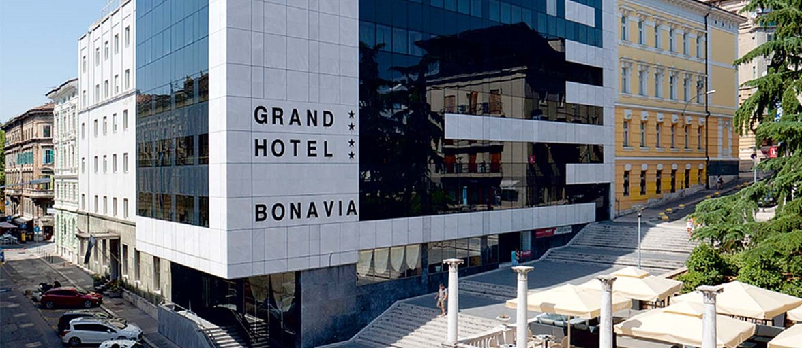
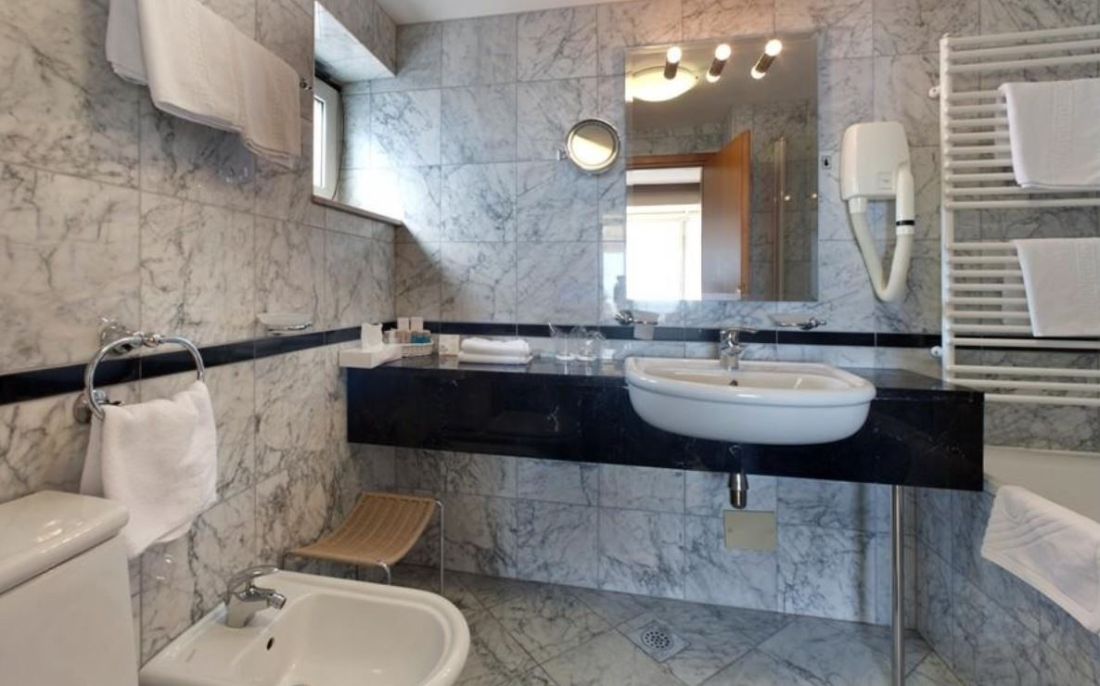
2st Option: HOTEL BONAVIA 4* PRICE: 67 Euro per person - in a double room, halfboard and all taxes included 10 % discount for a third person on an extra bed PRICE: 79 Euro per person - in a single room, halfboard and all taxes included

Slide 13
THANK YOU FOR YOUR ATTENTION

